Slide 1
Sales performance dashboard
FastAPI + SQLite backend, Vue 3 + Chart.js frontend
Mohamed Moin Peer | MSc Data Analytics, Queen's University Belfast
Notes:
Hello, I'm Mohamed Moin Peer, an MSc Data Analytics graduate from Queen's University Belfast. This is a full-stack sales dashboard: a FastAPI backend serving numbers from a SQLite database, and a Vue and Chart.js frontend where a manager can filter, compare periods and drill into regions, categories and products. I'll cover the problem, the data, the backend, the frontend, what the dashboard reveals, and how I tested it, with a live demo at the end. About 25 minutes. (~1 minute)

Slide 2
Managers ask the same questions every week
How are we doing?
Where is growth from?
Revenue, profit, margin and orders against the previous period
Channels, regions and the trend over time
What sells?
Where is margin leaking?
Top products by revenue, profit or units
Categories and products with low margins
Notes:
Every week sales managers ask similar questions: how are we doing against last period, where is growth coming from, which regions and products matter, and where are we losing margin. Usually that means asking an analyst to run a query and paste numbers into slides. The goal here was a self-service dashboard that answers those questions instantly and consistently. (~1.5 minutes)

Slide 3
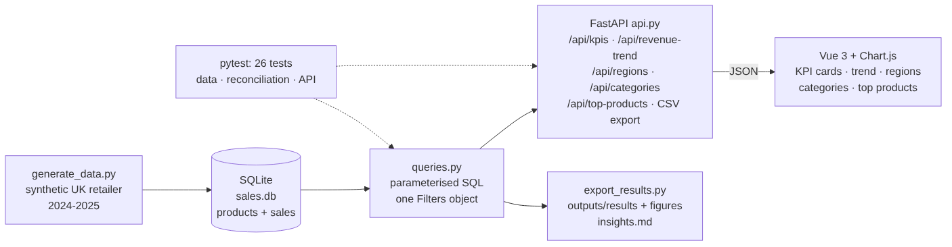
What I built: data, API, dashboard and tests
9
5
4
26
API endpoints
KPI cards
interactive charts + table
automated tests
Notes:
Here's the architecture. A Python generator builds a SQLite database. All SQL lives in one module, queries.py, which takes a single Filters object. The FastAPI app exposes nine endpoints and also serves the frontend. The Vue page calls the API and draws charts with Chart.js. A separate export script writes results and charts to the outputs folder, and 26 tests check the data, the queries and the API. Keeping SQL in one place means switching to a real warehouse would only touch that one file. (~2 minutes)

Slide 4
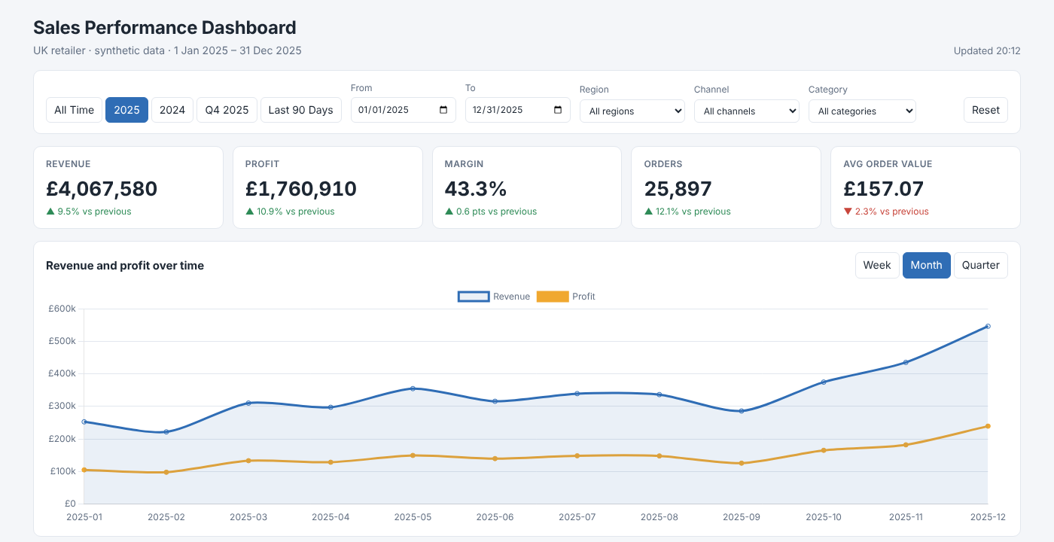
The finished dashboard
Notes:
This is the finished dashboard for 2025. At the top: date presets and filters. Then five KPI cards, each with the change against the previous comparable period, green for up and red for down. Below that, revenue and profit over time with a week, month or quarter toggle; revenue by region and by category, both clickable; and the top ten products with an export button. I'll come back to what these numbers tell us. (~1.5 minutes)

Slide 5
The data
A synthetic UK retailer, 2024-2025
Notes:
First, the data behind it. (~0.5 minutes)

Slide 6
48,994 order lines with realistic patterns built in
48,994
2 years
8
40
order lines
2024-2025
UK regions
products, 5 categories
Patterns built in
Honest simplifications
Online grows ~22% a year, in-store roughly flat
November-December peak, quiet January-February
Weekend uplift in store; heavier discounts in Nov and Jan
Fixed random seed: identical results for everyone
One product per order (no basket analysis)
Regional growth differences are random, not designed
Notes:
Real sales data is confidential, so I generated a realistic dataset with a fixed seed, which means anyone who clones the repo gets identical numbers. It covers two years, eight UK regions, online and in-store channels, consumer and business customers, and 40 products in five categories. I deliberately built in patterns a real retailer has: online grows faster than in-store, November and December peak, in-store sales rise at weekends, and discounts are heavier in November and January. One simplification: each order has one product line, so I can't do basket analysis. (~2 minutes)

Slide 7
Two tables, with the business rules enforced in the schema
CREATE TABLE sales (
line_id INTEGER PRIMARY KEY,
order_id TEXT NOT NULL,
order_date TEXT NOT NULL, -- YYYY-MM-DD
region TEXT NOT NULL,
channel TEXT CHECK (channel IN ('Online','In-store')),
segment TEXT CHECK (segment IN ('Consumer','Business')),
product_id INTEGER REFERENCES products(product_id),
quantity INTEGER CHECK (quantity > 0),
unit_price REAL,
discount REAL CHECK (discount >= 0 AND discount < 1),
revenue REAL, -- qty * price * (1 - discount)
cost REAL, -- qty * unit_cost
profit REAL -- revenue - cost
);
CREATE INDEX ix_sales_date ON sales(order_date);
products (40 rows)
product_id, product_name, category, list_price, unit_cost
Checked by tests
Revenue and profit formulas on every line
No orphan products
Full date coverage
December > 1.5 × January
Notes:
The database has two tables: products, and sales lines. Revenue is quantity times price times one minus the discount; profit is revenue minus cost. These rules are enforced with CHECK constraints, for example quantity must be positive and discount below 100%, and a test re-checks the revenue formula on every one of the 48,994 lines. Indexes on date, region and product keep the filtered queries fast. (~1.5 minutes)

Slide 8
The FastAPI backend
One filter model, nine endpoints
Notes:
Now the backend. (~0.5 minutes)

Slide 9
One Filters object, validated once, used by every query
def get_filters(start: date | None = None, end: date | None = None,
region: str | None = None, channel: str | None = None,
category: str | None = None) -> Filters:
start = start or MIN_DATE
end = end or MAX_DATE
if start > end:
raise HTTPException(400, "start must be on or before end")
if region and region not in OPTIONS["regions"]:
raise HTTPException(400, f"Unknown region '{region}'")
...
return Filters(start, end, region, channel, category)
@app.get("/api/kpis", response_model=KPIs)
def kpis(f: Filters = Depends(get_filters)):
return queries.kpis(con, f)
422
Wrong type, e.g. start=not-a-date
400
start after end, or an unknown region, with a helpful message
Pydantic models
Validate responses and generate /docs
Notes:
This is the most important design decision. Every endpoint takes the same five optional filters: start, end, region, channel and category. FastAPI validates them once in a shared dependency: bad dates give a 422, start after end or an unknown region gives a clear 400 message. The result is a single Filters object passed to every query, so the KPI cards, the trend, the regions and the table can never disagree about which data they describe. (~2 minutes)

Slide 10
Nine endpoints cover everything the page needs
Endpoint | Extra parameters | Returns
/api/filters |  | Regions, channels, categories, date range
/api/kpis |  | Revenue, profit, margin, orders, AOV + % change
/api/revenue-trend | grain = day | week | month | quarter | Revenue, profit, orders per period
/api/regions |  | Revenue, profit, margin %, share % per region
/api/categories |  | The same per category, plus units
/api/channels |  | Online vs in-store
/api/top-products | limit (1-40), sort = revenue | profit | units | Best products with margin %
/api/export/products.csv |  | CSV download for current filters
/api/health |  | Status and row count
Notes:
Here are the endpoints. Filters tells the frontend which options exist. KPIs returns the headline numbers with percentage changes. The trend endpoint supports four grains. Regions, categories and channels return breakdowns with margin and share. Top products can sort by revenue, profit or units, with a validated limit. There's a CSV export for whatever is filtered, and a health check. FastAPI generates interactive documentation at /docs automatically from the type hints and response models. (~1.5 minutes)

Slide 11
Comparing with the right previous period
Selected period | Compared with | Rule
1 Jan - 31 Dec 2025 | 1 Jan - 31 Dec 2024 | whole months
1 Oct - 31 Dec 2025 (Q4) | 1 Jul - 30 Sep 2025 (Q3) | whole months
10 - 19 Mar 2025 | 28 Feb - 9 Mar 2025 | same number of days
All of 2024 | no data → 'no comparison period' | null, not 0%
A bug I caught
The first version went back the same number of days. Because 2024 was a leap year, 2025 was compared with 2 Jan - 31 Dec 2024. Fixed with a calendar-month rule and covered by a test.
Notes:
A percentage change is only meaningful against a fair comparison. My rule: if the selection is whole calendar months, compare with the same number of whole months before, so 2025 compares with 2024 and Q4 with Q3. My first version simply went back the same number of days, which compared 2025 with the 2nd of January 2024 onwards because 2024 was a leap year. Small, but a manager would notice. For any other range, it compares the same number of days immediately before. If there's no earlier data, the card says 'no comparison period' instead of showing a misleading number. (~2 minutes)

Slide 12
Safe SQL, and numbers that always add up
clauses = ["s.order_date BETWEEN ? AND ?"]
params = [start, end]
if region:
clauses.append("s.region = ?")
params.append(region) # a parameter, never SQL
order_col = {"revenue": "revenue", "profit": "profit",
"units": "units"}[sort] # whitelist
Injection test
region = "London' OR '1'='1"
→ revenue 0, because it is treated as a plain value.
@pytest.mark.parametrize("f", FILTER_CASES)
def test_breakdowns_reconcile(con, f):
total = kpis(con, f)["revenue"]
for fn in (by_region, by_category,
by_channel, revenue_trend):
assert sum_revenue(fn(con, f)) ≈ total
Reconciliation
4 breakdowns × 3 filter combinations must equal the KPI total.
Notes:
Two quality points. First, safety: user values only ever go into SQL as parameters, never pasted into the string, and the sort column comes from a fixed whitelist. A test sends a classic injection string as a region and checks it simply matches nothing. Second, consistency: tests check that regions, categories, channels and the trend each add back up to the KPI total, for three different filter combinations. If a join ever duplicated rows, these tests would fail immediately. (~2 minutes)

Slide 13
The Vue 3 + Chart.js frontend
Reactive filters, no build step
Notes:
Now the frontend. (~0.5 minutes)

Slide 14
Simple to run, careful about state
No build step
Reactive filters
No stale data
index.html, app.js, styles.css; Vue and Chart.js bundled in vendor/ (works offline)
A watcher on the query string reloads all panels in parallel
Request IDs: a slow, older response never overwrites newer numbers
Efficient charts
Clear errors
Responsive
Chart objects kept outside Vue reactivity, updated in place
API messages are shown in the header, e.g. if the server is not running
Grid collapses to one column; less important columns hide on phones
Notes:
I chose Vue 3 without a build step: three files plus the two libraries bundled locally, so it works offline and anyone can open it without installing Node. The filters are reactive: a watcher rebuilds the query string, and any change reloads every panel in parallel. Two details matter. Each load gets a request ID, so if a slow response arrives after a newer one it is ignored and never overwrites fresh numbers. And the Chart.js objects are kept outside Vue's reactivity, which avoids a known performance problem, and they are updated in place rather than recreated. The layout is responsive down to phone width. (~2 minutes)

Slide 15
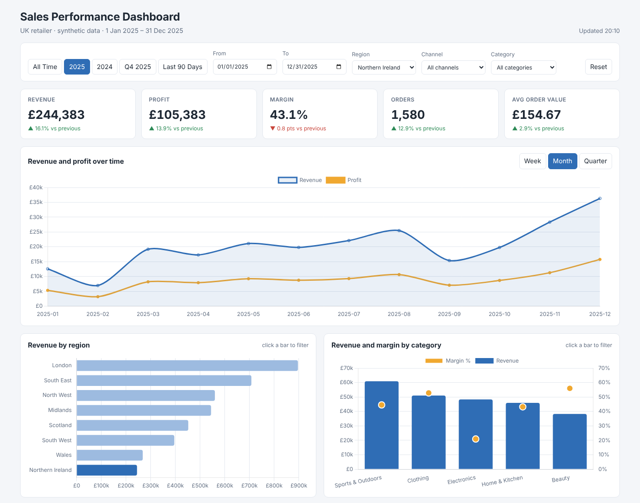
Click a bar to filter the whole dashboard
Keeps context
The clicked chart ignores its own filter and highlights the selection.
Everything else follows
KPIs, trend, categories and products all switch to the selection.
Notes:
Cross-filtering: clicking a region bar filters everything to that region; click again to clear it. Here I've selected Northern Ireland for 2025. Notice the region chart still shows all regions, with the selection highlighted. That's deliberate: the region chart ignores its own filter, otherwise it would collapse to a single bar and you'd lose the context. The KPI cards now compare Northern Ireland 2025 with Northern Ireland 2024. The category chart works the same way. (~1.5 minutes)

Slide 16
What the dashboard shows
2025 compared with 2024
Notes:
Now, what the dashboard reveals for 2025. (~0.5 minutes)

Slide 17
Revenue up 9.5% to £4.07m, with margin slightly better
£4.07m
£1.76m
43.3%
revenue, +9.5%
profit, +10.9%
margin, +0.6 pts
25,897
£157.07
orders, +12.1%
average order value, -2.3%
So what?
Growth came from more orders, not bigger baskets: test bundles and add-on recommendations to lift order value.
Notes:
Headline numbers for 2025 against 2024: revenue £4.07m, up 9.5%; profit £1.76m, up 10.9%; margin 43.3%, up 0.6 points. Orders grew 12.1%, but average order value fell 2.3%. So growth came from more orders, not bigger baskets. That points to a possible opportunity in bundles or add-on recommendations. (~1.5 minutes)

Slide 18
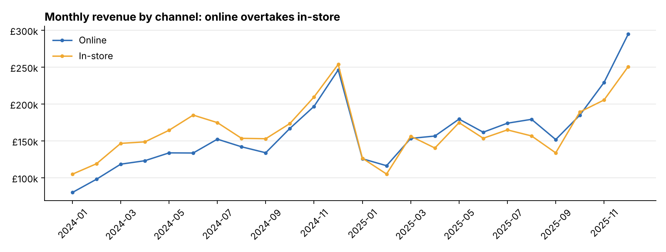
Online grew 22.1% while in-store was flat
+22.1%
online growth
-1.5%
in-store
So what?
Online is now 52% of revenue: plan marketing and stock around it, and use stores for click-and-collect and returns.
Notes:
The channel view tells the main growth story. Online revenue grew 22.1% while in-store changed -1.5%. Online overtook in-store during 2025 and is now 52% of revenue. For the business, that suggests shifting marketing spend and stock allocation toward online, and asking what the stores are for: perhaps click-and-collect and returns. (~1.5 minutes)

Slide 19
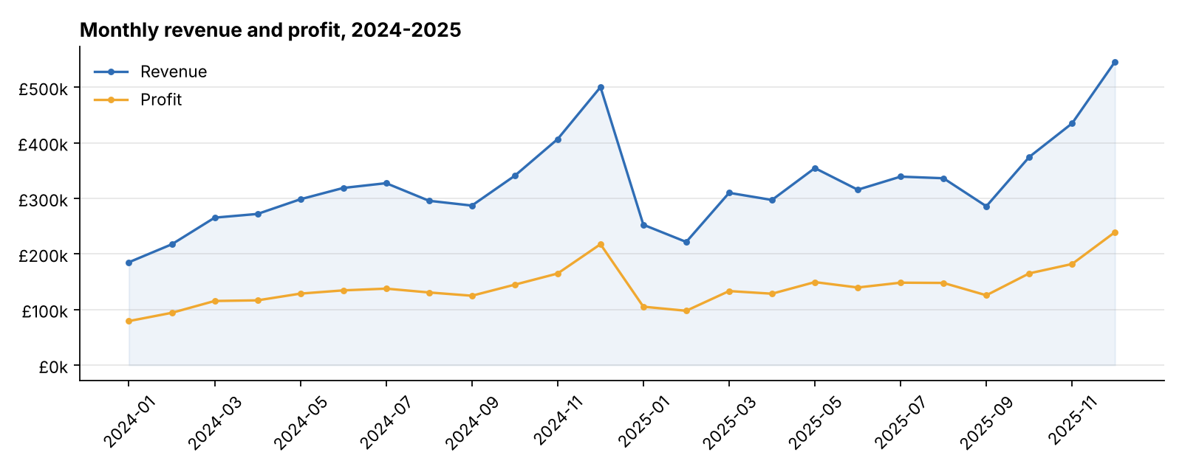
Q4 delivers 33% of the year's revenue
33%
of 2025 revenue in Q4
So what?
Plan stock and staffing for Q4 early; treat January promotions as a margin cost, not free volume.
Notes:
Seasonality is strong. Revenue climbs from October and peaks in December, then drops sharply in January and February. Q4 2025 delivered 33% of the year's revenue in a quarter of the time. Profit follows revenue, though the gap narrows slightly in November and January when discounting is heavier. Practically: secure stock and staff for Q4 early, and plan January promotions knowing they cost margin. (~1.5 minutes)

Slide 20
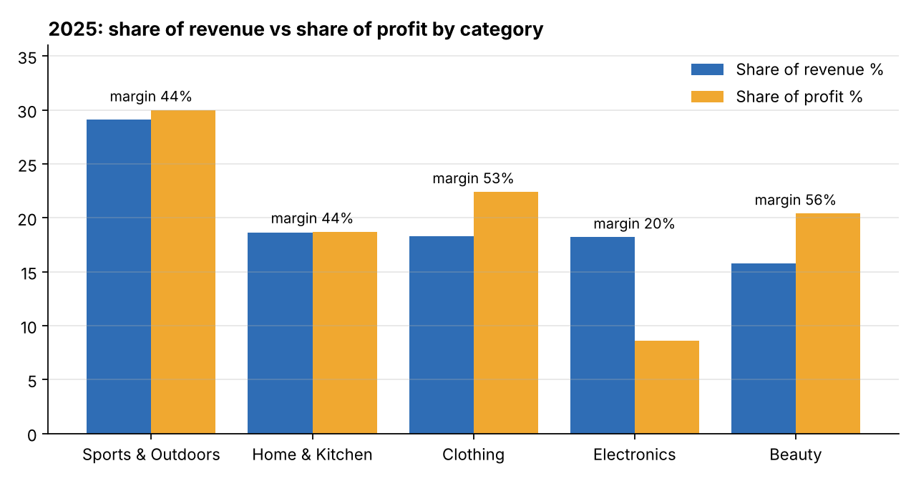
Electronics: 18.2% of revenue, only 8.6% of profit
Category | Margin
Sports & Outdoors | 44.5%
Home & Kitchen | 43.5%
Clothing | 53%
Electronics | 20.4%
Beauty | 55.8%
So what?
Avoid discounting electronics; push higher-margin Beauty and Clothing in promotions.
Notes:
This is the insight I'd lead with in a meeting. Electronics brings 18.2% of revenue but only 8.6% of profit, because its margin is about 20%, against 44 to 56% elsewhere. Beauty and Clothing are the opposite: smaller shares of revenue, bigger shares of profit. In the products table, low margins are highlighted in red; Portable Charger is a top-ten product by revenue at around 17% margin. Discounting electronics is therefore the most expensive promotion the business can run. (~2 minutes)

Slide 21
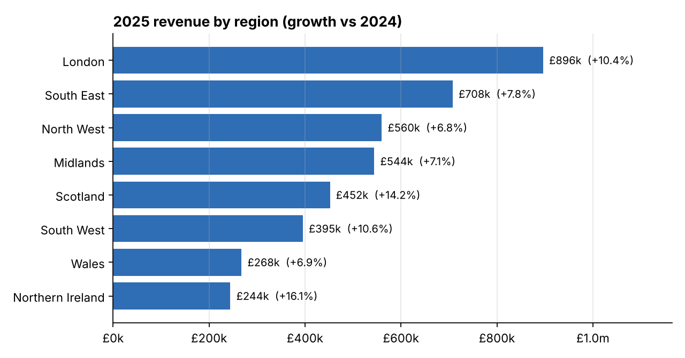
Regions: London leads; growth differences are small
Largest
London 22% of revenue, South East 17.4%
Careful
Regional growth gaps here are random variation. On real data, check against normal noise before acting.
Notes:
London is the largest region at 22% of revenue, then the South East. All regions grew, between about 7 and 16%. I want to be careful here: I didn't build any regional growth differences into the data, so these differences are random variation. That's a useful honesty point. On real data, before acting on a regional difference, I'd check whether it's larger than normal month-to-month noise. (~1.5 minutes)

Slide 22
26 tests across data, queries and the API
6
Data
Row counts, revenue formula on every line, no orphans, dates, reproducible, seasonality
10
Queries
Reconciliation (3 filter sets), previous period, empty selection, sorting, SQL injection
10
API
Health, filters, 400/422 validation, trend grains, limits, CSV export, frontend served
pytest → 26 passed
Notes:
There are 26 tests, and they run against a fresh database in a temporary folder, never the real one. Data tests check row counts, the revenue formula on every line, no orphan products, full date coverage, reproducibility and seasonality. Query tests check reconciliation, the previous-period rule including the leap-year case, empty selections returning zeros not errors, sorting and the injection case. API tests use FastAPI's TestClient to check validation errors, trend grains, limits, CSV export and that the frontend is served. (~2 minutes)

Slide 23
Lessons and limitations
Lessons
Limitations
One filter model keeps every chart consistent
Define the comparison period carefully
Reconciliation tests catch serious errors cheaply
Say what is noise, not just what is on the chart
Synthetic data
One product line per order: no basket analysis
No login or user roles
No caching: fine for 49k rows, not for millions
Notes:
Lessons: one shared filter model removes a whole class of inconsistency bugs; percentage changes need a carefully defined comparison period; reconciliation tests are cheap and catch serious errors; and being honest about what's noise matters as much as the charts. Limitations: the data is synthetic, orders have one line each, there's no authentication, and queries hit SQLite directly with no caching. (~1.5 minutes)

Slide 24
Next steps
1
Real data source
PostgreSQL or a warehouse: only queries.py changes
2
Caching
Cache popular queries for larger datasets
3
Forecast
Next-quarter forecast line on the trend chart
4
Login and roles
Managers see their own regions
5
Deploy + CI
Render or Azure App Service; tests in GitHub Actions
Notes:
Next steps, in order: connect to a real data source such as PostgreSQL, which only changes queries.py; add caching for larger data; add a simple forecast line for the next quarter; add login so different managers see their own regions; and deploy, for example to Render or Azure App Service, with tests running in GitHub Actions. (~1 minute)

Slide 25
Live demo and questions
python -m sales_dashboard serve → http://127.0.0.1:8000
github.com/MOIN-PEER/sales-dashboard | Thank you
Notes:
For the demo I run 'python -m sales_dashboard serve' and open the browser. I click the 2025 preset and read the KPI changes; switch the trend to quarters; click Electronics to show its low margin and the products driving it; click a region to show cross-filtering; export the CSV; and finally open /docs to show the interactive API documentation. Thank you, happy to take questions. (~3 minutes including demo)

