Slide 1

Benchmark of Error Correction Models
Moise C.J. MEKA
Supervised by Laurent Falquet
21st October 2026

Slide 2
Outline
Context
Method
Results
Conclusion

Slide 3
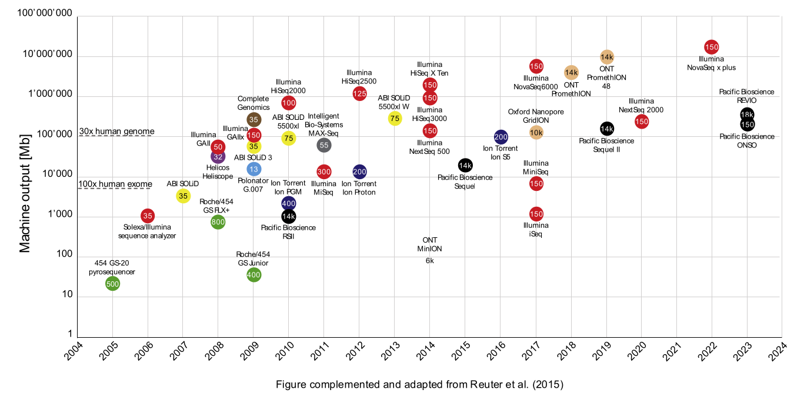
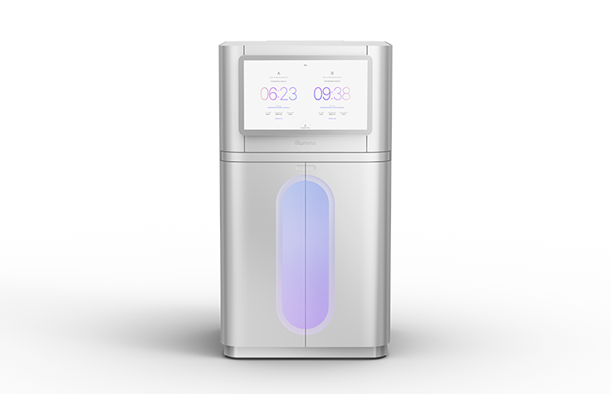
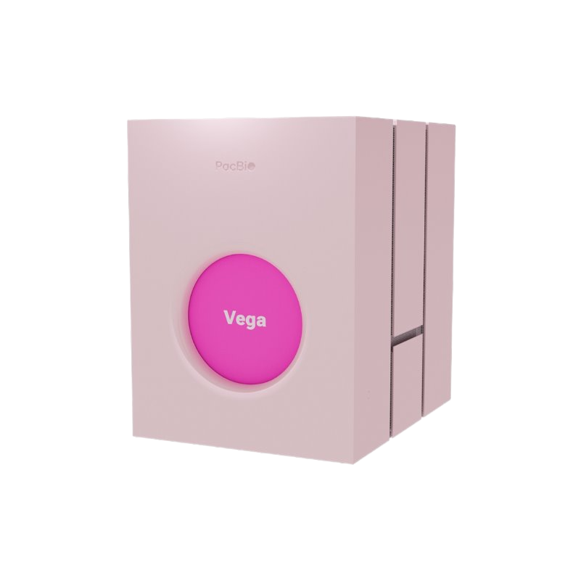
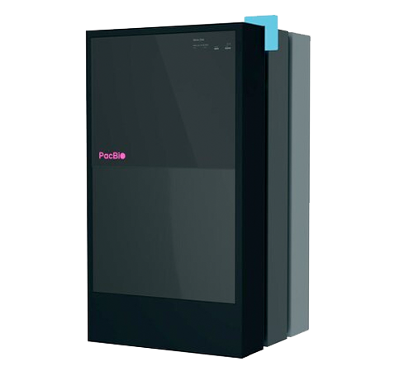
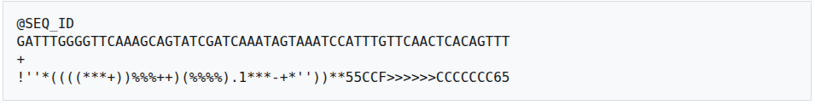
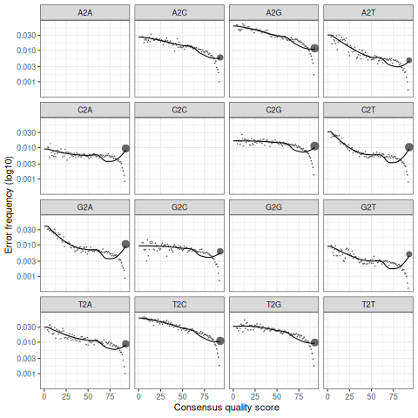
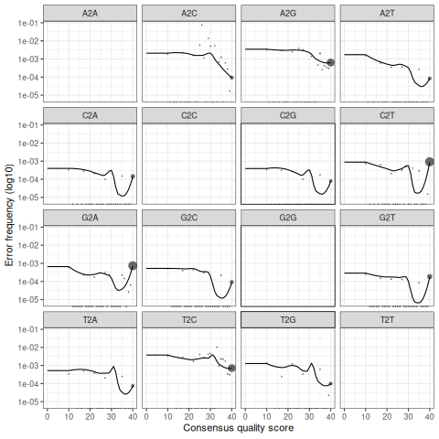
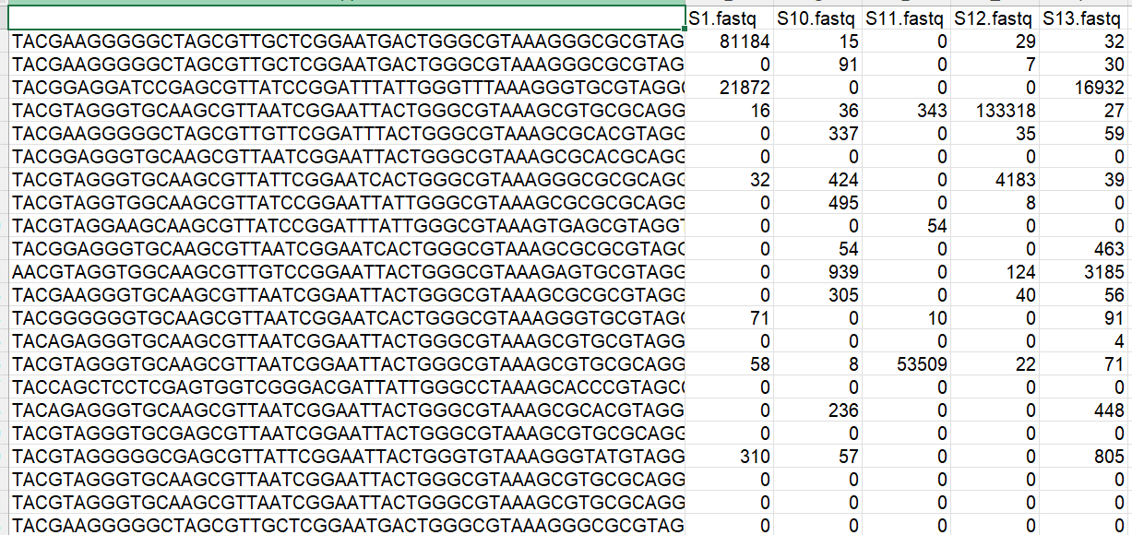
Context
(1) Quality Control, Trimming and Filtering
(2) Dereplicate
(3) Learn Error Rates
(4) Denoising
(5) Merge Paired Reads
(6) Construct Sequence Table
(7) Remove Chimeras
(8) Assign Taxonomy
How can we reduce the data size while maintaining the same performance?
Which error function performs best for this process?
Notes:
Sequencing output are fastq files with sequence DNA and Quality Score (reads)
In amplicon metagenomics, those reads are processed with dada2, through multiple steps from (1) Quality Control, Trimming and filtering until (8) Taxonomy assignment
The results of this process is sequence table with sample in column and ASV as rows
Since the sequencing is continuous improving. The current sequencing machine give hgh quality data with increasing fastq file size
To solve this issue with size growing companies like Illumina and PacBio decide to perform a quality score compression, where we went from continuous quality score to binned quality score.
This binning of quality score add issue in the Learning error step of dada2, where we went from error plots with almost colinear error to error plots with this concave shape
Face of this issue two questions come in us head: (1) How can we reduce the data size while maintaining the same performance? (2) Which error function performs best for this process?

Slide 4
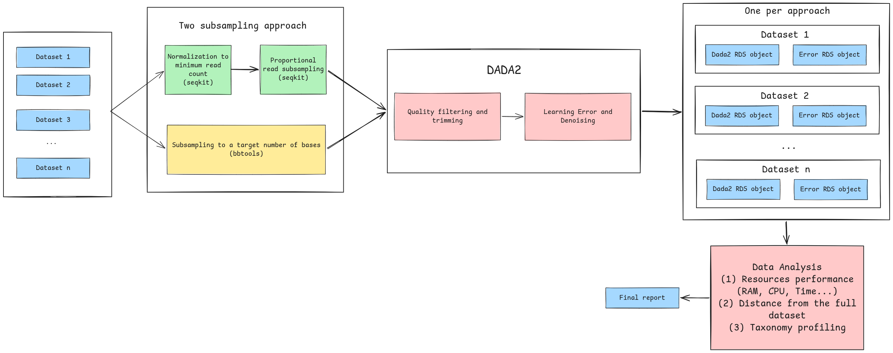
Method (1/2)
Proportional read subsampling:
  1%, 5%, 10%, 25%, 50%
Subsampling to target number of bases:
  1e+04, 1e+05, 1e+06, 1e+07, 1e+08
Notes:
To answer those two questions, we used the following method :
Here we used 2 approaches :
Proportional read subsampling with the proportions 1% up to 50%
Subsampling to target number of bases with 10 thousands, 100 thousands, 1 million, 10 millions and 100 millions of bases
For the both approaches we apply Quality filtering and trimming
Then learning error with multiple error functions and for each error function the denoising
The results of these steps were RDS files with dada and error objects for each dataset and each approaches.
We then made data visualizations and analysis on resources performances, error distances to the full dataset and Taxonomy profiling

Slide 5
Method (2/2)
Datasets summary
Dataset Name | Location | Sequencer | Binned Quality Score | Library Type | Segmentation | Chemistry | Total reads | Sum reads length | Min Length | Average Length | Max Length | Total reads normalized | Prop keep
UniBe_Revio | UniBe | Revio | Yes |  |  |  | 9236715 | 13794617120 | 96 | 1493.5 | 4527 | 49373 | 0,53%
UniBe_Sequel | UniBe | Sequel | No |  |  |  | 49373 | 74723118 | 328 | 1513.4 | 3107 | 49373 | 100,00%
UniBe_Vega | UniBe | Vega | Yes | Kinnex |  |  | 36272836 | 54747826494 | 51 | 1509.3 | 14226 | 49373 | 0,14%
UniL_Sequel2 | UniL | Sequel2 | No | Standard |  | Non SPRQ | 296860 | 444180800 | 432 | 1496.3 | 4631 | 49373 | 16,63%
UniL_Revio-Standard-SPRQ | UniL | Revio | Yes | Standard |  | SPRQ | 1160968 | 1779919750 | 539 | 1533.1 | 6368 | 49373 | 4,25%
UniL_Revio-Standard-NON-SPRQ | UniL | Revio | Yes | Standard |  | Non SPRQ | 1730934 | 2643585905 | 274 | 1527.3 | 7765 | 49373 | 2,85%
UniL_Revio-Kinnex-Segmented-SPRQ-NX | UniL | Revio | Yes | Kinnex | Segmented | SPRQ NX | 584136 | 874997625 | 97 | 1497.9 | 5404 | 49373 | 8,45%
UniL_Revio-Kinnex-Segmented-SPRQ | UniL | Revio | Yes | Kinnex | Segmented | SPRQ | 1404011 | 2061300440 | 51 | 1468.2 | 4663 | 49373 | 3,52%
UniL_Revio-Kinnex-Non-Segemented-SPRQ-NX | UniL | Revio | Yes | Kinnex | Non Segmented | SPRQ NX | 609565 | 908547129 | 1129 | 1490.5 | 4651 | 49373 | 8,10%
Notes:
During this research project we used 9 datasets:
3 from the University of Bern and 6 from the University of Fribourg
1 dataset per university had non-binned quality score
The datasets were generated using various sequencing machine, Libraries and Protocol

Slide 6
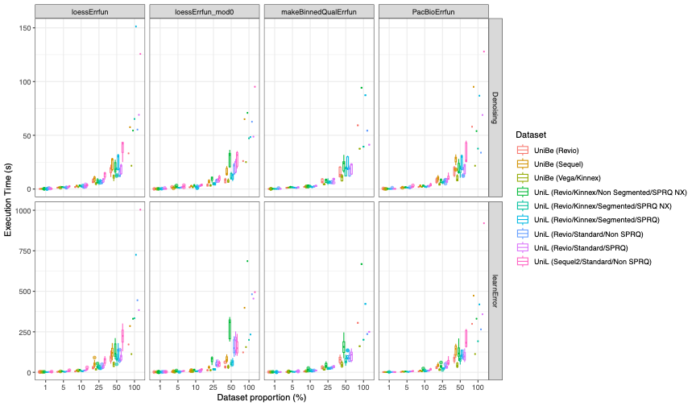
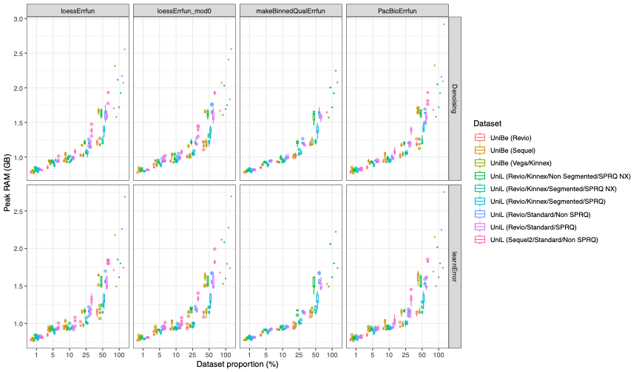
Results: Proportional read subsampling (1/4)
Execution Time (s)
Peak RAM (GB)

Slide 7
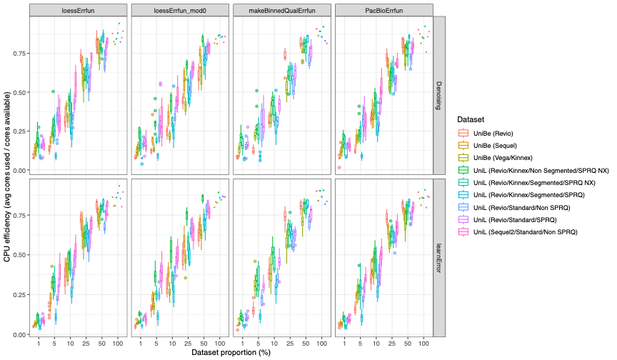
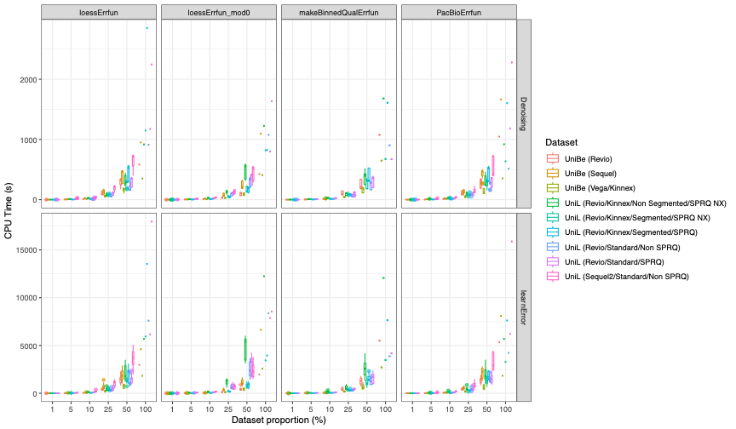
Results: Proportional read subsampling (2/4)
CPU efficiency
CPU Time (s)

Slide 8
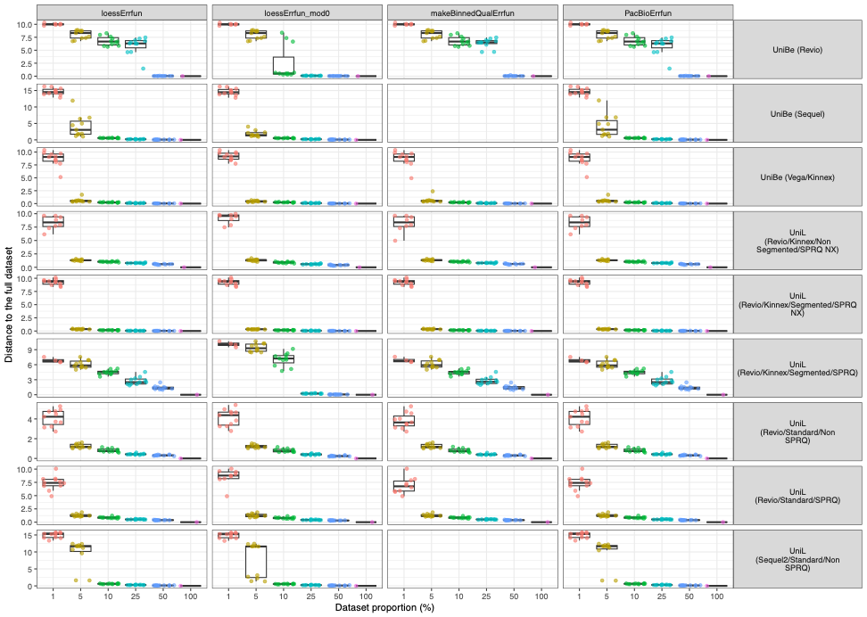
Results: Proportional read subsampling (3/4)

Slide 9
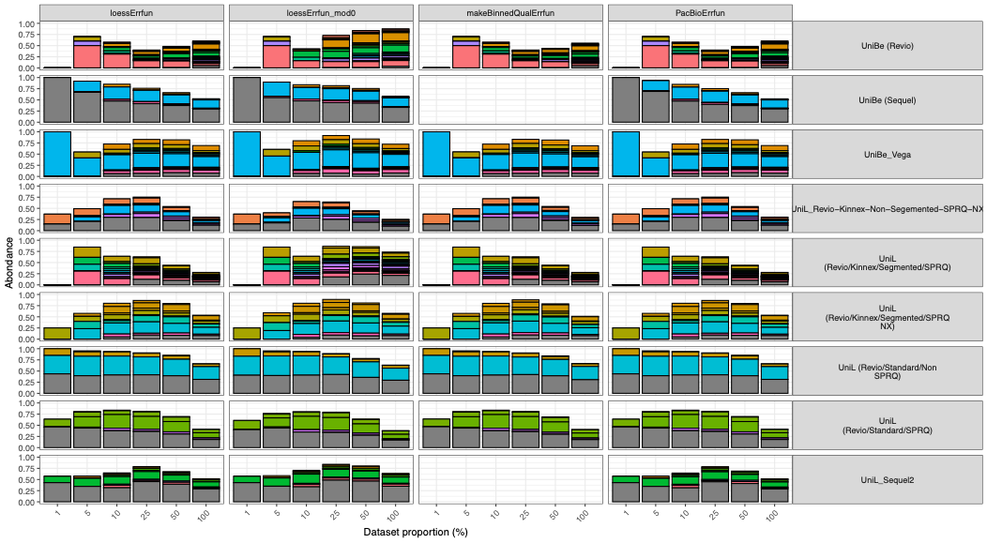
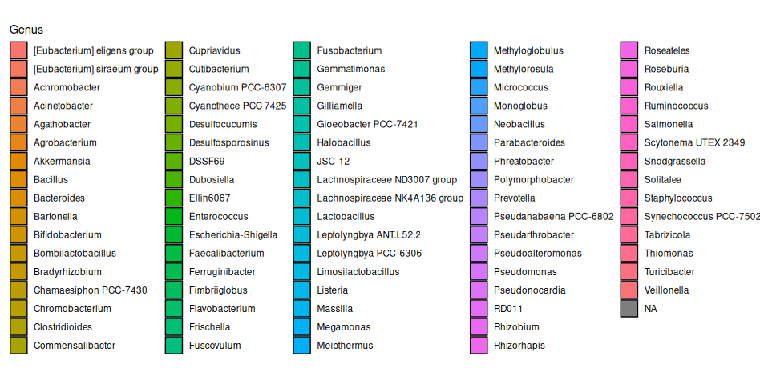
Results: Proportional read subsampling (4/4)

Slide 10
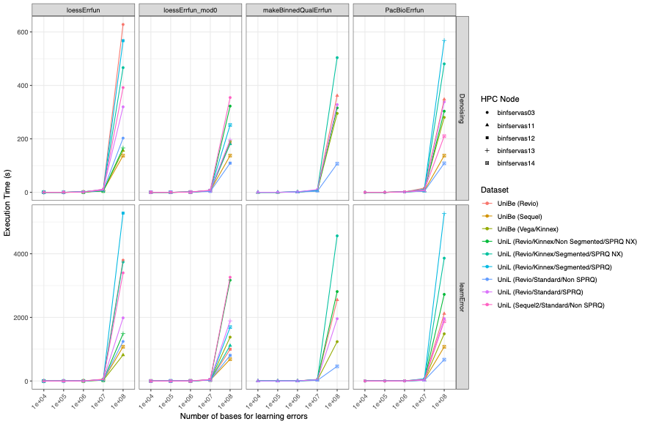
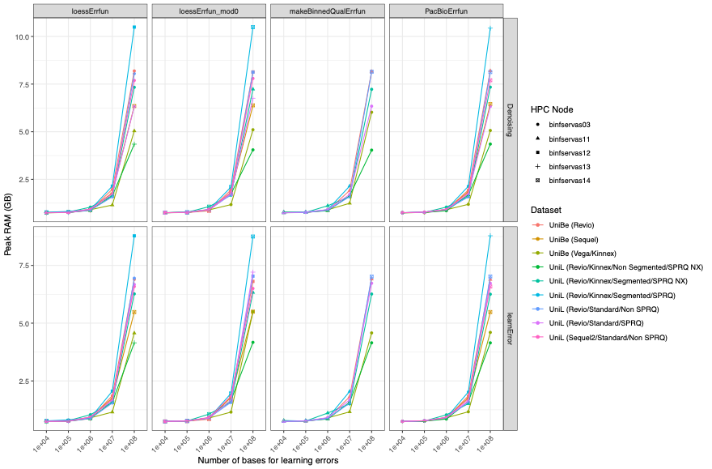
Results: Subsampling to target number of bases (1/4)
Execution Time (s)
Peak RAM (GB)

Slide 11
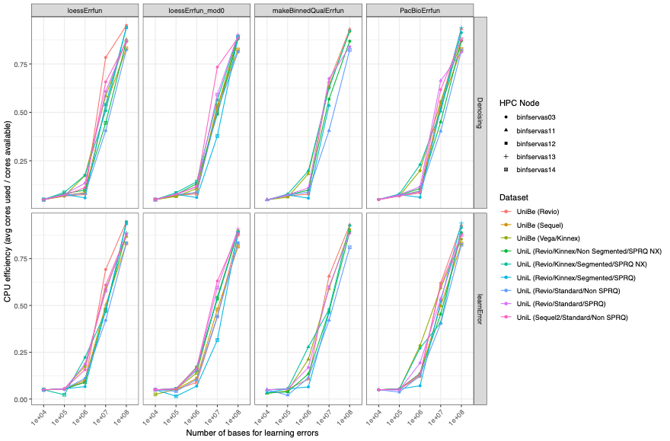
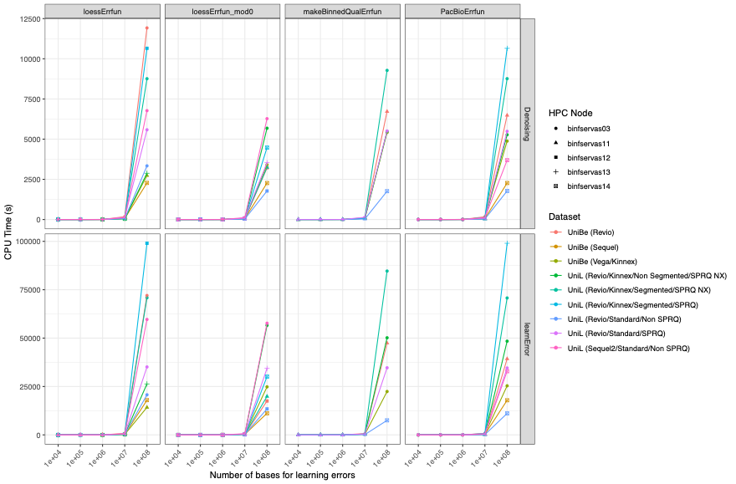
Results: Subsampling to target number of bases (2/4)
CPU efficiency
CPU Time (s)

Slide 12
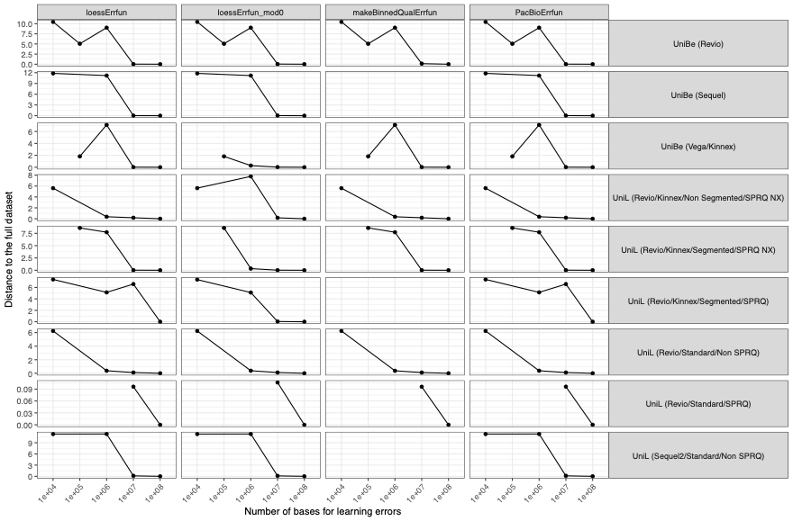
Results: Subsampling to target number of bases (3/4)

Slide 13
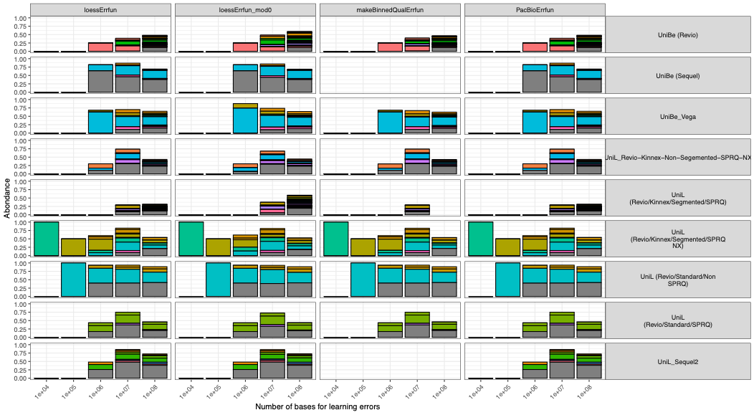
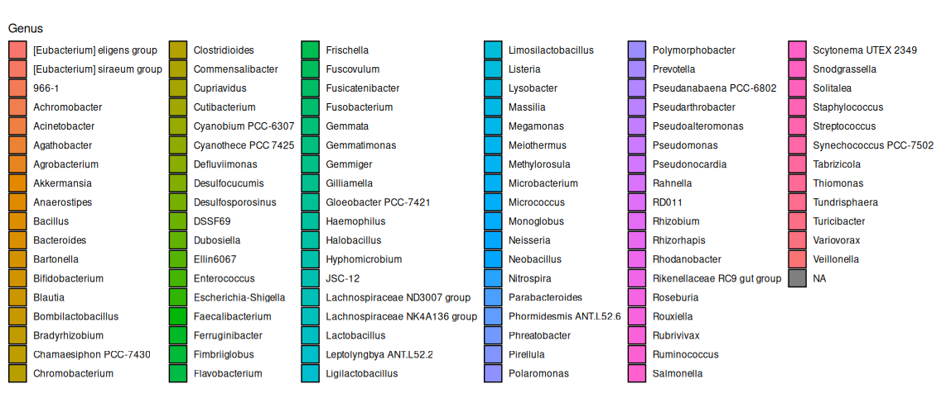
Results: Subsampling to target number of bases (4/4)

Slide 14
Conclusion

