Slide 1
Rijndael
Advanced Encryption Standard

Slide 2
Overview
Definitions
Who created Rijndael and the reason behind it
Algorithm breakdown
Attacks on AES/Rijndael

Slide 3
Definitions
Block cipher
  Consists of two paired algorithms, one for encryption, E, and another for decryption, E-1. Both algorithms accept two inputs: an Nb-bit input block and a Nk-bit key.
Iterated block cipher
  Constructed by composing several simpler functions. Each iteration is termed a round, and there are rarely less than 4 or more than 64 of them.
The Galois Fields (GF)
  A field that contains only finitely many elements. The order of a finite field is always a prime or a power of a prime

Slide 4
Who created Rijndael and why?
Designed by Joan Daemen and Vincent Rijmen as a candidate for the Advanced Encryption Standard.
Joan Daemen and Vincent Rijmen also designed block cipher.
The algorithm must implement symmetric key cryptography as a block cipher and (at a minimum) support block sizes of 128 bits and key sizes of 128, 192, and 256 bits.

Slide 5
Who created Rijndael and why?
(cont.)
3 design goals
  Resistance against know attacks
  Speed and code compactness on a variety of platforms
  Design simplicity

Slide 6
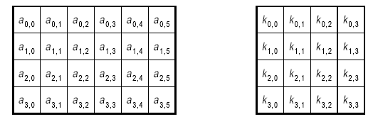
Algorithm breakdown
Description
  Variable block lengths and key lengths supported
    128, 192, 256
  Number of columns in the state and round key arrays depend on the sizes

Slide 7
Algorithm breakdown
Round transformation
Step 1: ByteSub Transformation
Step 2: ShiftRow Transformation
Step 3: MixColumn Transformation
Step 4: Round Key Addition
Final round is a little different because it removes the MixColumns step.

Slide 8
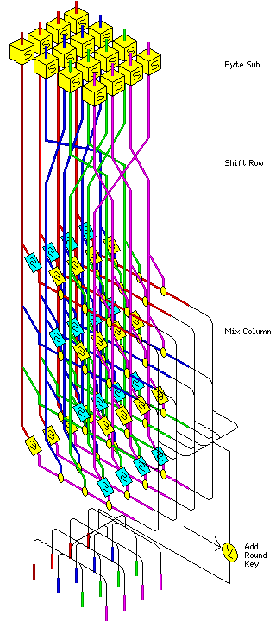
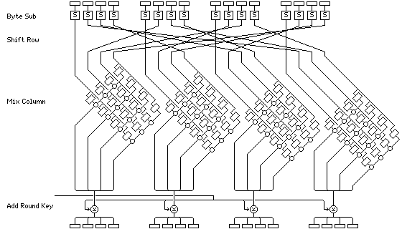
Algorithm breakdown

Slide 9
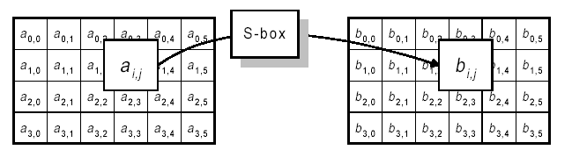
Algorithm breakdown
Step 1: ByteSub Transformation
Each byte of the block is replaced by its substitute in an S-box.
Each byte is treated independently
Single S-box is used for the entire state

Slide 10
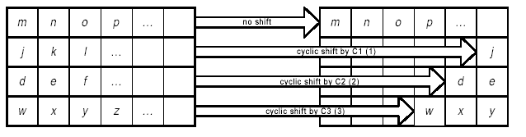
Algorithm breakdown
Step 2: ShiftRow Transformation
Each row of the state is shifted cyclically a certain number of steps.
  The number a row is shifted can’t be the same.

Slide 11
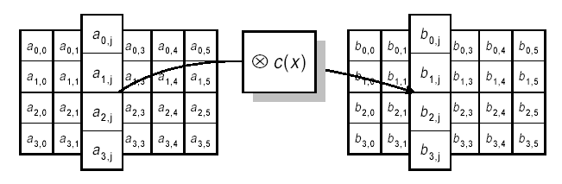
Algorithm breakdown
Step 3: MixColumn Transformation
State columns are treated as polynomials over GF(2⁸)
Each column is multiplied by modulo x⁴ + 1 by a fixed polynomial c(x) = `03` x³ + `01` x² + `01`x + `02`

Slide 12
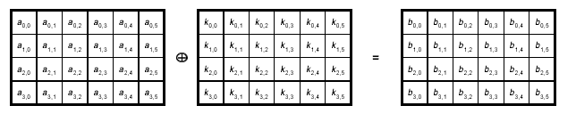
Algorithm breakdown
Step 4: Round Key Addition
XOR round key with state

Slide 13
Attacks on AES/Rijndael
Algebraic attacks
  People have shown Rijndael can be written as an over defined system of multivariate quadratic equations
  Paper published at Eurocrypt 2000 Shamir describe an algorithm called XL able to solve efficiently many such systems of equations.
    However this fails miserably
  128-bit Rijndael, the problem of recovering the secret key from one single plaintext can be written as a system of 8000 quadratic equations with 1600 binary unknowns.

Slide 14
Attacks on AES/Rijndael
(cont.)
Nicolas Courtois and Josef Pieprzyk investigate how to improve XL and adapt it to such special systems. They propose a new class of attacks, attack, called XSL attacks.
  Ciphers like Rijndael were referred to as XSL ciphers, because their rounds are composed of the XOR of key material, a nonlinear substitution provided by an S-box, and a linear diffusion stage.

Slide 15
Attacks on AES/Rijndael
(cont.)
Assuming that one could build a machine that could recover a DES key in a second (i.e., try 2⁵⁵ keys per second), then it would take that machine approximately 149 trillion years to crack a 128-bit AES key.

