Slide 1
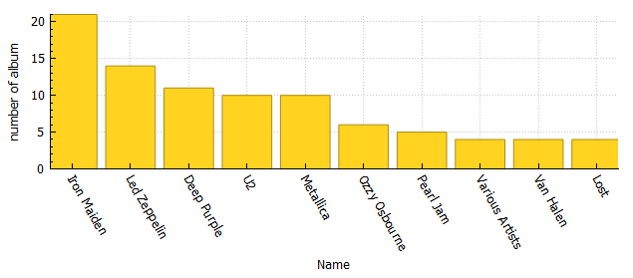
Who are the top ten of artists and what is number of albums for each one?
<visualization>
This is graph which show and explain the top ten of artists and what is number of albums for each one

Slide 2
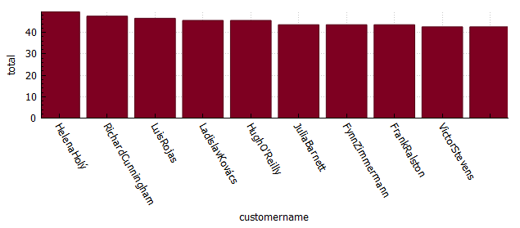
what is the best seller of top ten?
<visualization>
This is graph which show and explain the best seller of top ten

Slide 3
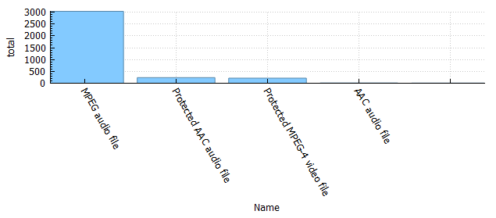
which media type is the most commonly used?
<visualization>
This is graph which show and explain which media type is the most commonly used

Slide 4
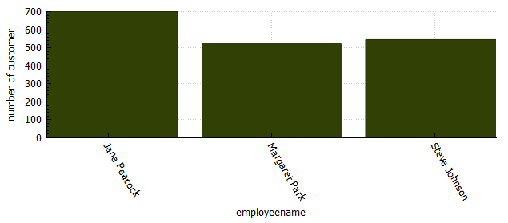
who is the most supportive employee?
<visualization>
This is graph which show and explain who is the most supportive emmployee

