Slide 1


Pizza Sales Analysis
SQL Project
By Monika Devi

Slide 2
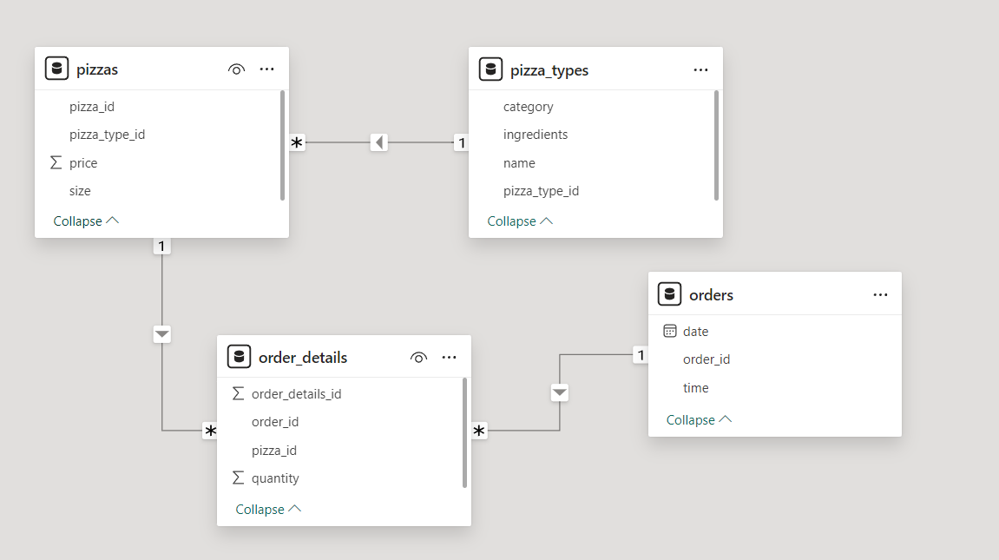
Our Schema

Slide 3
Dataset Contents
The dataset has 4 tables.
1. The order_details tables has 48621 rows containing order details regarding pizza type and order quantity.
2. The orders table record the datetime indicators of the 21351 orders.
3. The pizza_types table specifies the category, ingredients information about the 33 different pizza types offered by the pizza place.
4. The pizzas table has 97 rows containing the pricing details of pizza based on the size and pizza type.

Slide 4
Problem Statements
KPI Requirement
We need to analyze key indicators for our sales data to gain insights into our business performance. Specifically , We want to calculate the following metrics:
Total Revenue:
Average Order Value:
Total Pizzas Sold:
Total Orders:
Average Pizzas per Order:
Daily Trend Total Orders:
Hourly Trend Total Orders:
Percentage of Sales by pizza Category:
Percentage of Sales by Pizza Size:
Total pizzas Sold by Pizzas Sold:

Slide 5
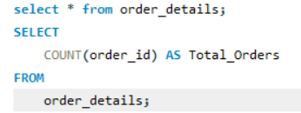
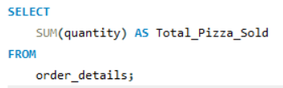


1. Total number of Orders :
2. Total pizzas quantity sold
Input -
Output - -

Slide 6
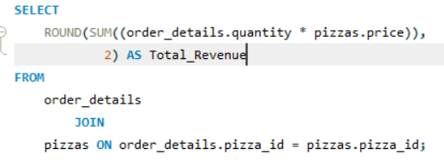

3 Total Revenue
Input -
Output -

Slide 7
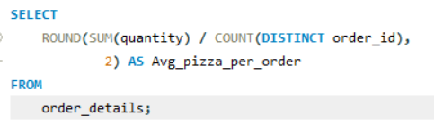

4. Average pizza per order (Average number of pizza sold per order)
Input -
Output -

Slide 8
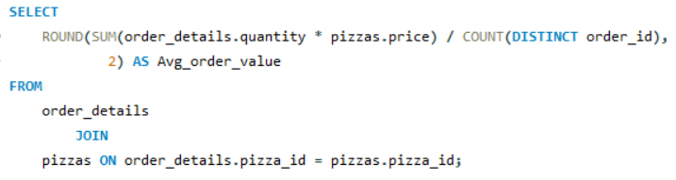

5. Average amount spent per order (Average Order Value)
Input -
Output -

Slide 9
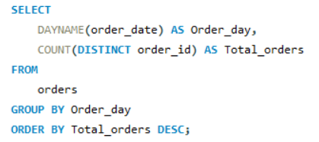
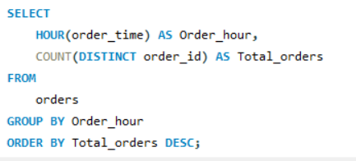
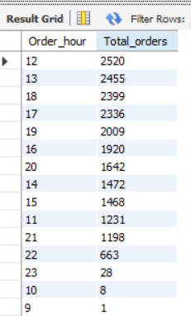
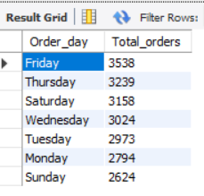
6. Daily Trends for Total Orders
7. Hourly Trends for Total Orders
Input -
Output -

Slide 10
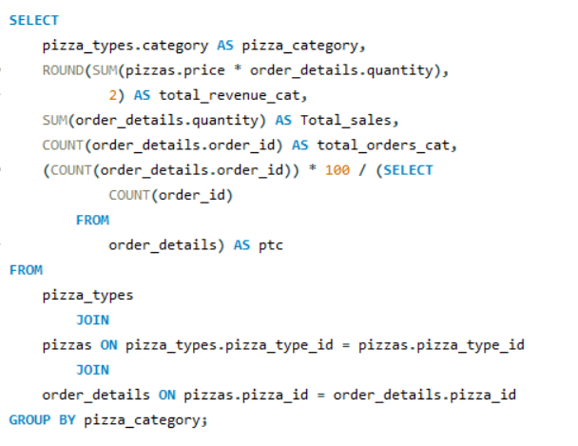
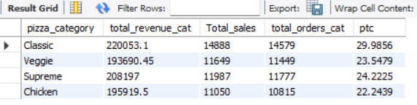
8 Persantage of Sales by pizza Category
Input -
Output -

Slide 11
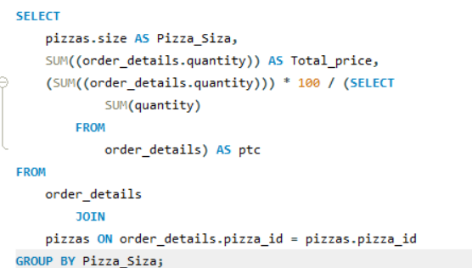
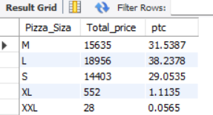
9. Percentage of sales by pizza size
Input -
Output -

Slide 12
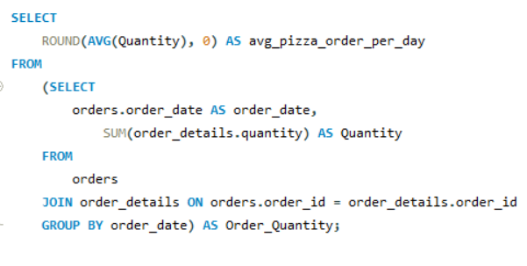

10. Number of pizzas order per day
Input -
Output -

Slide 13
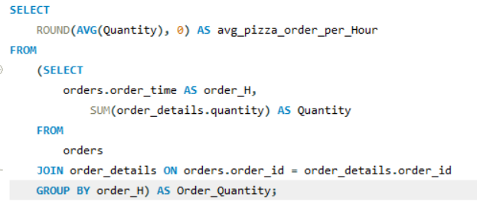

11. Number of pizzas order per Hour
Input -
Output -

Slide 14
Thank You

