Slide 1

Presented By - J.Monika Register No. - 6EDD4B2F9CCC6BFBCEE4A3D3E0B3C2AF Department - Department of commerce Honours College - Sri Kanyaka Parameswari Arts & Science College For Women
Employee Data Analysis Using Excel

Slide 2
Project Title
Employee Performance Analysis Using Excel

Slide 3
AGENDA
1.Problem Statement
2.Project Overview
3.End Users
4.Our Solution and Proposition
5.Dataset Description
6.Modelling Approach
7.Results and Discussion
8.Conclusion

Slide 4
Problem Statement
Problem Statement: Despite efforts to enhance productivity, many organizations struggle to accurately monitor and understand the trends in employee productivity over time. This often leads to inefficiencies, unaddressed performance issues, and missed opportunities for improvement.
The challenge lies in the ability to analyze large volumes of performance data in a way that reveals meaningful trends and actionable insights. This project aims to address this issue by developing a systematic approach using Excel to analyze and visualize employee productivity trends.
By identifying patterns, seasonal variations, and factors influencing productivity, the organization can make informed decisions to enhance overall employee performance and operational efficiency." This problem statement clearly outlines the issues faced by organizations, the purpose of the project, and the expected outcomes, making it a strong foundation for your project.

Slide 5
Project Overview
Analyzing Employee Productivity Trends Using Excel
Objective: To analyze and visualize employee productivity trends over time using Excel, with the goal of identifying patterns and factors that influence productivity, thereby enabling data-driven decision-making for performance improvement.
Scope: Collect and clean productivity data (e.g., work hours, task completion).- Analyze trends using Excel tools like Pivot Tables and charts.- Identify key patterns and seasonal variations.- (Optional) Predict future productivity trends.- Create reports and dashboards to present findings.
Outcome: Deliver actionable insights on employee productivity to help optimize performance and operational efficiency.

Slide 6
End Users
HR Managers: To monitor and improve employee productivity. Team Leaders: To identify performance trends and address issues. Executives: To make strategic decisions based on productivity insights. Employees: To understand their own productivity trends and areas for improvement.

Slide 7
Solution and Value Proposition
Our Solution: We provide an Excel-based tool that analyzes employee productivity over time. It highlights trends, patterns, and factors affecting performance, helping organizations gain clear insights into how their employees are performing.
Proposition: With this solution, organizations can make informed decisions to boost productivity, identify areas for improvement, and ultimately enhance overall business efficiency.

Slide 8
Dataset Description
Data Set Description: The dataset includes information on employee productivity, such as:-
Employee Details: Names, departments, and roles.-
Work Hours: Total hours worked by each employee over specific periods.-
Task Completion: Number and type of tasks completed.-
Deadlines Met: Records of whether tasks were completed on time.-
Performance Ratings: Quality of work based on manager assessments. This data is organized by time periods (e.g., daily, weekly, monthly) to help analyze trends and patterns in employee productivity.

Slide 9
Modelling Approach
1. Data Preparation: Clean and organize the data in Excel to ensure it's ready for analysis.
2. Trend Analysis: Use Excel’s tools like Pivot Tables and charts to explore and visualize productivity trends over time.
3. Pattern Identification: Identify key patterns, such as peak performance times or consistent productivity dips.
4. Predictive Modeling (Optional): Apply Excel’s forecasting functions to predict future productivity based on historical data. This approach helps turn raw data into actionable insights for improving employee performance.

Slide 10
Results
Trend Insights: Identified patterns in productivity, such as peak times when employees are most productive and periods with lower performance. Performance Variations: Noted differences in productivity across departments or roles.
Predictive Insights (if applicable): Estimated future productivity trends based on historical data. Discussion: Impact: Discuss how these trends and patterns can help improve employee performance and operational efficiency. Recommendations: Provide suggestions for addressing productivity dips or leveraging peak performance times.

Slide 11
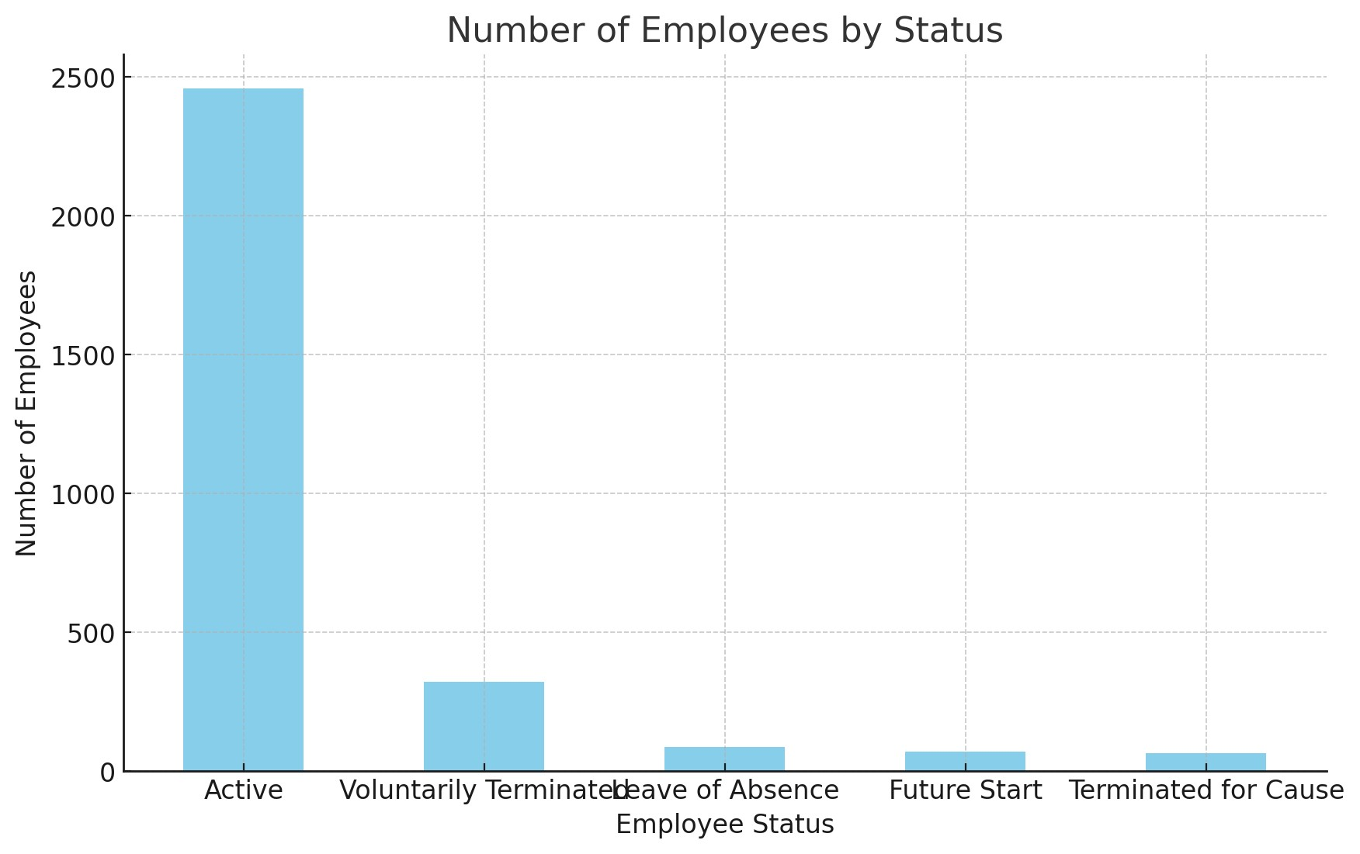

Slide 12
Conclusion
The analysis revealed key trends and patterns in employee productivity, highlighting times of high and low performance. By understanding these trends, organizations can make informed decisions to enhance productivity, address performance issues, and optimize overall efficiency. The insights gained provide a solid foundation for improving employee performance management and strategic planning.

