Slide 1
Employee Salary Analysis
STUDENT NAME: MONIKA S
REGISTER NO: 312204592, 88A8070584BED048EFB4235B8ECC055C
DEPARTMENT: COMMERCE
COLLEGE: K.C.S KASI NADAR COLLEGE OF ARTS & SCIENCE

Slide 2
PROJECT TITLE
Employee Salary Analysis

Slide 3
AGENDA
Problem Statement
Project Overview
End Users
Our Solution and Proposition
Dataset Description
Modelling Approach
Results and Discussion
Conclusion

Slide 4
PROBLEM STATEMENT
Compare the salaries of employees within the company to industry standards or competitors to determine if adjustments are needed to remain competitive.“
Analyze the distribution of employee salaries to identify any disparities or patterns across different departments, roles, or experience levels.“
Average salary, age of employee according to their department, gender and role.

Slide 5
PROJECT OVERVIEW
In this analysis I am going to ease the process of identify the employees average salary and average age using excel, with the help of below mentioned tools in excel.
Tables
Slicer
Pivot Chart( Line chart, Pie chart, Bar chart)
By inserting formula to make interactive dashboard

Slide 6

WHO ARE THE END USERS?
Human Resources Department
Finance Department
Compensation and Benefit specialist
Operational Manager
IT and Data management team

Slide 7
OUR SOLUTION AND ITS VALUE PROPOSITION
1. Advanced Analytical Tools:
Formulas and Functions
Pivot Tables
2. User-Friendly Interface:
Accessibility
Ease of Use
3. Comprehensive Data Management:
Data Organization
Data Integration
4. Scenario Analysis
Used to analyses different situation
5. Visual Representation:
Charts and Graphs

Slide 8
Dataset Description
1.Data overview
For employee salary analysis, gather data on employee demographics, salary
components(base, bonuses, etc.), and market comparisons.
2. Data Fields
ID
Name
Surname
Age
Tenure
Gender
Region
Department
Manager
Hours
Salary band
FTE Salary
Salary
Performance

Slide 9
MODELLING
Data cleaning
Creating table
Creating pivot chart
Creating dashboard
Inserting pivot chart in dashboard
Inserting formulas in dash board to make interaction
Creating interactive dashboard by putting all together elements.
9

Slide 10
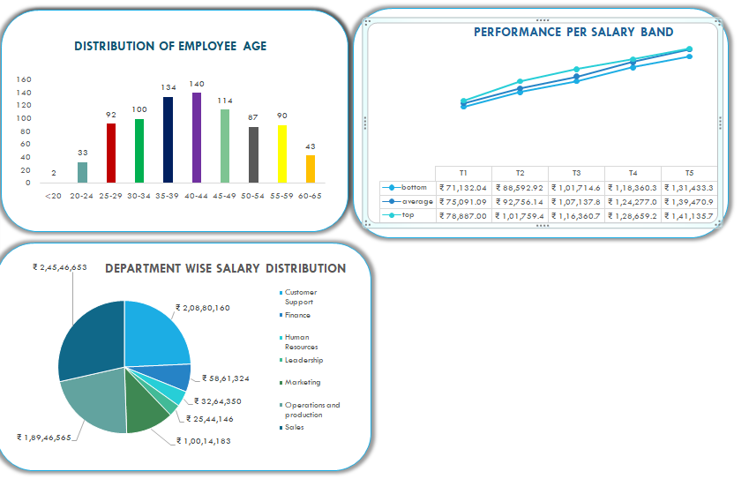
RESULTS
10

Slide 11
Conclusion
The employee salary analysis indicates that overall compensation aligns with industry standards but reveals discrepancies within certain departments.
Notable pay variations among similar roles suggest the need for adjustments to ensure fairness.
Performance-based salary increments are well-correlated, yet regional differences must be addressed.
Implementing a structured review process and regular benchmarking are recommended to improve equity and maintain competitiveness.
Enhanced communication about compensation policies will support employee satisfaction and retention.

