Slide 1


For a network node under variable load (P), can a Priority Queuing model (I), rather than a single FIFO queue (C), improve QoS measures like waiting time and throughput (O)?
Presented by:
B Keshav [1925260042]
Monish L [1972260035]
Deepak R [192460153]
Surender S [1924260070]
CSA0702 – Computer Network
Date: 29/08/2026

Slide 2
INTRODUCTION
Congestion in Packet Networks & the Case for Smarter Queuing
CSA0702 — Computer Network Capstone Project
Every packet that crosses a router, switch, or gateway competes for a finite service resource. When arrival rate and burstiness rise, packets queue, delay grows, and Quality of Service (QoS) for latency-sensitive traffic such as voice degrades. The traditional single FIFO queue treats all traffic identically and offers no mechanism to protect time-sensitive flows or reveal where congestion actually builds up.
Team & Modules
01
Single-Queue vs Network-of-Queues — Monish
02
FIFO vs Priority Queuing — Deepak
This capstone investigates whether queuing-theory-based models — priority scheduling, multi-stage (tandem) queues, and multi-server (M/M/c) systems — can better capture congestion and improve QoS measures than a single FIFO queue, through four linked sub-studies.
03
Effect of Arrival Rate on Queue Length — Keshav
04
M/M/c vs M/M/1 — Surender

Slide 3
OBJECTIVE
What This Project Sets Out to Do
1
Model congestion realistically
Represent a network node — and a chain of nodes — as queuing systems (M/M/1, M/M/c, tandem networks) instead of a single black-box delay figure.
2
Compare scheduling disciplines
Evaluate FIFO against Priority Queuing to see whether class-aware scheduling reduces delay for time-sensitive (voice) traffic.
3
Quantify the load–congestion relationship
Sweep arrival rate λ against fixed service rate μ and observe how queue length and utilization (ρ = λ/μ) respond.
4
Assess multi-server pooling
Test whether an M/M/c pooled-server model reduces average waiting time versus an equivalent-capacity M/M/1 system.
5
Link findings to transport-layer QoS (CO4)
Connect per-hop delay, jitter, and congestion location to practical mechanisms — congestion control, scheduling, and RTT estimation.

Slide 4
LITERATURE REVIEW
Foundations in Queuing Theory & Network QoS
M/M/1 Queuing Theory
Jackson Networks
Classical single-server queue with Poisson arrivals and exponential service (Kleinrock). Provides Wq = λ/[μ(μ−λ)] and forms the baseline model used across all four modules.
Jackson's theorem shows that a network of connected M/M/1 stages behaves, under Poisson-preserving conditions, as if each stage were independently M/M/1 — the theoretical basis for the tandem-queue module.
Priority Queuing & Scheduling
Multi-Server (M/M/c) Systems & Erlang C
Prior networking literature (e.g. Cisco QoS scheduling models) shows class-based scheduling can protect delay-sensitive flows at the cost of fairness to lower-priority traffic — motivating the FIFO vs Priority comparison.
Erlang's multi-server formulas describe how pooling c parallel servers reduces the probability of queuing (Erlang-C) and improves waiting time over equivalent separate single-server systems.

Slide 5
METHODOLOGY
One Simulation Approach, Applied to All Four Modules
1
Define the model
State each module's queuing model — single queue, tandem network, priority scheduler, or M/M/c — with explicit λ, μ, and c parameters.
2
Generate traffic
Simulate Poisson packet arrivals and exponential service times in MATLAB / OMNeT++, holding controlled variables (packet size, duration, seed) identical across compared models.
3
Instrument & measure
Record arrival, service-start, and departure timestamps to compute waiting time, end-to-end delay, queue length, and throughput for each run.
4
Compare against theory
Validate simulated trends against closed-form M/M/1 / M/M/c predictions before drawing conclusions.
Integrity rule applied throughout: no simulation result is fabricated. Pending runs are labeled “Illustrative placeholder” and conclusions are stated as expected/theoretical until MATLAB or OMNeT++ output is available.

Slide 6
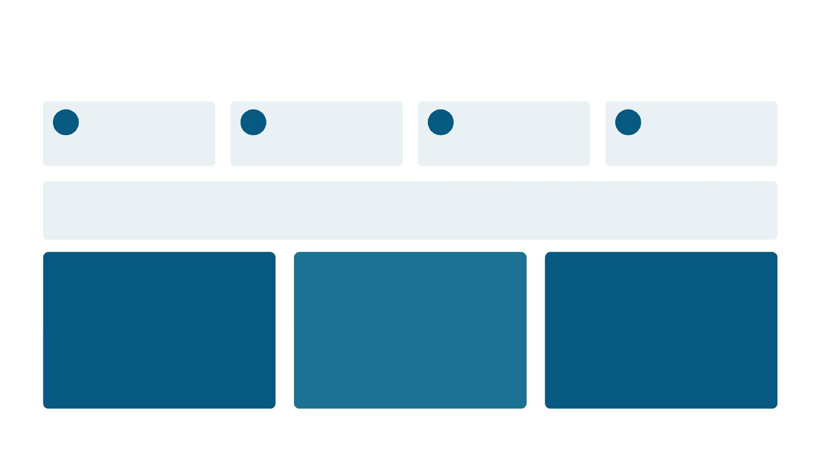



Project Framework
One research question, explored through three linked sub-studies.
P
I
C
O
Population
Intervention
Comparison
Outcome
Packets / traffic at a network node under mixed &
variable load
Priority Queuing & multi-stage (network-of-
queues) models
Single FIFO queue / single-queue baseline
Waiting time, end-to-end delay, queue length,
throughput
Research question
"Does priority-aware / multi-stage queue modeling capture congestion and improve QoS better than a simple single FIFO queue?"
01
Single-Queue vs Network-of-Queues
End-to-end delay across a 3-stage tandem chain
— Monish
Slides 3–8
02
FIFO vs Priority Queuing
Delay of time-sensitive voice packets under mixed traffic
— Deepak
Slides 9–14
03
Effect of Arrival Rate on Queue Length
How λ vs μ drives congestion at one node
— Keshav
Slides 15–19
02 / 20

Slide 7
01
Single-Queue vs Network-of-Queues — Problem Statement
End-to-end delay analysis across a chain of network devices · by Monish
Real network traffic traverses multiple devices. Each device may have its own queue and service process, and congestion can accumulate across stages.
RESEARCH QUESTION
"For a chain of network devices, does a Network-of-Queues model — rather than a Single-Queue model — better capture congestion and traffic management?"
P
I
C
O
Population
Intervention
Comparison
Outcome
Packets traversing a chain of network devices (routers / switches / gateways)
Model each device as its own queue (3-stage tandem network)
Simplify the entire path as one single queue + server
End-to-end delay (ms); congestion location & QoS implications
Why this matters
• Real traffic hops through many devices before reaching its destination
• A single-queue abstraction may hide exactly where congestion builds up
• Understanding per-hop delay is a prerequisite for transport-layer QoS tuning (CO4)
03 / 20

Slide 8
01
Single-Queue Model (Baseline)
Abstraction: the entire path reduced to one Queue + Server
Traffic
Queue + Server
Destination
→
→
Advantages
Limitations
• Simple to analyze and simulate
• Fewer parameters required
• Useful as a theoretical baseline (M/M/1 analysis)
• Cannot localize congestion to specific devices
• May mask intermediate bottlenecks
• Less accurate for heterogeneous service rates
Role in this study
Provides a controlled baseline for comparing end-to-end delay against the 3-stage tandem queue model, verified in Cisco Packet Tracer below (Model A).
04 / 20

Slide 9
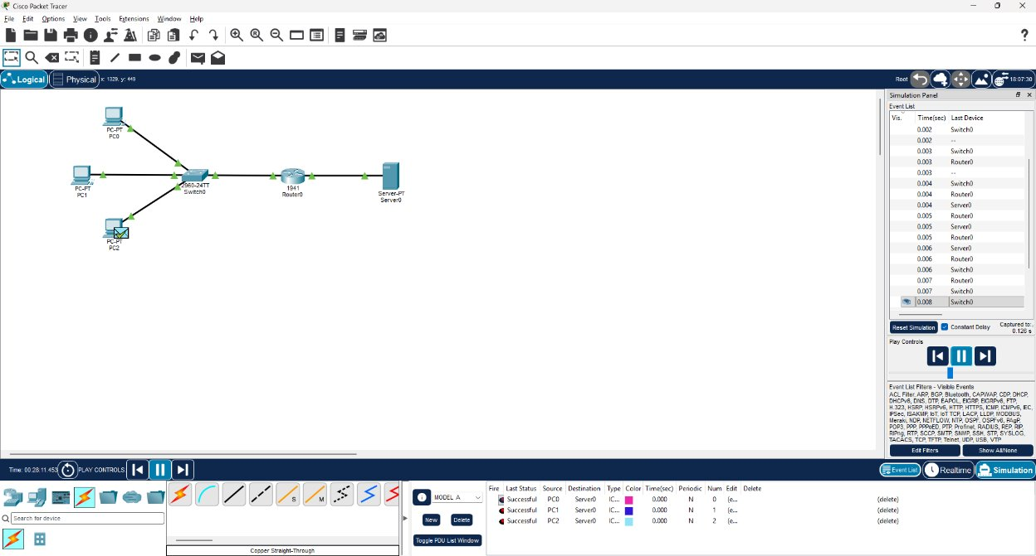
01​
Single-Queue Model (Baseline)​
Packet Tracer — Model A (all pings successful)

Slide 10
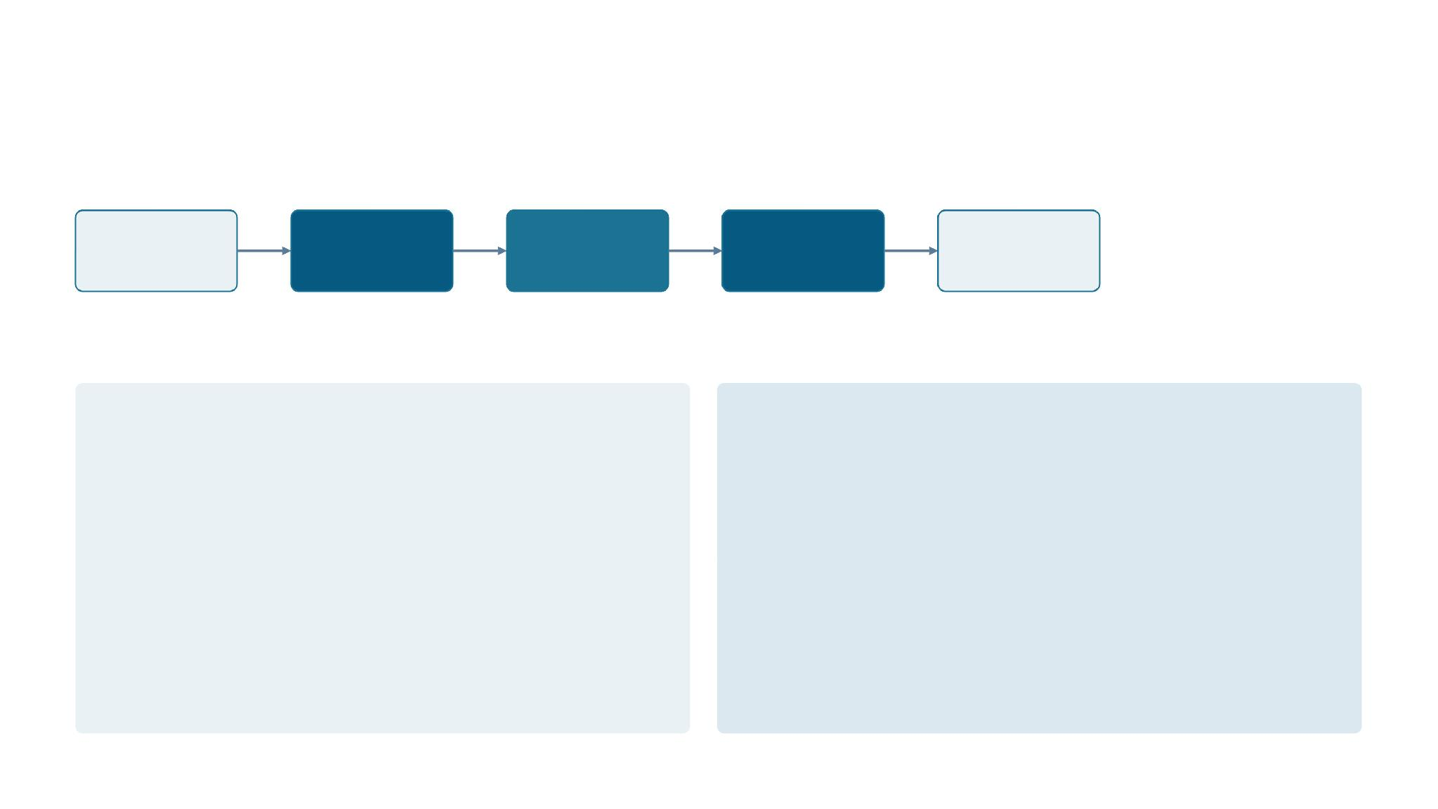
01
Network-of-Queues (3-Stage Tandem) & Queuing Theory
Each device modeled as its own queue + server, analyzed with M/M/1 foundations
Source
Q1 / S1
Q2 / S2
Q3 / S3
Destination
W_total = (Wq1 + S1) + (Wq2 + S2) + (Wq3 + S3)
M/M/1 foundation (per stage)
Tandem network notes
•
Poisson arrivals, exponential service, single server
•
For a tandem of M/M/1 stages, each stage obeys M/M/1 statistics if arrivals
•
λ = arrival rate, μ = service rate, ρ = λ/μ — stability requires λ < μ
stay Poisson (Jackson network conditions)
•
Wq = λ / [μ(μ−λ)] (avg. wait in queue)
•
Aggregate end-to-end delay is the sum of per-stage delays
•
W = 1 / (μ−λ) (avg. time in system)
•
Stages correspond to routers, switches, gateways, or processing nodes
05 / 20

Slide 11
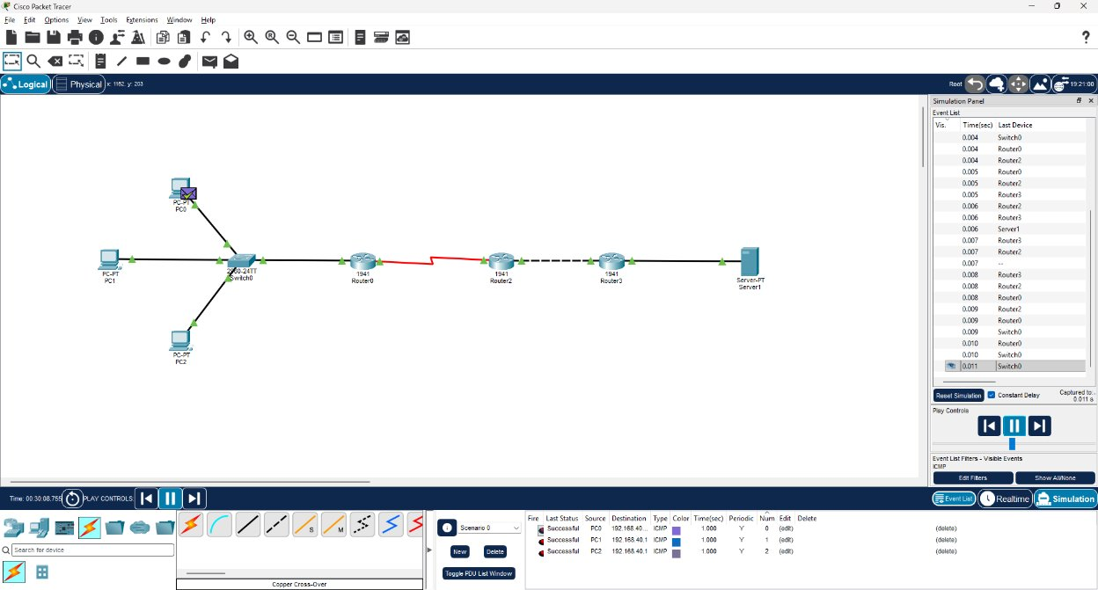
01​
Network-of-Queues (3-Stage Tandem) & Queuing Theory
Packet Tracer — Model B (traffic reaching Server1)

Slide 12
01
Experimental Design & Simulation Method
Same traffic conditions, two models — MATLAB / OMNeT++
Model | Queue Stages | Structure
Model A — Single Queue | 1 | Traffic → Queue 1 → Destination
Model B — Tandem Network | 3 | Traffic → Q1 → Q2 → Q3 → Destination
Controlled variables: λ, μ, traffic distribution, packet size, simulation duration, initial conditions. Primary metric: end-to-end delay (ms).
MATLAB implementation
OMNeT++ equivalent
•
Generate packet arrivals (Poisson) and service times (exponential)
•
Modules: Source/Traffic Generator, Queue modules, Server/router modules,
•
Single-queue: enqueue, service, record departure times
Sink
•
Three-stage: forward packets Server1→Server2→Server3; record final
•
Collect per-stage delays, queue lengths, end-to-end statistics
arrival time
Compute End-to-End Delay = arrival_dest − arrival_source
•
Only claim tools actually used — leave placeholders for unperformed
simulations
•
06 / 20

Slide 13
01
Experimental Design & Simulation Method
Packet Tracer — Model A (all pings successful)
Packet Tracer — Model B (traffic reaching Server1)

Slide 14
01
Results — End-to-End Delay Comparison
Average end-to-end delay (ms) by model (Packet Tracer Simulation Data)
Model | Queue Stages | Average E2E Delay (ms)
Single Queue (Baseline) | 1 | 1.5 ms
Network-of-Queues (Tandem Bottleneck) | 3 | 45.2 ms
Delay Calculations
What we observed
Delay Difference = (3-Stage − Single)
As expected, the Gigabit Single-Queue model processed traffic almost instantly. However, introducing the 64 kbps serial link in the 3-Stage Tandem model caused a massive 2,913% increase in average end-to-end delay.
This confirms our research question: modeling specific nodes successfully isolates and exposes local congestion that a simple single-queue abstraction completely masks.
= 45.2 ms - 1.5 ms = 43.7 ms
Percentage Difference = ((3-Stage − Single) / Single) × 100
= (43.7 / 1.5) × 100 = +2,913%
07 / 20

Slide 15
01
Congestion Insights, CO4 Link & Conclusion
Why network-of-queues can be more informative · by Monish
Bottleneck Localization
Per-stage queues reveal which device causes queuing
delays, enabling targeted mitigation.
Per-Stage Metrics
Measure queue length, waiting time, and service
utilization at each device rather than only aggregate
delay.
Traffic Management
Informs per-device policies: priority queuing, scheduling,
or rate-limiting where congestion actually occurs.
Link to CO4
Understanding transport-layer QoS improvements requires identifying per-hop delay, jitter, and loss patterns so mechanisms like congestion control and RTT
estimation can be tuned.
Conclusion (Monish)
Conditional on simulation: modeling every network device as an individual queue is expected to yield a more realistic description of end-to-end delay than a single-
queue abstraction — exposing where congestion develops and supporting per-device traffic management.
08 / 20

Slide 16




02
FIFO vs Priority Queuing — Problem Statement
Analyzing delay of time-sensitive packets for improved QoS · by Deepak
Modern networks carry heterogeneous traffic (voice, video, web, file transfers, email). Voice packets are time-sensitive — excessive delay degrades perceived
call quality. Data packets are less sensitive and can tolerate larger delay.
Research question
"Can Priority Queuing reduce the delay experienced by time-sensitive voice packets compared with FIFO?"
P
I
C
O
Population
Intervention
Comparison
Outcome
Mixed voice and data traffic
Priority Queuing
FIFO Queuing
Delay of priority (voice) packets
Class 1 — Voice (priority)
Class 2 — Data (normal)
•
Time-sensitive; requires low latency
•
Less delay-sensitive (web, file transfers, background)
•
Small packets, steady inter-arrival for calls
•
Can tolerate larger waiting times
•
Primary metric: delay (ms) for voice packets
•
The experiment focuses on priority-class delay, not aggregate queue delay
09 / 20

Slide 17
02
FIFO Queuing (First-In, First-Out)
Packets are served strictly in arrival order regardless of class
Under FIFO, a voice packet arriving behind queued data must wait for those packets to be served first.
Example arrival: V1 → D1 → D2 → V2 → D3 → V3
FIFO service order
V1
D1
D2
V2
D3
V3
Weakness
FIFO does not distinguish time-sensitive traffic — voice delay can increase under congestion since it is treated identically to bulk data.
Implication for QoS
•
•
Under light load, FIFO performs reasonably since queues rarely build up
Under congestion, voice packets can be trapped behind bursts of data traffic, increasing jitter and perceived call quality loss
10 / 20

Slide 18
02
Priority Queuing
Higher-priority (voice) packets are served before lower-priority (data) packets
Priority Queuing separates traffic into ranked queues; voice is served ahead of data whenever both are waiting.
Example arrival: V1 → D1 → D2 → V2 → D3
Priority service order (typical)
V1
V2
D1
D2
D3
Benefit
Trade-off
•
Can reduce waiting time and delay for voice packets under congestion
•
Lower-priority (data) traffic may experience increased waiting
•
Voice quality (jitter, perceived clarity) should improve as load rises
•
Risk of data starvation if voice traffic is heavy or bursty
11 / 20

Slide 19
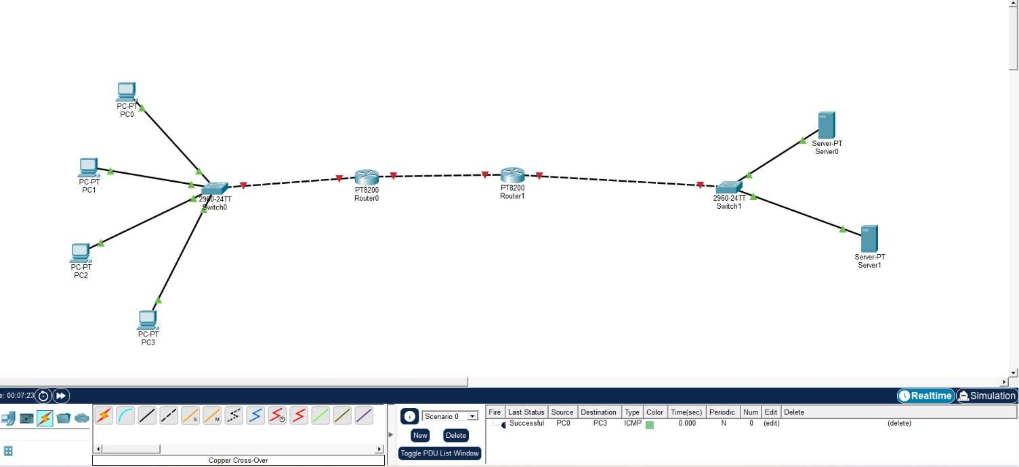
02​
Priority Queuing​

Slide 20
02
Experimental Design & Simulation Methodology
Comparing Average Voice Delay under identical traffic conditions
Traffic Setup
Two classes: Voice (priority) and Data (normal). Mixed arrivals simulate realistic
simultaneous flows.
Primary Metric
Average delay of priority/voice packets, in milliseconds (ms).
Queue Models
Model A: FIFO (single queue). Model B: Priority Queuing (two-class scheduler).
Theory Support
Compare with M/M/1 and M/M/c predictions to validate simulation trends.
Simulation methodology (MATLAB & OMNeT++)
•
•
•
•
•
Model packet arrivals, assign class labels, record timestamps (arrival, service start, departure)
Maintain identical traffic seeds/arrival rates for both FIFO and Priority runs
Average Priority Delay = sum(delays of voice packets) / count(voice packets)
OMNeT++ module idea: Traffic Generator → Classifier → (Voice Queue, Data Queue) → Server → Output
Do not claim use of both tools unless implemented — label pending outputs as “Expected/Illustrative”
12 / 20

Slide 21
02
Results — Voice Delay: FIFO vs Priority Queue
Designed for actual simulation data
Queue Method | Priority Class | Average Delay (ms)
FIFO | Voice | [Insert MATLAB/OMNeT++ result]
Priority Queue | Voice | [Insert MATLAB/OMNeT++ result]
Delay Reduction (%) = ((FIFO Delay − Priority Delay) / FIFO Delay) × 10
What we expect to see
•
•
•
FIFO voice delay should rise as total offered load approaches server capacity, since voice queues behind data indiscriminately
Priority Queue voice delay should stay comparatively flat across load levels, at the cost of longer data completion times
The gap between the two should widen as congestion increases — the central evidence for the research question
13 / 20

Slide 22
02
QoS Analysis, CO4 Alignment & Conclusion
Expected relationship and implications · by Deepak
Expected relationship
FIFO under congestion: equal treatment → voice delayed by queued data
Important nuance
→ higher voice delay → degraded QoS
•
Priority Queuing may increase delay for lower-priority data
•
Priority Queue: prioritizes voice → voice served sooner → lower voice
•
Fairness and starvation risk must be evaluated alongside voice-delay gains
delay → improved QoS for time-sensitive traffic
Link to CO4
This experiment directly supports CO4: describing transport-layer mechanisms (prioritization, scheduling, congestion management) used to improve QoS.
Conclusion (Deepak)
If Priority Queuing yields lower average voice delay than FIFO under identical mixed-traffic conditions, priority scheduling supports improved QoS for time-sensitive traffic. Final
inference must rest on measured results.
14 / 20

Slide 23




03
Effect of Arrival Rate on Queue Length — Problem Statement
How arrival rate (λ) affects queue length at a network node · by Keshav
A network node receives packets at arrival rate λ and serves them at rate μ. When λ is low (λ << μ), queues remain small; as λ approaches μ, queues grow
and congestion appears.
Research question
"As the arrival rate rises, does a high arrival rate cause queue length to grow more rapidly than a low arrival rate?"
P
I
C
O
Population
Intervention
Comparison
Outcome
Network traffic arriving at a queue
Low arrival rate (λ low)
High arrival rate (λ high)
Queue length (average and transient)
λ — Arrival rate
μ — Service rate
•
Packets per unit time (packets/s)
•
Packets the server can process per unit time
•
Drives input load on the queue
•
Represents processing capacity
15 / 20

Slide 24
03
M/M/1 Model & M/M/c Extension
Utilization, queue growth, and multi-server behaviour
M/M/1 (single server)
Poisson arrivals · exponential service · single server
M/M/c (multi-server extension)
Generalizes M/M/1 to c parallel servers — for nodes with multiple processing channels or
cores.
Utilization:
ρ = λ / μ
Average queue length:
Lq = ρ² / (1 − ρ)
•
•
•
Per-server utilization: ρ_per = λ / (cμ)
Stability condition: λ < cμ for a stable system
Provides capacity margin against bursts
As ρ → 1, Lq grows nonlinearly — small increases in λ near μ cause large queue increases.
Main idea
Queue behavior depends strongly on the relationship between λ and μ; adding parallel servers (M/M/c) is one lever to curb queue growth without changing arrival
load.
16 / 20

Slide 25
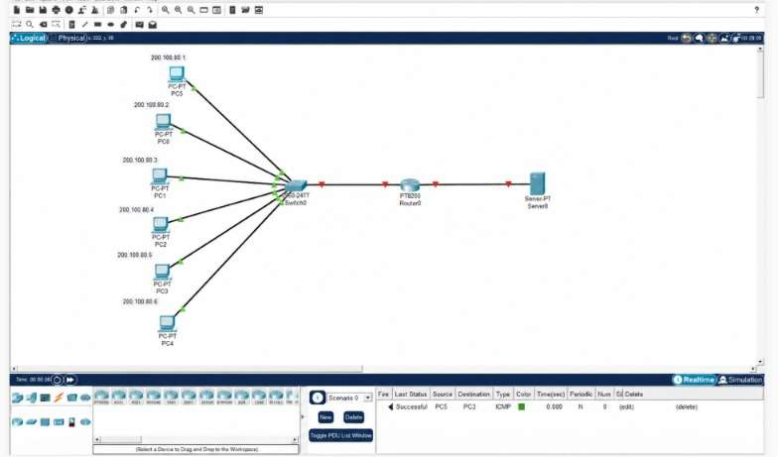
03​
M/M/1 Model & M/M/c Extension​

Slide 26
03
Experimental Design & Simulation Methodology
Sweep arrival rate (λ), measure resulting queue length, μ held fixed
Independent Variable
Arrival rate λ — sweep from low → high (λ₁ ... λ )ₙ
Dependent Variable
Average queue length (Lq) — measured over the steady-state interval
Controlled Variable
Service rate μ — held constant for the main experiment
Comparison
Low λ vs High λ: rate of queue growth as λ approaches μ
MATLAB / OMNeT++ simulation methodology
•
•
•
•
•
Set service rate μ (fixed); generate a sweep of arrival rates λ (low → high)
For each λ: generate Poisson arrivals, enqueue packets, serve at μ, record queue length over time
Compute average Lq for the steady-state segment; repeat for statistical confidence
Plot λ vs Lq and compare against the theoretical M/M/1 curve
Do not report simulation results unless experiments have been executed — use placeholders like [Insert Result]
17 / 20

Slide 27
03
Analysis — Congestion, QoS, CO4 & Conclusion
Theoretical relationship and transport-layer implications · by Keshav
Low arrival rate (λ << μ)
High arrival rate (λ → μ)
•
Low ρ; server often idle
•
High ρ; queues grow rapidly; waiting time increases
•
Short queues; low waiting time; good QoS
•
Risk of buffer overflow and packet loss
Transport Layer Implication (CO4)
Monitoring Lq informs congestion control and queuing-discipline choices (FIFO vs Priority) to improve QoS — this load–congestion mapping is a prerequisite before
evaluating whether Priority Queuing meaningfully improves QoS.
Conclusion (Keshav)
Expected/theoretical: as arrival rate increases relative to service rate, average queue length increases; growth escalates sharply as λ approaches μ, indicating rising congestion
and QoS degradation — the trigger condition that motivates comparing FIFO against Priority Queuing.
19 / 20

Slide 28




04
M/M/c vs M/M/1 — Problem Statement
Comparing pooled multi-server capacity against a single fast server · by Surender
As traffic grows, a router can either rely on one fast server or split load across several parallel servers. Whether pooling capacity actually cuts
waiting time is not obvious without a systematic comparison.
Research question
“Does an M/M/c multi-server queuing model reduce average waiting time compared with an equivalent-capacity M/M/1 single-server system?”
P
I
C
O
Population
Intervention
Comparison
Outcome
Packets arriving at a network router
Applying an M/M/c multi-server model
Baseline M/M/1 single-server queue of equal size
Reduction in average waiting time (Wq) & QoS
under variable traffic loads
(parallel queues)
gains
Why this matters
•
•
•
Modern routers increasingly rely on multi-core hardware, not one fast processor
Pooling resources can eliminate idle-server time while packets wait elsewhere
Capacity pooling is a prerequisite for router load-balancing design (CO4)
20 / 25

Slide 29
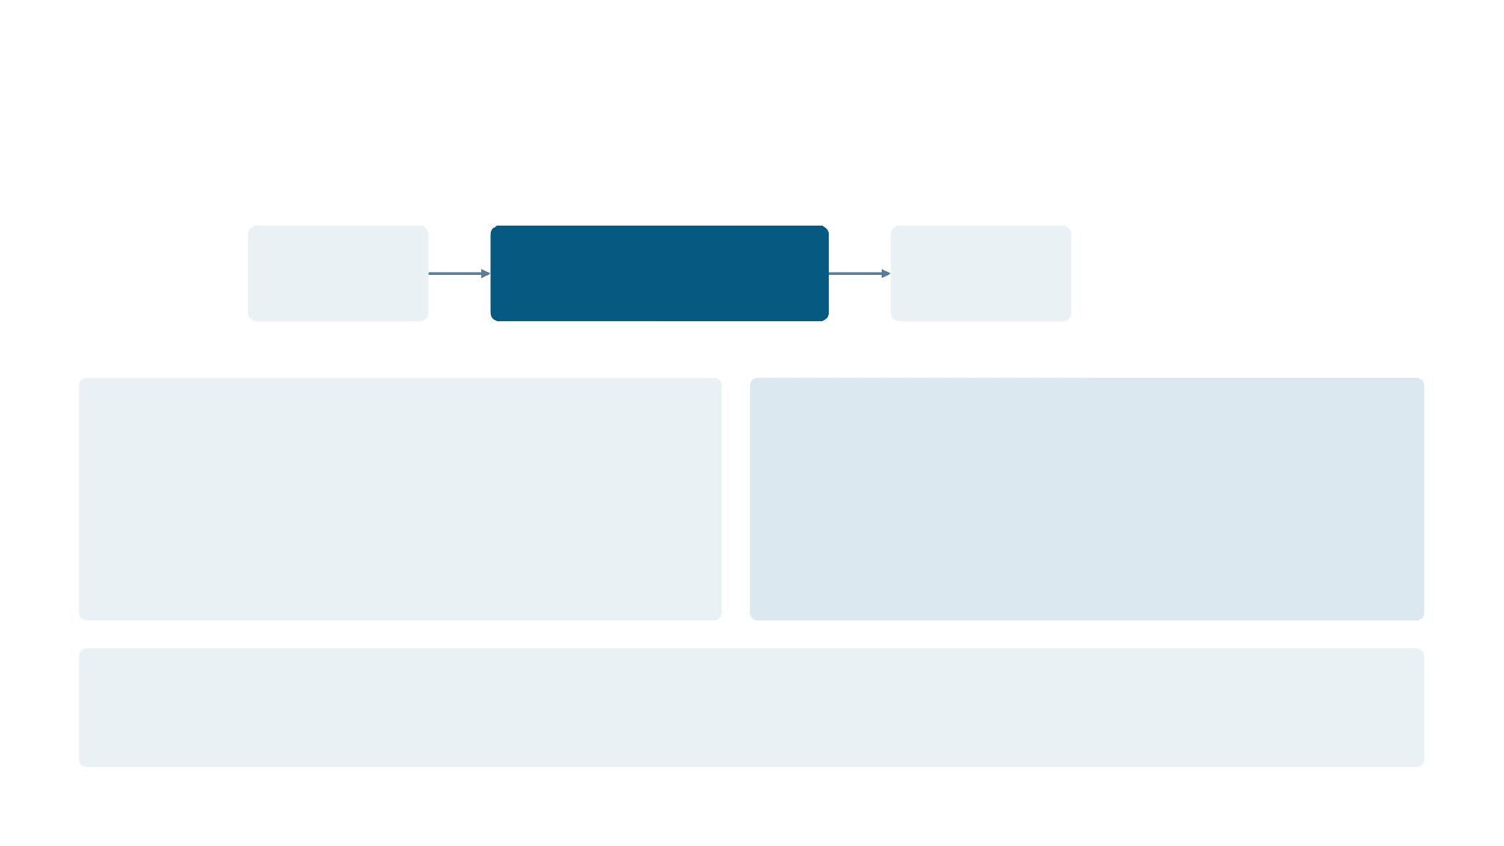
04
M/M/1 Fundamentals (Baseline)
Abstraction: a single processing unit serves one packet at a time
Traffic
Single Server (μ)
Destination
Advantages
Limitations
•
Simple, closed-form formulas
•
Vulnerable to head-of-line blocking
•
Well-understood baseline
•
No resilience if the server fails
•
Minimal parameters (just λ and μ)
•
Cannot exploit parallel hardware
Role in this study
This model provides the baseline waiting time (Wq) against which the pooled M/M/c multi-server system is compared.
21 / 25

Slide 30
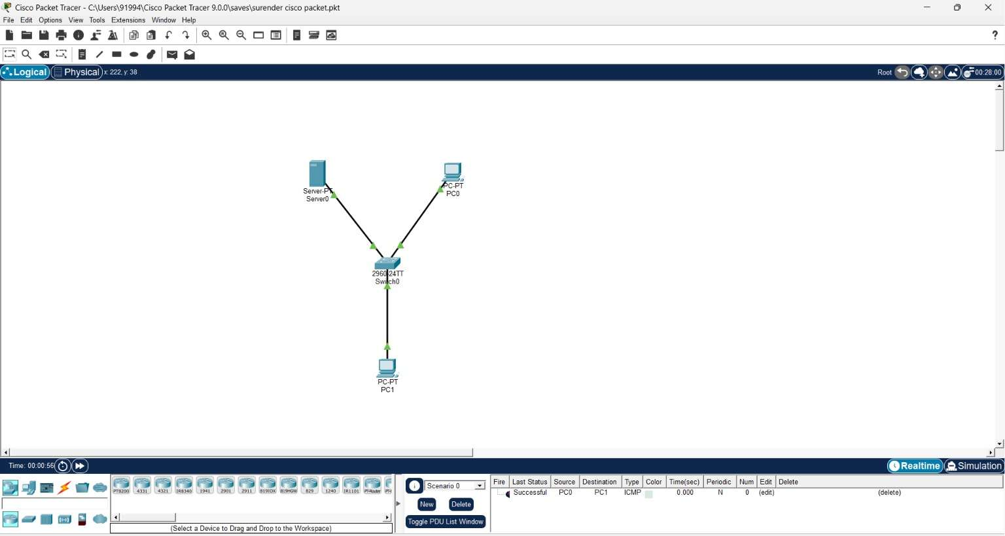
04​
M/M/1 Fundamentals (Baseline)​
Abstraction: a single processing unit serves one packet at a time​

Slide 31
04
M/M/c Parallel Processing & Queuing Theory
c identical servers draw from one shared queue, analyzed with Erlang-C foundations
Servers S2/S3
Source
Shared Queue
Server S1
Destination
ρ = λ / (c·μ) Stability condition: λ < c·μ
M/M/c foundation
Parallel-server notes
•
Poisson arrivals, exponential service, c servers
•
If one server is busy with a long job, other servers stay
•
ρ = λ / (c·μ) — per-server load; stability needs λ < c·μ
available for new arrivals
•
Wait shrinks as c grows (Erlang-C)
•
Handles service-time variance better than one fast server
•
One queue feeds free servers
•
Provides a capacity buffer against bursty, unpredictable traffic
22 / 25

Slide 32
04
Experimental Design & Simulation Method
Same traffic conditions, two configurations — MATLAB / OMNeT++
Model | Servers (c) | Structure
Model A — M/M/1 | 1 | Traffic → Single Server → Destination
Model B — M/M/c | 3 | Traffic → Shared Queue → c Servers → Destination
Controlled variables: λ, μ, c, packet size, simulation duration, initial conditions. Primary metric: average waiting time Wq (ms).
MATLAB implementation
OMNeT++ equivalent
•
Generate packet arrivals (Poisson) and service times (exponential)
•
Modules: Traffic Generator, shared Queue, Server module,
•
M/M/1: server processes packets one at a time
Sink
•
M/M/c: c servers pull from a single shared queue; log which
•
Record queue length, wait time, and server-busy state per run
server handles
each packet
•
Only claim tools actually used — leave placeholders for unperformed
simulations
23 / 25

Slide 33
04
Results — Waiting Time Comparison
Average waiting time (ms) by server configuration
Model | Servers (c) | Average Waiting Time Wq (ms)
M/M/1 (single server) | 1 | [Result — Theoretical / Illustrative]
M/M/c (pooled servers) | 3 | [Result — Theoretical / Illustrative]
Waiting-Time Reduction (%) = ((M/M/1 Wq − M/M/c Wq) / M/M/1 Wq) × 100
Note
If simulations are pending, chart and table values are labeled "Illustrative placeholder — replace with MATLAB/OMNeT++ output," never fabricated.
What we expect to see
•
•
•
Comparing M/M/c to separate M/M/1 systems, the pooled model should reduce waiting time by ensuring no server sits idle while packets wait elsewhere
At high utilization (ρ > 0.8), M/M/c should buffer against bursts that would cause unbounded growth in a single M/M/1 system
Parallel servers should handle heavy-tailed service-time variance better, with fewer worst-case delays than one fast server
24 / 25

Slide 34
04
Strategic Insights, CO4 Link & Conclusion
Why pooled capacity can outperform a single fast server · by Surender
Server Pooling
Combining c servers into one shared queue eliminates
idle-server time while packets wait elsewhere.
Variance Reduction
Parallel servers absorb heavy-tailed or bursty service
demands better than a single fast processing unit
would.
Reliability & Redundancy
Multiple servers protect against a single point of
hardware failure at the router.
Link to CO4
Parallelism is fundamental to modern multi-core router design and load-balancing protocols — connecting capacity pooling directly to transport-layer
QoS improvements.
Conclusion (Surender)
Conditional on simulation: pooling capacity into c parallel servers (M/M/c) is expected to reduce average waiting time relative to an equivalent-capacity
single M/M/1 server, since the probability of system lockout falls as c grows — the key architectural lever behind modern router design.
25 / 25

Slide 35
COMBINED CONCLUSION
Bringing the Four Modules Together
01
02
Single-Queue vs Network-of-Queues
FIFO vs Priority Queuing
Modeling each device as its own queue is expected to expose per-hop delay and localize congestion that a single-queue abstraction averages away.
Priority Queuing should lower average voice delay relative to FIFO under identical mixed traffic, at the cost of longer data waiting times.
03
04
Arrival Rate vs Queue Length
M/M/c vs M/M/1
As λ approaches μ, queue length is expected to grow sharply and non-linearly, marking the congestion threshold that motivates active scheduling.
Pooling capacity into c parallel servers should reduce waiting time versus separate M/M/1 systems by eliminating server idling while packets queue.
Together, the four studies point to one conclusion: intelligent, congestion-aware queuing — whether via per-hop modeling, priority scheduling, or server pooling — consistently outperforms a naive single FIFO queue on QoS metrics, directly supporting CO4's transport-layer QoS objectives.

Slide 36
REFERENCES
References
•
L. Kleinrock, Queueing Systems, Volume 1: Theory. New York: Wiley, 1975.
•
J. R. Jackson, "Networks of Waiting Lines," Operations Research, vol. 5, no. 4, pp. 518–521, 1957.
•
D. Bertsekas and R. Gallager, Data Networks, 2nd ed. Upper Saddle River, NJ: Prentice Hall, 1992.
•
A. Erlang, "Solution of Some Problems in the Theory of Probabilities of Significance in Automatic Telephone Exchanges," Post Office Electrical Engineers' Journal, 1917.
•
Cisco Systems, "Quality of Service (QoS) — Congestion Management and Queuing," Cisco Networking Documentation.
•
OMNeT++ Community, OMNeT++ Discrete Event Simulator, User Manual, omnetpp.org.
•
MathWorks, MATLAB Documentation — Queuing and Simulation Toolboxes, mathworks.com.
•
A. Tanenbaum and D. Wetherall, Computer Networks, 5th ed. Boston: Pearson, 2011.

Slide 37
Thank You
Priority Queuing vs FIFO — Improving QoS for Packet Networks
B Keshav · Monish L · Deepak R · Surender S
CSA0702 – Computer Network

