Slide 1

Placify: AI-Driven Placement Preparation System
PRESENTED BY :
MONISH R - 714024104134
NANDHA KUMAR J - 714024104136
PRANESH I - 714024104160
PRASANNA B - 714024104162
RISHI S - 714024104176
IIInd YEAR CSE-’C’
SIET
SUPERVISED BY :
Mr. B SANJAY KRISHNA AP/CSE, SIET

Slide 2
AGENDA
OBJECTIVE
ABSTRACT
INTRODUCTION
EXISTING SYSTEM AND ITS DRAWBACKS
PROPOSED SYSTEM
TECH STACK
REFERENCE
LITERATURE SURVEY
FLOW CHART
MODULE DISCRIPTION
EXPECTED OUTPUT
CONCLUSION
RESULT

Slide 3
OBJECTIVE
Enable students to prepare for campus placements through an AI-powered platform that integrates coding practice, resume analysis, mock interviews, and personalized learning resources.
Improve placement readiness by providing intelligent career guidance, company-specific preparation, real-time performance tracking, and AI-generated feedback using Google Gemini.
Simplify the placement preparation process by offering a centralized, interactive, and personalized learning environment that enhances students' technical, aptitude, and interview skills.

Slide 4
ABSTRACT
The Placify platform is an AI-powered placement preparation system designed to help students enhance their technical, aptitude, and interview skills through a single integrated application. It offers coding practice, personalized learning paths, resume analysis, and AI-based mock interviews to improve overall placement readiness.
The application leverages Google Gemini AI to provide intelligent career guidance, resume feedback, interview question generation, and personalized recommendations based on user performance. With company-specific preparation, progress tracking, and an interactive dashboard, Placify delivers a comprehensive and efficient solution for campus placement preparation.

Slide 5
INTRODUCTION
Campus placement preparation often requires students to use multiple platforms for coding practice, aptitude learning, resume building, interview preparation, and career guidance, making the process time-consuming and less organized.
Many students struggle to identify their strengths, track their progress, and receive personalized feedback, which reduces their confidence and placement readiness.
Placify addresses these challenges by integrating AI-powered mentorship, coding practice, resume analysis, mock interviews, company-specific preparation, and progress tracking into a single intelligent platform, providing a personalized and efficient placement preparation experience.

Slide 6
EXISTING SYSTEM AND ITS DRAWBACKS
Students rely on multiple platforms for coding practice, aptitude preparation, resume building, and interview preparation, making the learning process fragmented and inefficient.
Most existing platforms provide generic learning resources with limited personalization, making it difficult for students to identify their weaknesses and improve effectively.
Manual resume reviews and mock interviews require mentors or trainers, which may not always be available and can be time-consuming.
Existing systems lack an integrated AI-driven solution that combines coding practice, resume analysis, interview preparation, company-specific guidance, and progress tracking within a single platform.

Slide 7
PROPOSED SYSTEM
Placify introduces an AI-powered placement preparation platform that integrates coding practice, resume analysis, mock interviews, and personalized learning into a single application.
The platform leverages Google Gemini AI to provide intelligent career guidance, resume feedback, interview question generation, and personalized recommendations based on user performance.
Students can prepare for placements through company-specific resources, coding challenges, aptitude practice, and real-time progress tracking, helping them identify and improve their weak areas.
The system provides a centralized, interactive, and personalized learning environment that enhances placement readiness while reducing dependence on multiple learning platforms.

Slide 8
TECH STACK
Software Requirements
Frontend: React.js, TypeScript, HTML5, Tailwind CSS
Backend: Node.js, Express.js
Database: MongoDB
AI Integration: Google Gemini API
Programming Languages: TypeScript, JavaScript
Tools & Platforms: VS Code, Git, GitHub, npm

Slide 9
REFERENCE
[1].Brown, T. B., et al. (2020). Language Models are Few-Shot Learners. Advances in Neural Information Processing Systems (NeurIPS), vol. 33, pp. 1877–1901.
[2]. OpenAI. (2023). GPT-4 Technical Report. arXiv:2303.08774, pp. 1–100.
[3] Devlin, J., Chang, M. W., Lee, K., & Toutanova, K. (2019). BERT: Pre-training of Deep Bidirectional Transformers for Language Understanding. Proceedings of NAACL-HLT, vol. 1, pp. 4171–4186.
[4] OpenAI. (2026). “Advances in Reasoning Models and Reinforcement Learning.” Technical Report, vol. 1, no. 1, pp. 1–30.
[5] Radford, A., et al. (2019). Language Models are Unsupervised Multitask Learners. OpenAI Technical Report, pp. 1–24.

Slide 10
LITERATURE SURVEY
YEAR | AUTHOR | TITLE | TECHNOLOGY USED | LIMITATION
2026 | Google DeepMind | Gemma 3: The Most Capable Model You Can Run on a Single GPU or TPU | Gemma 3, LLM, Multilingual AI | Limited reasoning compared to larger frontier models.

Slide 11
LITERATURE SURVEY
YEAR | AUTHOR | TITLE | TECHNOLOGY USED | LIMITATION
2025 | Fei, H., et al | On Path to Multimodal Generalist: General-Level and General-Bench | Multimodal LLM, Deep Learning | Requires extensive benchmark datasets and high-end hardware.

Slide 12
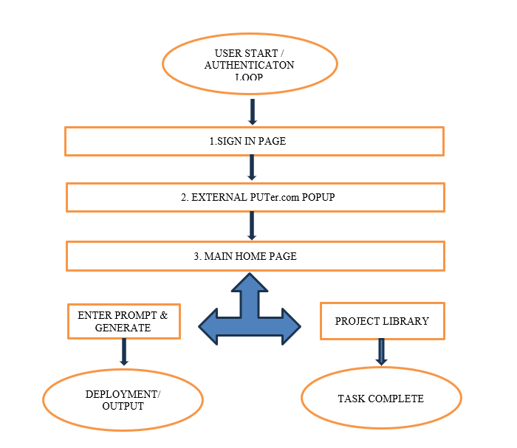
FLOW CHART

Slide 13
MODULE DESCRIPTION
1. User Authentication
Enables secure user registration and login.
Manages user profiles and personalized placement progress.
2. Learning & Coding Module
Provides coding challenges, aptitude practice, and structured learning paths.
Tracks coding performance and skill improvement.
3. AI Resume Analyzer
Uses Google Gemini AI to analyze resumes.
Suggests improvements in skills, formatting, and content.

Slide 14
MODULE DESCRIPTION
4. AI Mock Interview
Generates role-specific interview questions.
Evaluates responses and provides personalized feedback.
5. AI Mentor & Career Guidance
Acts as an intelligent assistant for placement preparation.
Offers career advice, learning recommendations, and company-specific guidance.
6. Placement Dashboard
Displays placement readiness, progress reports, achievements, and learning statistics.
Helps students monitor their overall preparation and identify weak areas.

Slide 15
FEATURES
AI-powered Resume Analyzer that evaluates resumes and provides personalized improvement suggestions.
AI Mock Interview system that generates role-specific interview questions and offers real-time feedback.
Coding Practice with company-specific problems, aptitude preparation, and structured learning paths.
AI Mentor that provides personalized career guidance, learning recommendations, and placement preparation support using Google Gemini.
Progress Tracking Dashboard to monitor coding performance, interview readiness, learning progress, and achievements.
Interactive and User-Friendly Interface that integrates all placement preparation resources into a single platform for an efficient learning experience.

Slide 16
CONCLUSION
Placify provides an AI-powered and integrated platform that simplifies placement preparation by combining coding practice, resume analysis, mock interviews, and personalized learning in one application.
The platform leverages Google Gemini AI to deliver intelligent career guidance, personalized feedback, and company-specific preparation, helping students improve their placement readiness effectively.
By tracking user progress and identifying areas for improvement, Placify enables students to develop technical, aptitude, and interview skills in a structured and efficient manner.
The project demonstrates how Artificial Intelligence can transform traditional placement preparation into a smarter, more personalized, and engaging learning experience.

Slide 17
RESULT
The system successfully provides AI-powered resume analysis, mock interviews, and personalized placement guidance using Google Gemini AI.
Students can improve their coding, aptitude, interview, and resume-building skills through an integrated and interactive learning platform.
The application delivers company-specific preparation, real-time progress tracking, and personalized recommendations, helping users identify and improve their weak areas.
Overall, Placify enhances placement readiness, learning efficiency, and career preparation by providing a centralized AI-driven solution for students.

Slide 18
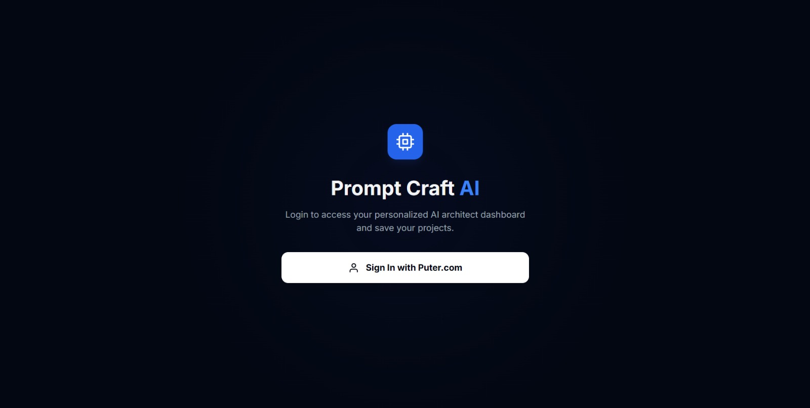
SIGN IN PAGE :

Slide 19
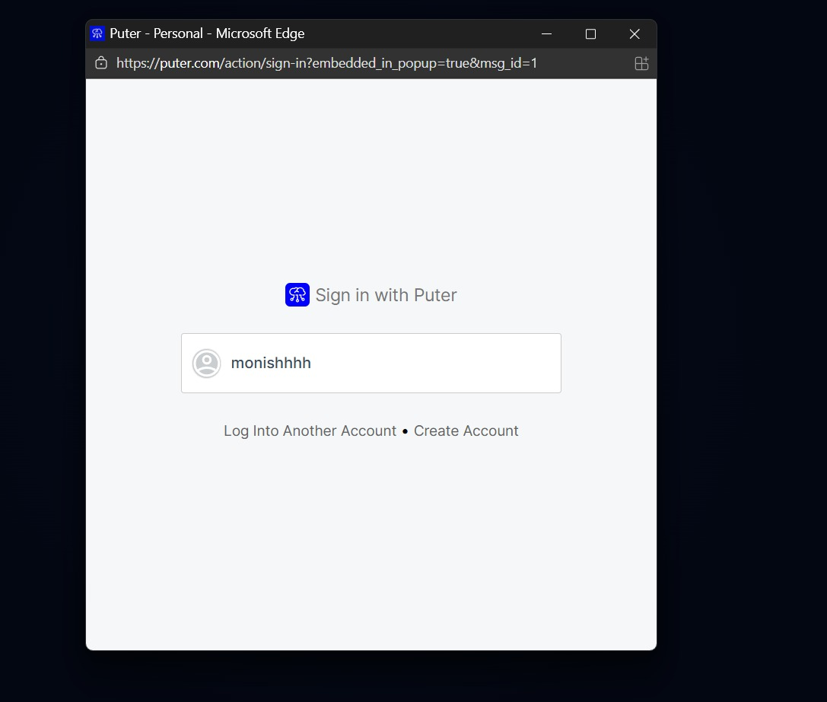
SIGN UP PAGE :

Slide 20
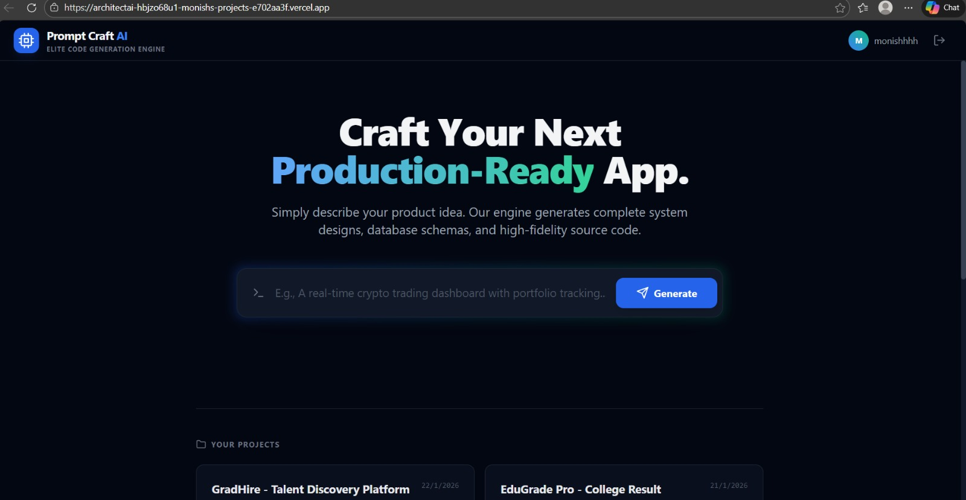
HOME PAGE :

Slide 21
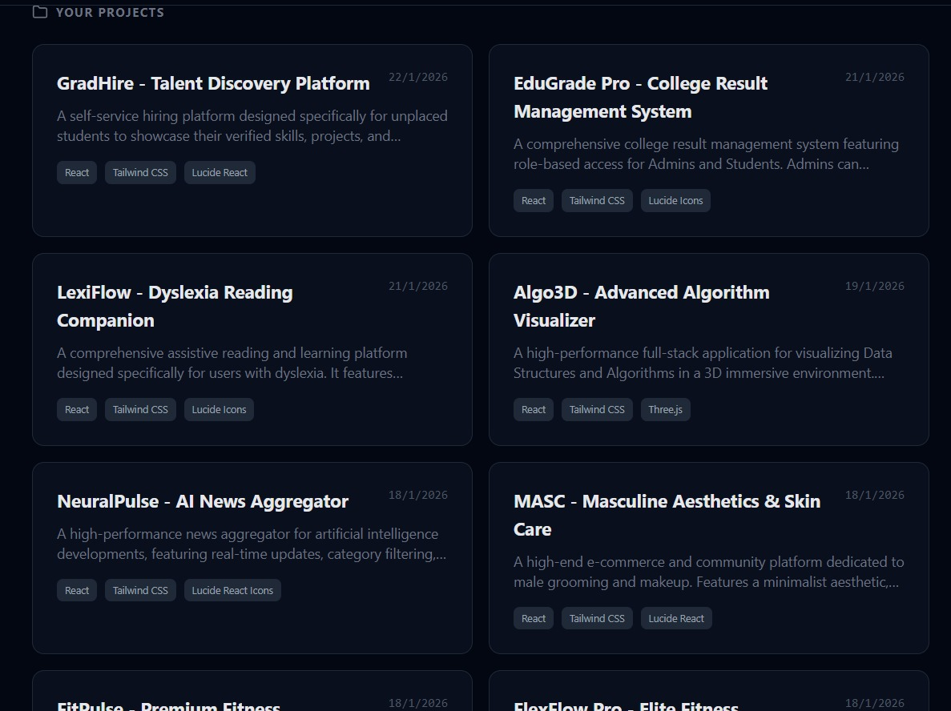
PROJECTS LIBRARY :

Slide 22
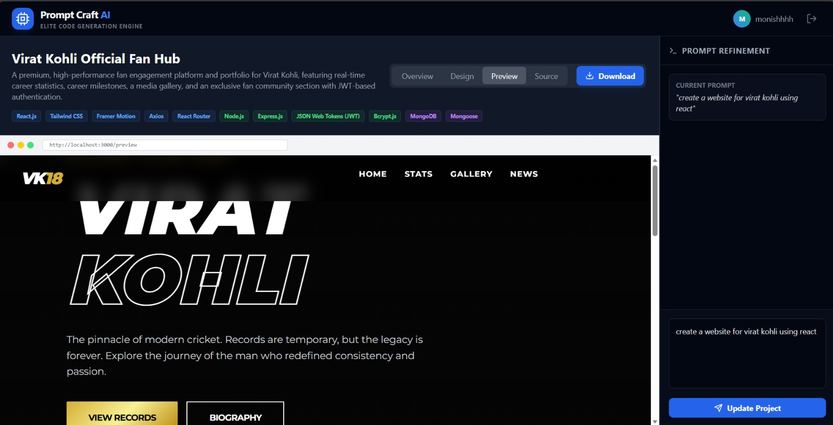
PROMT REFINEMENT PAGE :

Slide 23
THANK YOU!!!

