Slide 1
ENHANCED AUTOMATIC SHORT-ANSWER GRADING SYSTEM USING BERT MODEL AND BI-LSTM NETWORK
Batch members
Hemalatha E (422420104304)
Monisha S (422420104022)
Sneha S (422420104035)
Under the Guidance of
Dr.L.JEGATHA DEBORAH,
Head of the Department,
Department of Computer Science and Engineering,
University College of Engineering Tindivanam.

Slide 2
BASE PAPER DETAILS
Title : | Automatic Short-Answer Grading via BERT-Based Deep Neural Networks
Author : | Xinhua Zhu , Han Wu, and Lanfang Zhang.
Name of the Transaction : | IEEE TRANSACTIONS ON LEARNING TECHNOLOGIES
Year and Month of Publication : | 1 JUNE 2022
Volume No. : | 15
Issue No. : | 3
Pages : | 364 - 375
DOI : | 10.1109/TLT.2022.3175537

Slide 3
ABSTRACT
Automatic short-answer grading (ASAG) is a crucial part of intelligent tutoring systems (ITS).
Deep learning is an advanced technique to understand sentences completely.
Using deep learning for ASAG is still hard because, it may not give high-precision scoring.
Additionally, ASAG’s corpus is small and doesn't have a lot of training data for deep learning.
To tackle these obstacles, BERT based deep neural network for ASAG is proposed.

Slide 4
ABSTRACT (CONT.)
Bidirectional Encoder Representations from Transformers (BERT) model is used to understand the answer better, even with limited examples.
To make ASAG even better, a special layer called the semantic refinement layer is incorporated which improves the BERT results.
The semantic refinement layer has Bi-LSTM network that helps to generate a powerful semantic representation.

Slide 5
INTRODUCTION
An automatic short answer grading (ASAG) system, is a technology-driven solution that assesses and assigns grades to various short answers and tests without requiring direct human intervention.
In this work ASAG is based on Natural Language Processing (NLP) techniques such as BERT (Bidirectional Encoder Representations from Transformers), to revolutionize the assessment of short answers in educational contexts.
By combining the process of BERT with deep neural networks, it promises to enhance the educational evaluation process.

Slide 6
INTRODUCTION (CONT.)
To refine the semantics of BERT outputs, a Semantic refinement layer is constructed which consists of a Bidirectional-Long short-term memory (Bi-LSTM) network.
Bi-LSTM network is used to enhance the hidden states of the BERT model.
Furthermore, this layer is connected to form a new hidden representation with a longer dimension to generate a powerful semantic representation for ASAG.

Slide 7
LITERATURE SURVEY
S.NO | TITLE | AUTHOR NAME | YEAR | TECHNIQUES | MERITS | DEMERITS
1 | Automatic Short Answer Grading With SemSpace Sense Vectors and MaLSTM | C. N. Tulu, M. Kaya, and M. Kocamanlar | 2021 | SemSpace Algorithm Word Sense Disambiguation (WSD) MaLSTM Model | It enhances the accuracy. Improved efficiency. It captures semantic similarity. | It require a large amount of training data. Lack of generalizability and robustness.
2 | ASAG Using Deep Neural Networks and Item Response Theory | Masaki Uto and Yuto Uchida | 2020 | Item- Response Theory model LSTM | Improved Scoring accuracy. Automated feature extraction. It captures non-linear relations. | It requires a large amount of data. Complex implementation.

Slide 8
S.NO | TITLE | AUTHOR NAME | YEAR | TECHNIQUES | MERITS | DEMERITS
3 | Automatic short answer grading by encoding student responses via a graph convolutional network. | H. Tan, C. Wang, Q. Duan, Y. Lu, and R. Li. | 2020 | Graph Convolutional Networks. | Improved Accuracy. Efficient grading. | Complex Implementation. It can still be complex to understand.
4 | Automatic short answer grading and feedback using text mining methods. | N. Siiuzen, A. N. Gorban, J. Levesley, and E. M. Mirkes. | 2020 | Text mining method. | It gives quick feedback. Objective evaluation of student responses | Complex Implementation. May not capture a deeper conceptual understanding

Slide 9
S.NO | TITLE | AUTHOR NAME | YEAR | TECHNIQUES | MERITS | DEMERITS
5 | BERT: Pre-training of deep bidirectional transformers for language understanding | J. Devlin, M. W. Chang, K. Lee, and K. Toutanova | 2019 | BERT | It capture both left and right context from the input. It is pre-trained on large scale. | Difficult to understand the context. Requires large amount of computational resources.
6 | Automatic text scoring using neural networks | D. Alikanioti, H.Yannakoudakis, and M. Rei | 2016 | LSTM and C&W embedding | Enhanced interpretability. Superior performance. | Large and diverse datasets are often required. Lack of Context Understanding.

Slide 10
PROBLEM STATEMENT
The existing Automatic Short Answer Grading model may suffer from a lack of deep understanding because of the data scarcity.
Additionally, such model may not give high precision scores.

Slide 11
OBJECTIVES
To overcome the problem of data scarcity issue, the Bi-directional encoder Representations from Transformers (BERT) model is incorporated, which effectively understands the context of the sentences.
To generate high precision scores, the semantics of BERT output needs to be refined, which is done by incorporating the Bidirectional Long short-term memory (Bi-LSTM) network.

Slide 12
SCOPE OF THE PROJECT
Online Learning platforms
Competitive Examinations
Educational Institutions
Language Learning Apps

Slide 13
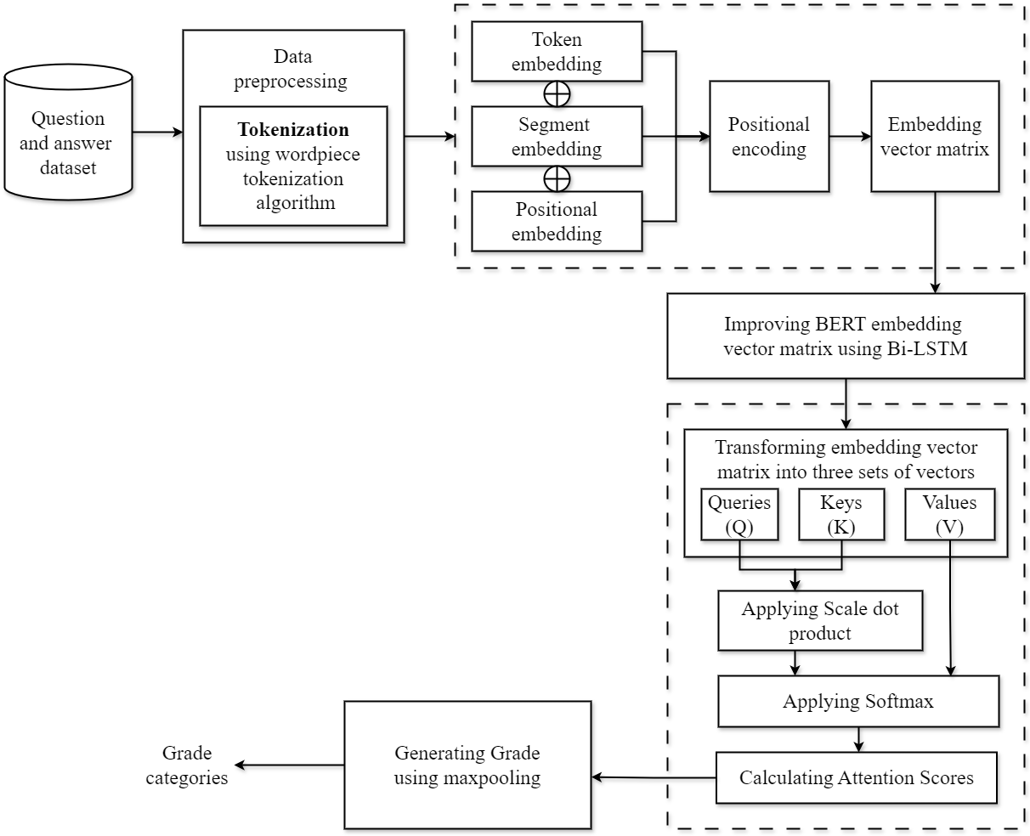
SYSTEM ARCHITECTURE

Slide 14
MODULE DESCRIPTION
BERT ENCODING
The BERT model generates contextualized representations of the text by processing the input sequence, which normally consists of the student's answer and the reference answer.
The input sequence for the fine-tuned BERT layer consists of a sentence pair comprising the student's answer and the reference answer.
The input to a BERT model is tokenized text, which is converted into embeddings which include token embeddings, segment embedding, positional embedding and positional encoding.

Slide 15
MODULE DESCRIPTION(CONT.)
Token embeddings represent the meaning of individual words or sub words as a vector.
Positional encodings encode the position of tokens in the sequence using sinusoidal functions to enable understanding of sequential order.
It learns to represent a token’s position in a sequence as a vector which is known as a hidden state.
The purpose of the positional embedding is to allow a Transformer to make sense of word ordering.

Slide 16
MODULE DESCRIPTION(CONT.)
Bi-LSTM NETWORK
A bidirectional Long Short-Term Memory (Bi-LSTM) network is incorporated to improve the output of BERT layer.
The input sequence is processed in two directions simultaneously from the beginning to the end (forward pass) and from the end to the beginning (backward pass).
Each direction has its own set of LSTM units that maintain and update hidden states over time, allowing the network to capture long-range dependencies and context in both directions.
The output of this bidirectional Long Short-Term Memory (Bi-LSTM) network is improved Vector matrix.

Slide 17
MODULE DESCRIPTION(CONT.)
ATTENTION MECHANISM
Attention mechanism is the main architectural component of transformers. It enables a neural network to make use of contextual information for predicting the current token.
After receiving the output from the Bi-LSTM network, the attention layer in a model like BERT processes this output to capture important contextual information and relationships within the sequence.
This process is achieved by using a multi-head attention mechanism. The contributions of these contexts to the fused semantics are automatically adjusted by a weight matrix.
After this combination process, the fused semantic representation is processed by layer normalization before being fed into the max-pooling layer for further evaluation.

Slide 18
MODULE DESCRIPTION(CONT.)
The attention layer plays a crucial role in integrating different levels of contextual information to enhance the system's ability to evaluate short answers accurately.
Attention works as follows: the token currently being predicted is mapped to a query vector 𝒒 and the tokens in the context are mapped to key vectors 𝒌 and value vectors 𝒗.
Finally, the output of the attention mechanism is the weighted sum of the values, where the values are weighted by the attention weights determined during the attention calculation process.

Slide 19
MODULE DESCRIPTION(CONT.)
MAX POOLING
In the max-pooling layer of the ASAG system, a max-pooling operation is performed on the semantic representation generated by the attention mechanism of the BERT model.
During the max-pooling operation in the ASAG system, the semantic representation is processed to extract the most relevant and significant features that are crucial for evaluating the student's answer.
In the Prediction Layer, a maxpooling operation is performed on the updated representation of tokens to obtain the final semantic representation Z for the answer pair (q, p).

Slide 20
MODULE DESCRIPTION(CONT.)
The max-pooling operation selects the maximum value from the fused semantic representation across a specific dimension or window.
By selecting the maximum value from the set of values in the representation, the max-pooling operation helps in capturing the most salient information that contributes to the overall understanding and assessment of the answer pair (question, student's answer).
The output of the maxpooling is predicted probability of grade categories.

Slide 21
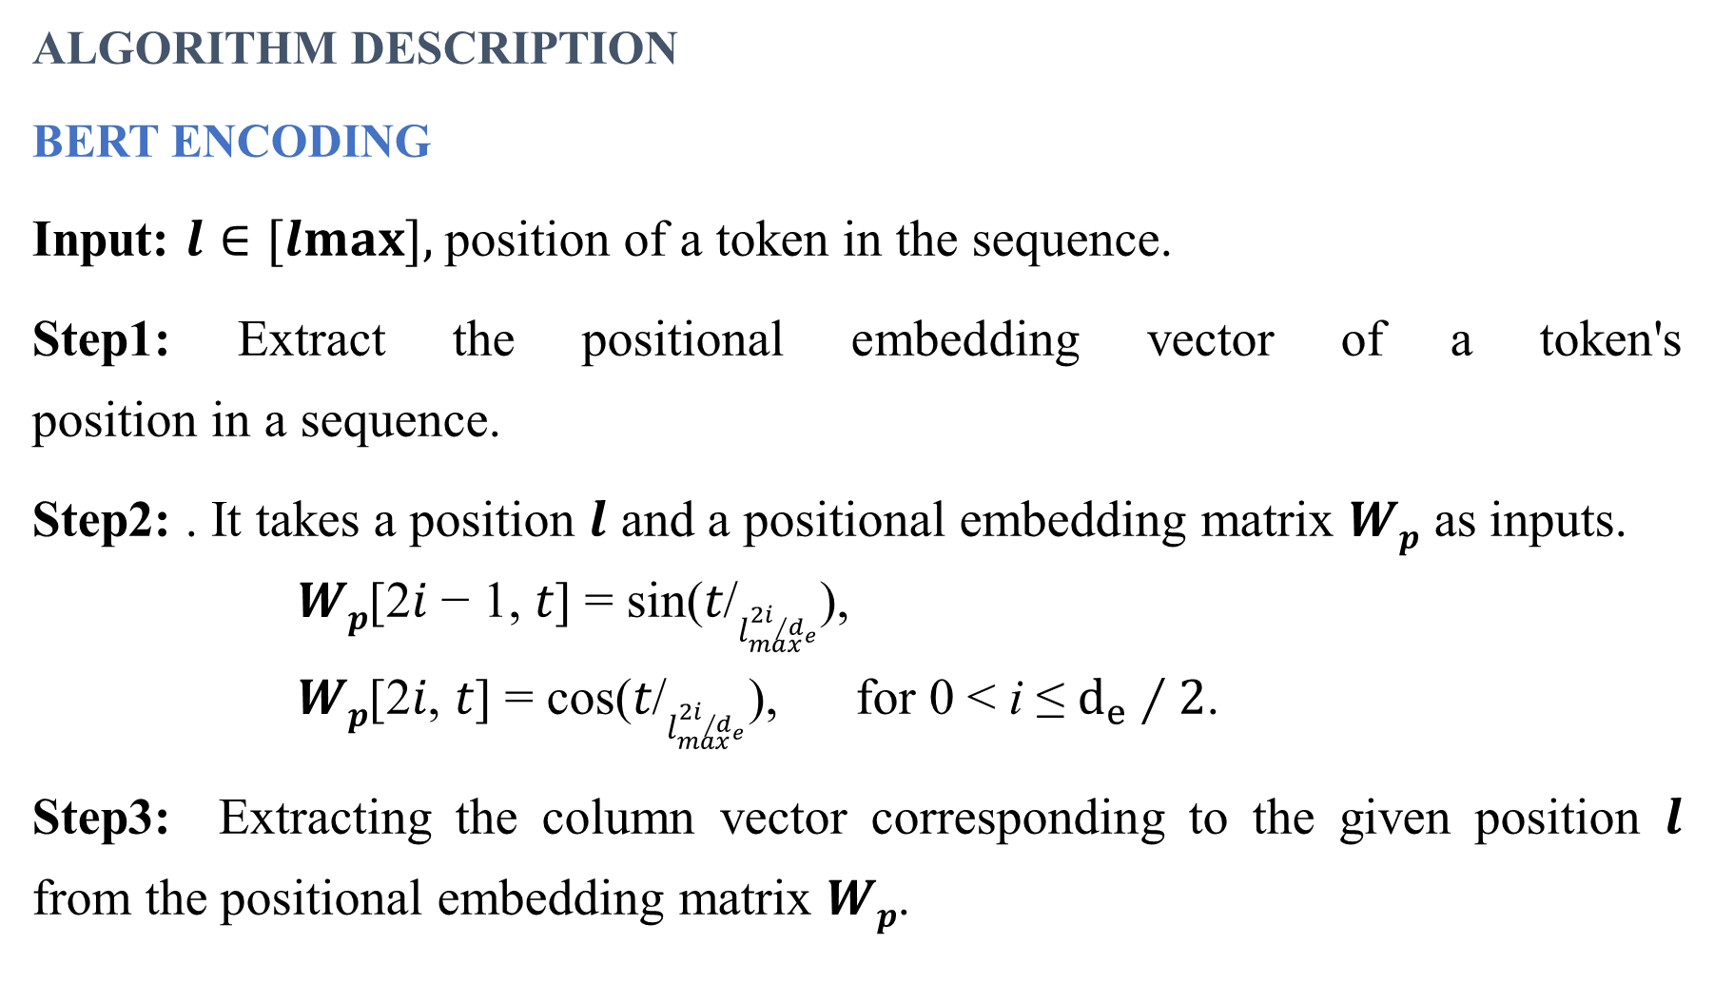
ALGORITHM DESCRIPTION
BERT ENCODING
Input: 𝒍 ∈ [𝒍𝐦𝐚𝐱], position of a token in the sequence.
Step1: Extract the positional embedding vector of a token's position in a sequence.
Step2: . It takes a position $l$ and a positional embedding matrix 𝑾_{𝒑} as inputs.
𝑾_{𝒑}[2𝑖 − 1, 𝑡] = sin(𝑡/$l_{max}^{2i∕d_{e}}$),
𝑾_{𝒑}[2𝑖, 𝑡] = cos(𝑡/$l_{max}^{2i∕d_{e}}$), for 0 < i ≤ $ⅆ_{e}∕2$.
Step3: Extracting the column vector corresponding to the given position $l$ from the positional embedding matrix 𝑾_{𝒑}.

Slide 22
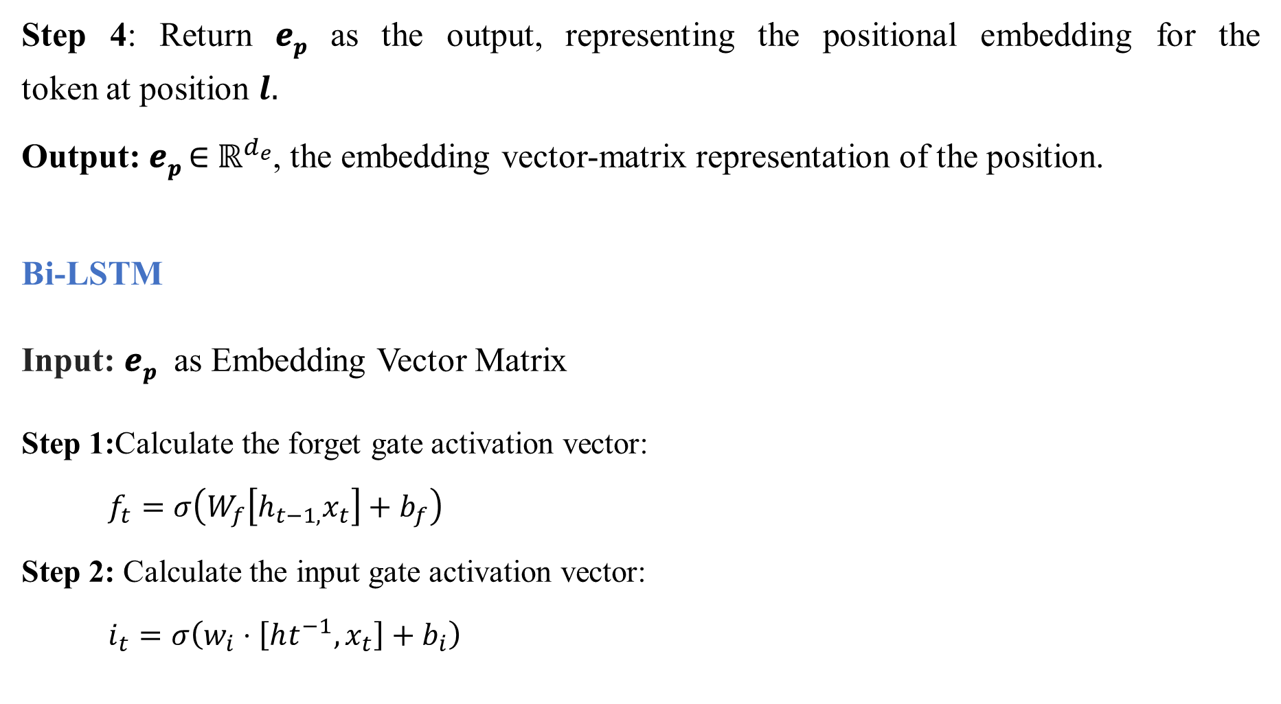
Step 4: Return 𝒆_{𝒑} as the output, representing the positional embedding for the token at position $l.$
Output: 𝒆_{𝒑} ∈ ${\text{ℝ}}^{d_{e}}$, the embedding vector-matrix representation of the position.
Bi-LSTM
Input: 𝒆_{𝒑} as Embedding Vector Matrix
Step 1:Calculate the forget gate activation vector:
$f_{t}=σ\left(W_{f}\left[h_{t−1,}x_{t}\right]+b_{f}\right)$
Step 2: Calculate the input gate activation vector:
$i_{t}=σ\left(w_{i}⋅\left[ht^{−1},x_{t}\right]+b_{i}\right)$

Slide 23
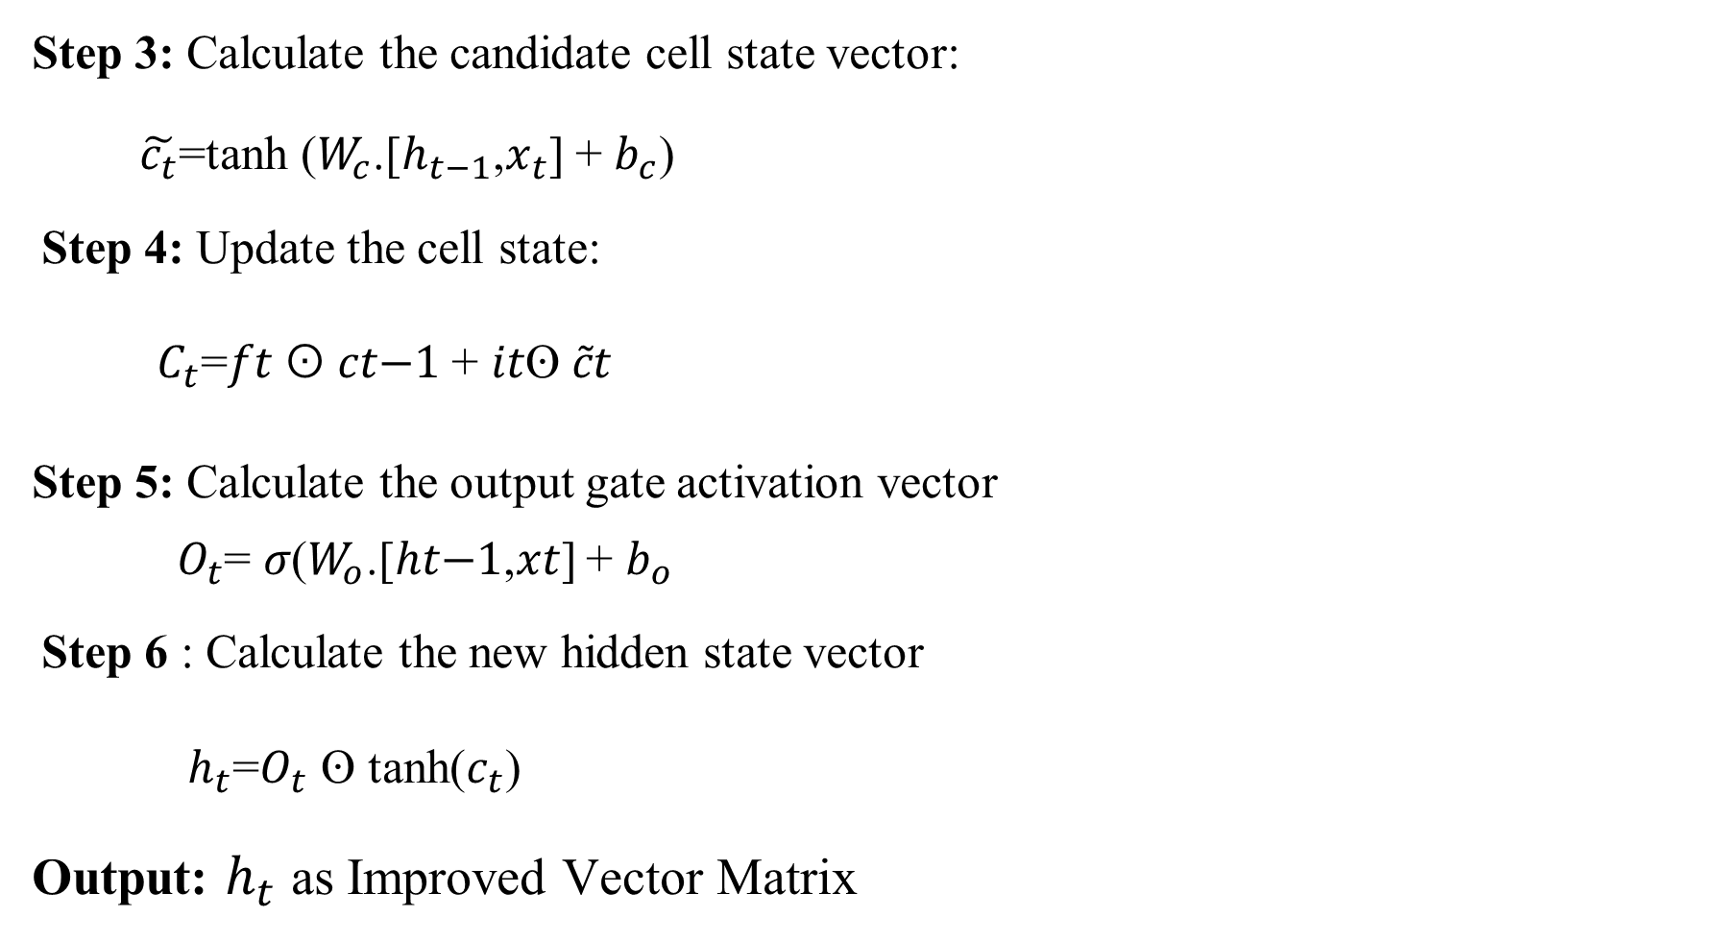
Step 3: Calculate the candidate cell state vector:
$\tilde{c_{t}}$=tanh ($W_{c}$.[$h_{t−1}$,$x_{t}$] + $b_{c}$)
Step 4: Update the cell state:
$C_{t}$=𝑓𝑡 ʘ 𝑐𝑡−1 + 𝑖𝑡ʘ 𝑐̃𝑡
Step 5: Calculate the output gate activation vector
$O_{t}$= 𝜎($W_{o}$.[ℎ𝑡−1,𝑥𝑡] + $b_{o}$
Step 6 : Calculate the new hidden state vector
$h_{t}$=$O_{t}$ ʘ tanh($c_{t}$)
Output: $h_{t}$ as Improved Vector Matrix

Slide 24
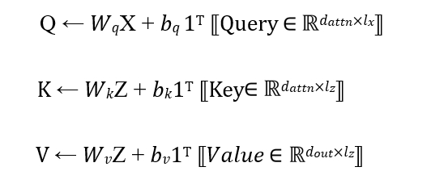
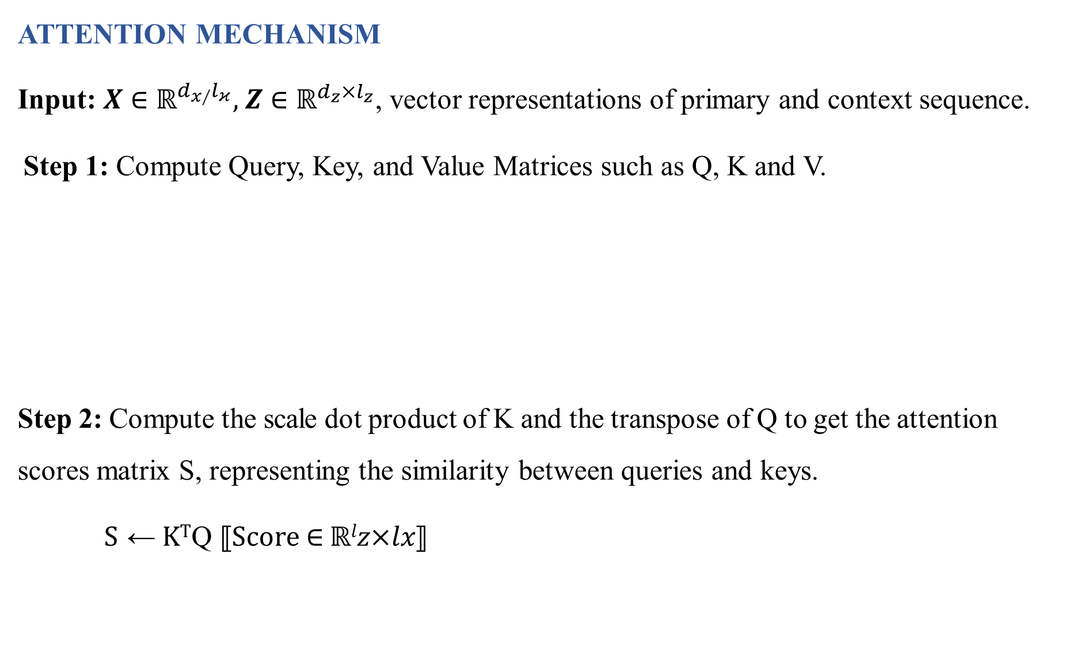
ATTENTION MECHANISM
Input: 𝑿 ∈ $ℝ^{d_{x∕}l_{κ}},$𝒁 ∈ $ℝ^{ⅆ_{z}×l_{z}}$, vector representations of primary and context sequence.
Step 1: Compute Query, Key, and Value Matrices such as Q, K and V.
Step 2: Compute the scale dot product of K and the transpose of Q to get the attention scores matrix S, representing the similarity between queries and keys.
S ← K^{T}Q ⟦Score ∈ ℝ^{𝑙}𝑧×𝑙𝑥⟧

Slide 25
Step 3: Apply the softmax function to the rows of S scaled by attention to compute the attention weights.
Step 4: To compute the output multiply the attention weights by V to get the output matrix which aggregates information from the context sequence based on attention weights.
𝑿^{(𝒉)}=V∙softmax(S/√𝑑_{𝑎𝑡𝑡𝑛})
Output: 𝑿^{(𝒉)} as Updated representation of tokens.

Slide 26
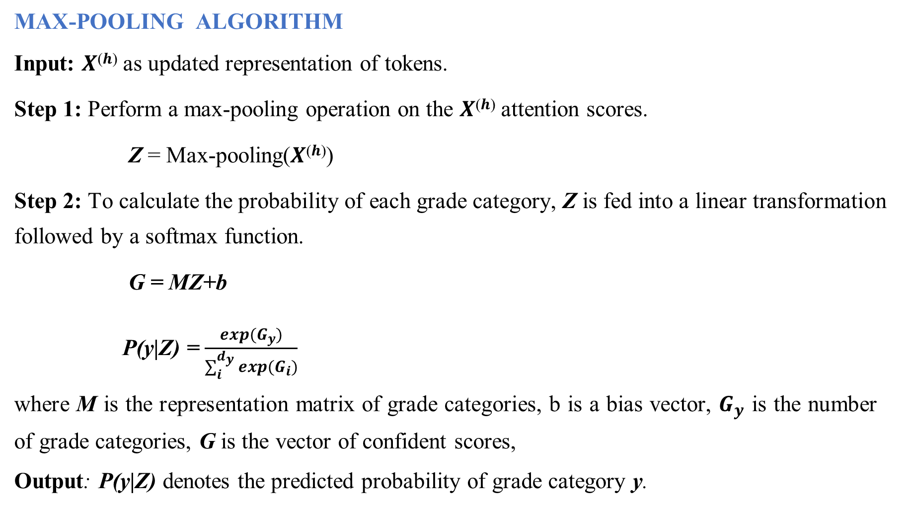
MAX-POOLING ALGORITHM
Input: 𝑿^{(𝒉)} as updated representation of tokens.
Step 1: Perform a max-pooling operation on the 𝑿^{(𝒉)} attention scores.
Z = Max-pooling(𝑿^{(𝒉)})
Step 2: To calculate the probability of each grade category, Z is fed into a linear transformation followed by a softmax function.
G = MZ+b
P(y|Z) = $\frac{exp(G_{y})}{\sum_{i}^{d_{y}}{exp(}G_{i})}$
where M is the representation matrix of grade categories, b is a bias vector, $G_{y}$ is the number of grade categories, G is the vector of confident scores,
Output: P(y|Z) denotes the predicted probability of grade category y.

Slide 27
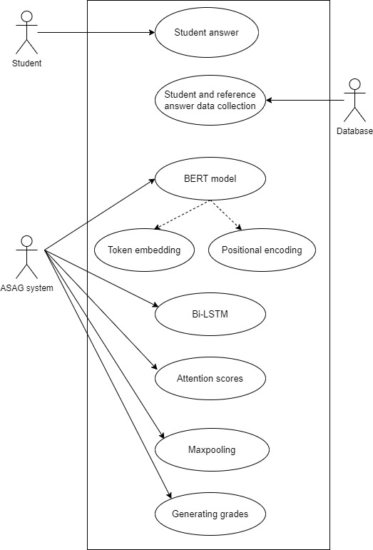
USECASE DIAGRAM

Slide 28
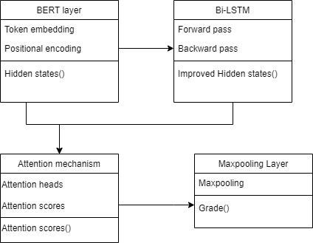
CLASS DIAGRAM

Slide 29
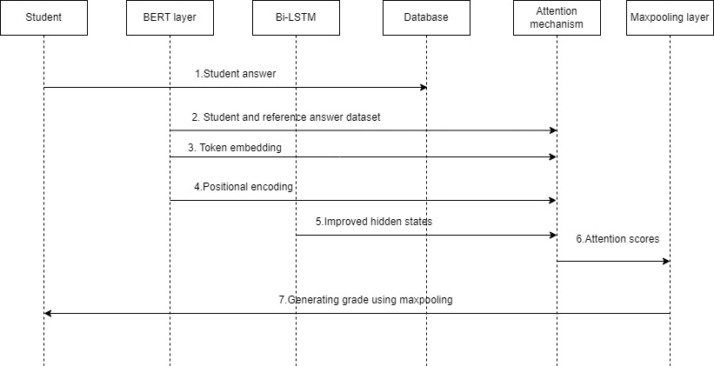
SEQUENCE DIAGRAM

Slide 30
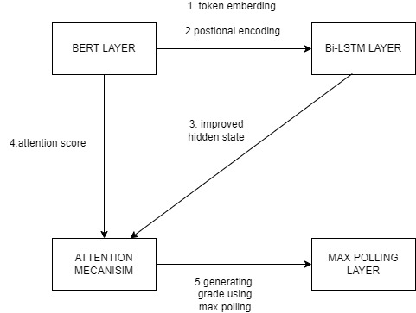
COLLABORATION DIAGRAM

Slide 31
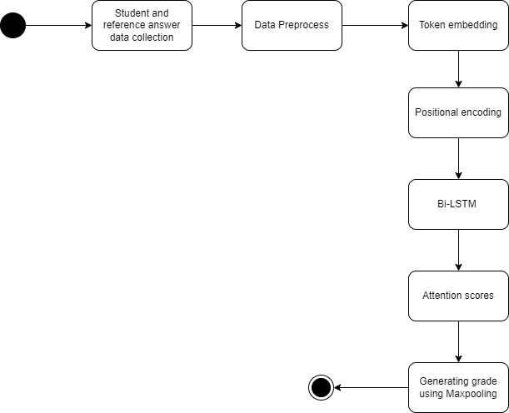
STATECHART DIAGRAM

Slide 32
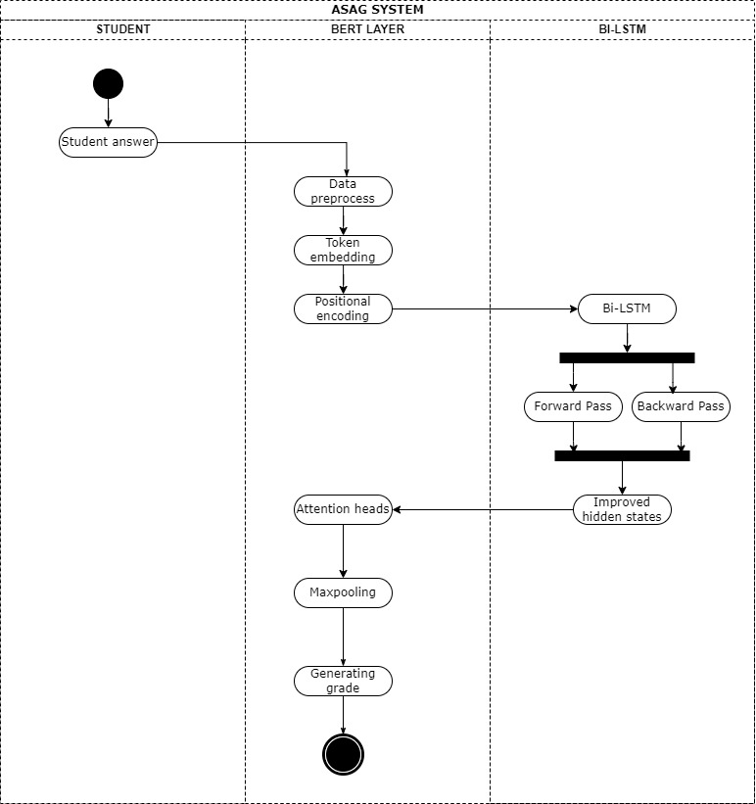
ACTIVITY DIAGRAM

Slide 33
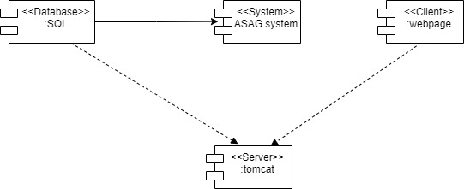
COMPONENT DIAGRAM

Slide 34
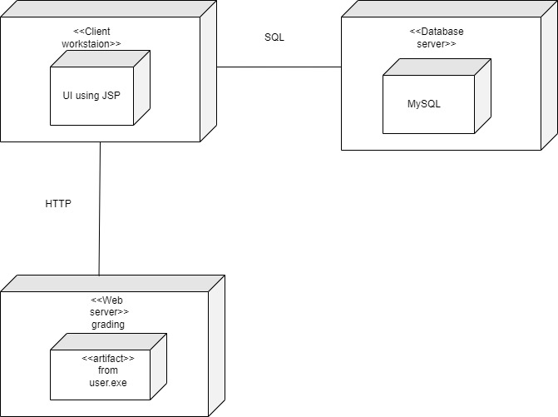
DEPLOYMENT DIAGRAM

Slide 35
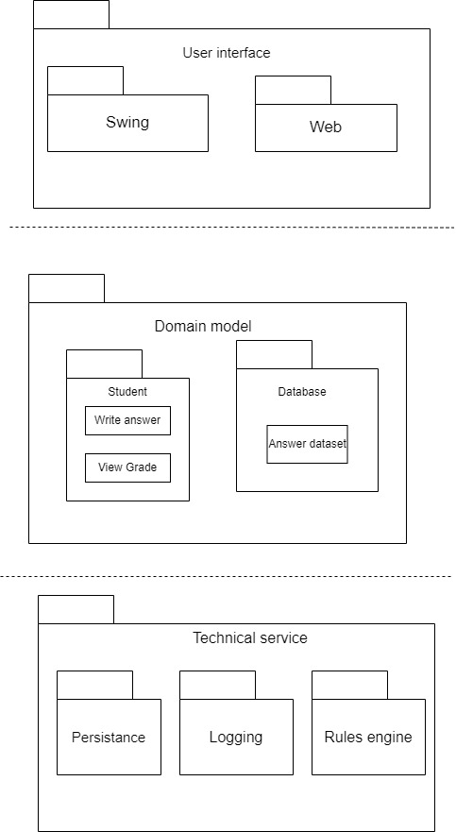
PACKAGE DIAGRAM

Slide 36

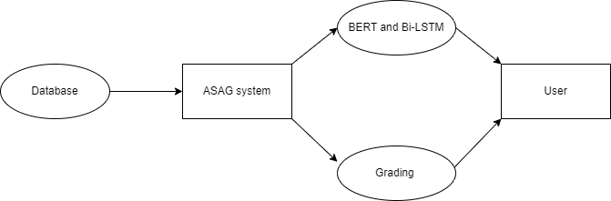
DATA FLOW DIAGRAM
DFD LEVEL 0
DFD LEVEL 1

Slide 37
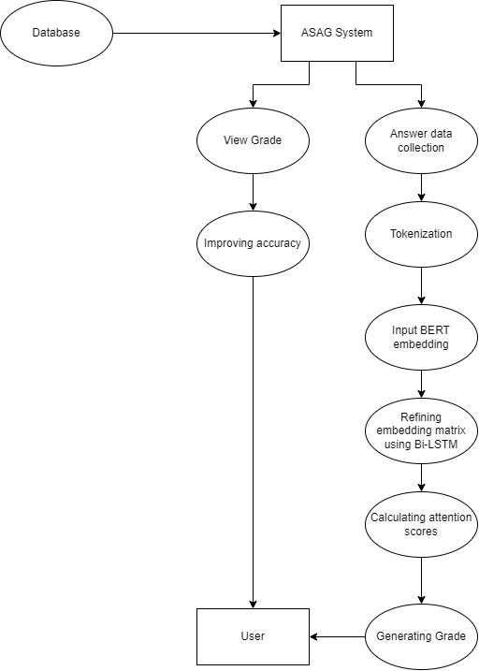
DFD LEVEL 2

Slide 38
IMPLEMENTATION
DATASET
The dataset we used in our experiments was the Short Answer Scoring SemEval-2013 dataset and Mohler dataset (2011).
We used the SciEntsBank corpus in the SemEval-2013 dataset. SciEntsBank corpus contains approximately 10 000 answers to 197 assessment questions in 15 different science domains.
This corpus is a benchmark for the ASAG classification task.
A computer science short-answer dataset were created by Mohler et al. from ten assignments and two exams of an introductory computer science class at the University of North Texas.

Slide 39
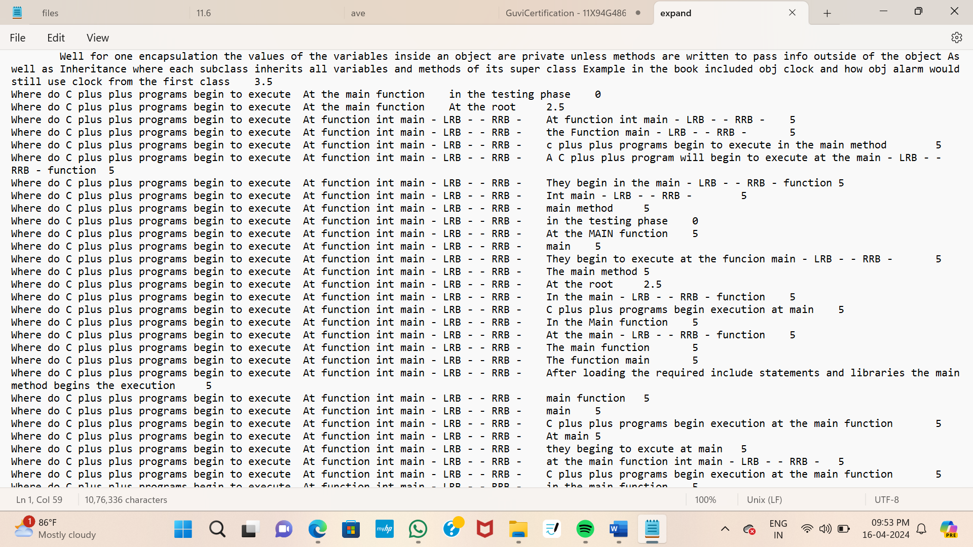

Slide 40
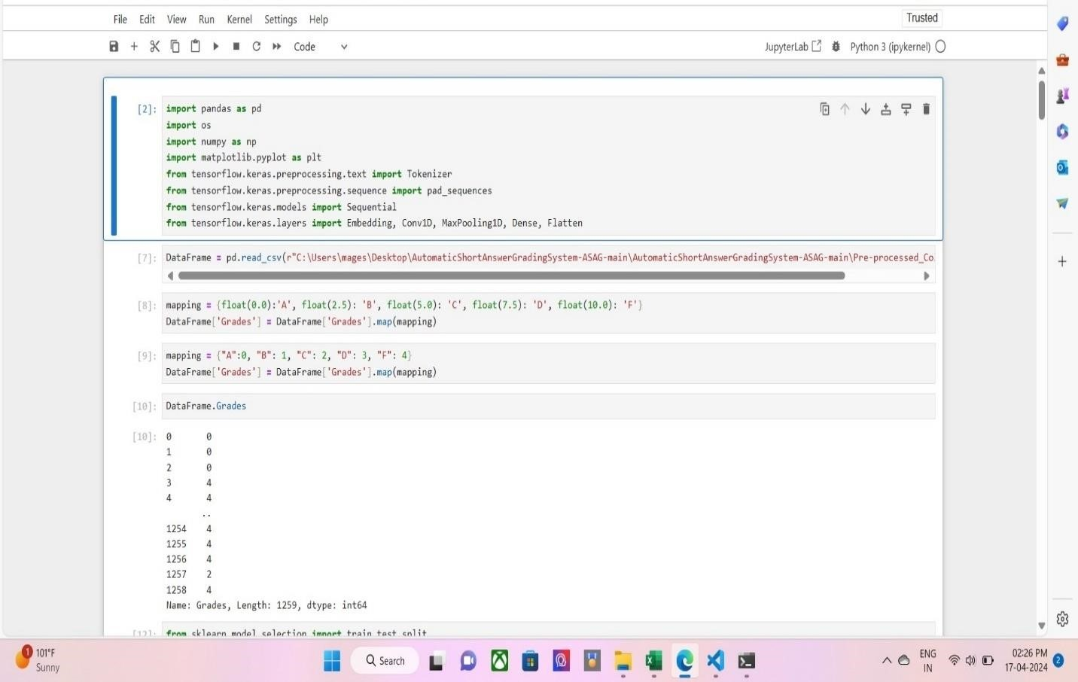
TOKEN EMBEDDING

Slide 41
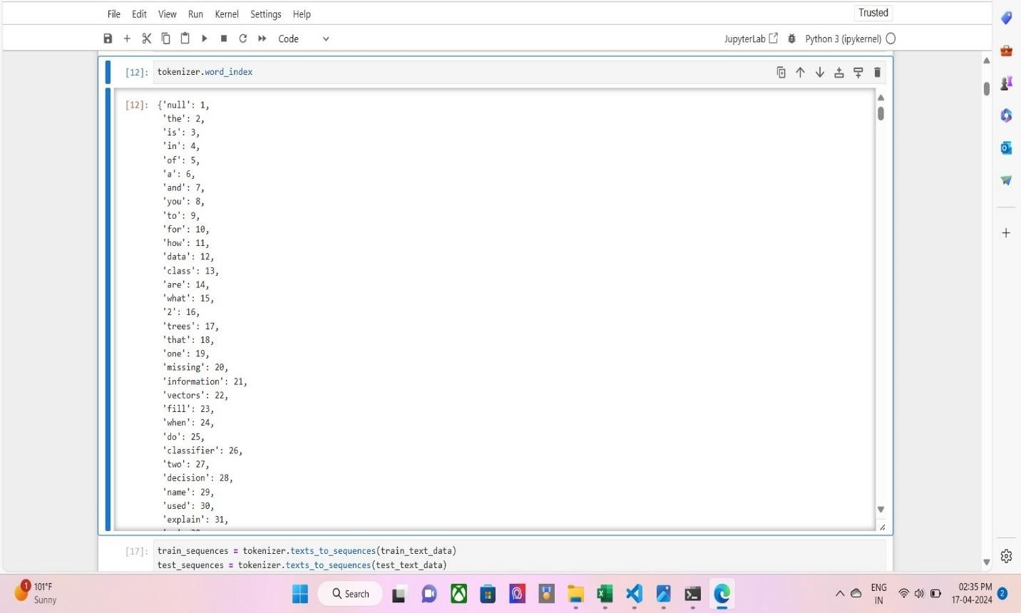
BERT TOKENIZER

Slide 42
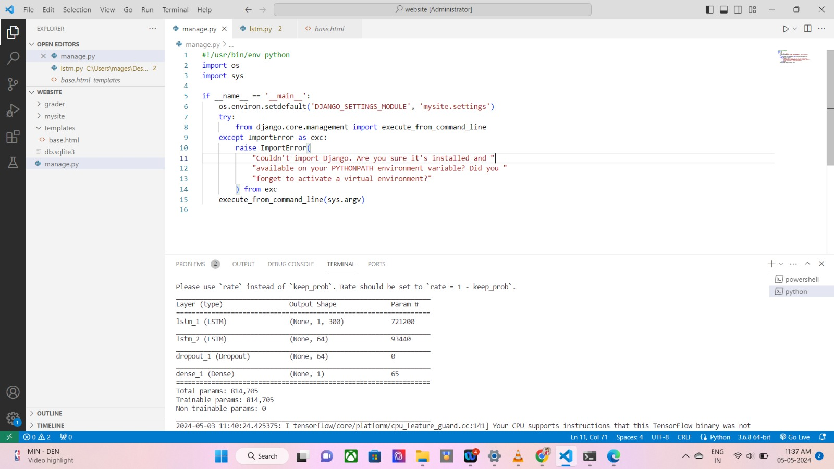
IMPLEMENTATION OF BI-LSTM

Slide 43
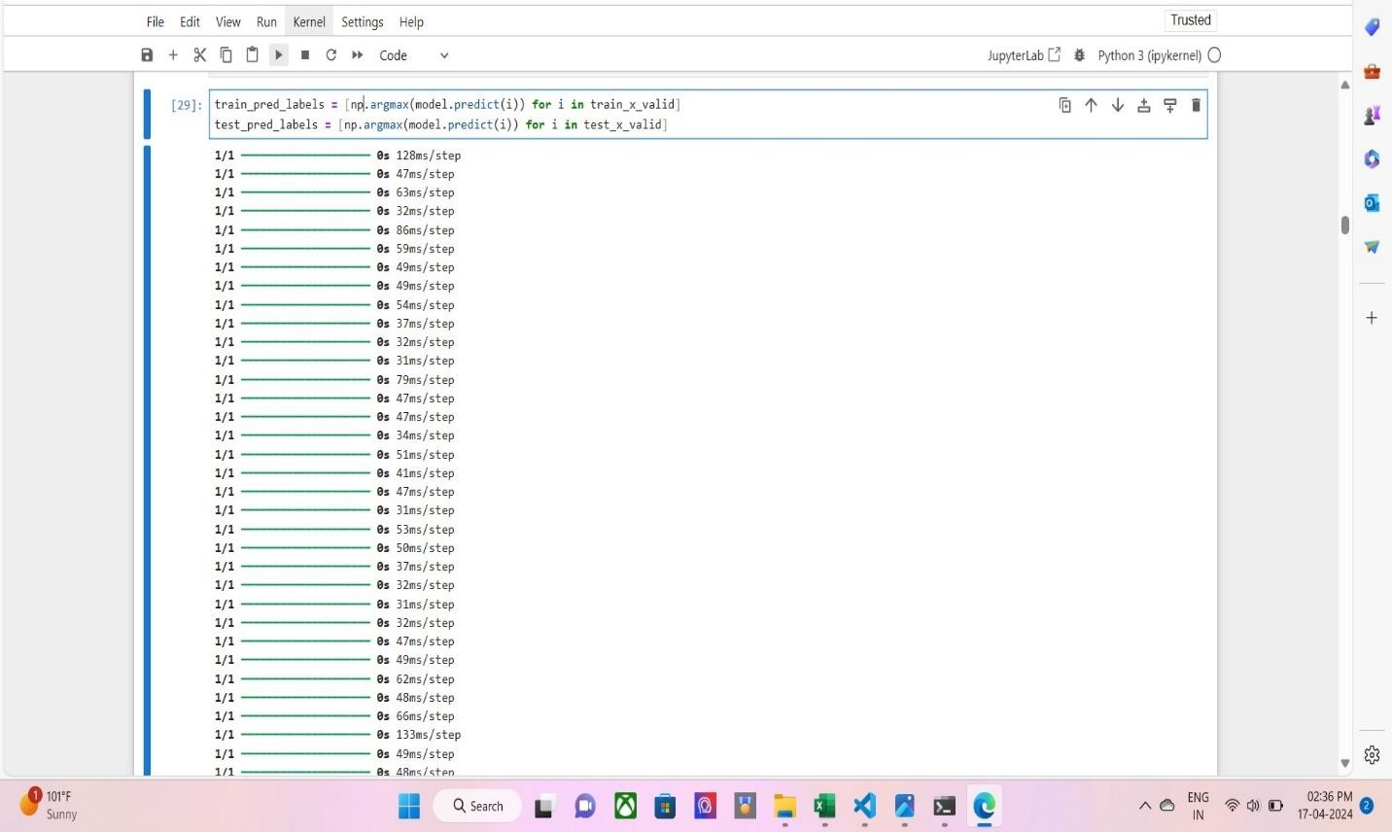
MAXPOOLING

Slide 44

ASAG QUESTION SET

Slide 45

GENERATING GRADE TO STUDENT ANSWER

Slide 46
RESULTS AND DISCUSSIONS
PERFORMANCE ANALYSIS
ASAG using BERT and Bi-LSTM network obtained the best performance. In most cases, it achieves the best accuracies compared to the other models.
In the given below table, the ablation result of w/o refinement shows that our semantic refinement layer significantly improves the grading accuracy of the BERT model on the Mohler dataset and the SemEval-2013 UQ subset.
As with the UQ subset in the SemEval-2013 dataset, the testing questions and training questions on the Mohler dataset originate from the same domain.
Therefore, this ablation result means that our semantic refinement layer can significantly improve the generalization ability of the BERT model to the features in the domain.

Slide 47
The ablation result of w/o Bi-LSTM with BERT shows that after directly replacing Bi-LSTM with the output of BERT, the grading accuracy of the model on two datasets has decreased to varying degrees.
This means that the complex gate structures in the Bi-LSTM network can extract more refined context information from the output of the BERT model, just as it performs in other natural language processing tasks, such as Named Entity Recognition.

Slide 48
Table 1: Accuracy obtained from different models on SemEval-2013 dataset
Different models | Unseen answer | Unseen questions | Unseen domain
Our model | 76.5 | 69.2 | 66.0
CNN | 70.1 | 68.8 | 63.4
BERT without Bi-LSTM | 72.3 | 65.7 | 65.7
Without multihead | 70.9 | 68.4 | 64.5

Slide 49
Table 2: Comparison of different models on Mohler dataset
Different models | MAE | RMSE | Pearson
Our model | 0.248 | 0.827 | 0.897
CNN | 0.309 | 0.821 | 0.884
BERT without Bi-LSTM | 0.254 | 0.833 | 0.884
Without multihead | 0.483 | 1.341 | 0.751

Slide 50
Table 3: Definition of parameters
FACTORS | DEFINITON
Precision | “The ratio of accurately predicted positive observations to total expected positive observations”.
Recall | “The ratio of actual positive instances that were predicted properly”.
F1 Score | “F1 score is the harmonic mean between Precision and Recall”.
Accuracy | “The number of true negatives (TN) and true positive (TP) samples divided by the total number of samples.”

Slide 51

Precision and recall obtained in our model
Precision = $\frac{TP}{TP+FP}$ = $\frac{77}{77+4}∗$100 = 0.95%
Recall = $\frac{TP}{TP+FN}$ = $\frac{77}{77+3}∗$100 = 0.96%
F1 = $\frac{Precision∗Recall}{Precision+Recall}∗$ 2 = 0.96%
ACCURACY =$\frac{TP+TN}{TP+TN+FP+FN}$ = 0.93%

Slide 52
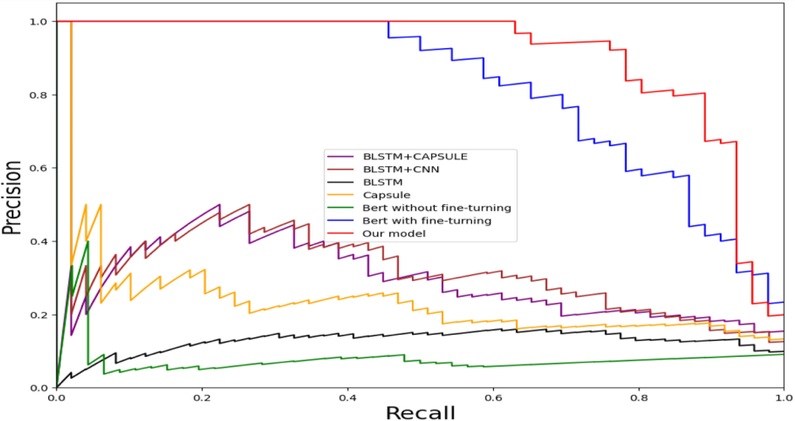
Comparison on Precision and recall with other models

Slide 53
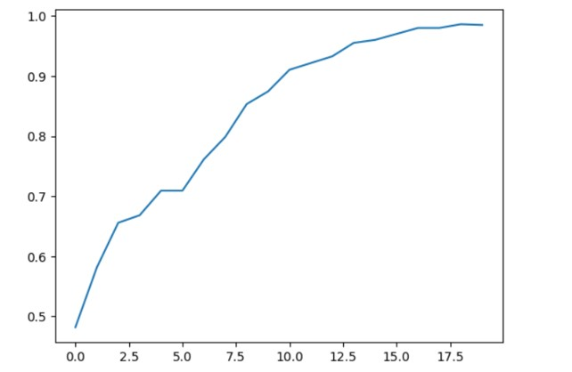
ASAG Accuracy

Slide 54
CONCLUSION
In this proposed a novel BERT-based deep neural network model for ASAG. Through extensive experimental comparison, this article reveals the following theoretical implications:
Word-embedding-based self-training neural networks, such as CNN and LSTM cannot play an important role in ASAG tasks with small datasets.
The BERT model, which has a deep transformer coding structure and is pre-trained on a large-scale corpus, can perform better by simply fine-tuning the ASAG task
On the fine-tuned BERT model, the LSTM can extract more fine semantics to deepen the BERT model’s understanding of the answer text and further improve the feature generalization ability of the BERT model in the domain.

Slide 55
FUTURE WORKS
We plan to improve the performance of their open-domain ITSs, such as the Unseen Domain subset in the SemEval-2013 benchmark. The Unseen Domain subset in the SemEval-2013 benchmark is a challenging task because it requires the ITS to be able to answer questions on a domain that it has not been trained on.
We plan to do this by training the models on a larger corpus. Training the model on a larger corpus will help it to generalize better to new domains.
In addition, we plan to use the BERT model to eliminate pronouns in students' answers in order to further improve the scoring accuracy of the ASAG task.

Slide 56
REFERENCES
Xinhua Zhu, Han Wu, and Lanfang Zhang, “Automatic Short-Answer Grading via BERT-Based Deep Neural Networks”, IEEE TRANSACTIONS ON LEARNING TECHNOLOGIES,vol.15,NO. 3, pp.364-371, JUNE 2022.
D.Alikaniotis, H. Yannakoudakis, and M. Rei, “Automatic text scoring using neural networks,” in Proc. 54th Annu. Meeting Assoc. Comput Linguistics, vol. 1, pp. 715–725, 2016.
Devlin, M. W. Chang, K. Lee, and K. Toutanova, “BERT: Pre-training of deep bidirectional transformers for language understanding,” in Proc. Annu. Conf. North Amer. Chapter Assoc. Comput. Linguistics, Hum. Lang. Technol., pp. 4171–4186, 2019.
C. N. Tulu, O. Ozkaya, and U. Orhan, “Automatic short answer grading with SemSpace sense vectors and MaLSTM,” IEEE Access, vol. 9, pp. 19270–19280, 2021.

Slide 57
M. Uto and Y. Uchida, “Automated short-answer grading using deep neural networks and item response theory,” in Proc. Int. Conf. Artif. Intell. Educ., pp. 334– 339, 2020.
H. Tan, C. Wang, Q. Duan, Y. Lu, and R. Li, “Automatic short answer grading by encoding student responses via a graph convolutional network,” Interact. Learn. Environ., vol. 2020, pp. 1–15, 2020.
N. Seuzen, A. N. Gorban, J. Levesley, and E. M. Mirkes, “Automatic short answer grading and feedback using text mining methods,” Procedia Comput. Sci., vol. 169, no. 2020, pp. 726–743, 2020.
W. Song, Z. Wen, Z. Xiao, and S. Park, “Semantics perception and refinement network for aspect-based sentiment analysis,” Knowl.-Based Syst., vol. 214, Art. no. 106755, 2021.

Slide 58
M . T. Nguyen, D. T. Le, and L. Le, “Transformers-based information extraction with limited data for domain-specific business documents,” Eng. Appl. Artif. Intell., vol. 97,Art. no. 104100,2021.
W. X. Liao, B. Zeng, X. W. Yin, and P. F. Wei, “An improved aspect category sentiment analysis model for text sentiment analysis based on RoBERTa,” Appl. Intell., vol. 51, pp. 3522–3533, 2021.
G. G. Smith, R. Haworth, and S. Zitnik, “Computer science meets education: Natural language processing for automatic grading of open-ended questions ineBooks,” J. Educ.Comput. Res., vol. 58, no. 7, pp.1227–1255, 2020
A . Sahu and P. K. Bhowmick, “Feature engineering and ensemble-based approach for improving automatic short-answer grading performance,” IEEE Trans. Learn. Technol., vol. 13, no. 1, pp. 77–90, Jan.–Mar. 2020.

Slide 59
Y. Zhang, C. Lin, and M. Chi, “Going deeper: Automatic short-answer grading by combining student and question models,” User Model. UserAdapted Interact., vol. 30, no. 1, pp. 51–80, 2020.
H. Yang, B. Zeng, J. Yang, Y. Song, and R. Xu, “A multi-task learning model for Chinese-oriented aspect polarity classification and aspect term extraction,” Neurocomputing, vol. 419, pp. 344–356, 2020.
J. Zhou, X. Huang, Q. Hu, and L. He, “SK-GCN: Modeling syntax and knowledge via graph convolutional network for aspect-level sentiment classification,” Knowl.-Based Syst., vol. 205, no. 3,Art. no. 106292,2020.
Y.Liuet al., “RoBERTa: A robustly optimized BERT pretraining approach,”arXiv:1907.11692v1,2019.

Slide 60
THANK YOU

