Slide 1
ENHANCING RECOMMENDATION SYSTEM WITH ATTENTION MECHANISM USING BP NEURAL NETWORK
Batch members
Hemalatha E (422420104304)
Monisha S (422420104022)
Sneha S (422420104035)
Under the Guidance of
Dr.R.KARTHIKA M.E.,P.HD.,
Assistant Professor,
Department of Computer Science and Engineering,
University College of Engineering Tindivanam.

Slide 2
OVERVIEW
Introduction
Abstract
Problem Statement
Objectives
Scope of the project
System architecture
Module description
Algorithm
Implementation
Performance Analysis
Conclusion and Future Work
References

Slide 3
INTRODUCTION
The basic idea of recommender systems is to recommend the most suitable items to users according to the hidden preferences of users.
Traditional recommendation types:
Content based filtering
Collaborative filtering
The traditional Collaborative Filtering(CF) recommendation algorithms are generally divided into two categories:
Matrix Factorization methods.
Neighborhood-based CF methods .

Slide 4
INTRODUCTION (CONT...)
Introducing the BP neural network into the neighborhood-based CF algorithm.
The ratings of the nearest users and items are fed into the BP neural network to improve accurate predictions.
The attention mechanism is incorporated into the BP neural network.
It is used to capture the global impact of the nearest users of the target user.
This BPAM++ framework improves the accuracy of the predicted ratings of recommendation while reducing the computational, storage costs and overfitting issues.

Slide 5
ABSTRACT
A recommender framework built on a back propagation neural network with an attention mechanism(BPAM++) is presented in this paper.
Deep neural network (DNN) is generally utilized in recommender system.
As DNN generate precise predictions.
Yet, it leads to high computational, storage costs and overfitting issues.

Slide 6
ABSTRACT (CONT...)
To resolve these problems BPAM++ is proposed.
BPAM++ reduces high computational, storage costs, overfitting issues and improves the accuracy.
The intricate relationships between the entities(target user or items) and their neighbors are learned using the BP neural network.
The purpose of the attention mechanism in this model is to record the global impact of the nearest user of the target user.

Slide 7
PROBLEM STATEMENT
Traditional recommendation models may give inaccurate predictions due to data sparsity.
Additionally, such models may suffer from high computational, storage costs and overfitting issues.

Slide 8
OBJECTIVES
Neighborhood-based CF algorithm is incorporated into BP neural network, this improves accuracy of recommendation that can capture complex relationships between users and items.
BP neural network can handle data sparsity and overfitting issues.
In addition, an attention mechanism is introduced in BPAM++ to focus on important features and reduce computational and storage costs.

Slide 9
SCOPE OF THE PROJECT
E-commerce platforms
Social media
News
Movies
Music
Educational platforms

Slide 10
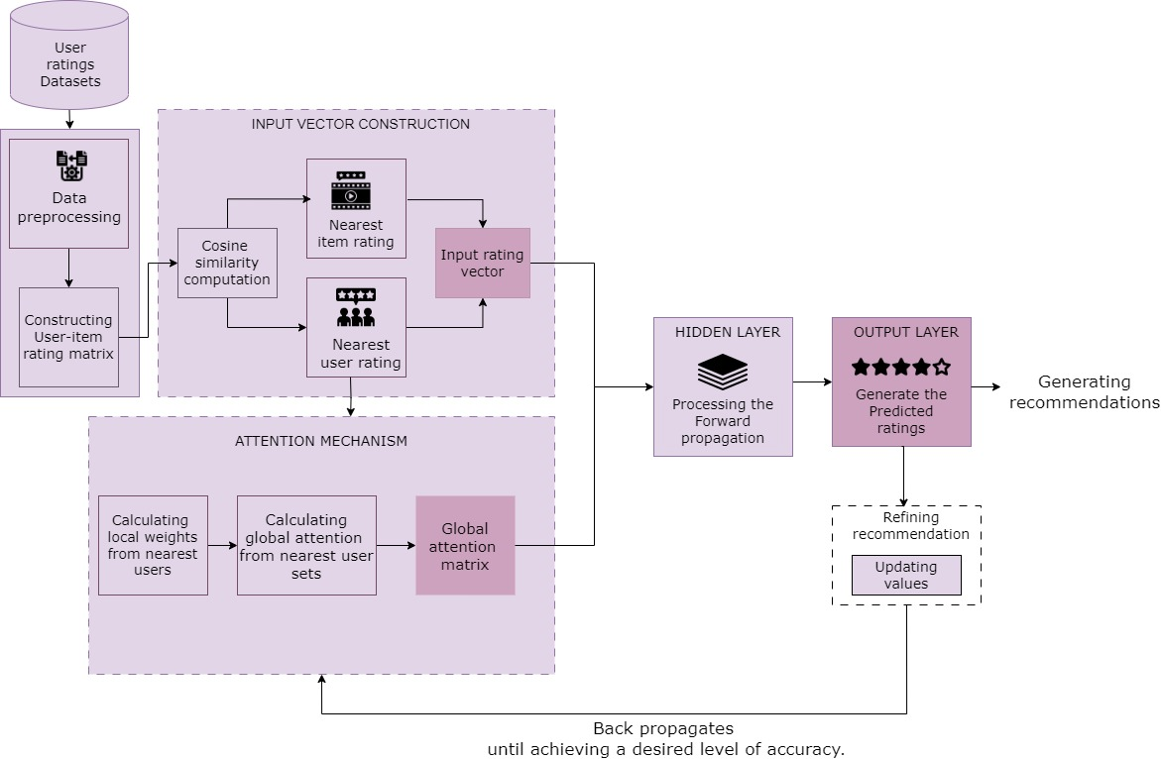
SYSTEM ARCHITECTURE

Slide 11
MODULE DESCRIPTION
INPUT VECTOR CONSTRUCTION:
The input vector is used to make personalized recommendations for each user based on their historical ratings and other relevant data.
And also the relationship between the target item and nearest items.
The input vector construction refers to the process of constructing an input vector that captures the relationship between the target user and their neighbors.
ALGORITHM:
Step 1: Extract rating matrix R from the database.
Step 2: Calculate cosine similarity between each user's rating vector and all other users' rating vectors in R.

Slide 12
MODULE DESCRIPTION (CONT..)
Step 3: Select k nearest users (KNU) for each user based on cosine similarity scores for each user u in R.
Step 4: Calculate cosine similarity between each item's rating vector and all other items' rating vectors in R.
Step 5: Select k nearest items (LNI) for each item based on cosine similarity scores
Step 6: For each user-item pair (u,i), create an input vector that includes the rating given by the user to the item, the ratings given by KNU to the item, and the ratings given by the user to LNI.

Slide 13
MODULE DESCRIPTION(CONT..)
ATTENTION MECHANISM:
The attention mechanism that captures the global impact of the nearest users of the target user on their nearest target user sets.
ALGORITHM:
Step 1: Compute similarity scores between user u and all other users in R.
Step 2: Select k nearest users (KNU) for user u based on similarity scores.
Step 3: Compute local weights for KNU.
Step 4: Normalize local weights.
Step 5: Compute global attention weights of KNU ratings using local weights.

Slide 14
MODULE DESCRIPTION(CONT..)
FORWARD PROPAGATION:
The forward propagation is used to predict the rating for a given user-item pair.
The output neuron then computes a weighted sum of its inputs , applies another activation function and produces the final prediction.
Each neuron in the hidden layer computes a weighted sum of its inputs, applies an activation function, and passes its output to neurons in the output layer.
ALGORITHM:
Step 1: Compute input vector for user-item pair (u, i).
Step 2: Compute local weights.
Step 3: Compute global attention weights of KNU and LNI ratings using local weights.

Slide 15
MODULE DESCRIPTION(CONT..)
Step 4: Concatenate input vector with global attention weights of KNU and LNI ratings.
Step 5: Compute output of hidden layer using input vector with attention.
Step 6: Compute output of output layer using hidden layer output.

Slide 16
MODULE DESCRIPTION(CONT..)
BACK PROPAGATION:
The back propagation process is used to update the weights of the neural network during training.
Each weight in the neural network is updated by a small amount proportional to its contribution to the overall error between predicted and actual ratings or ranking scores.
ALGORITHM:
Step 1: Compute error between predicted rating and actual rating.
Step 2: Compute derivative of output layer output with respect to error.
Step 3: Compute derivative of hidden layer output with respect to output layer output.
Step 4: Compute derivative of input vector with attention with respect to hidden layer output.

Slide 17
MODULE DESCRIPTION(CONT..)
Step 5: Split derivative of input vector with attention into derivatives of input vector, KNU ratings, and LNI ratings.
Step 6: Compute derivative of KNU and LNI attention weights with respect to their respective ratings.
Step 7: Update global attention matrix using derivatives of KNU and LNI attention weights.
Step 8: Update local weight matrix using derivatives of input vector and hidden layer output.
Step 9: Update KNU and LNI ratings using derivatives of attention weights and ratings.
Step 10: Repeat steps 1-9 for all training examples until convergence.

Slide 18
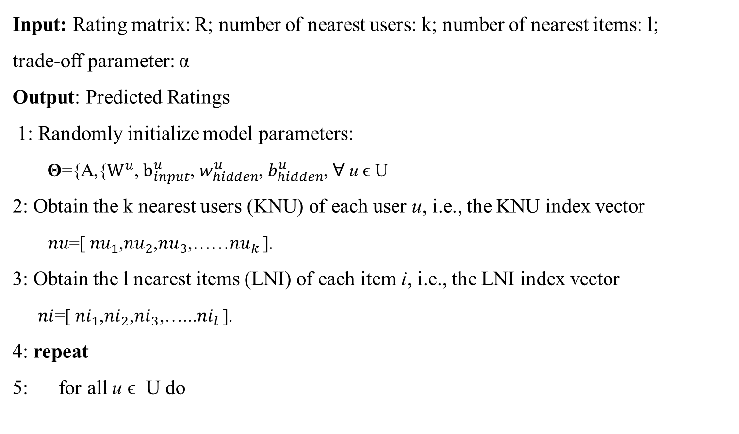
THE OVERALL ALGORITHM FRAMEWORK FOR BPAM++
Input: Rating matrix: R; number of nearest users: k; number of nearest items: l;
trade-off parameter: α
Output: Predicted Ratings
1: Randomly initialize model parameters:
Θ={A,{$W^{u}$, $b_{input}^{u}$, $w_{hidden}^{u}$, $b_{hidden}^{u}$, ꓯ u ϵ U
2: Obtain the k nearest users (KNU) of each user u, i.e., the KNU index vector
$nu$=[ $nu_{1}$,$nu_{2}$,$nu_{3}$,……$nu_{k}$ ].
3: Obtain the l nearest items (LNI) of each item i, i.e., the LNI index vector
$ni$=[$ni_{1}$,$ni_{2}$,$ni_{3}$,…...$ni_{l}$ ].
4: repeat
5: for all u ϵ U do

Slide 19
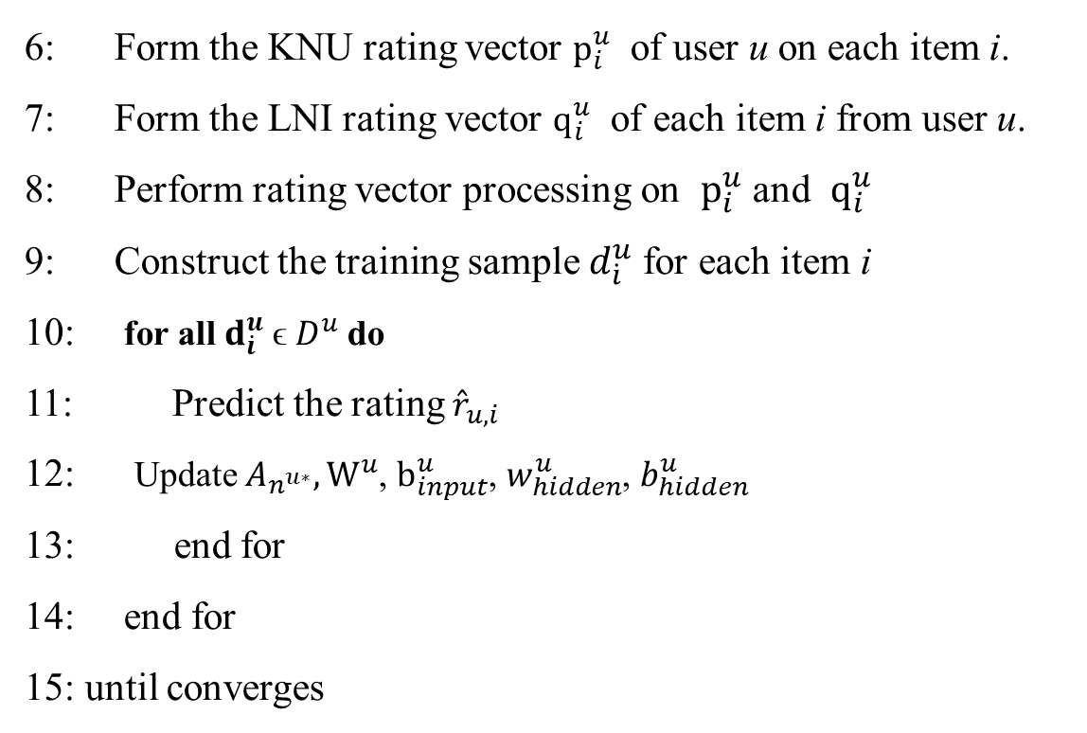
6: Form the KNU rating vector $p_{i}^{u}$ of user u on each item i.
7: Form the LNI rating vector $q_{i}^{u}$ of each item i from user u.
8: Perform rating vector processing on $p_{i}^{u}$ and $q_{i}^{u}$
9: Construct the training sample $d_{\dot{i}}^{u}$for each item i
10: for all $d_{\dot{i}}^{u}$ϵ $D^{u}$do
11: Predict the rating ${\hat{r}}_{u,i}$
12: Update $A_{n^{u∗}},W^{u}$, $b_{input}^{u}$, $w_{hidden}^{u}$, $b_{hidden}^{u}$
13: end for
14: end for
15: until converges

Slide 20

IMPLEMENTATION
BPAM++ - master Data set

Slide 21
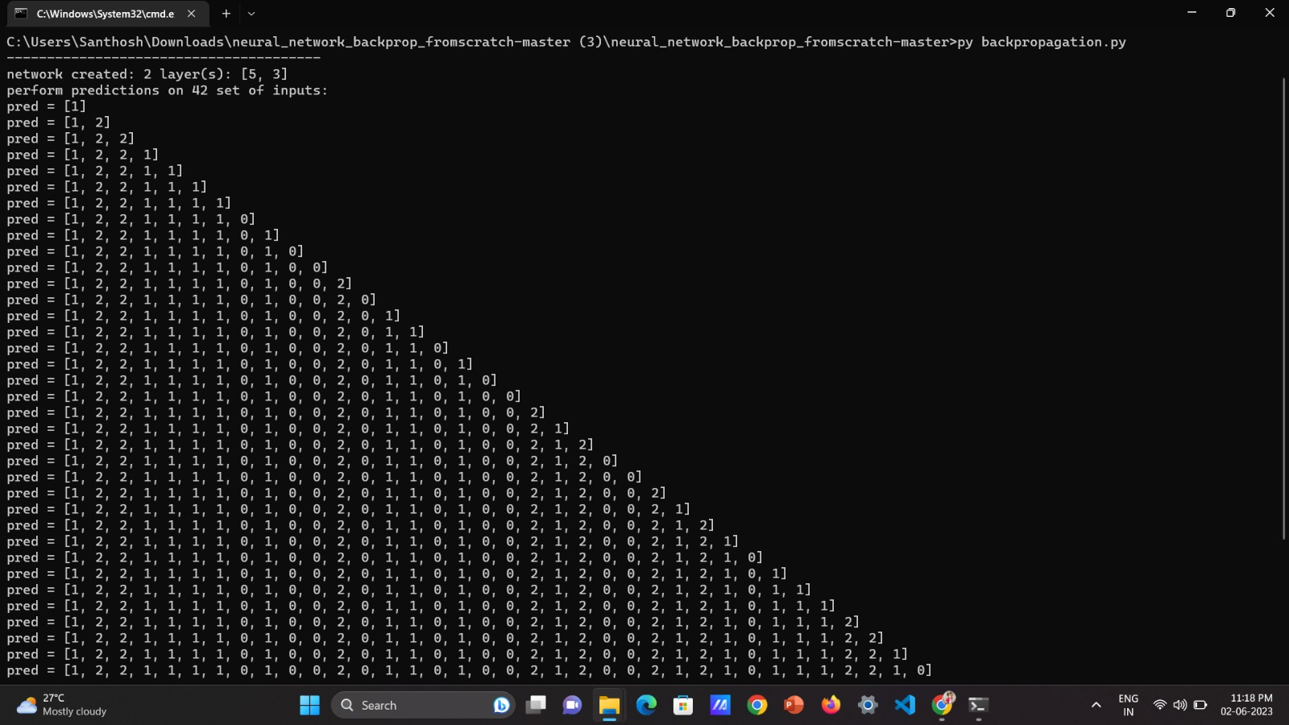
Predicted Results

Slide 22
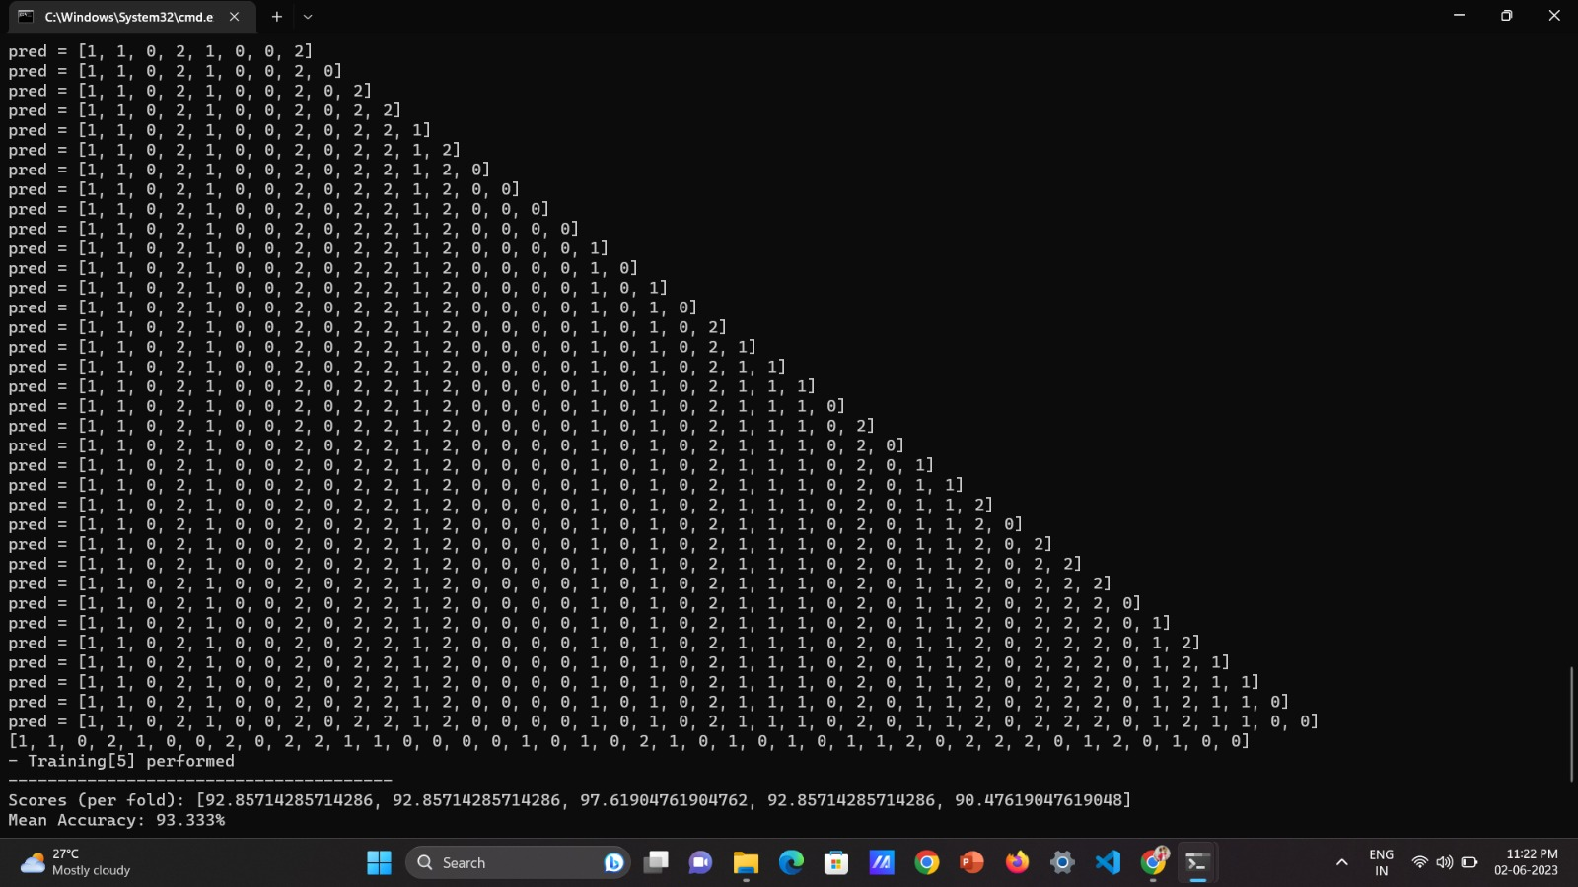
Calculated Mean Accuracy

Slide 23
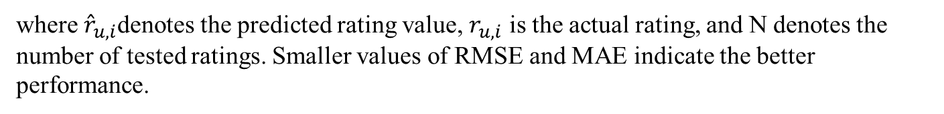
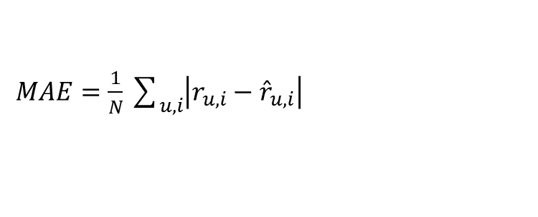
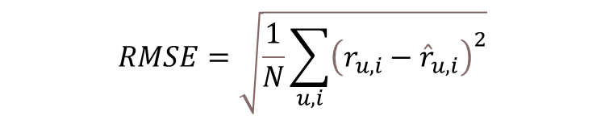
PERFOMANCE ANALYSIS
Performance analysis for recommender systems involves evaluating the effectiveness and efficiency of the system in providing accurate and relevant recommendations to users. To perform a comprehensive performance analysis, you can use a combination of offline evaluation, where historical data is used to evaluate the system, and online evaluation, where real-time user interactions are monitored and analyzed.
$$RMSE=\sqrt{\frac{1}{N}\sum_{u,i}{{\left(r_{u,i}−{\hat{r}}_{u,i}\right)}^{2}}}$$
$MAE=\frac{1}{N}\sum_{u,i}{\left|r_{u,i}−{\hat{r}}_{u,i}\right|}$
where ${\hat{r}}_{u,i}$denotes the predicted rating value, $r_{u,ⅈ}$ is the actual rating, and N denotes the number of tested ratings. Smaller values of RMSE and MAE indicate the better performance.

Slide 24
Comparison with different methods :
Comparison on Computational costs
Models | Costs
BPAM++ | 204
NeuMF | 2,736
DMF | 98,432
DeepCF | 270,464
Comparison on storage cost :
Datasets | BPAM++ | NeuMF | DMF | DeepCF
ml-la | 60,390 | 829,312 | 5,701,632 | 8,519,168
filmtrust | 122,148 | 288,912 | 2,702,848 | 3,791,104
jd-1 | 1,573,929 | 2,009,232 | 25,732,096 | 32,325,376
jd-2 | 1,480,500 | 1,890,592 | 24,213,504 | 30,427,136
jd-3 | 1,571,094 | 2,005,632 | 25,686,016 | 32,267,776
Automotive | 163,968 | 383,632 | 4,036,096 | 5,427,456
Beauty | 939,204 | 2,759,632 | 29,192,704 | 38,187,264
Kindle Store | 2,387,805 | 10,415,152 | 101,668,864 | 135,161,088

Slide 25
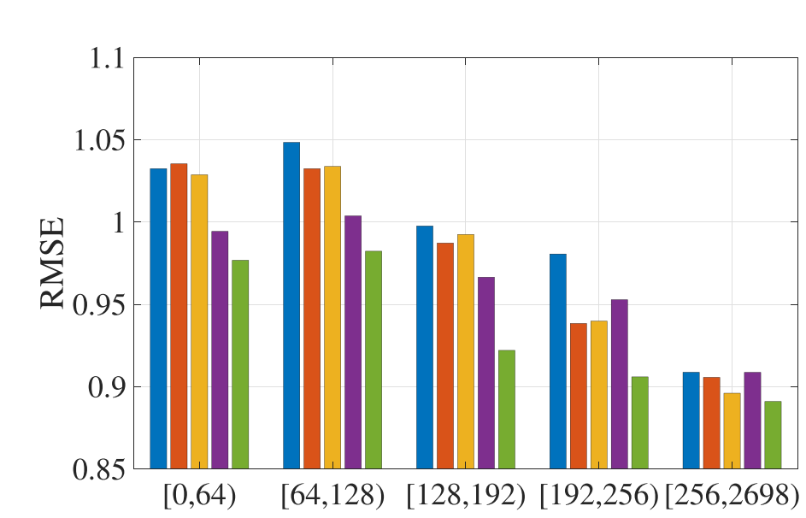
Comparison on addressing overfitting issues:
RMSE Comparison on overfitting issues

Slide 26
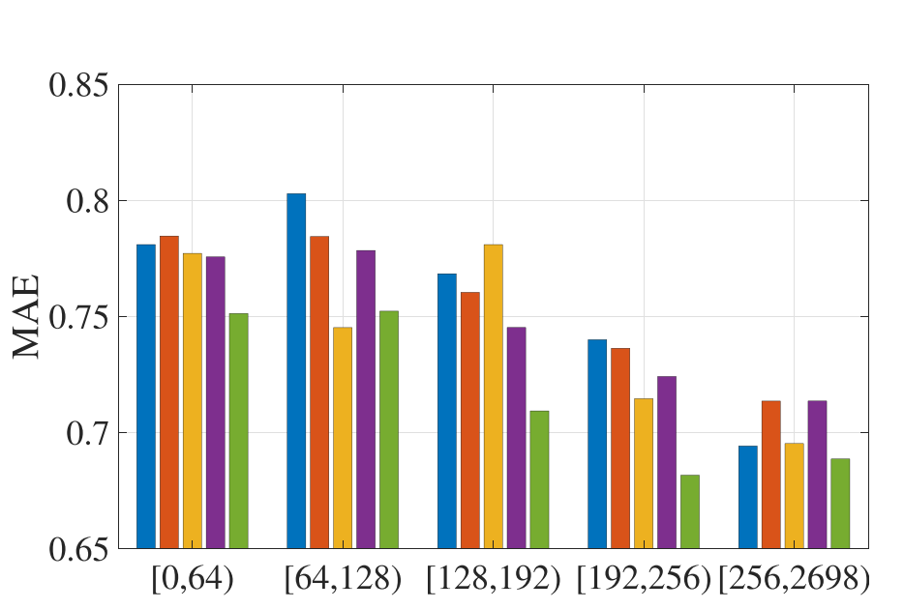
MAE Comparison on overfitting issues
.
We can observe that the overfitting issues of BPAM++ model is significantly lower
than the overfitting issues of these DNNs-based models namely NeuMF, DMF and
DeepCF.

Slide 27
CONCLUSION
In this work, we have proposed a novel recommender framework based on BP neural network with attention mechanism, called BPAM++.
In the proposed BPAM++ framework, the BP neural network is utilized to learn the complex relationship between the target users and their neighbors and the complex relationship between the given items and their neighbors.
In this way, BPAM++ outperforms DNN based models which only utilizes the traditional matrix factorization and neighbor models.
Compared with DNNs, shallow BP neural network can not only reduce the computational and storage costs, but also prevent the model from overfitting caused by the small number of ratings.
Besides, an attention mechanism is introduced in BPAM++ to capture the global attention weights about users’ impact on their nearest target user set.

Slide 28
FUTURE WORK
In this paper, we mainly focus on the rating matrix in the recommender systems.
In the future, we aim to introduce content information of users and items or social relationship of users to calculate similarities between users and items instead of only utilizing the rating vectors of users and items.
So that we can obtain their more accurate nearest neighbors. Richer information usually leads to better performance.
Moreover, except for the simple concatenation, it is also encouraged to explore other aggregation methods to construct the input vector.

Slide 29
REFERENCES
C.-D. Wang, Z.-H. Deng, J.-H. Lai, and P. S. Yu, “Serendipitous recommendation in E-commerce using innovator-based collaborative filtering,” IEEE Trans. Cybern., vol. 49, no. 7, pp. 2678–2692, Jul. 2019.
J. Ma, J. Wen, M. Zhong, W. Chen, and X. Li, “MMM: Multi-source multi-net micro-video recommendation with clustered hidden item representation learning,” Data Sci. Eng., vol. 4, no. 3, pp. 240–253, 2019.
Q.-Y. Hu, L. Huang, C.-D. Wang, and H.-Y. Chao, “Item orientated recommendation by multi-view intact space learning with overlapping,” Knowl.Based Syst., vol. 164, pp. 358–370, 2019.
P. Hu, R. Du, Y. Hu, and N. Li, “Hybrid item-item recommendation via semiparametric embedding,” in Proc. Int. Joint Conf. Artif. Intell., pp. 2521–2527, 2019.
C.-C. Hsu, M.-Y. Yeh, and S.-D. Lin, “A general framework for implicit and explicit social recommendation,” IEEE Trans. Knowl. Data Eng., vol. 30, no. 12, pp.2228–2241, Dec. 2018.

Slide 30
L. Huang, C.-D. Wang, H.-Y. Chao, J.-H. Lai, and P. S. Yu, “A score prediction approach for optional course recommendation via cross-user-domain collaborative filtering,” IEEE Access, vol. 7, pp. 19 550–19 563, 2019.
W. Fu, Z. Peng, S. Wang, Y. Xu, and J. Li, “Deeply fusing reviews and contentsfor cold start users in cross-domain recommendation systems,” in Proc. AAAI Conf. Artif. Intell., pp. 94–101, 2019.
8. A. Ferraro, “Music cold-start and long-tail recommendation: Bias in deep
representations,” in Proc. 13th ACM Conf. Recommender Syst., pp. 586–590, 2019.
9. H.-J. Xue, X. Dai, J. Zhang, S. Huang, and J. Chen, “Deep matrix factorization
models for recommender systems,” in Proc. Int. Joint Conf. Artif. Intell.,pp. 3203–
320 , 2017.
W. Yan, D. Wang, M. Cao, and J. Liu, “Deep auto encoder model with convolutional text networks for video recommendation,” IEEE Access, vol. 7, pp. 40 333–40 346, 2019

Slide 31
THANK YOU

