Slide 1
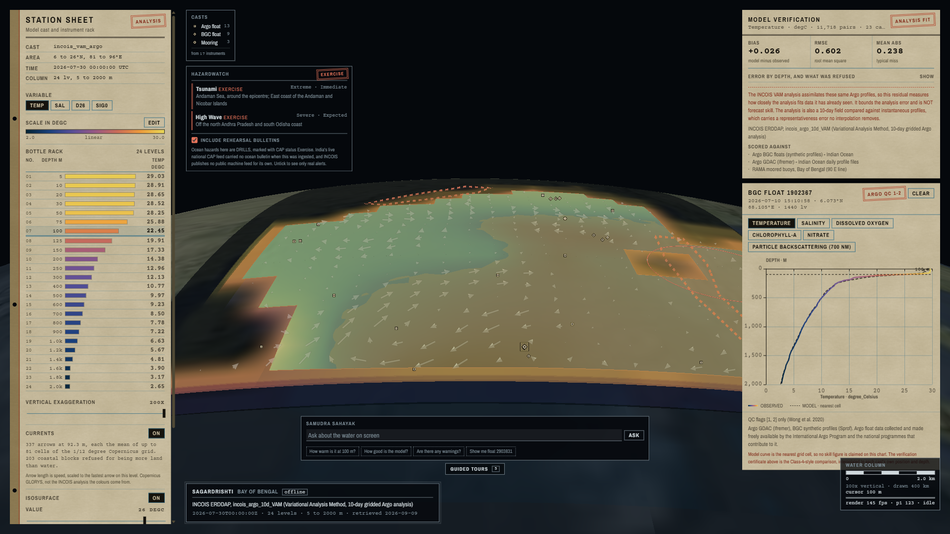

SMART INDIA HACKATHON 2026
TITLE PAGE
SagarDrishti सागर दृष्टि
A browser-native 3D digital twin of India's ocean
▪ Problem Statement ID - SIH26067
▪ Problem Statement Title - Web-based 3D Visualization Platform for Ocean Model Data and In-situ Observations
▪ Theme - Disaster Management
▪ PS Category - Software
▪ Team ID - [TEAM ID]
▪ Team Name (Registered on portal) - [TEAM NAME]
Running today, offline: 24 depth levels from 5 m to 2000 m, the 26 degC isosurface, 337 current vectors and CAP warning areas.
Not a proposal on paper. 543 automated tests · 51 fps at 1080p on integrated graphics · 10.5 M gridded values · 16,390 QC-passed instrument levels · zero requests that leave the machine. Every figure in this deck was measured, not estimated.

Slide 2
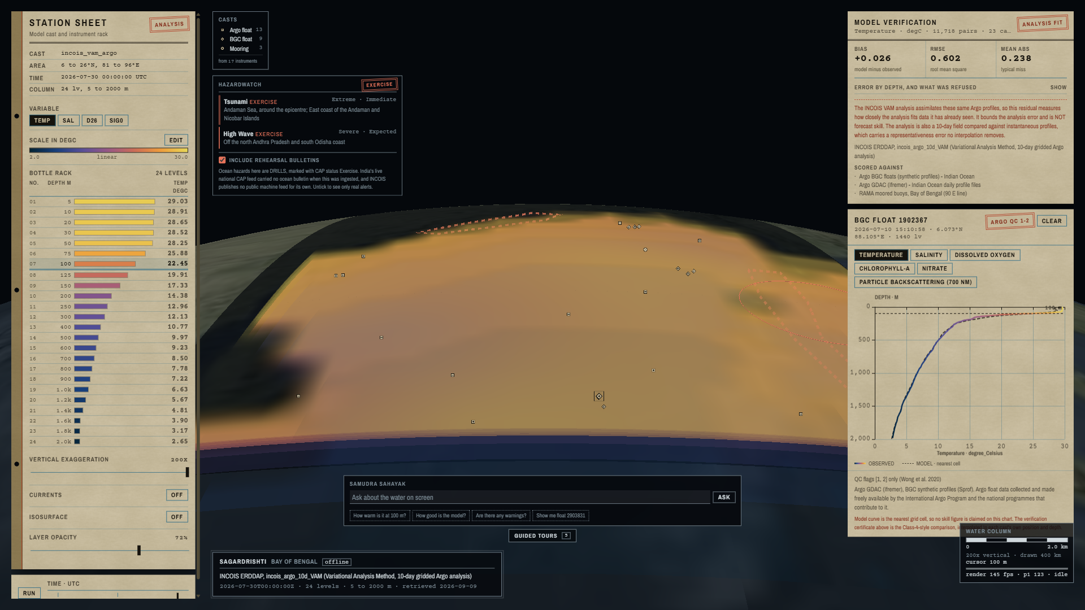
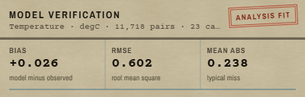
IDEA TITLE
[TEAM NAME]
SagarDrishti सागर दृष्टि One screen where INCOIS's 3D model fields and the instruments in the water finally meet, with a number saying how far apart they are.
THE PROBLEM · INCOIS'S OWN WORDS
▪ “No integrated, web-based 3D visualization platform currently exists” that renders model fields and in-situ observations together.
▪ Forecasters are “forced to toggle between disparate software packages”
▪ which “impedes timely hazard assessment, search-and-rescue support, fishery advisories”
PROPOSED SOLUTION · HOW IT ADDRESSES THE PROBLEM
▪ Volumetric water column in a browser. 24 depth levels, 5 m to 2000 m, as blended depth slices, extracted isosurfaces and time animation. No client install.
▪ Instruments fused into the same scene. 25 real casts from 17 instruments; click one to read its measured profile against the model at that point and time.
▪ A skill number beside the field. Class-4-style verification prints bias and RMSE per depth band, with the caveat that limits it, on the same screen.
▪ Hazards drawn over the water they concern. Live CAP v1.2 from NDMA SACHET, India's national alert backbone.
▪ A new source is a config entry, not a rewrite. YAML registry plus a plugin interface; OGC WMS/WCS and CF served.
One scene: model field, instrument casts, hazard areas, the verification card and a measured profile against the model.
INNOVATION AND UNIQUENESS
PROOF ON SCREEN
Skill, not just pictures
The only viewer that prints how wrong the model is, beside it
Air-gapped by construction
Zero off-machine requests; a test fails the build if one appears
An agent that cannot invent
Code withholds any answer stating a number no tool produced
Derived fields as plugins
Density (TEOS-10) and cyclone-heat depth, no change to the store
▪ 11,718 matched pairs from 23 real casts, per depth band
▪ 13 ocean parameters including oxygen, chlorophyll-a, nitrate and pH
▪ The caveat is printed in red analysis fit, NOT forecast skill
Printed on the running screen, beside the field itself.

Slide 3
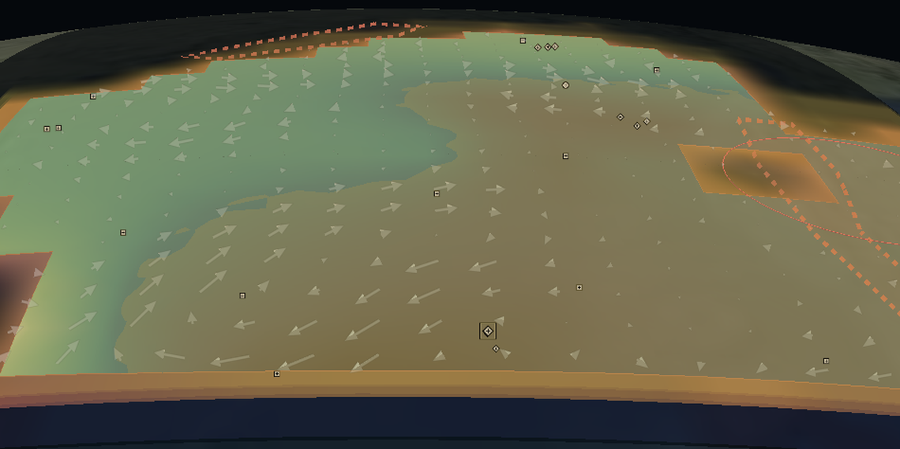
TECHNICAL APPROACH
[TEAM NAME]
NetCDF · ASCII · CAP XML → source registry (YAML) → chunked Zarr cube → FastAPI + OGC WMS / WCS → WebGL 3D scene in the browser
1 DATA SOURCES
2 INGEST AND REGISTRY
3 DATA PLANE (FastAPI)
4 BROWSER (CesiumJS · WebGL2)
INCOIS ERDDAP analysis field · 24 levels
data/sources.yaml
one entry per source: kind, variables, units
/field a whole water column
Argo GDAC (Ifremer) core float profiles
CF normalisation
two fill conventions, scale_factor, depth-positive-down
/profiles instrument casts and levels
Argo BGC (Sprof) O2 · chl-a · NO3 · pH
NetCDF · XML
zarr chunks
/isosurface marching-cubes mesh
JSON · PNG
Quality control
Argo flags 1 and 2; pressure to depth by TEOS-10
/currents block-averaged vectors
RAMA moored buoys the 90 E line
Plugins
new instrument kinds and derived fields
/scorecard Class-4 verification
Copernicus GLORYS currents · 1/12 deg
/warnings active CAP areas
▪ Depth slices · isosurface · time animation
▪ Current vectors at the depth cursor
▪ Instrument marks told apart by shape
▪ Colorbar editor · depth cursor · 200x exaggeration
▪ Guided tours that drive the scene
NDMA SACHET CAP v1.2 alert feed
Rechunk to Zarr
10.5 M gridded values · 16,390 levels
/wms /wcs OGC · CF-1.8 NetCDF
All open. No licence, no paywall.
A new source is config, not a rewrite.
Offline by default: reads only the local cube.
No install. 51 fps at 1080p on an integrated GPU.
5
VERIFICATION · Class-4 method
6
AGENT PLANE · detachable service
7
ANY OGC CLIENT
The model is interpolated to each cast's own position and depth, bilinear in latitude and longitude and linear in depth. A level is refused, never filled, if a surrounding cell is missing; all 4,672 unpaired levels are counted and served by reason.
Samudra Sahayak is a separate service over the same public API. A guard WITHHOLDS any sentence stating a number no tool produced. Kill the process and every core requirement still passes.
The same fields are published as WMS 1.3.0 and WCS 1.0.0, so QGIS and the desktop tools INCOIS already runs can consume this without us writing a client for them.
TECHNOLOGIES USED
Next.js 15
TypeScript
CesiumJS · WebGL2
ECharts
Python 3.11
FastAPI
xarray · Zarr
NumPy · SciPy
gsw (TEOS-10)
scikit-image
Parquet
Docker
Playwright
pytest
Standards implemented: CF Conventions · OGC WMS 1.3.0 · OGC WCS 1.0.0 · OASIS CAP v1.2 · TEOS-10 equation of state · Argo QC, Wong et al. 2020 · GODAE OceanView Class 4, Ryan et al. 2015

Slide 4
FEASIBILITY AND VIABILITY
[TEAM NAME]
FEASIBILITY IS NOT A FORECAST HERE. THE SYSTEM ALREADY RUNS. EVERY FIGURE BELOW WAS MEASURED, NOT ESTIMATED.
543
automated tests, 10 of them
driving a real browser
51 fps
at 1080p on integrated Intel
graphics, not a gaming GPU
0
requests leave the machine;
a test fails the build if one does
10.5 M
gridded values in the demo cube
from two agencies
16,390
QC-passed instrument levels
from 17 real instruments
13
ocean parameters served,
2 of them computed by plugins
ANALYSIS OF FEASIBILITY
POTENTIAL CHALLENGES AND RISKS
STRATEGIES TO OVERCOME THEM
TECHNICAL
DATA
DATA
▪ Proven stack. CesiumJS, FastAPI, xarray and Zarr are mature and open; nothing here needs inventing.
▪ Frame budget cleared. 51 fps median on the weakest target GPU, against a 30 fps floor.
▪ Instrument coverage is uneven. Glider and CTD files are not published on INCOIS ERDDAP.
▪ Datasets disagree on axes. GLORYS stops at 1942 m where the INCOIS field has a 2000 m level.
▪ Parsers already written and tested. Glider and CTD ingest needs a file, not code.
▪ Never stretch one grid onto another. The served depth is printed beside the requested one.
OPERATIONAL
TECHNICAL
TECHNICAL
▪ Reads INCOIS's own ERDDAP. Zero data duplication; the agency keeps its single source of truth.
▪ No client install. A browser is the whole deployment surface.
▪ Volumetric rendering is costly. Translucent overdraw is the dominant frame cost.
▪ Scaling to the full basin. The national grid is far larger than the demo box.
▪ Depth-space level of detail. At most 10 of 24 slices blended at once; slices-only is the proven floor.
▪ Chunked Zarr over range requests. Cost is view-dependent, not dataset-dependent.
ECONOMIC
ADOPTION AND TRUST
ADOPTION AND TRUST
▪ Zero licence cost. Fully open source, one commodity GPU server.
▪ Skills exist in-house. Standard Python and JavaScript; INCOIS already runs ERDDAP and LAS.
▪ A wrong number is worse than none. A skill figure quoted without its caveat would mislead.
▪ A false alarm is unacceptable. A drill must never read as a live warning.
▪ The caveat travels with the number. Printed on screen, in the API and in every agent answer.
▪ Four independent drill guards. CAP status Exercise is refused, dashed, stamped and spoken.
VIABILITY · WHY THIS SURVIVES AFTER THE HACKATHON
Native deployment path
The PS is INCOIS's own tooling request. We read their ERDDAP, so there is no data to migrate and no second source of truth.
Standards, not a silo
OGC WMS 1.3.0 and WCS 1.0.0 mean their existing desktop tools can consume this without us writing a client for them.
Maintainable by the owner
Standard Python and JavaScript, a documented plugin registry, and a test suite that fails loudly. INCOIS already runs ERDDAP and LAS.
Costs nothing to keep
Zero licences, one commodity GPU server, and a browser as the entire client-side footprint.

Slide 5
IMPACT AND BENEFITS
[TEAM NAME]
POTENTIAL IMPACT ON THE TARGET AUDIENCE
DISASTER MANAGERS
INCOIS runs India's Tsunami Early Warning Centre. A CAP bulletin stops being text and becomes a shape on the water, beside the field that explains it.
OPERATIONAL FORECASTERS
The daily question "can I trust today's field?" is answered per depth band on the same screen, in seconds rather than a separate offline report.
SEARCH AND RESCUE
Depth-resolved currents, not just the surface, which is what a drifting object actually follows.
FISHERY ADVISORIES
Potential Fishing Zone advisories reach about 9 lakh fisherfolk households; subsurface temperature and oxygen are the inputs behind them.
RESEARCH, EDUCATION, OUTREACH
The PS names public outreach and e-learning. Guided tours narrate the ocean for schools and exhibitions from the same engine.
BENEFITS · SOCIAL, ECONOMIC, ENVIRONMENTAL
NATIONAL ALIGNMENT
▪ Faster hazard assessment. One tool replaces the toggling the PS describes; the model and the instruments are already side by side.
▪ Verifiable, not decorative. Bias +0.026 degC and RMSE 0.602 degC over 11,718 matched pairs, with the analysis-fit caveat attached.
▪ Trust where it matters most. The model is within about 0.12 degC below 500 m and 2.07 degC across the thermocline at 50 to 100 m, which is exactly the layer a cyclone forecaster reads.
▪ Zero licence cost. Fully open source against proprietary 3D suites; one deployment serves the nation.
▪ Resilient by design. Runs air-gapped, so a network failure at a control room or a nodal centre does not take the tool down.
▪ Wider access. A browser and, in the next phase, Indian-language voice widen who can interrogate the ocean beyond specialists.
Digital India
Deep Ocean Mission
Blue Economy
SAGAR / MoES mandate
UN SDG 14: Life Below Water
Deployable on INCOIS infrastructure
The PS is an internal INCOIS tooling request, so the deployment story is native rather than argued.
WHAT CHANGES ON THE DAY IT MATTERS · A DEPRESSION FORMS IN THE BAY
1
SEE THE HEAT
Switch to the depth of the 26 degC isotherm. The layer a cyclone can feed on is a surface in the scene, not a number in a table.
2
CHECK THE MODEL
The verification card says the field is 2.07 degC off across 50 to 100 m. The forecaster knows how much to trust it, before acting.
3
CONFIRM AGAINST THE WATER
Click the nearest Argo float. Its measured profile is drawn against the model at that point and hour.
4
PUT THE WARNING IN CONTEXT
The CAP bulletin is drawn over the water it concerns, beside the field that explains it. All of this with the network off.

Slide 6
RESEARCH AND REFERENCES
[TEAM NAME]
DETAILS AND LINKS OF THE REFERENCE AND RESEARCH WORK
WHERE WE SIT · GAP ANALYSIS
METHOD AND VERIFICATION
Capability | Desktop tools | Web viewers | Digital Ocean | Sagar Drishti
Browser-native, no install | ✘ | ✔ | ✔ | ✔
True volumetric water column | ✔ | ✘ | ~ | ✔
Model + in-situ in ONE 3D scene | ✘ | ✘ | ~ | ✔
Model-vs-observation skill on screen | ✘ | ✘ | ✘ | ✔
CAP hazard layer in ocean context | ✘ | ✘ | ✘ | ✔
Runs fully offline / air-gapped | ✔ | ✘ | ✘ | ✔
▪ Ryan et al. 2015: GODAE OceanView Class 4 verification, J. Op. Oceanogr. 8 · the method behind our scorecard
▪ Wong et al. 2020: Argo data and its QC flags, Front. Mar. Sci. 7:700 · why we keep only flags 1 and 2
▪ IOC, SCOR, IAPSO: TEOS-10 thermodynamic equation of seawater · our density field
▪ Balakrishnan Nair et al. 2013: INCOIS Ocean State Forecast validation, Current Science 105(2) · the Indian validation precedent
WEB 3D OCEAN VISUALISATION
▪ Qin et al. 2021: Web 3D framework for time-varying ocean forecast data, Env. Modelling & Software 135 · the closest ancestor
▪ Yu, Qin & Xu 2025: WebGPU volume rendering of ocean scalars, Applied Sciences 15(5):2782 · our rendering optimisations
▪ Tucker et al. 2020: Argovis, J. Atmos. Ocean. Tech. 37(3):401 · the API contract we follow
▪ Blower et al. 2013: ncWMS, Env. Modelling & Software 47 · OGC WMS over CF-NetCDF
▪ Signell & Pothina 2019: Cloud coastal model analysis, JMSE 7(4):110 · why Zarr rather than whole NetCDF files
▪ pyParaOcean (IISc): desktop ocean volumetrics we bring to the browser
DATA SOURCES WE INGEST
Desktop tools: ODV, IDV, pyParaOcean. Web viewers: Argovis, MyOcean. INCOIS's Digital Ocean portal does advertise 3D and 4D visualisation; what it does not do is fuse instruments into a true volumetric scene or publish model skill beside the field. Full landscape and citations in our prior-art review.
▪ INCOIS ERDDAP: the analysis field, 24 levels, 5 to 2000 m
▪ Argo GDAC (Ifremer): Indian Ocean profile files
▪ Copernicus Marine: GLOBAL_ANALYSISFORECAST_PHY_001_024 currents
▪ NOAA PMEL: RAMA moored buoy array, Indian Ocean
OUR OWN WORK, AND HOW IT CAN BE CHECKED
▪ 543 automated tests; 10 of them drive a real browser through this exact demo, so the claims on these slides cannot rot silently.
▪ Our density field reproduces the published TEOS-10 check values to six decimal places.
▪ Every panel on screen prints its own dataset name, timestamp and citation, so any figure here can be traced back to its source.
▪ Prior-art review of 15 papers and 8 existing tools is what produced the gap analysis above, before a line of code was written.
▪ Nothing is claimed that is not built: the deck names what is missing (glider and CTD files, an unrun Docker path) as plainly as what works.
▪ NDMA SACHET: India's national CAP alert backbone
▪ INCOIS: Indian National Centre for Ocean Information Services
OPEN STANDARDS IMPLEMENTED
▪ CF Conventions for climate and forecast metadata
▪ OGC Web Map Service (WMS) 1.3.0
▪ OGC Web Coverage Service (WCS) 1.0.0
▪ OASIS Common Alerting Protocol (CAP) v1.2
HOW THE RESEARCH CHANGED THE BUILD · not a bibliography, a set of decisions
Ryan 2015 → we verify in observation space and refuse to fill a level, rather than scoring on the model grid.
Wong 2020 → QC flags 1 and 2 only; 4,672 levels excluded and each one counted by reason.
Yu 2025 → stop paying for a slice once it cannot change the picture: 10 of 24 blended at a time.
Signell 2019 → Zarr chunks over HTTP range reads instead of whole NetCDF files.

