Slide 1


SMART INDIA HACKATHON 2026
SagarDrishti
A browser-native 3D digital twin of India's ocean
▪ Problem Statement ID - SIH26067
▪ Problem Statement Title - Develop a web-based interactive 3D visualization platform that integrates numerical ocean model outputs and in-situ observations.
▪ Theme - Disaster Management
▪ PS Category - Software
▪ Team ID -
▪ Team Name (Registered on portal) - PixelPaws
Not a proposal on paper. 567 automated tests · 51 fps at 1080p on integrated graphics · 30,012 QC-passed instrument levels · zero requests leave the machine.
SagarDrishti SIH26067 Ministry of Earth Sciences INCOIS Indian National Centre for Ocean Information Services web-based interactive 3D visualization platform numerical ocean model outputs in-situ observations Disaster Management Software Bay of Bengal Indian Ocean

Slide 2
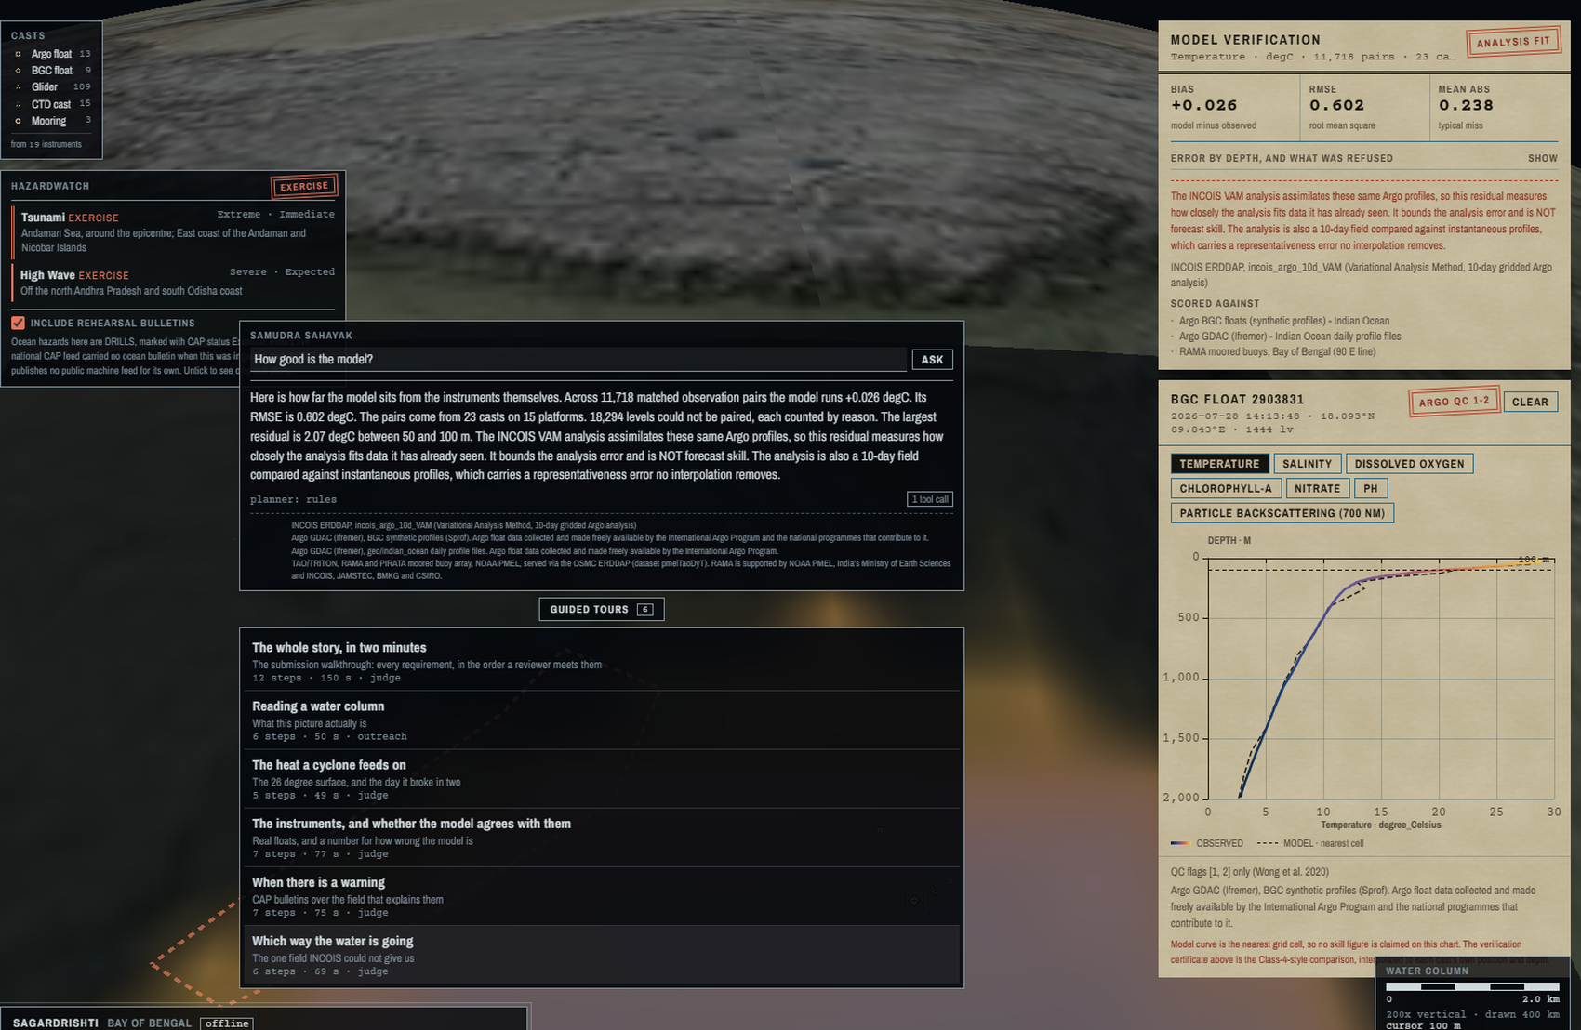
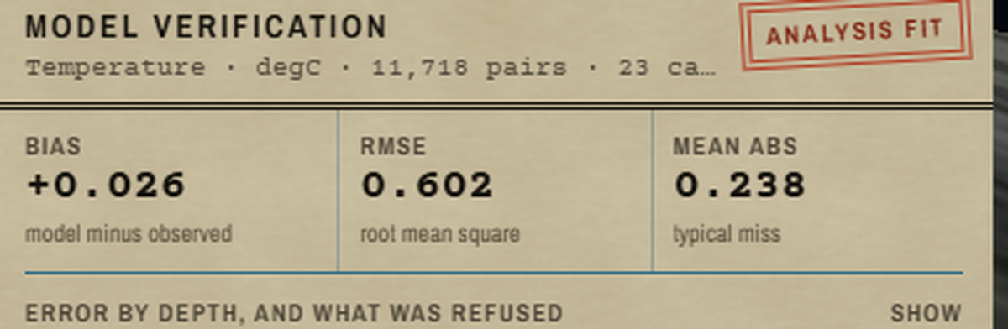
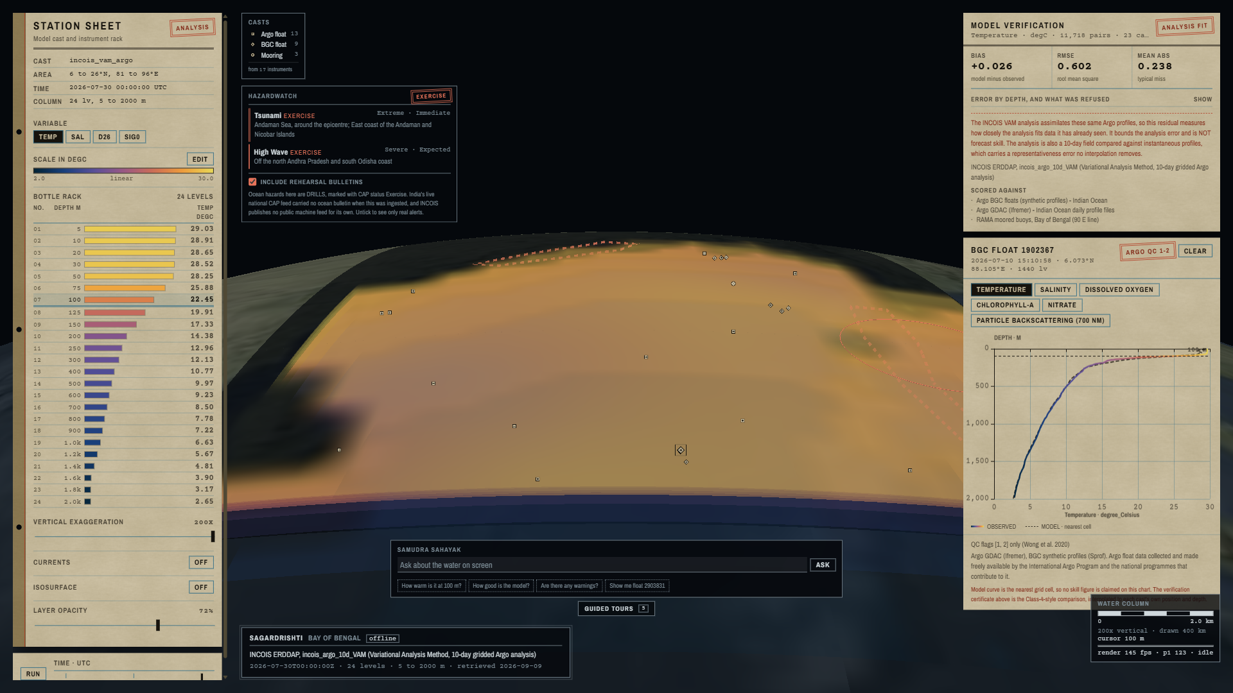
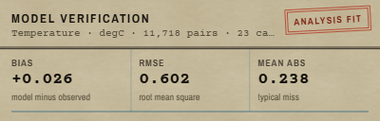
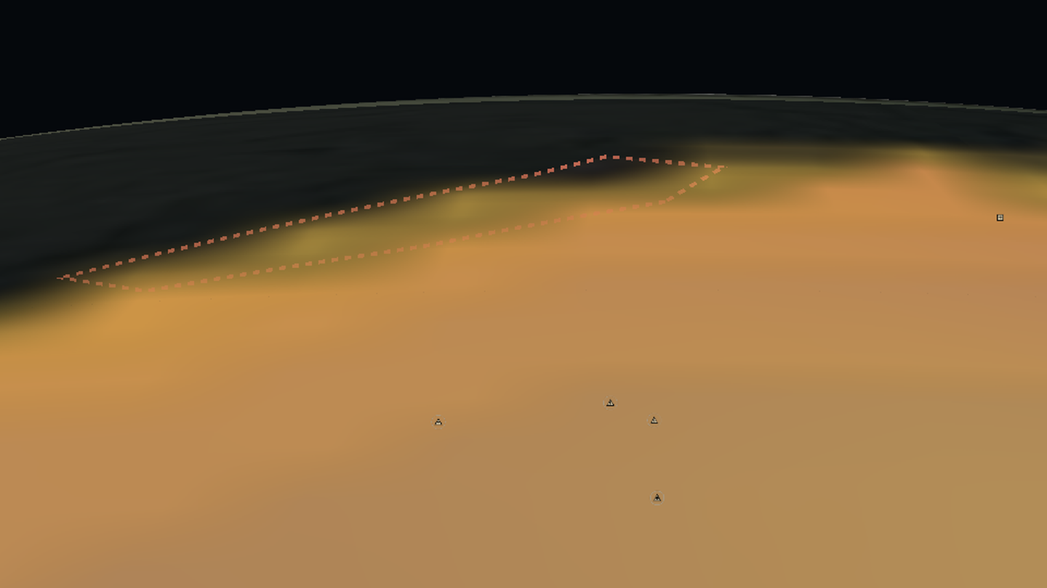
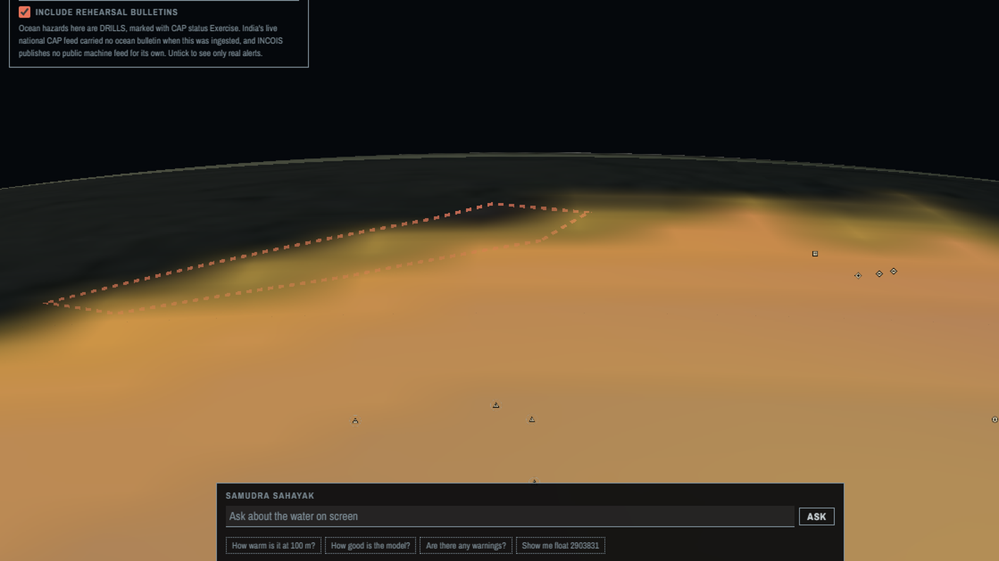
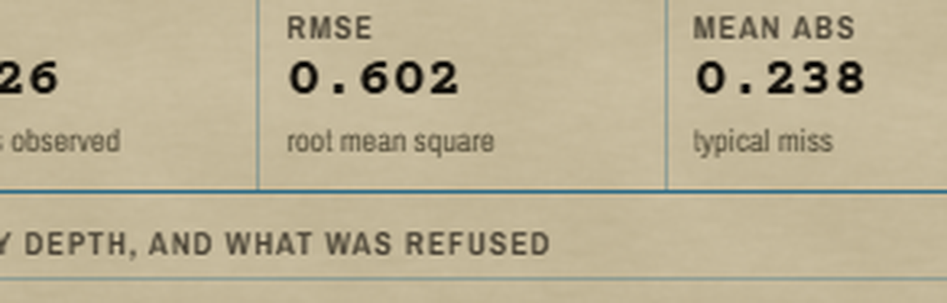
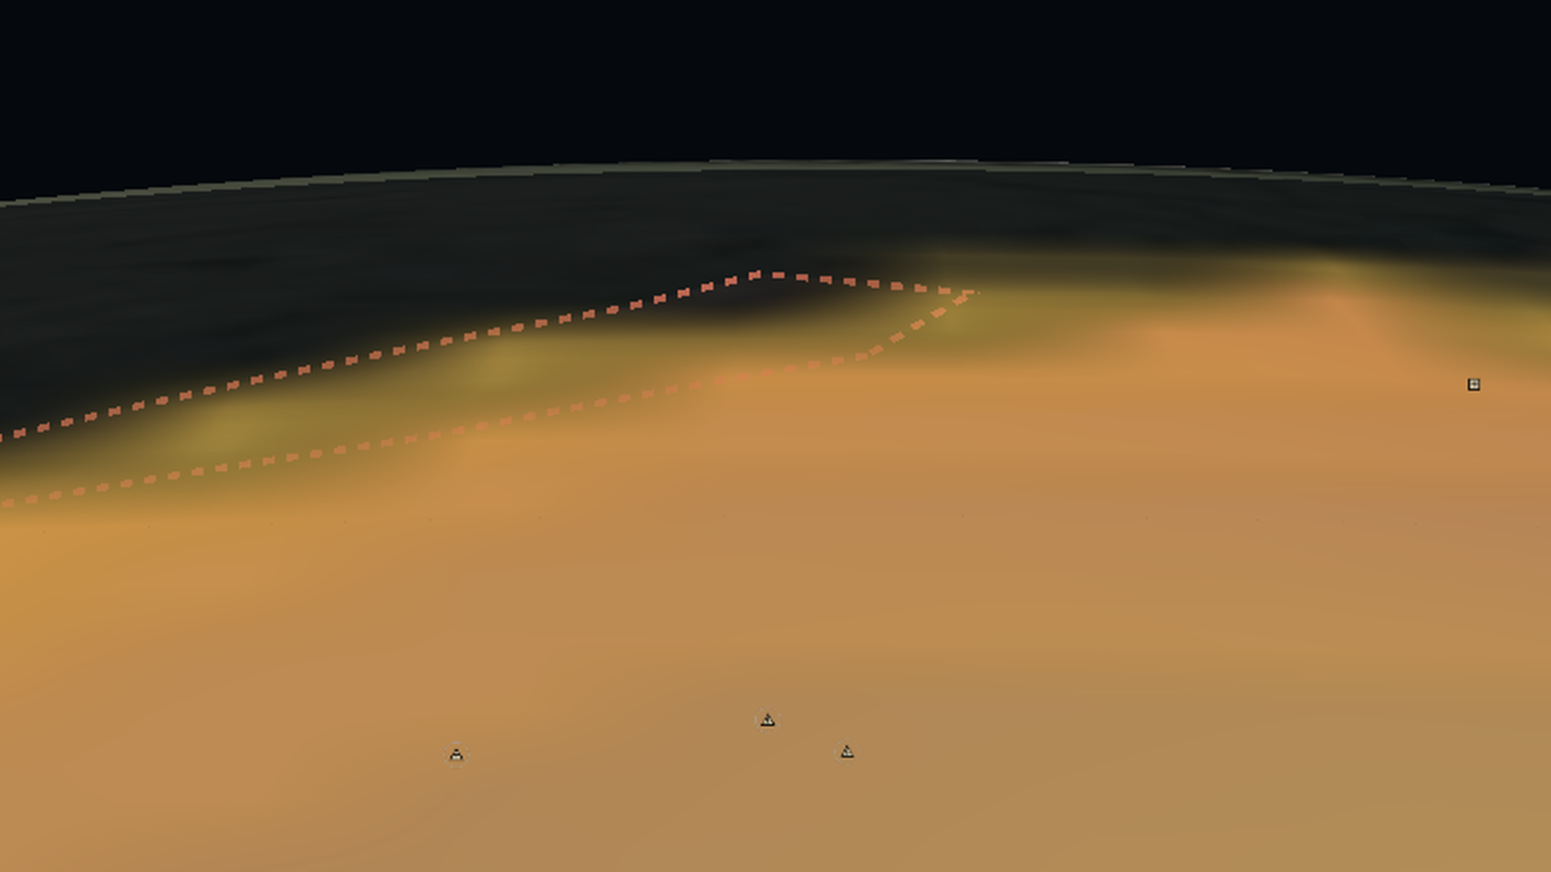
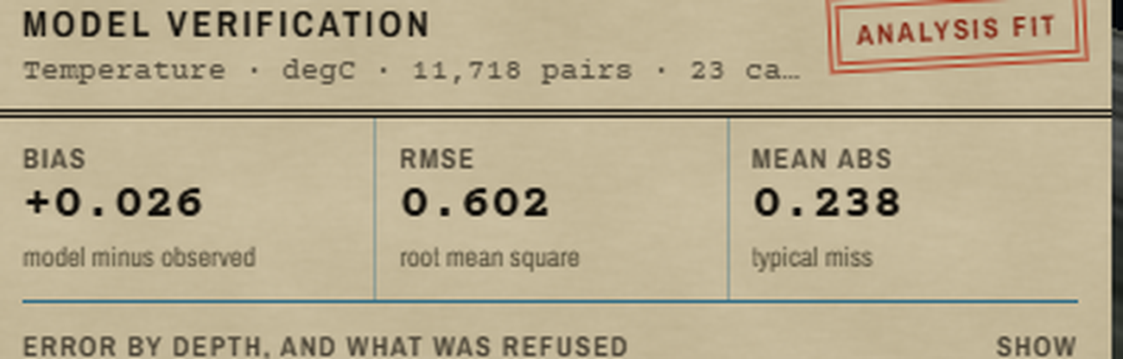
The Problem & Our Solution
PixelPaws
SagarDrishti Bay of Bengal: model fields and the instruments in the water, on one screen, with a number for the gap between them.
THE PROBLEM · INCOIS'S OWN WORDS
▪ “No integrated, web-based 3D visualization platform currently exists” so forecasters toggle between disparate software packages, which impedes hazard assessment, search and rescue, fishery advisories and climate monitoring.
PROPOSED SOLUTION · HOW IT ADDRESSES THE PROBLEM
Volumetric column in a browser. 24 levels, 5 m to 2000 m.
All four instrument classes. 149 casts: temperature, salinity, oxygen, chlorophyll.
A skill number beside the field. Bias and RMSE per depth band.
Hazards drawn over the water. Live CAP v1.2 from NDMA SACHET.
A new source is config, not code. YAML plus a plugin. OGC WMS/WCS served.
WHERE THIS SITS
Nobody occupies the full cell.
DESKTOP
IN A BROWSER
pyParaOcean · IDV
SagarDrishti
11,718 matched pairs
VOLUMETRIC
13,622 levels refused
ODV · Ferret / LAS
MyOcean · Argovis
0.602 degC RMSE
2D ONLY
volumetric rendering depth-slice navigation isosurface extraction time-step animation Argo profiling float glider CTD BGC biogeochemical moored buoy in-situ instrument profile depth-vs-variable chart geospatially accurate markers co-visualization single interactive environment

Slide 3
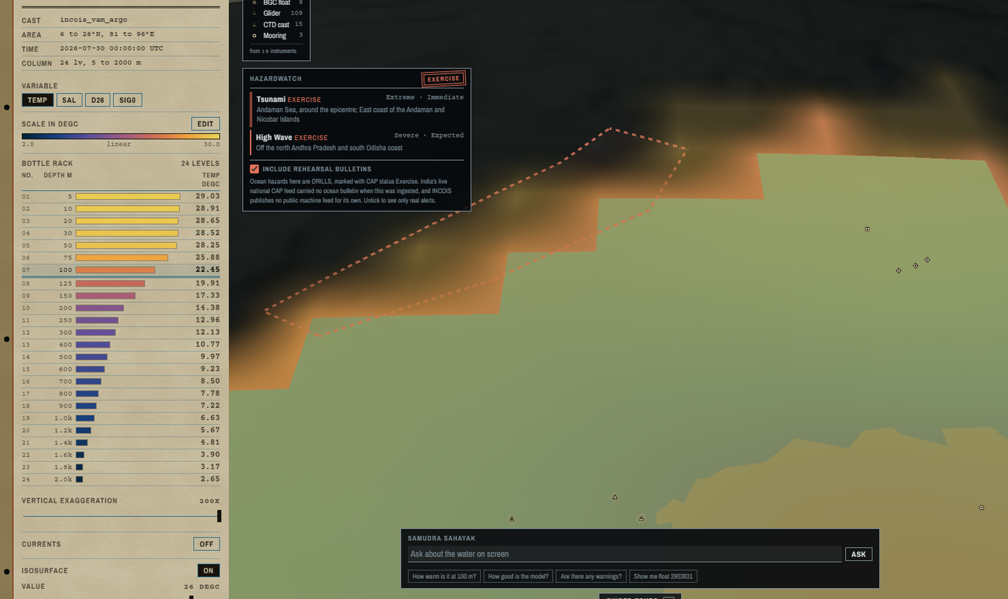
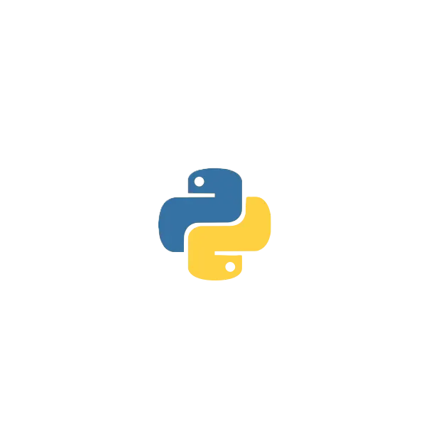





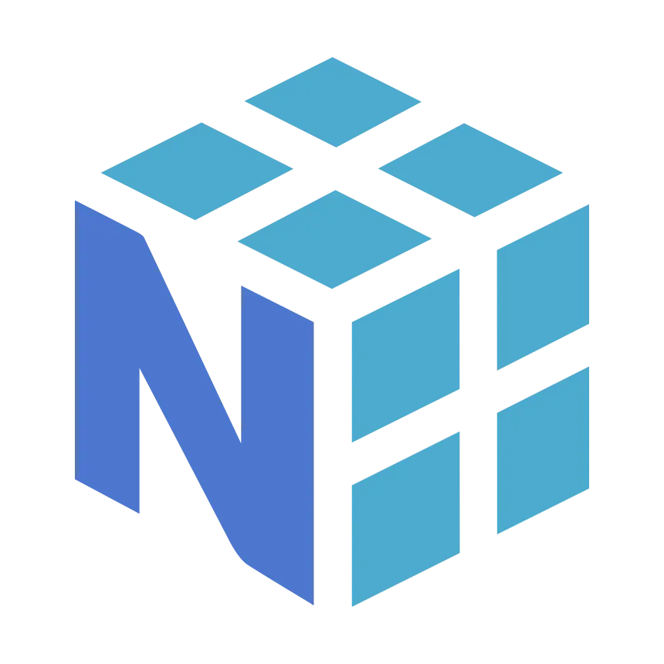
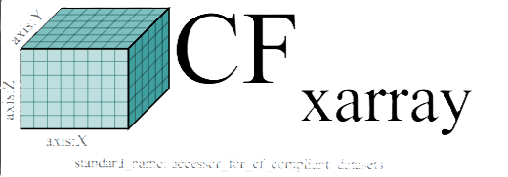
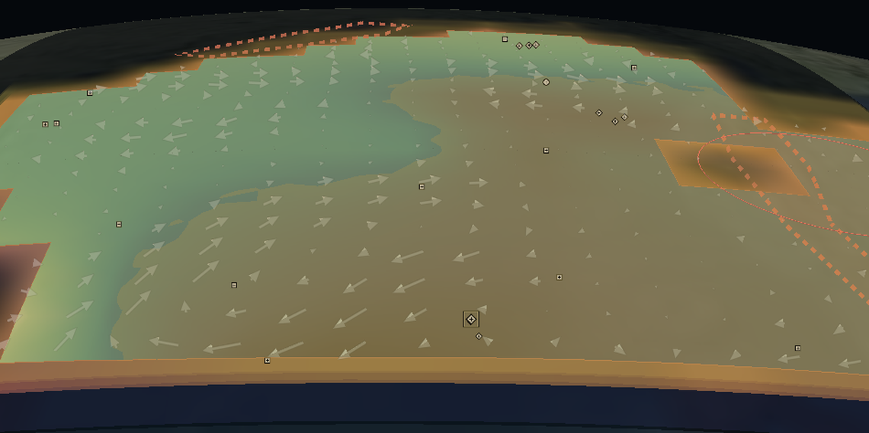
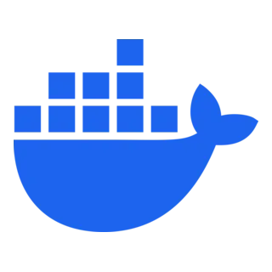


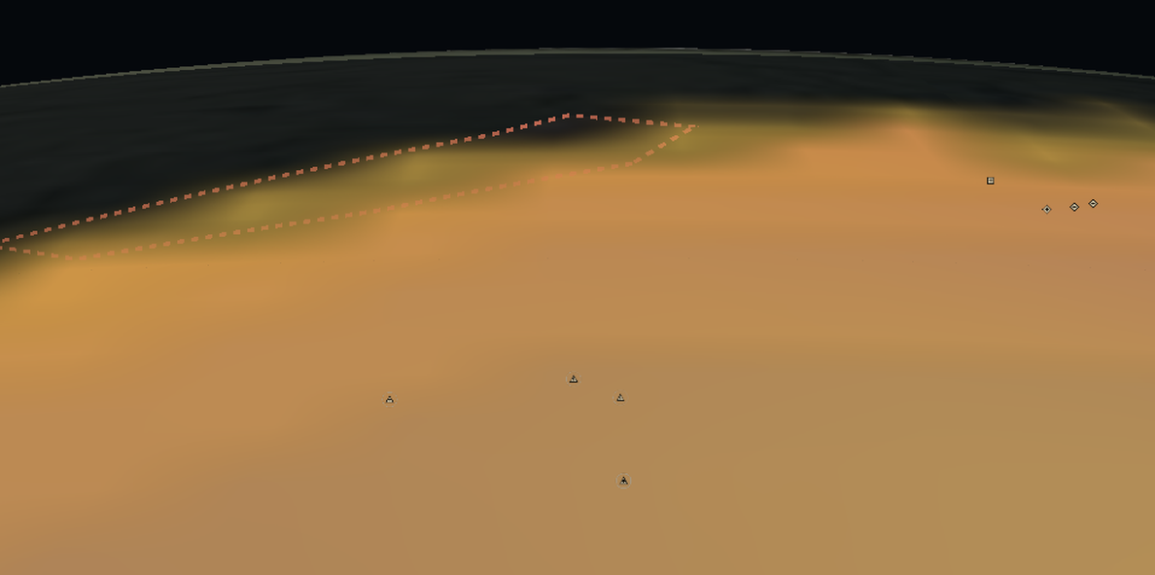
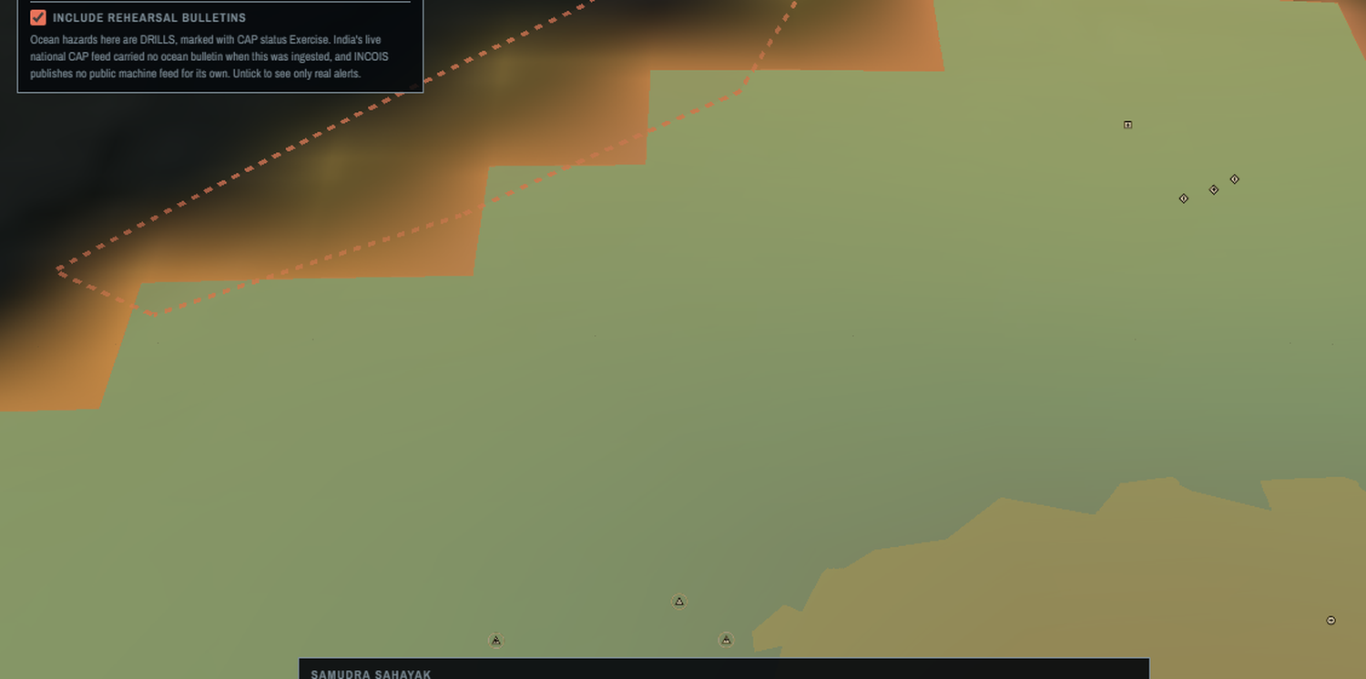
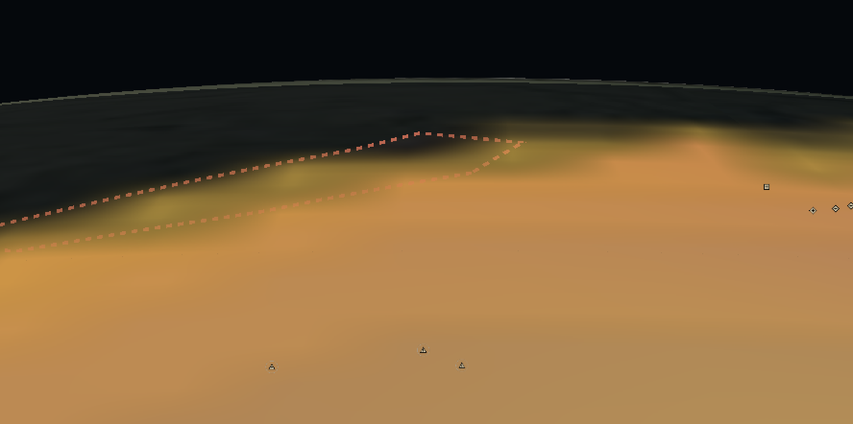
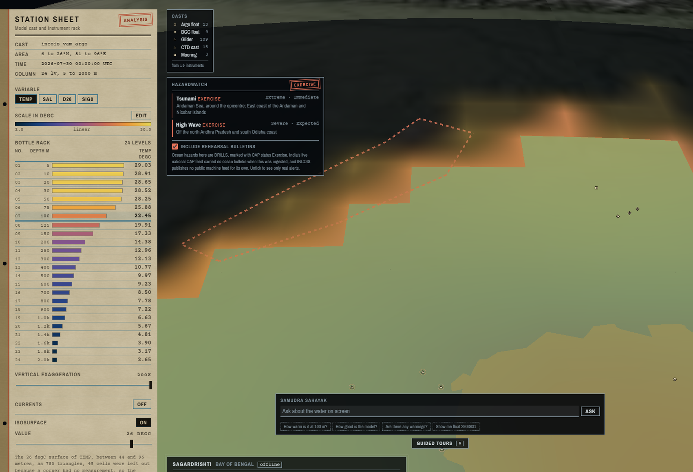
TECHNICAL APPROACH
PixelPaws
NetCDF · ASCII · CAP XML → source registry (YAML) → chunked Zarr cube → FastAPI + OGC WMS / WCS → WebGL 3D scene in the browser
1 SOURCES
INCOIS ERDDAP · LAS
Argo GDAC · Argo BGC
glider · CTD · RAMA
Copernicus GLORYS
NDMA SACHET (CAP)
2 INGEST
CF normalisation
QC flags 1 and 2
plugins: HF-radar, ADCP ready
rechunk to Zarr
10.5 M values
3 DATA PLANE
FastAPI · 13 routes
/field /profiles
/isosurface /currents
/scorecard /warnings
OGC WMS · WCS · interoperable
4 BROWSER
CesiumJS · WebGL2
depth slices, 24 levels
isosurface · current vectors
colorbar · variable
time-step animation
SAMUDRA SAHAYAK · detachable service
calls the same public API. Cut this line and every P0 still passes.
Working prototype: the 26 degC isosurface, marching cubes, offline.
5
VERIFICATION · Class-4 method
7
ANY OGC CLIENT
Interpolated to each cast's own position and depth. A level is refused, never filled.
Published as WMS 1.3.0 and WCS 1.0.0: a scalable, interoperable path into the tools INCOIS already runs.
TECHNOLOGIES USED
gsw (TEOS-10)
Playwright
Nextjs
Typescript
CesiumJS
ECharts
Python 3.11
FastAPI
xarray · Zarr
NumPy · SciPy
Docker
pytest
scikit-image
Parquet
Standards: CF Conventions · OGC WMS 1.3.0 · OGC WCS 1.0.0 · OASIS CAP v1.2 · TEOS-10 · Argo QC (Wong 2020) · Class 4 (Ryan 2015)
NetCDF ASCII delimited text xarray Zarr chunked store CF Conventions FastAPI REST API OGC WMS 1.3.0 WCS 1.0.0 CesiumJS WebGL2 Next.js TypeScript Python 3.11 Docker plugin architecture modular extensible source registry HF-radar ADCP additional sensors minimal code change

Slide 4
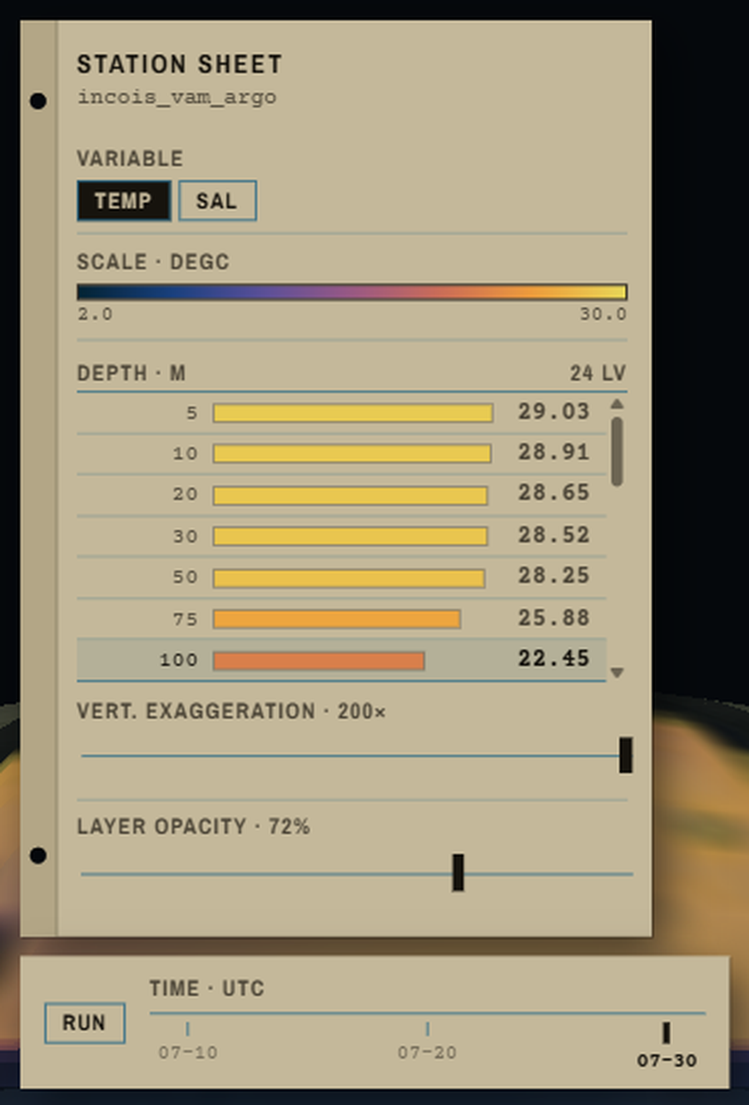
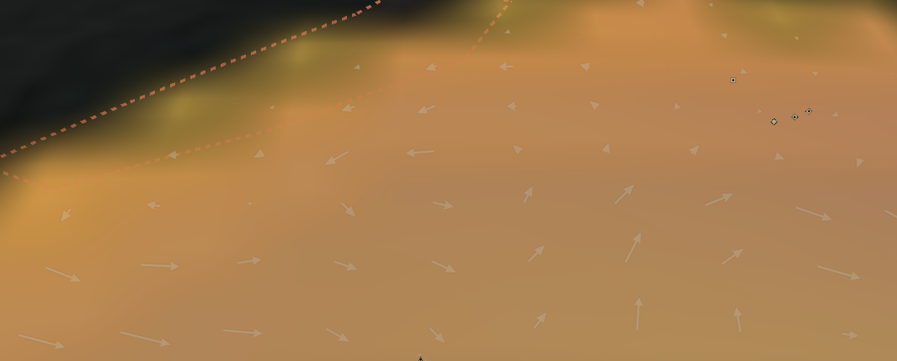
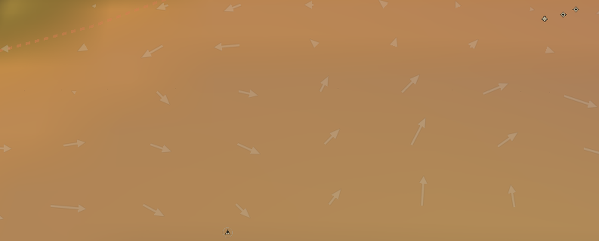
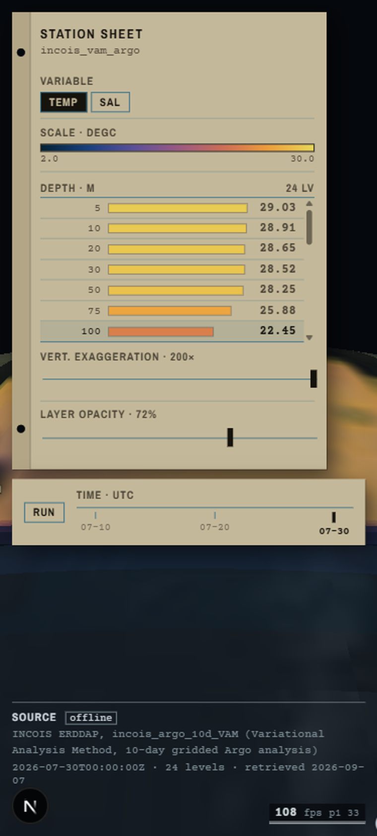
FEASIBILITY AND VIABILITY
PixelPaws
FEASIBILITY IS NOT A FORECAST HERE. THE SYSTEM ALREADY RUNS. EVERY FIGURE BELOW WAS MEASURED, NOT ESTIMATED
60-SEC DEMO
567
automated tests, 11 in a browser
51 fps
at 1080p on integrated graphics
0
requests leave the machine
10.5 M
gridded values, two agencies
30,012
QC-passed levels, 19 instruments
13
ocean parameters, 2 by plugins
ANALYSIS OF FEASIBILITY
POTENTIAL CHALLENGES AND RISKS
STRATEGIES TO OVERCOME THEM
▪ Proven stack. CesiumJS, FastAPI, Zarr.
▪ Frame budget cleared. 51 fps on the weakest GPU.
DATA
DATA
▪ Instrument coverage is uneven. Not on INCOIS ERDDAP.
▪ Datasets disagree on axes. GLORYS stops at 1942 m.
▪ Parsers already written. A file, not new code.
▪ Never stretch one grid onto another. The served depth is printed.
▪ Reads INCOIS's own ERDDAP. No duplication.
▪ Zero licence cost. One GPU server, open source.
THE SAME BUILD, ON A PHONE
TECHNICAL
TECHNICAL
1
variable selector
▪ Volumetric rendering is costly. Translucent overdraw dominates.
▪ Scaling to the full basin. The national grid is larger.
▪ Depth-space level of detail. At most 10 of 24 slices at once.
▪ Chunked Zarr over range requests. Cost is view-dependent.
2
colorbar, min / max, log
3
24 levels, 5 m to 2000 m
4
vertical exaggeration
ADOPTION AND TRUST
ADOPTION AND TRUST
5
layer opacity
▪ A wrong number beats no number. Its caveat must travel.
▪ A false alarm is unacceptable. Drills are dashed.
▪ The caveat travels with the number. On screen and in the API.
▪ Four independent drill guards. Exercise is refused.
6
time-step animation
Every control PS requirement F4 names. No install.
VIABILITY · WHY THIS SURVIVES AFTER THE HACKATHON
Native deployment path
INCOIS's own request. No data migrates.
Standards, not a silo
WMS 1.3.0 and WCS 1.0.0: their tools read it.
Maintainable by the owner
Standard Python and JavaScript.
Costs nothing to keep
Zero licences, one GPU server.
feasibility scalable architecture browser-native no client-side dependencies deployable on INCOIS infrastructure offline air-gapped commodity GPU server zero licence cost open source colorbar editor variable selector layer opacity vertical exaggeration slider customizable colorbar

Slide 5
IMPACT AND BENEFITS
PixelPaws
POTENTIAL IMPACT ON THE TARGET AUDIENCE
DISASTER MANAGERS
A tsunami or high-wave CAP bulletin becomes a shape on the water.
OPERATIONAL FORECASTERS
“Can I trust today's field?” answered per depth band.
SEARCH AND RESCUE
Depth-resolved currents, which is what a drifting object follows.
FISHERY ADVISORIES
Subsurface temperature behind advisories reaching ~9 lakh households.
RESEARCH, EDUCATION, OUTREACH
Guided tours narrate the ocean for schools and exhibitions.
BENEFITS · SOCIAL, ECONOMIC, ENVIRONMENTAL
NATIONAL ALIGNMENT
Rs 0
licence cost, against
proprietary 3D suites
9 lakh
fisherfolk households
reached by PFZ advisories
0.602
degC RMSE, with the
analysis-fit caveat attached
Digital India
Deep Ocean Mission
Blue Economy
SAGAR / MoES mandate
UN SDG 14: Life Below Water
Deployable on INCOIS infrastructure
The PS is an internal INCOIS tooling request, so the deployment story is native rather than argued.
WHAT CHANGES ON THE DAY IT MATTERS · A DEPRESSION FORMS IN THE BAY
1 SEE THE HEAT
Switch to the depth of the 26 degC isotherm, the layer a cyclone feeds on.
2 CHECK THE MODEL
The card says the field is 2.07 degC off across 50 to 100 m.
3 CONFIRM AGAINST THE WATER
Click the nearest Argo float. Its measured profile against the model.
4 PUT THE WARNING IN CONTEXT
The CAP bulletin is drawn over the water it concerns. Network off.
operational oceanographers forecasters hazard assessment search-and-rescue fishery advisories climate monitoring tsunami storm surge high wave early warning CAP Common Alerting Protocol NDMA SACHET public outreach science communication e-learning exhibitions students policymakers

Slide 6
RESEARCH AND REFERENCES
PixelPaws
WHERE WE SIT · GAP ANALYSIS
DETAILS AND LINKS OF THE REFERENCE AND RESEARCH WORK
Capability | Desktop tools | Web viewers | Digital Ocean | Sagar Drishti
Browser-native, no install | ✘ | ✔ | ✔ | ✔
True volumetric water column | ✔ | ✘ | ~ | ✔
Model + in-situ in ONE 3D scene | ✘ | ✘ | ~ | ✔
Model-vs-observation skill on screen | ✘ | ✘ | ✘ | ✔
CAP hazard layer in ocean context | ✘ | ✘ | ✘ | ✔
Runs fully offline / air-gapped | ✔ | ✘ | ✘ | ✔
METHOD AND VERIFICATION
▪ Ryan et al. 2015: GODAE OceanView Class 4 verification, J. Op. Oceanogr. 8 · the method behind our scorecard
▪ Wong et al. 2020: Argo data and its QC flags, Front. Mar. Sci. 7:700 · why we keep only flags 1 and 2
▪ IOC, SCOR, IAPSO: TEOS-10 thermodynamic equation of seawater · our density field
▪ Balakrishnan Nair et al. 2013: INCOIS Ocean State Forecast validation, Current Science 105(2) · the Indian validation precedent
WEB 3D OCEAN VISUALISATION
▪ Qin et al. 2021: Web 3D framework for time-varying ocean forecast data, Env. Modelling & Software 135 · the closest ancestor
▪ Yu, Qin & Xu 2025: WebGPU volume rendering of ocean scalars, Applied Sciences 15(5):2782 · our rendering optimisations
▪ Tucker et al. 2020: Argovis, J. Atmos. Ocean. Tech. 37(3):401 · the API contract we follow
▪ Blower et al. 2013: ncWMS, Env. Modelling & Software 47 · OGC WMS over CF-NetCDF
▪ Signell & Pothina 2019: Cloud coastal model analysis, JMSE 7(4):110 · why Zarr rather than whole NetCDF files
▪ pyParaOcean (IISc): desktop ocean volumetrics we bring to the browser
DATA SOURCES WE INGEST
Desktop tools: ODV, IDV, pyParaOcean. Web viewers: Argovis, MyOcean. INCOIS's Digital Ocean portal advertises 3D and 4D; what it does not do is fuse instruments into the volume or publish model skill beside the field.
▪ INCOIS ERDDAP: the analysis field, 24 levels, 5 to 2000 m
▪ Argo GDAC (Ifremer): Indian Ocean profile files
▪ Copernicus Marine: GLOBAL_ANALYSISFORECAST_PHY_001_024 currents
▪ NOAA PMEL: RAMA moored buoy array, Indian Ocean
▪ NDMA SACHET: India's national CAP alert backbone
OUR OWN WORK, AND HOW TO CHECK IT
▪ INCOIS: Indian National Centre for Ocean Information Services
OPEN STANDARDS IMPLEMENTED
567 automated tests, 11 in a real browser
▪ CF Conventions for climate and forecast metadata
▪ OGC Web Map Service (WMS) 1.3.0
6 dp TEOS-10 check values reproduced exactly
▪ OGC Web Coverage Service (WCS) 1.0.0
▪ OASIS Common Alerting Protocol (CAP) v1.2
100% of panels cite dataset and timestamp
HOW THE RESEARCH CHANGED THE BUILD · not a bibliography, a set of decisions
15 + 8 papers and existing tools reviewed for the gap analysis
Ryan 2015 → verify in observation space
Wong 2020 → QC flags 1 and 2 only
Yu 2025 → drop a slice that cannot change the picture
Signell 2019 → Zarr chunks over HTTP range reads
GODAE OceanView Class 4 verification Ryan 2015 Wong 2020 Argo quality control TEOS-10 equation of seawater Qin 2021 Yu 2025 Argovis pyParaOcean Signell 2019 CF Conventions OASIS CAP v1.2 interoperability national international ocean data portals

