Slide 1

A . R . E . S
Autonomous Region Explorer and Surveyor
Guided by:
Mr. Arun P.S.
Dept. of ECE
Assistant Professor
Presented by:
Krishnendu S.B. (37)
Monunith A. (41)
Nikita Snell (42)
Sivaprasad M. (52)
S7 EC-2

Slide 2
Overview
Introduction
Working
Applications
Future Expansion
Reference

Slide 3
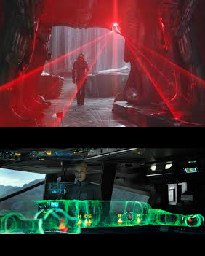
What Is This Exactly?
This product is a drone that maps an environment around it and the data obtained is processed into a 3-D map.
The prototype sends out laser covering the entire space and gives the data to a processing algorithm.
After processing the data, it is send to another s/m to map a skeletal structure of the area.
Thus the area will be mapped without the help of an individual.

Slide 4
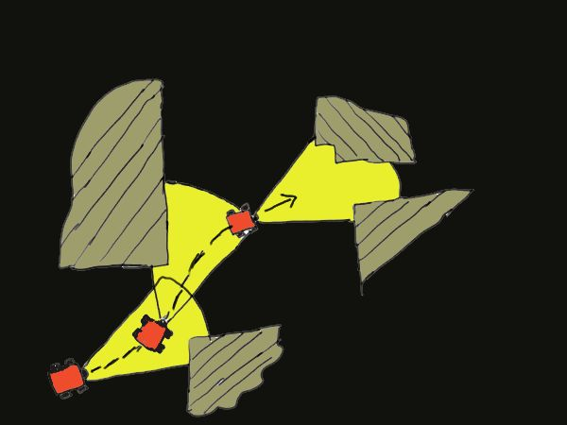
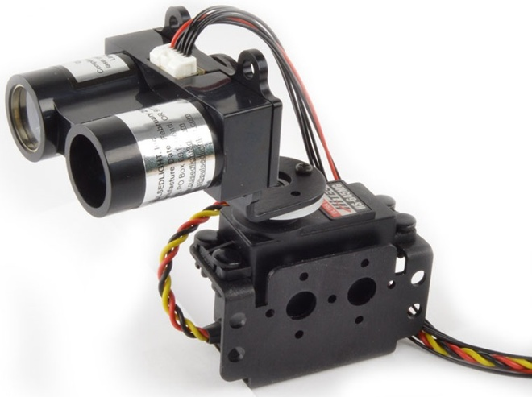
How Does This Work?
SLAM algorithm: Simultaneous Localization And Mapping. This algorithm is applied to obtain the raw data of the map, which is send to a processing software to decipher and render it in 3-D.
LiDAR : Light Detection And Ranging. It is a distance measuring device which gives a 360 degree distance measurement. It works by using a LASER which is pointed to the measuring distance.
Using the above 2 equipments, a raw data is obtained, which is then processed into a 3D map.

Slide 5
Block Diagram
Quadcopter
Remote Control
LiDAR
Arduino
Arduino
PC
Transmitter
Receiver
ROS
(SLAM Algorithm)

Slide 6
Flow Chart
Input : data from the sensor reading, contain landmark and extraction of environment geographical map is captured.
Mapping : Obtain the extracted part or sector of the environment map geographical information (Current map location).
Localization : Determine and estimates the position in the environment, obstacles (landmark) and navigation planning.
Output : Moves and navigates through the environment based on the results obtains in mapping and localization process.

Slide 7
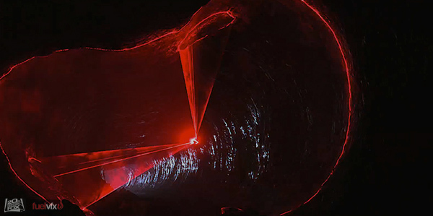
Why Do You Need It?
Surveying: Since it is autonomous, the drone can be customized to move to the target location and retrieve the required measurements. These measured data can be transferred to a compatible processing software to get the desired dimensions and area.
Cave Exploration: A.R.E.S can be sent into unexplored caves or mines to map out a skeletal structure of the tunnel or the path and produce a 3D map of the cave

Slide 8
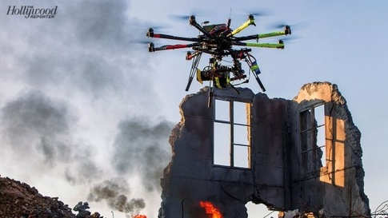
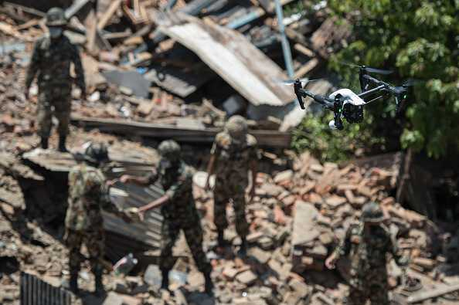
What Else With It?
What if you are a rescue operator and there are civilians trapped in a building, but you're not aware of the dangers that lurk inside the room. As a result there will be a huge confusion regarding the precautionary methods one has to follow.
This is where, our project comes into picture. The drone is autonomous and therefore it can go to the target environment and map the area for possible presence of trapped civilians as well as, all the environmental parameters. This allows the rescue operators to pinpoint the location and take proper precautionary steps before jumping into the scene.

Slide 9
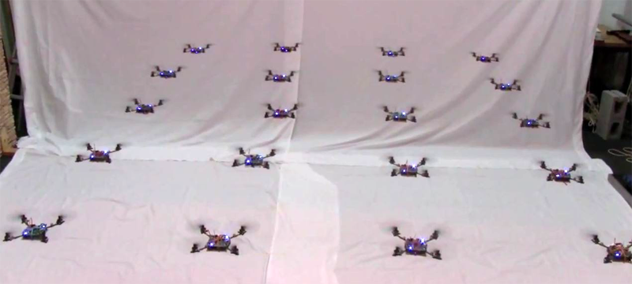
What More...?
A swarm of drones can be created to work together which can communicate with each other can efficiently map a structure. Since the individual drones can be implemented as standalone and as swarm, the product can be customized to be used in different ways.

Slide 10
Work Plan

Slide 11
Reference
[1] D. Bender, F. Rouatbi, M. Schikora, D. Cremersy and W. Koch, "Scaling the world of monocular SLAM with INS-measurements for UAS navigation," 2016 19th International Conference on Information Fusion (FUSION), Heidelberg, 2016, pp. 1493-1500.
[2] G. Deng, J. Li, W. Li and H. Wang, "SLAM: Depth image information for mapping and inertial navigation system for localization," 2016 Asia-Pacific Conference on Intelligent Robot Systems (ACIRS), Tokyo, 2016, pp. 187-191.
[3] H. Durrant-Whyte and T. Bailey, "Simultaneous localization and mapping: part I," in IEEE Robotics & Automation Magazine, vol. 13, no. 2, pp. 99-110, June 2006.

Slide 12
Thank You

