Slide 1


MOOCLink: Building and Utilizing Linked Data from Massive Open Online Courses
Sebastian Kagemann
Indiana University
Srividya Bansal
Arizona State University

Slide 2


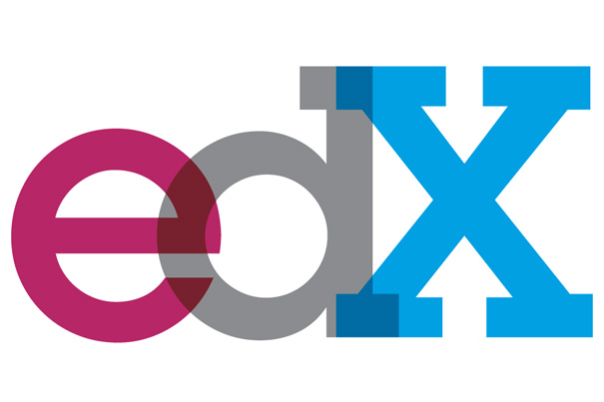
MOOCs
Notes:
Massive Open Online Courses or MOOCs are online courses accessible to anyone on the web. Hundreds of institutions have joined in an effort to make education more accessible by teaming up with MOOC providers such as Coursera, edX and Udacity, the three providers whose data we incorporate into our linked data. Delivering course content through lecture videos as well as traditional materials such as readings and problem sets, MOOCs encourage interactivity between professors and students around the world by way of discussion forums and graded assessments.
With the advent of websites providing these courses, it is difficult to discern which classes are best-suited to someone’s interests or learning goals. Basic information about courses and their curriculums available on course websites allow users to assess this to an extent, however manually comparing several courses teaching similar material can be tedious. As a result, there are a handful of existing websites such as Class Central that aggregate MOOCs from different providers and allow users to compare and rate courses. They have a weakness however in that they do not allow the user to do things such as search and compare courses on specific topics, the length of the course, and other basic data which is openly available from MOOC providers. Given the data provided by these MOOC providers (by API or openly on their webpages), we saw an opportunity to allow more specific search incorporating things such as syllabi details, course length, recommended background, and how these relate to one another as Linked Data.
The result of this is an in-development web app, MOOCLink, which creates Linked Data from online course information and utilizes that data to discover and compare online courses.

Slide 3
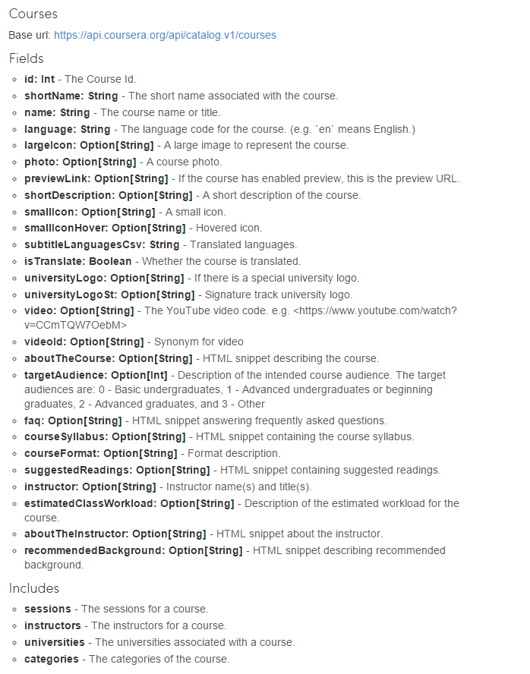
MOOC Data
Data fields from the Coursera Catalog API: https://tech.coursera.org/app-platform/catalog/
Notes:
- Mapping categories manually

Slide 4



Existing Linked Education Data Specifications
Notes:
IEEE-LOM is encoded in XML and includes nine categories with sub-elements that hold data. An
RDF binding for LOM exists [9], however development is halted at the time of this paper’s writing.
SCORM is an extensive technical standard, typically encoded in XML, that defines how educational content should be packaged, how it is delivered, and how learners navigate between different parts of an online course. An RDF binding of SCORM has yet to be developed.
In 2013, the Learning Resource Metadata Initiative (LRMI) specification was incorporated into Schema.org’s vocabulary for tagging educational content [13]. Rather than using the defunct LOM binding or creating a new binding of SCORM to RDF, we chose to extend a vocabulary meant for Linked Data, Schema.org, for which an RDF mapping exists [12], to include properties unique to open courseware.

Slide 5
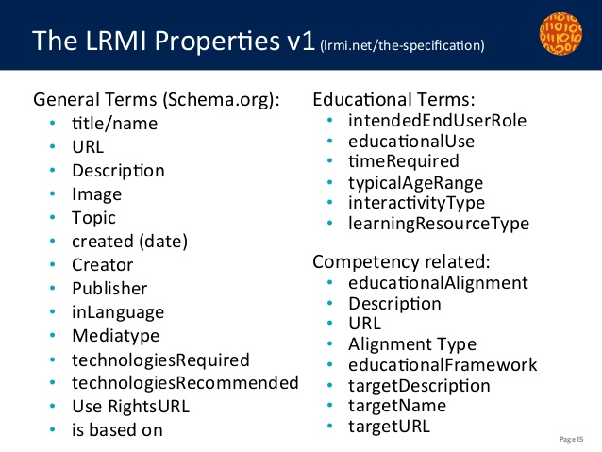
Learning Resource Metadata Initiative (LRMI)
Notes:
LRMI introduced fields for online course details including the type of learning resource, time required, and so on. While there is significant overlap between LRMI’s additions to Schema.org, Schema.org’s Creative Work properties and MOOC course details like those provided in Coursera’s API, several crucial missing data fields such as syllabus details, course difficulty, and predicates linking courses to other objects, make it necessary to extend the vocabulary for MOOC data.

Slide 6
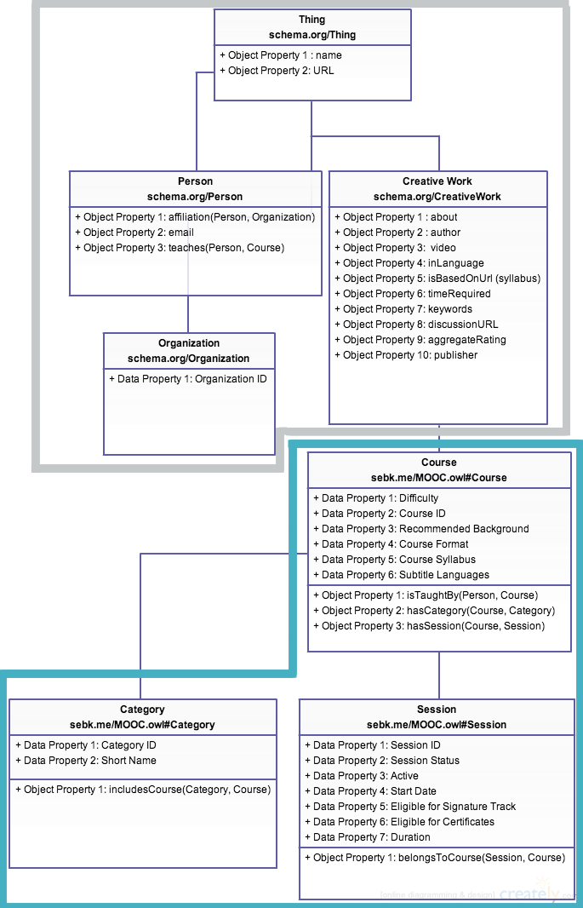
Extending Schema.org
Relevant
Schema.org
properties
Extended
MOOC
properties
Notes:
Schema.org is organized as a hierarchy of types, each associated with a set of properties. CreativeWork is Schema.org’s type for generic creative work including books, movies, and now educational resources. The LRMI specification adds properties to CreativeWork including the time it takes to work through a learning resource (timeRequired), the typical age range of the content’s intended audience (typicalAgeRange), as well as specifying properties previously available in Schema.org’s CreativeWork type like the subject of the content (about) and the publisher of the resource (publisher
Schema.rdfs.org hosts an RDF/XML version of Schema.org’s ontology, which we imported into Stanford Protégé to extend with additional types and properties.

Slide 7
Linked Data Generation

Slide 8
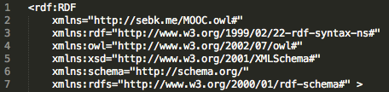
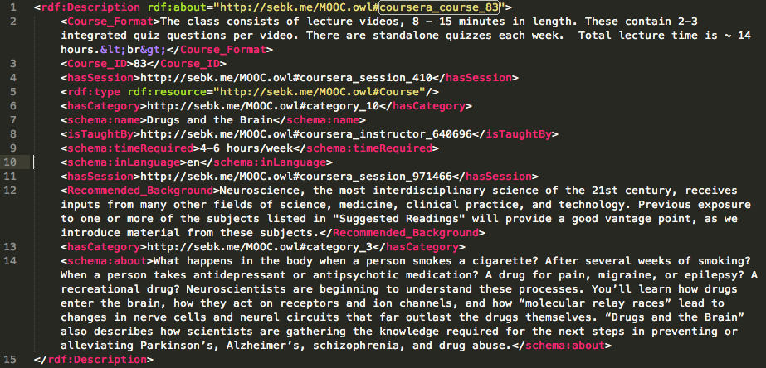
MOOC RDF/XML
Notes:
- Not all of the properties available
- Data cleansing is needed to remove tags

Slide 9
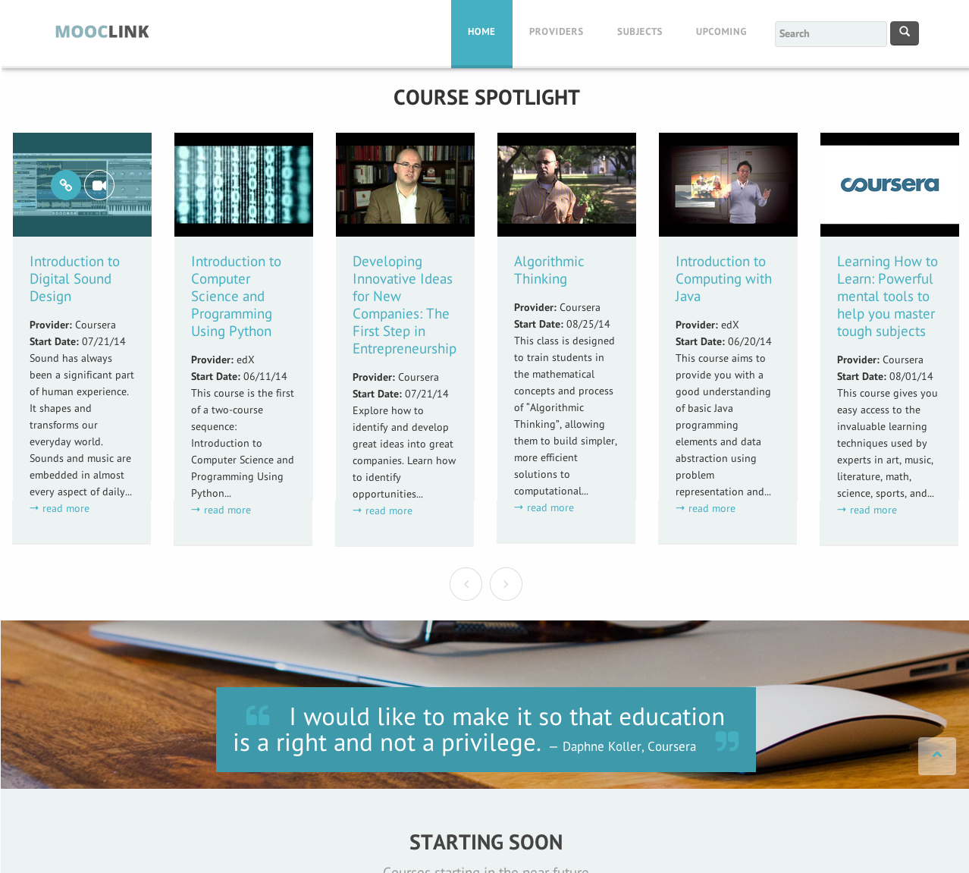
MOOCLink
Notes:
MOOCLink is a web application which aggregates online courses as Linked Data and utilizes that data to discover and compare online courseware.
Bootstrap template
Sections on home page

Slide 10
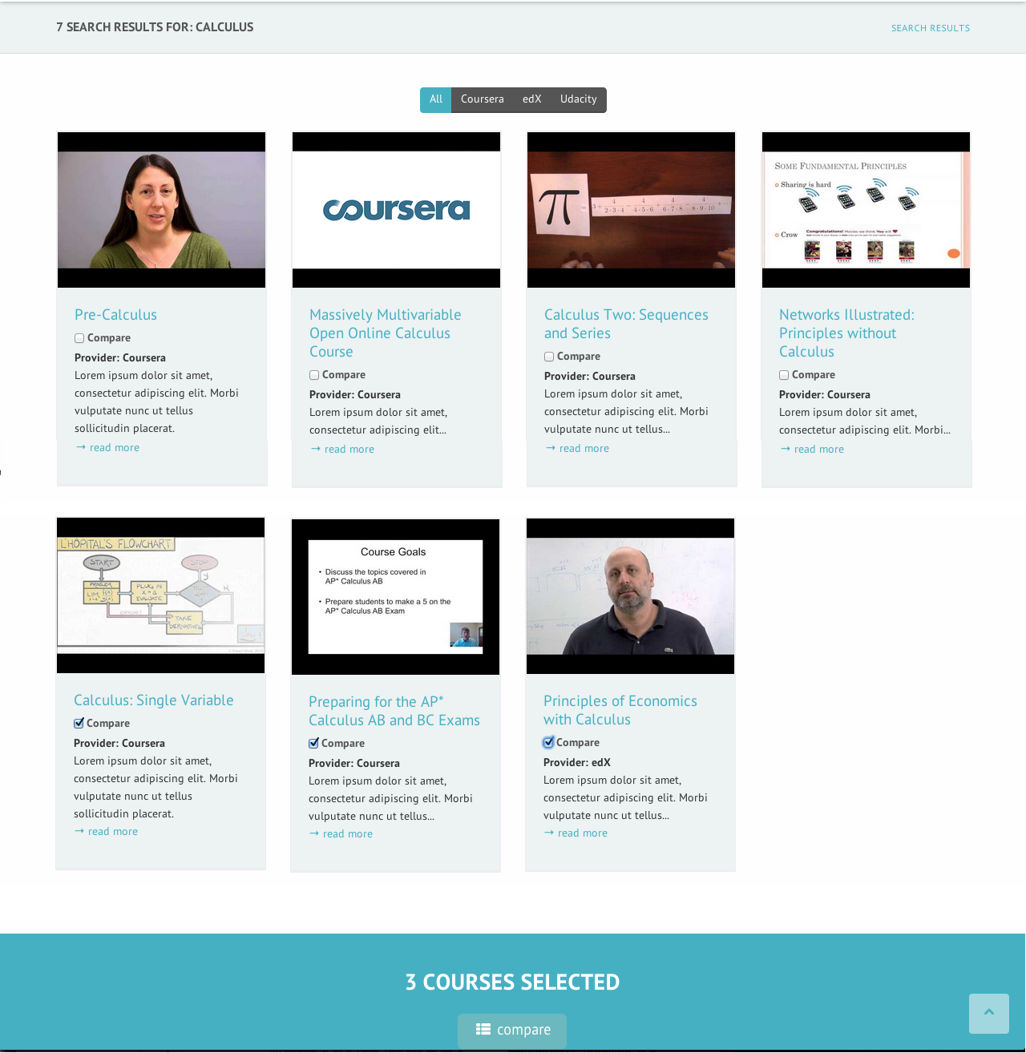
Search

Slide 11
Course Comparison

Slide 12
Course Details

Slide 13



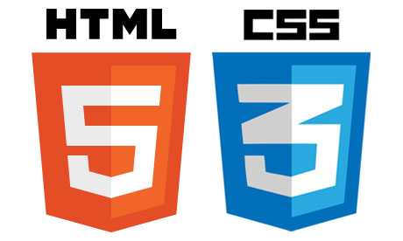
Semantic Web Stack
Notes:
A semantic web stack of Apache Tomcat as the web server and servlet container, Fuseki as the SPARQL server, TDB as the RDF store, and JavaServer Pages and Java Servlets to dynamically create webpages is proposed to achieve this.

Slide 14
Future Work
Notes:
Our future work will focus on: incorporating demographic data, reviews, developing an item pipeline for our crawlers, automating website updates, enabling user profiles, course tracks, natural language processing of syllabi and summaries for more robust data and search.

