Slide 1
PACMAN
MEHMOOD SHEIKH
(21A-001-SE)

Slide 2
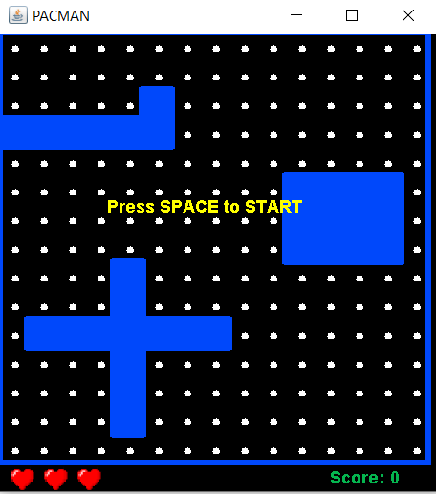
INTRODUCTION
PACMAN, the objective of the game is to eat all of the dots placed in the maze while avoiding ghosts

Slide 3
How the Pacman game works?
ALGORITHM

Slide 4
STEPS:
01
06
DESINGING
MOVE GHOST
02
07
LEVEL
DRAWN PACMAN
03
08
CHECK-MAZE
MAIN
04
09
CHANGING LEVEL
INITIALIZE
05
DEATH

Slide 5
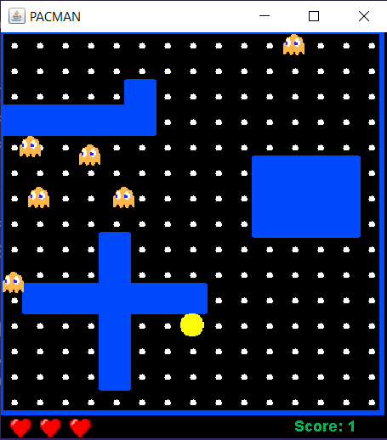
ALGORITHM:
STEP 1:[DESINGING] Create model class to design interface.
STEP 2:[LEVEL] Set leveldata[] = []
[0 = blue block, 16 = white dots ,2 = top border , 4 = right border, 8 = bottom borders, 1 = left borders]
STEP 3: [CHECK-MAZE]
TILL (i < N_BLOCKS * N_BLOCKS && finished):
if ((screenData[i]) != 0)then :
Set finished = false
i++
[LOOP ENDS]
[N_BLOCKS = no. of boxes (225)]
STEP 4:[CHANGING LEVEL]
if (N_GHOSTS < MAX_GHOSTS) then:

Slide 6
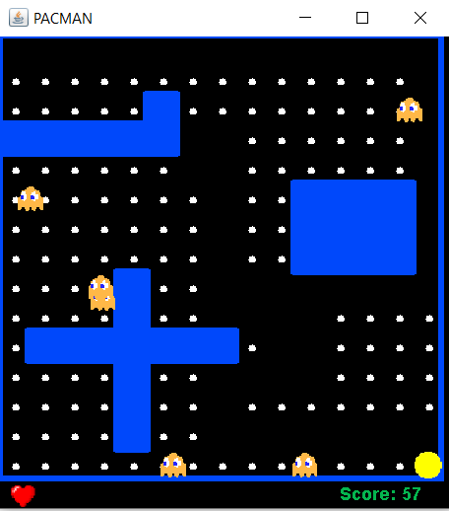
Set N_GHOSTS++
[END OF IF STRUCTURE]
if (currentSpeed < maxSpeed)then:
Set currentSpeed++
[END OF IF STRUCTURE]
STEP 5:[DEATH]
if (lives == 0) then:
Set inGame = false
[END OF IF STRUCTURE]
STEP 6 : [MOVE GHOST]
if (pacman_x > (ghost_x[i] - 12) && pacman_x < (ghost_x[i] + 12)
&& pacman_y > (ghost_y[i] - 12) && pacman_y < (ghost_y[i] + 12)
&& inGame) then:
Set dying = true;
[END OF IF STRUCTURE]

Slide 7
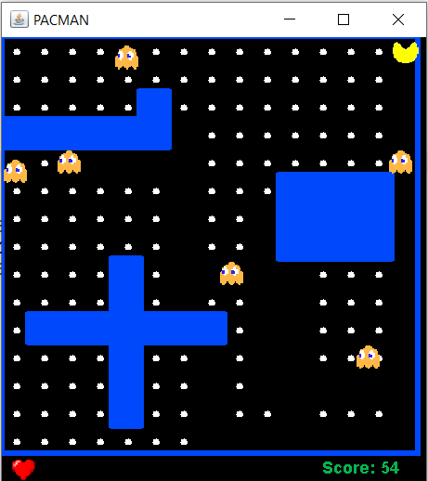
STEP 7 : [DRAWN PACMAN]
if (req_dx == -1) then:
Set g2d.drawImage(left, pacman_x + 1, pacman_y + 1, this);
else if (req_dx == 1) then:
Set g2d.drawImage(right, pacman_x + 1, pacman_y + 1, this);
else if (req_dy == -1) then:
Set g2d.drawImage(up, pacman_x + 1, pacman_y + 1, this);
else then:
Set g2d.drawImage(down, pacman_x + 1, pacman_y + 1, this);
[END OF IF STRUCTURE]
STEP 8 : [MAIN]
Main class is created to initiate Pacman game.
STEP 9 : [INITIALIZE]
Pacman pac = new Pacman;

Slide 8
THANKYOU!

