Slide 1
FLINT
Demonstration

Slide 2
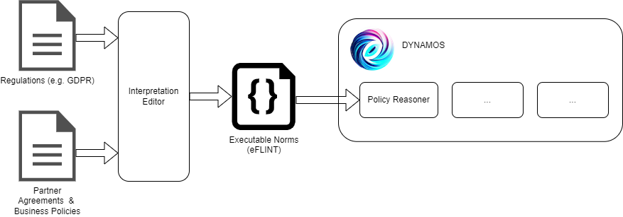
Policy Enforcement Pipeline – MooI Project

Slide 3
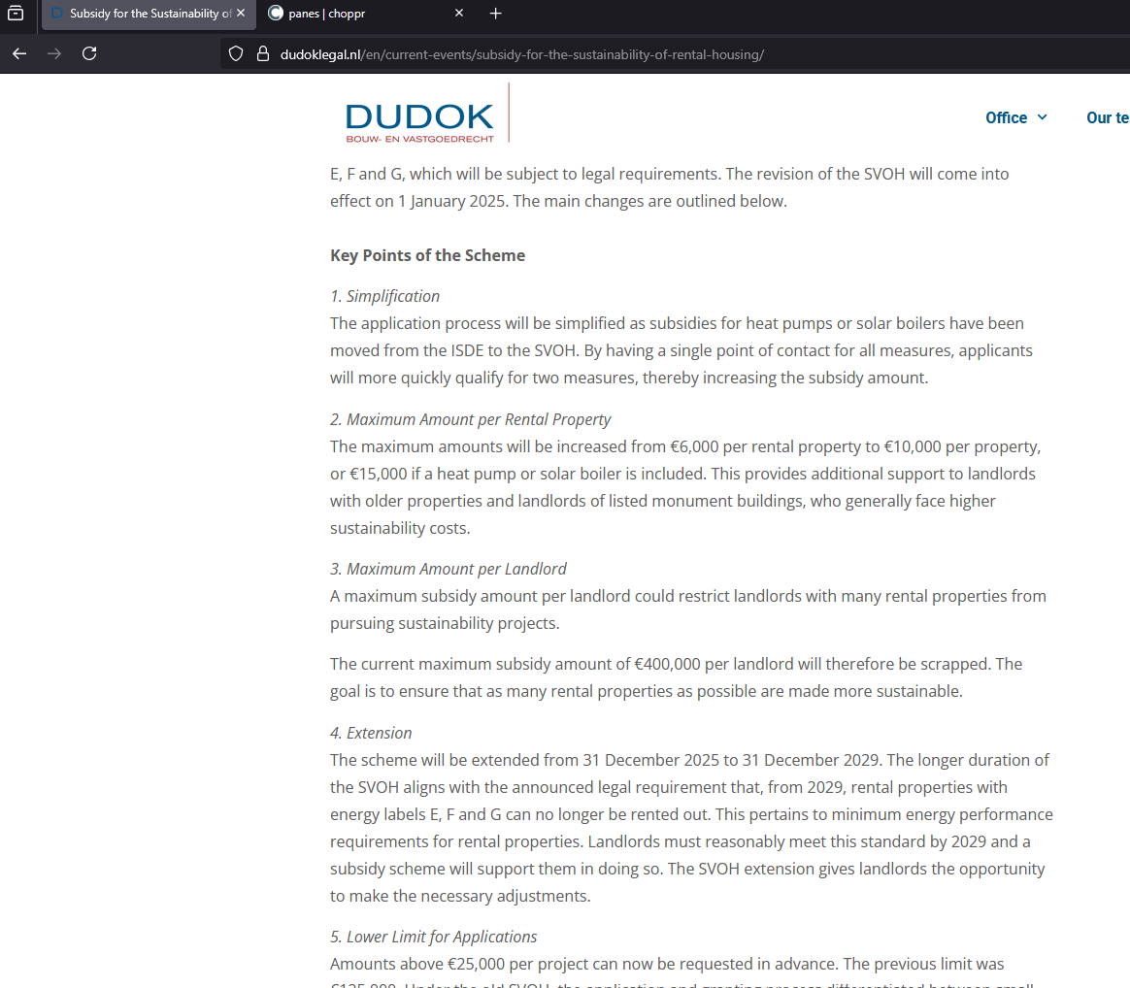
Rental house renovation - Source
5. Lower Limit for Applications
Amounts above €25,000 per project can now be requested in advance. The previous limit was €125,000. Under the old SVOH, the application and granting process differentiated between small projects (subsidy under €125,000) and large projects (subsidy of €125,000 or more). Applications under €125,000 were submitted after the activities had been carried out, while applications of €125,000 or more had to be submitted before the activities took place. The new adjustment lowers the limit to €25,000, allowing landlords to apply for subsidies before carrying out sustainability measures.
https://dudoklegal.nl/en/current-events/subsidy-for-the-sustainability-of-rental-housing/

Slide 4
Natural Language text preparation
https://choppr.app/

Slide 5
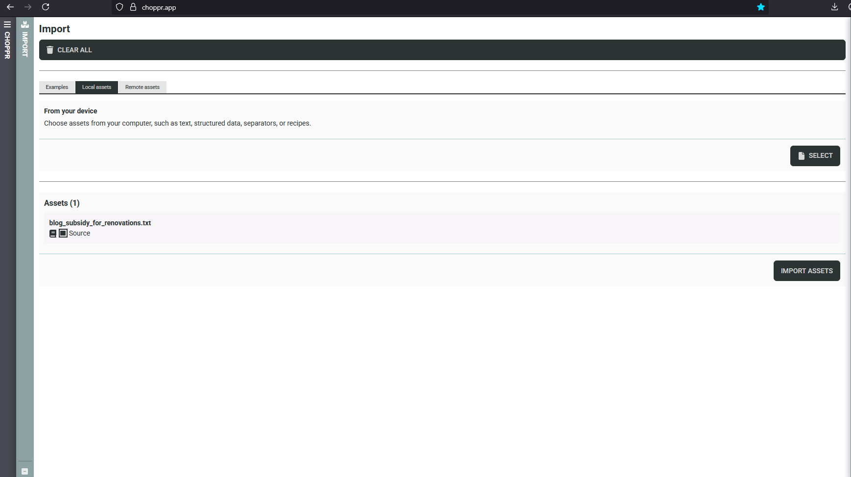
Source decomposition - Choppr
Convert a document into an RDF representation
Enhanced with information about the structure of the document
https://choppr.app/

Slide 6
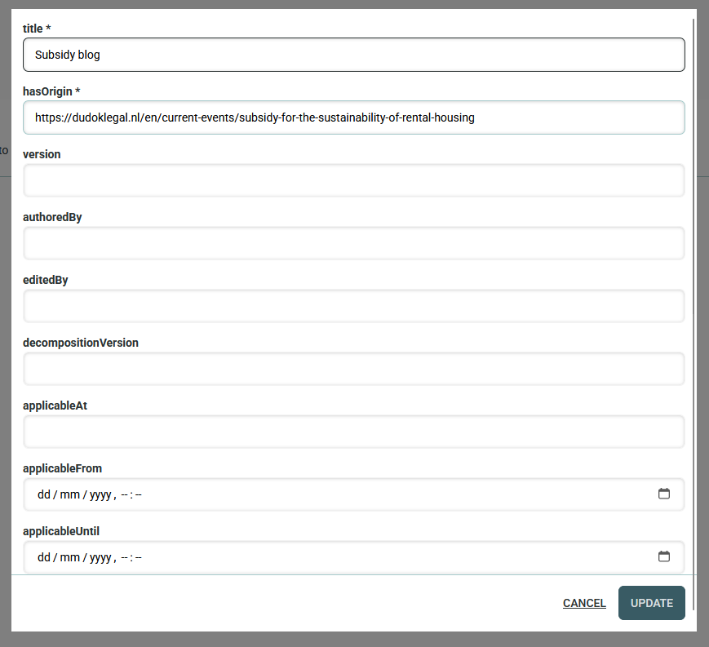
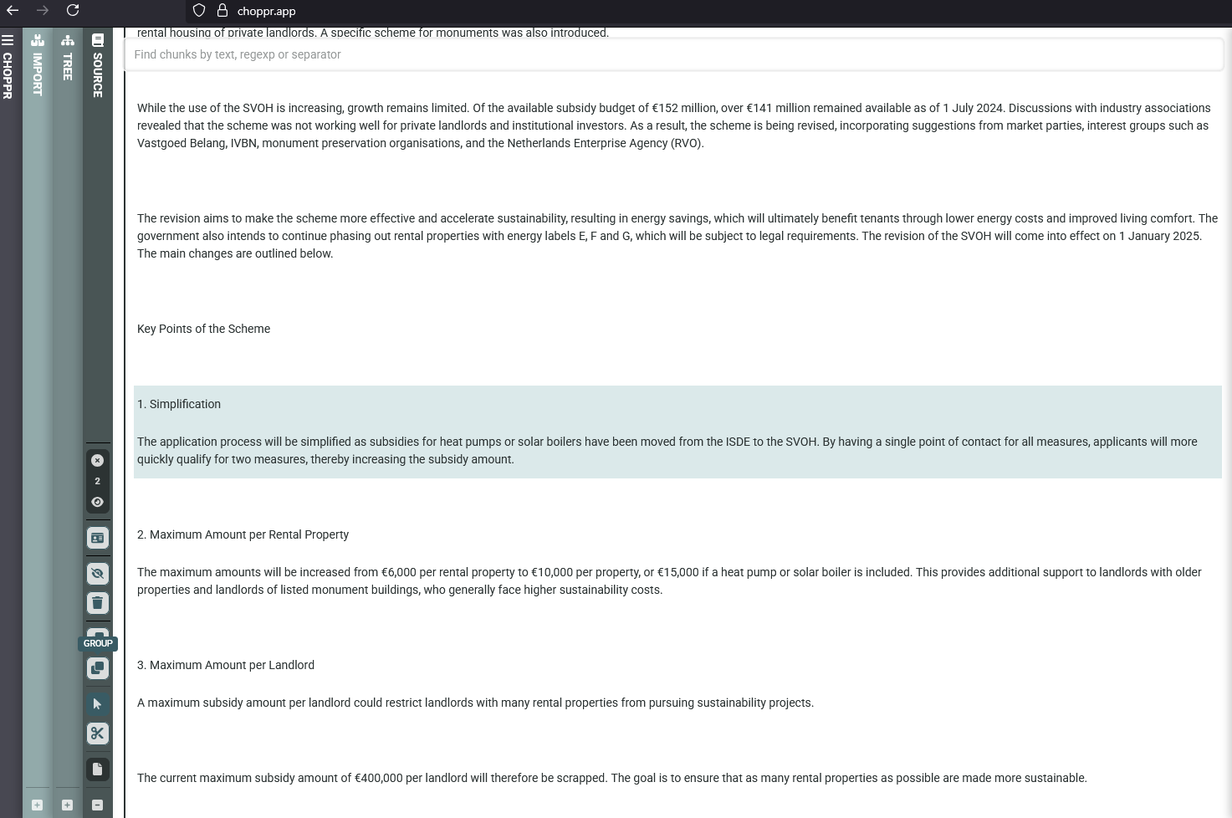
Source decomposition – Group sections
Optionally group sections
Save to file

Slide 7
Rule Interpretation and editing
https://rule-editor.netlify.app/

Slide 8
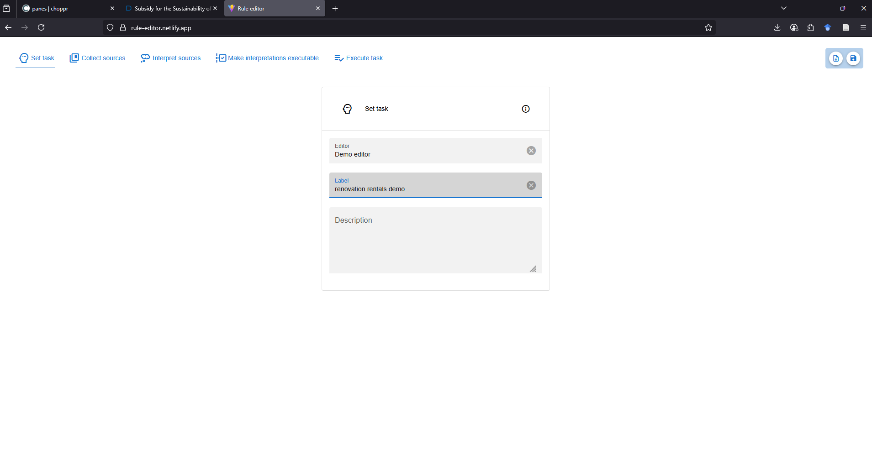
Rule editor – setup
Rule editor interface for analyzing and structuring rules
Takes as input the decomposed source document
https://rule-editor.netlify.app/

Slide 9
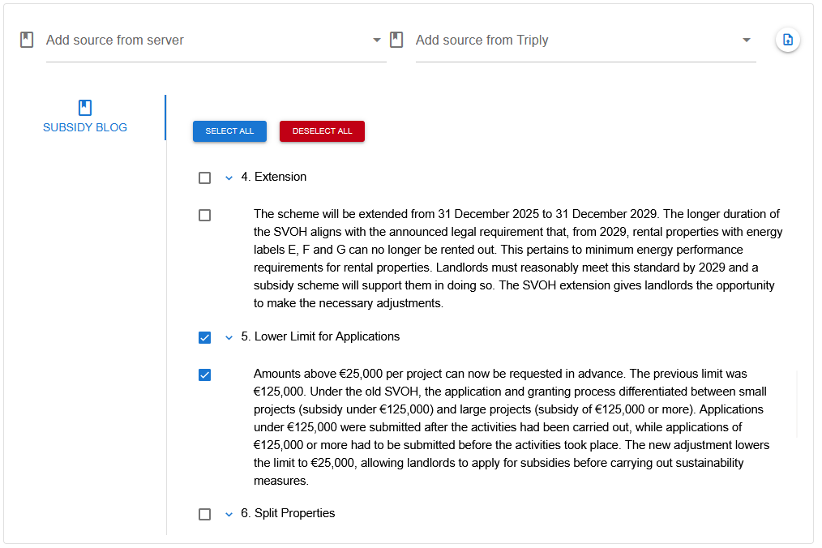

Rule editor – upload file
Load JSON from filesystem
Select segments to analyze

Slide 10
Rule Editor – Renovation subsidy
In the old regulation landlords can request subsidy:
Before the renovations if the cost is above €125.000
After renovations if the cost is below €125.000
In the new regulation landlords can request subsidy:
Before the renovations if the cost is above €25.000
After renovations if the cost is below €25.000
5. Lower Limit for Applications
Amounts above €25,000 per project can now be requested in advance. The previous limit was €125,000. Under the old SVOH, the application and granting process differentiated between small projects (subsidy under €125,000) and large projects (subsidy of €125,000 or more). Applications under €125,000 were submitted after the activities had been carried out, while applications of €125,000 or more had to be submitted before the activities took place. The new adjustment lowers the limit to €25,000, allowing landlords to apply for subsidies before carrying out sustainability measures.
Source: https://dudoklegal.nl/en/current-events/subsidy-for-the-sustainability-of-rental-housing

Slide 11
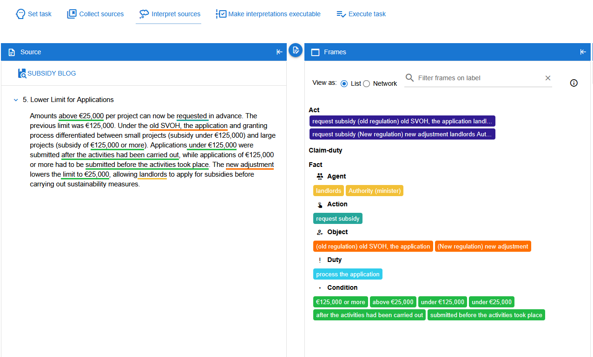
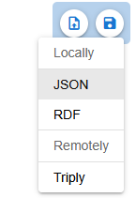
Rule editor – analysis
Identify and edit entities and relationships
Save FLINT code to file

Slide 12
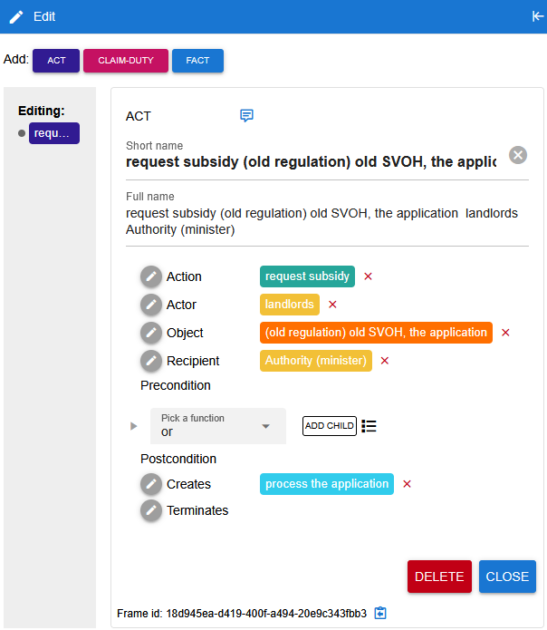
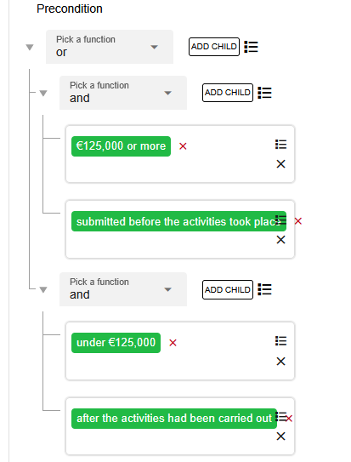
Rule Editor – Old Regulation
In the old regulation landlords can request subsidy:
Before the renovations if the cost is above €125.000
After renovations if the cost is below €125.000

Slide 13
Rule Editor – New Regulation
In the new regulation landlords can request subsidy:
Before the renovations if the cost is above €25.000
After renovations if the cost is below €25.000

Slide 14

Next steps
Transform FLINT norms to executable (eFLINT)
Integrate eFLINT reasoner with DYNAMOS

Slide 15
THANK YOU
Sources:
https://choppr.app/
https://rule-editor.netlify.app/

