Slide 1
Multi-Agent Reinforcement Learning For Chain Reaction game
Project by
MANISH GAYEN 21161
SUCHETAN G U 21342
ANIRUDH TIKOO 20043

Slide 2
Problem Statement
Teaching agents to play chain reaction game through reinforcement learning.

Slide 3
What is chain reaction game?

Slide 4
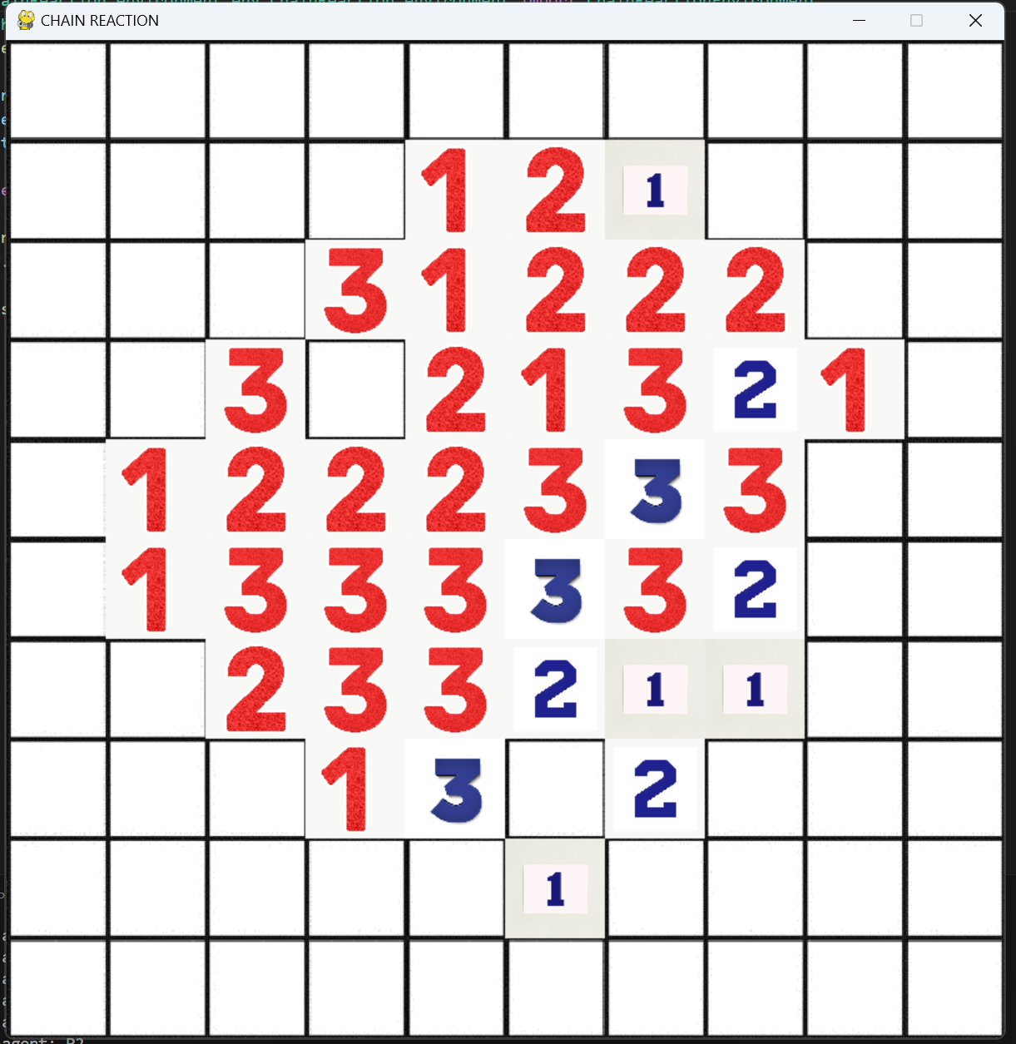
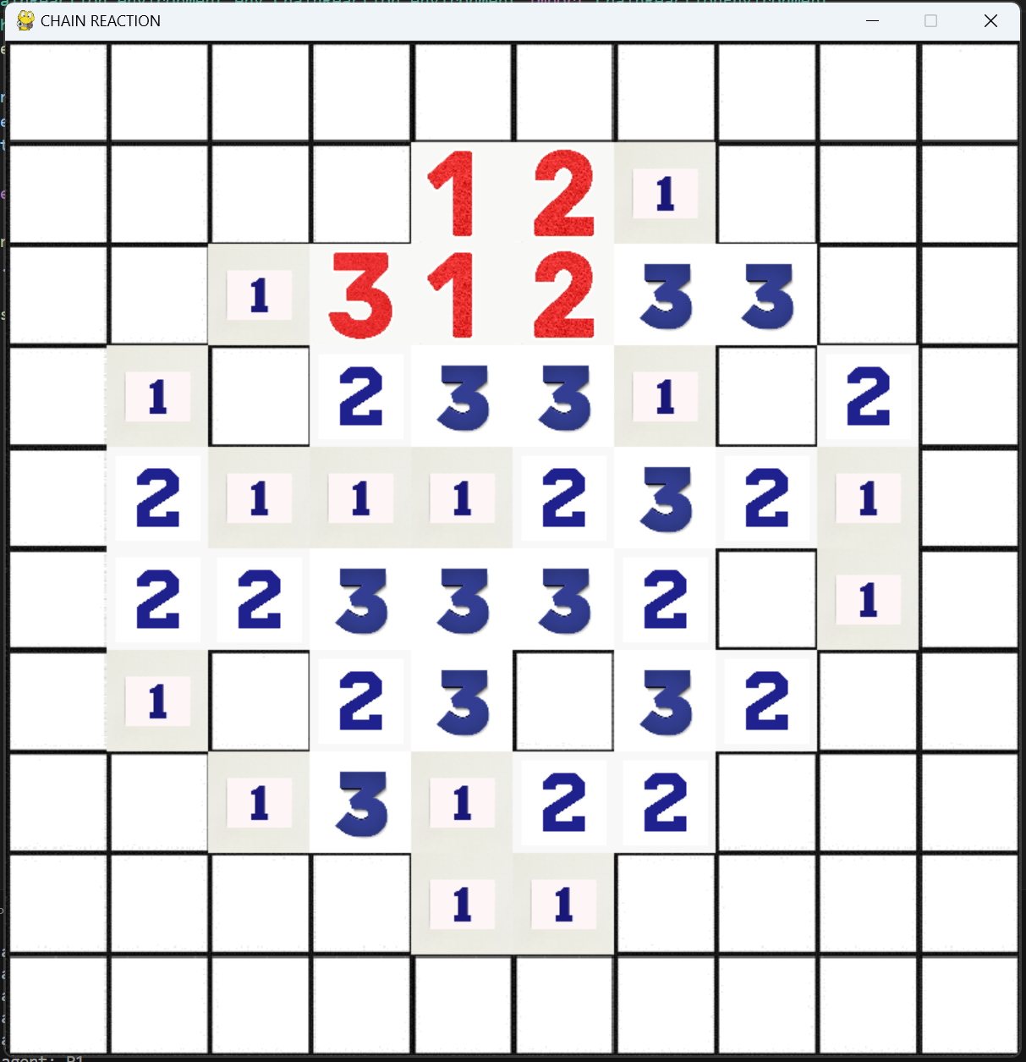
What is chain reaction game?

Slide 5
Challenges
Large state space and action space.
Unlike games like chess, each position is equally valued.
No traditional strategy to win.

Slide 6
Our solution
We have tried MADDPG and PPO to solve the problem.
It models the multi-agent dynamics of the game.
Provides a scalable framework with decentralized execution.
Efficiently handles the non-stationarity of multi-agent environments.
Supports both collaboration and competition between agents.
Is a well-established and proven algorithm in the domain of multi-agent learning.

Slide 7
Architecture
The architecture involves an actor critic network.
Following the methodology of Centralised Training and Decentralised Execution, the Critic network takes input from both the agents and passes the output is passed onto actor networks to choose an action. Since our setup is an adversarial one, at each step, the critic network gets input for only one agent and processes it and sends the output to the same agent’s actor network. This prevents the agents from learning each other’s move prior to play but results in faster training of the critic network.
Agents take action sequentially that is, 1 agent takes action and the next agent takes action the next step.
Game gets over when only one agent has no tiles left on the board.
Rewards:
+1 for taking away opponent tile(s)
-1 for not taking away any opponent tile
+100 for winning agent
-100 for losing agent

Slide 8
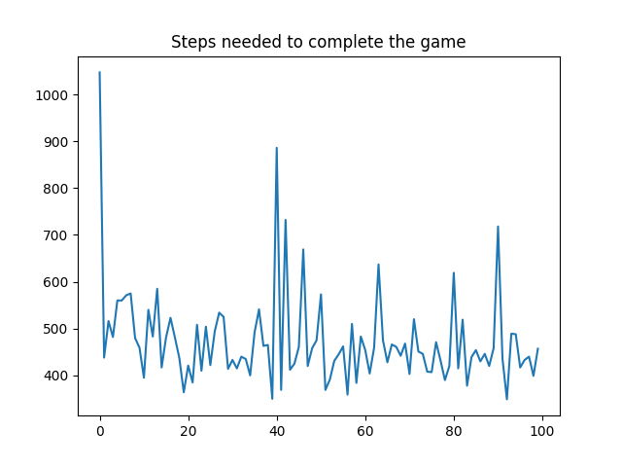
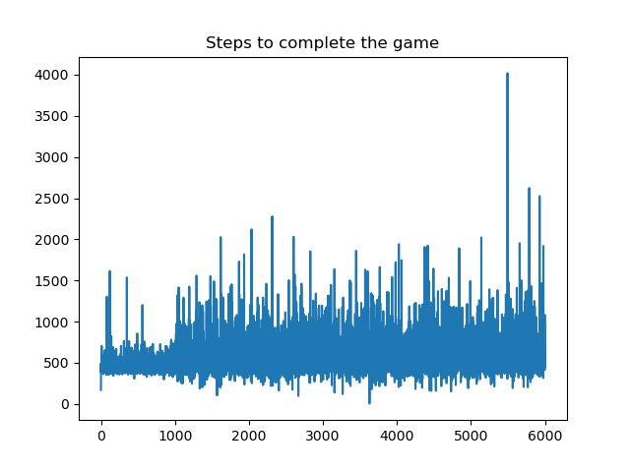
Results
Random Actions
PPO

Slide 9

Team composition
MANISH GAYEN 21161: Debugging, Documentation
SUCHETAN G U 21342 : Environment Design
ANIRUDH TIKOO 20043: Algorithm implementation

