Slide 1
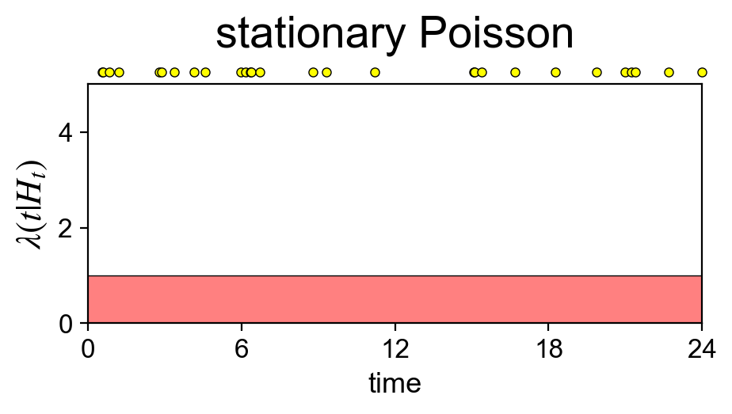
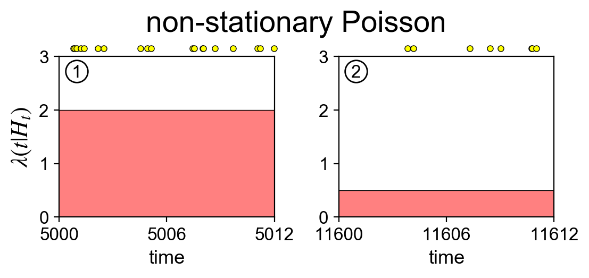
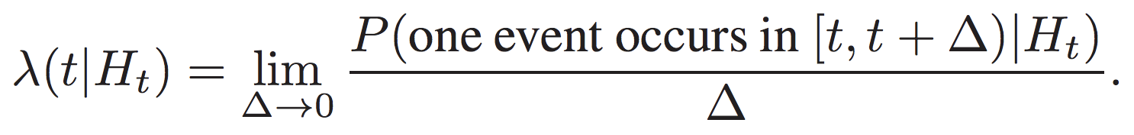
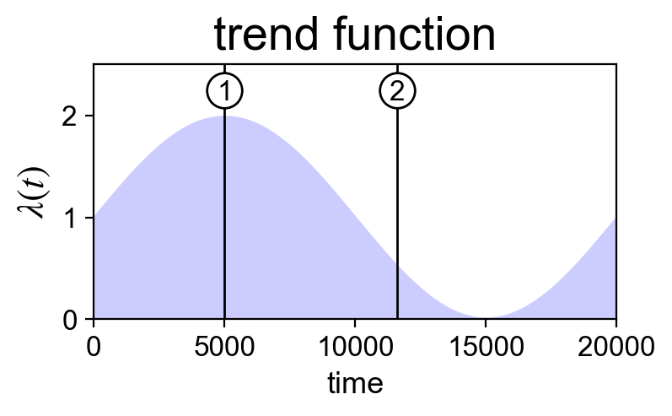
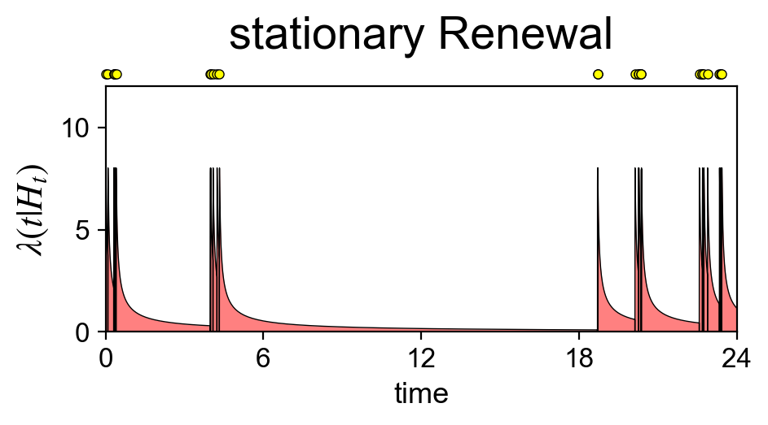
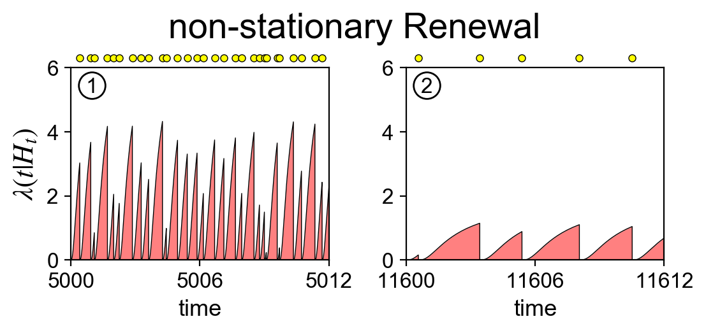
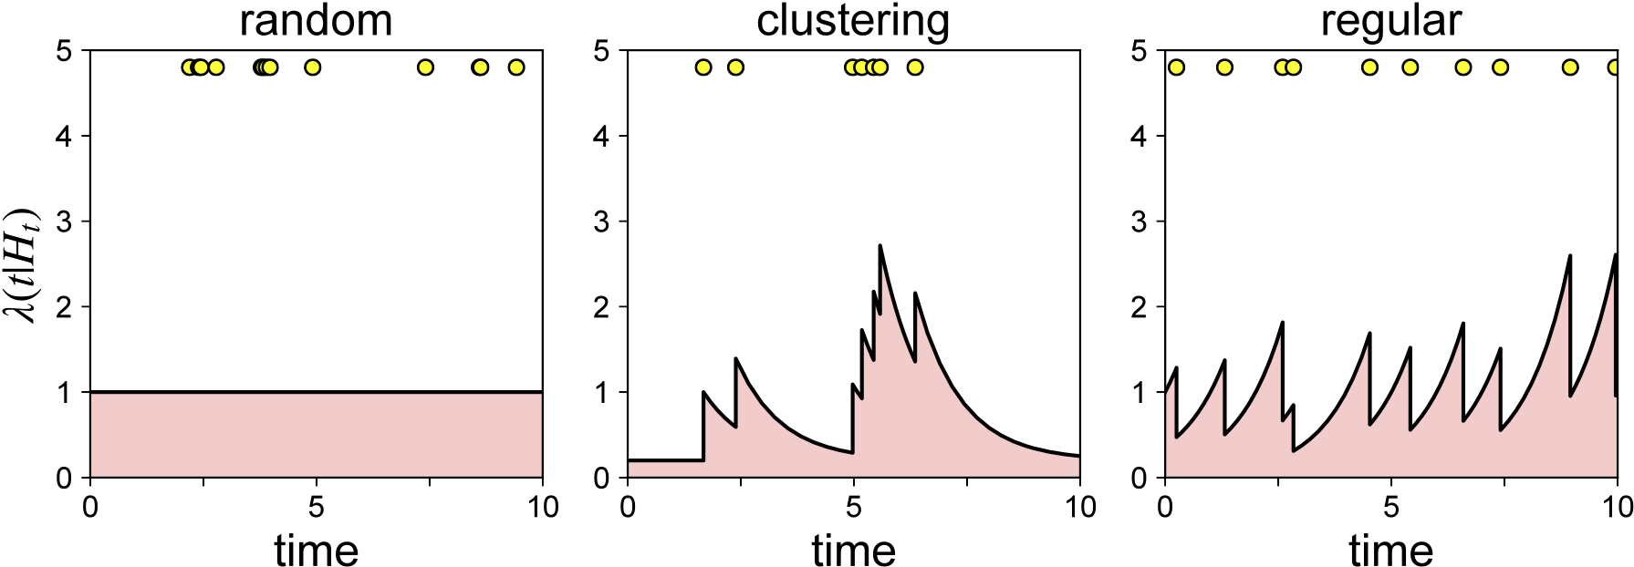
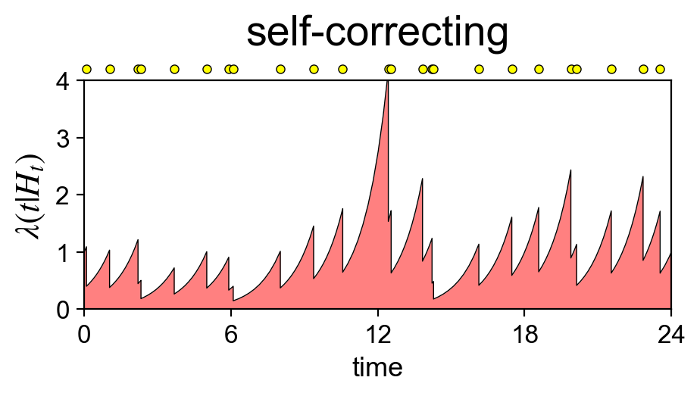
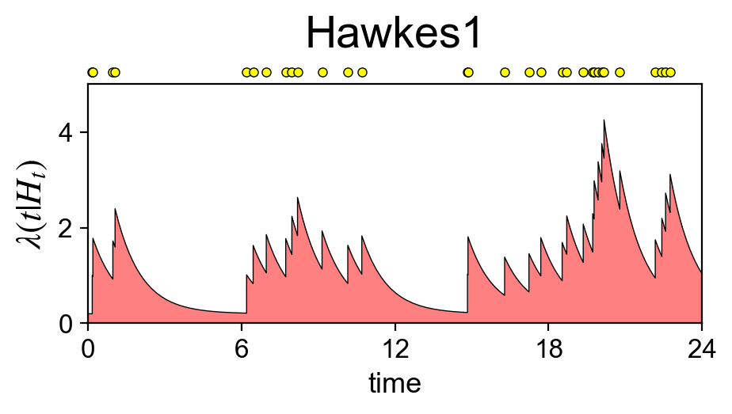
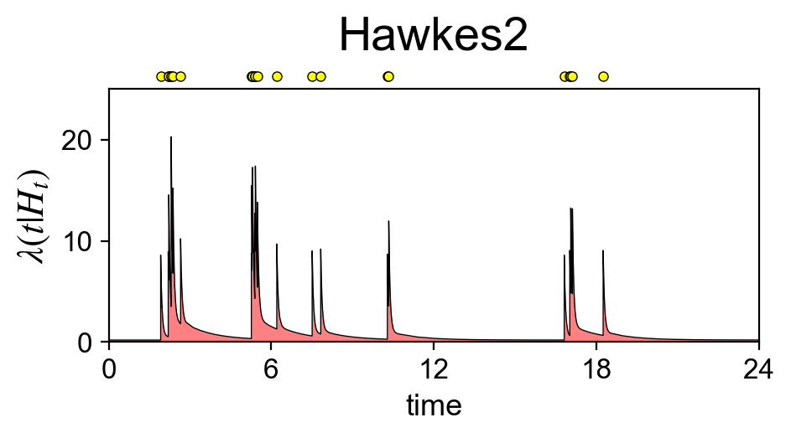
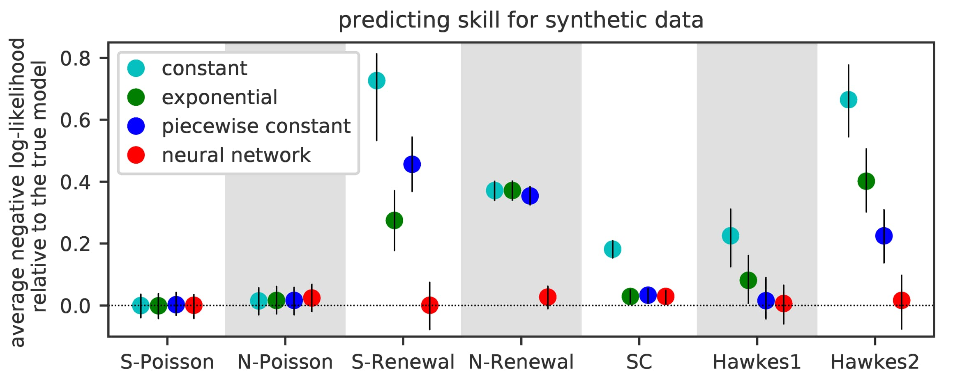
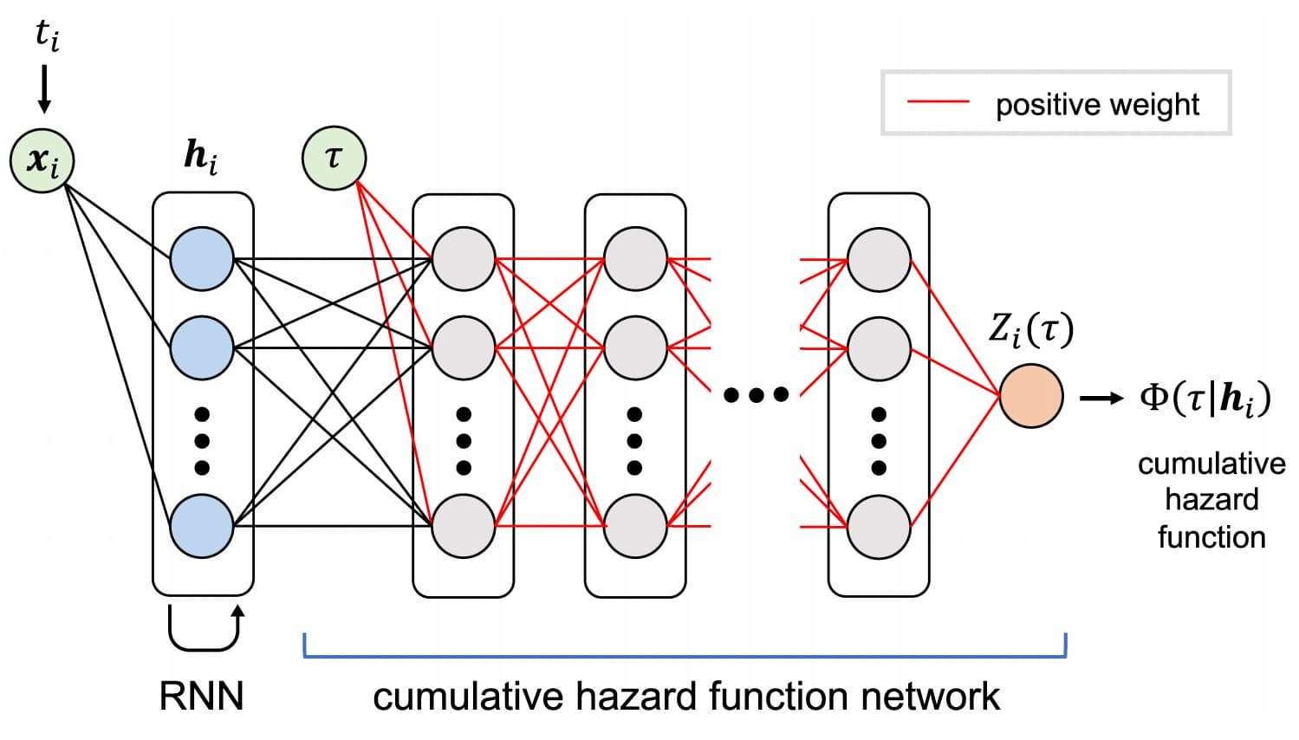
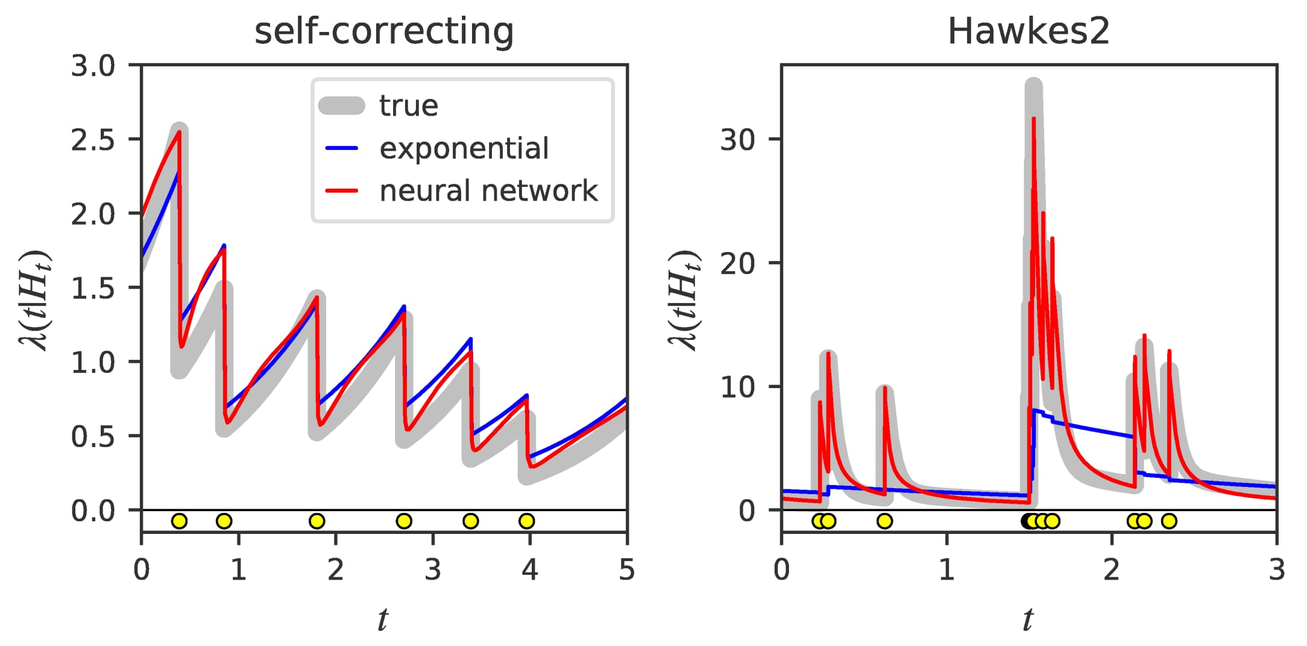
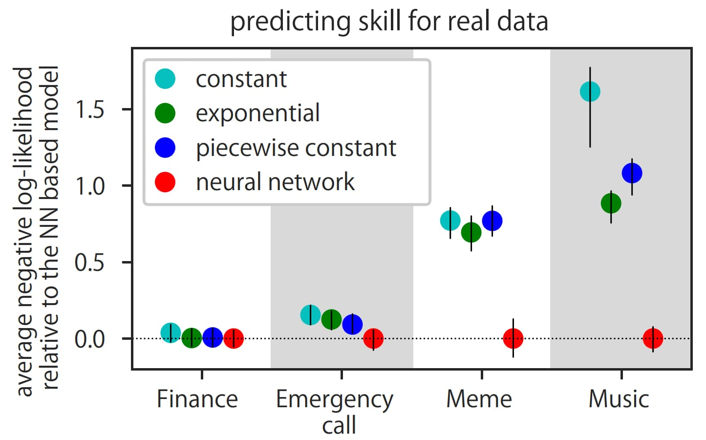






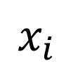



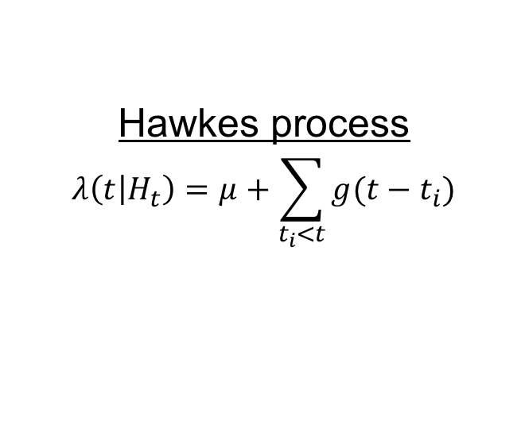
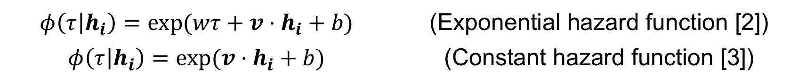

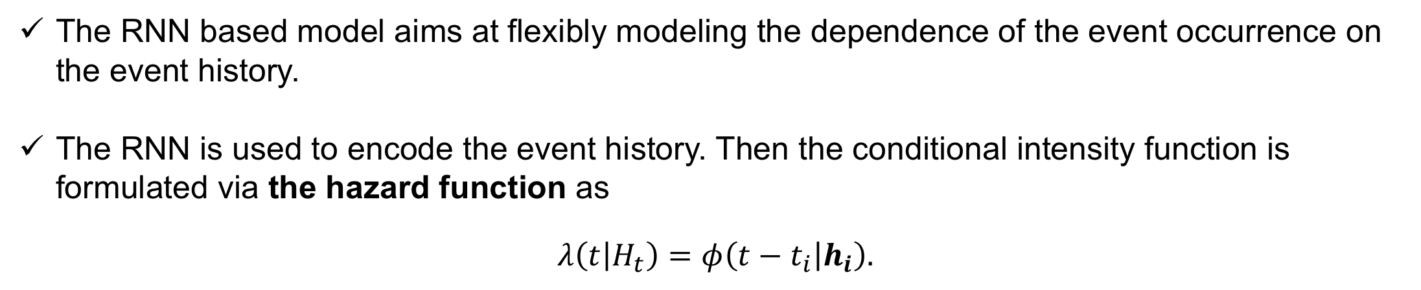

Fully Neural Network based Model for General Temporal Point Processes
Takahiro Omi^{1,3}, Naonori Ueda^{2,3}, Kazuyuki Aihara¹
¹ The University of Tokyo, ² NTT Communication Science Laboratories, ³ RIKEN AIP
Temporal Point Process
Method
Experiments
A temporal point process is a mathematical model of temporally discrete events such as earthquakes, financial transactions, communication in a social network, user activity at a web site, and so on.
Conditional Intensity function characterizes the temporal point process:
Parametric models of the conditional intensity function:
Our novel approach
Instead of the hazard function, we model the cumulative hazard function,
$$Φ\left(τ | h_{i}\right)=\int_{0}^{τ}{φ\left(s | h_{i}\right)ds}.$$
The hazard function is given by differentiating the cumulative hazard function,
$$φ\left(τ | h_{i}\right)=\frac{∂}{∂τ}Φ\left(τ | h_{i}\right)\text{.}$$
The log-likelihood function of the model is reformulated as
$$\log{L}\left(\left\{t_{i}\right\}\right)=\sum_{i}{\left[log\left\{\frac{∂}{∂τ}Φ\left(τ=t_{i}−t_{i−1} | h_{i}\right)\right\}−Φ\left(t_{i}−t_{i−1} | h_{i}\right)\right]}$$
😆This can be exactly evaluated even for a complex model of the cumulative hazard function!!
Proposed model
The feedforward neural network model of the cumulative hazard function
The cumulative hazard function is a monotonically increasing function of $τ$, which can be reproduced by constraining the particular network connections to be positive [1].
Synthetic datasets
* The mean inter-event interval is 1 for all the sequences.
Seven simulated sequences.
Poisson process
$$λ\left(t | H_{t}\right)=μ$$
Hawkes process
$$λ\left(t | H_{t}\right)=μ+\sum_{t_{i}<t}{g(t−t_{i})}$$
Self-correcting process
$$λ\left(t | H_{t}\right)=\exp\left[μt−\sum_{t_{i}<t}{α}\right]$$
The proposed model is better or similar than the other models.
Background: RNN based Approach to Point Processes
The RNN based model aims at flexibly modeling the dependence of the event occurrence on the event history.
The RNN is used to encode the event history. Then the conditional intensity function is formulated via the hazard function as
$$λ\left(t | H_{t}\right)=φ\left(t−t_{i} | h_{i}\right).$$
The constant or exponential hazard function is sensitive to model misspecification.
$$λ(t|H_{t})$$
$$φ(t−t_{i}|h_{i})$$
RNN
$$h_{i}$$
event
$$x_{i}$$
$x_{i}=t_{i}−t_{i−1}$ or
$x_{i}=log(t_{i}−t_{i−1})$
time
$$t_{i−1}$$
$$t_{i}$$
Our contribution
(Flexibility) The hazard function can be flexibly modeled.
(Efficiency) The log-likelihood function can be exactly evaluated without any numerical approximations, so that the model can be efficiently trained.
Related works
Real datasets
The parametric model of the hazard function $φ\left(t−t_{i} | h_{i}\right)$:
Problem
The hazard function is usually modeled by a specific parametric function. However such an assumption can limit the expressive power of the model.
If we use a complex model for the hazard function, the log-likelihood function cannot be exactly evaluated😢. This is because the loglikelihood function of the model,
$$\log{L}\left(\left\{t_{i}\right\}\right)=\sum_{i}{\left\{\log{φ\left(t_{i}−t_{i−1} | h_{i}\right)}−\int_{0}^{t_{i}−t_{i−1}}{φ\left(τ | h_{i}\right)}dτ\right\}},$$
includes the integral of the hazard function.
Our model also performs better than the other models for the real datasets.
$$φ\left(τ | h_{i}\right)=\exp{(wτ+{v⋅h}_{i}+b)}$$ | (Exponential hazard function [2])
$$φ\left(τ | h_{i}\right)=\exp{({v⋅h}_{i}+b)}$$ | (Constant hazard function [3])
 | Flexibility | Closed-form likelihood
Exponential hazard function [2] |  | ✔️
Constant hazard function [3] |  | ✔️
Piecewise constant hazard function [4] |  | ✔️
(Proposed) Neural cumulative hazard function | ✔️ | ✔️
Continuous-time LSTM model [5] | ✔️
We also confirmed
Our model also outperforms the other models for a timing prediction task where the predictive performance is evaluated by the mean absolute error.
Our model outperforms the state-of-the-art continuous-time LSTM model (see the paper for the details).
* The continuous-time model employs a quite different network architecture than the other RNN based models.
References: [1] J. Sill, Monotonic Networks, NIPS 1998. [2] N. Du, H. Dai, R. Trivedi, U. Upadhyay, M. Gomez-Rodriguez, and L. Song. Recurrent marked temporal point processes: Embedding event history to vector. KDD 2016. [3] H. Huang, H. Wang, and Br. Mak. Recurrent poisson process unit for speech recognition. AAAI 2019. [4] H. Jing and A. J. Smola. Neural survival recommender. WSDM 2017. [5] H. Mei and J. M. Eisner. The neural hawkes process: A neurally self-modulating multivariate point process. NIPS 2017.

