Slide 1
Web Design
洪紹晏

Slide 2
HOME ABOUT PORTFOLIO BLOG CONTACT

Slide 3

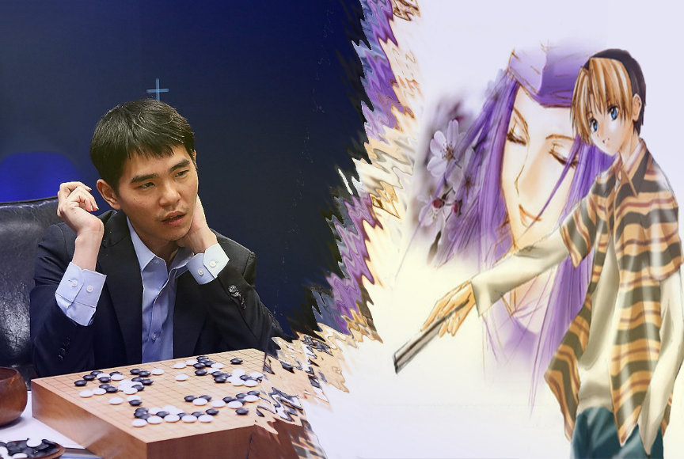
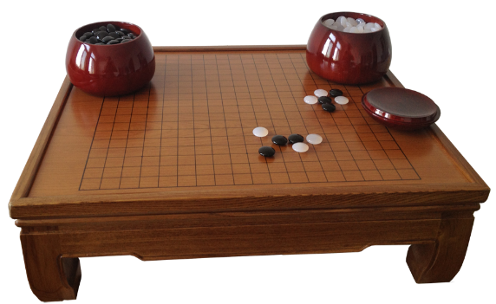
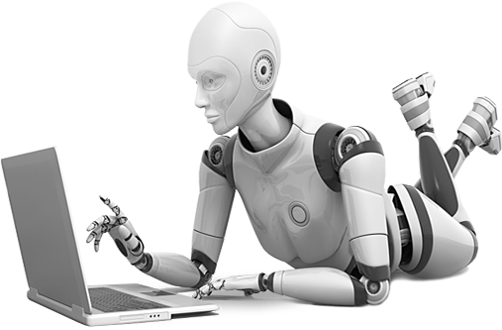
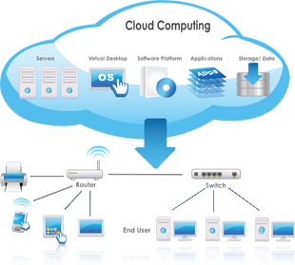
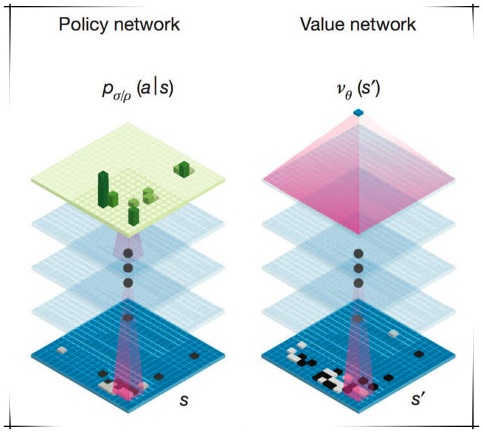



HOME ABOUT PORTFOLIO BLOG CONTACT
Move Picker
Position Evaluator
Copyright 2016

Slide 4
設計說明-洪紹晏
藍色：一些自然界的景象都是藍色的，如水和天空，給人舒服的感覺
READ MORE
Hover #D2E6FF
READ MORE
Normal #8CC8FF
READ MORE
Pressed #0070C0

