Slide 1
ECPS 211 · Machine Learning & Data Mining · Winter 2026
Crypto Price Prediction
Rolling Backtesting · Baselines · LSTM · Ablation Study
Group Members:
Tae Moon
Ronnie Yin
Javier Ramos
Abhijit Rao
Hanish Kishan
Dataset: ETH-USD (Ethereum) via Yahoo Finance · Project 11

Slide 2
OVERVIEW
Project Overview
01
02
03
Data
Baselines
Lag + Ridge
Yahoo Finance · yfinance
ETH-USD daily OHLCV
2017 – 2026, 3,008 rows
Last Value (tomorrow = today)
7-Day Moving Average
MAE · RMSE · Dir. Acc.
30 return lags + log_volume
+ volatility_14 · Pipeline
Optuna alpha (32 features)
04
05
06
Ablation
Backtest
LSTM
4 groups: lags, +volume,
+volatility, all 32
Permutation importance + PDP/ICE
Ridge +120.6% (Sharpe 1.14)
LSTM −159.3% · Buy&Hold
ETH-USD bear market test
64→32 units · dropout
Early stopping · ReduceLROnPlateau
Next-day return target

Slide 3
DATA
Dataset & Features
Source & Split
Derived Features
Provider: Yahoo Finance via yfinance Asset: ETH-USD (Ethereum) — configurable Range: 2017-01-01 to present Rows: 3,008 daily records (OHLCV) Preprocessing: Forward-fill, dropna Timezone-naive datetime index Split: Time-based only — no shuffle
Returns rₜ
(Pₜ − Pₜ₋₁) / (Pₜ₋₁ + ε)
Day-over-day return (stationarity-friendly)
volatility_14
14-day rolling std(returns)
Backward-looking only
log_volume
Split | Rows | Start Date | End Date | %
TRAIN | 2105 | 2017-12-09 | 2023-09-13 | 70.0%
VALIDATION | 451 | 2023-09-14 | 2024-12-07 | 15.0%
TEST | 452 | 2024-12-08 | 2026-03-05 | 15.0%
TOTAL | 3008 |  |  | 100.0%
log(1 + volume)
Log-transformed volume
Return lags 1–30
rₜ₋₁, rₜ₋₂, … rₜ₋₃₀
30 return lags + 2 extra features (32 total)

Slide 4
METHODS
Evaluation Framework & Metrics
MAE
RMSE
Dir. Acc.
Mean Absolute Error
Root Mean Squared Error
Directional Accuracy
mean |yᵢ − ŷᵢ|
√mean(yᵢ − ŷᵢ)²
% correct up/down sign
Magnitude of price error
Penalizes large errors more
Practical trading signal
Methodology Principles
› Time-based splits only — no data shuffling to prevent future leakage
› Expanding-window walk-forward: retrain Ridge on all past data per test window
› Optuna (Bayesian) for Ridge alpha; objective: validation MAE on returns
› Same test period for all models: baselines, Ridge, and LSTM
› Ablation: 4 feature groups (lags only, +volume, +volatility, all 32)

Slide 5
BASELINES
Baseline Models
Baseline 1 — Last Value
Baseline 2 — 7-Day Moving Average
P̂ₜ₊₁ = Pₜ
P̂ₜ₊₁ = (1/7) Σᵢ₌₀⁶ Pₜ₋ᵢ
Tomorrow's price equals today's price.
No information from volume or direction.
Dir. Acc. is not meaningful (predicts no change → often 0%).
Smoothed price over 7 prior days.
Captures local trend, filters single-day noise.
Dir. Acc. is meaningful (predicts a direction).
$82.21
$117.91
$138.74
51.58%
~2.7%
~3.9%
~4.6%
MAE (ETH-USD)
RMSE (ETH-USD)
MAE
Dir. Acc.
✓ Best on MAE & RMSE across all assets
✗ Directional accuracy is not meaningful
✓ Best directional accuracy among baselines (51.58%)
✗ Higher MAE/RMSE than last value (more smoothing error)

Slide 6
LAG-FEATURE MODEL
Ridge Regression with Lag Features
Feature Engineering & Pipeline
Test Set Results (ETH-USD)
Features (32 total): 30 return lags + log_volume + volatility_14
$83.72
$118.41
~2.8%
~3.9%
Scaler: StandardScaler on all 32 columns via ColumnTransformer
MAE
RMSE
Model: Ridge regression (linear; regularized)
54.16%
Hyperparameter search: Optuna (Bayesian) over Ridge alpha; objective: validation MAE on returns
Best alpha applied to test; permutation importance and PDP/ICE computed on test set
Directional Accuracy
Rolling Backtest Results
Target: Next-day return (stationarity-friendly); price via P̂ₜ₊₁ = Pₜ(1 + r̂ₜ)
Train on past only → predict next day → roll forward
Retrain on all past data before each test window (expanding window)
Mean ± std of MAE and Dir.Acc across multiple test windows
Expanding window is stricter; Dir.Acc 55.55% ± 5.49%

Slide 7
ABLATION STUDY
Feature Ablation — What Actually Helps?
Feature Set | # Features | MAE | Dir. Acc.
Lags only | 30 | 0.028193 ★ | 52.97%
Lags + Volume | 31 | 0.028550 | 55.34% ★
Lags + Volatility | 31 | 0.028210 | 52.26%
All (Lags + Vol + Volat.) | 32 | 0.028497 | 54.16%
Ablation Insight
› Lags only best MAE (0.028193) › Adding volume: largest direction gain (+2.37 pp vs lags only) › +Volatility alone adds little over lags › +Volume gives the largest direction gain
at small cost to magnitude

Slide 8
BACKTEST -EXPANDING-WINDOW EVALUATION
Expanding-Window Walk-Forward — Ridge
How Expanding-Window Evaluation Works
Step 1
Train: Days 1–531
→ Day 532
Step 2
Train: Days 1–532
→ Day 533
Step 3
Train: Days 1–533
→ Day 534
…
Train: …
→ …
Minimum training window required; retrain Ridge before each test window
Fixed Split vs. Expanding-Window — Ridge (ETH-USD)
Evaluation | Fixed-Split Test | Expanding-Window
MAE | $83.72 | 0.030806
RMSE | $118.41 | —
Dir. Acc. | 54.16% | 55.55% ± 5.49%

Slide 9
BACKTEST –TRUE ROLLING WINDOW EVALUATION
True Rolling Window— Ridge
How True Rolling -Window Evaluation Works (W:500 Days)
Step 1
Train: Days 32 … 531
→ Day 532
Step 2
Train: Days 33 … 532
→ Day 533
Step 3
Train: Days 34 … 533
→ Day 534
…
Train: …
→ …
Minimum training window required; retrain Ridge before each test window
Fixed Split vs. True Rolling — Ridge (ETH-USD)
Evaluation | Fixed-Split Test (Price Ridge) | True Rolling (W=500, 2508 predictions)
MAE (Price) | 82.67 | 60.44
RMSE (Price) | 118.50 | 100.50
Dir. Acc. (Up/Down) | 51.54% | 50.50%
Lag+Ridge predicts next-day price using 30 price lags + previous-day log(volume) and 14-day volatility
True rolling: retrain each step on the last W=500 days; evaluated over 2508 one-step-ahead predictions

Slide 10
BACKTEST
Rolling Backtest Strategy & Results
How the Backtest Works
Results by Asset — Ridge vs LSTM
1 Signal Generation
Model predicts next-day return. BUY if predicted return > 0, else stay flat.
2a Expanding Window
Retrain on ALL past data before each prediction. No future leakage. Strictly realistic simulation of live trading.
2b True Rolling Window (W=500)
Retrain on the most recent 500 days before each prediction (fixed window). No future leakage. Better reflects concept drift/regime changes.
3 P&L & Sharpe Ratio
On BUY days: accumulate actual return. Sharpe = mean daily P&L / std. Higher Sharpe = better risk-adjusted return.
4 Why It Matters
Bridges academic metrics (MAE, Dir.Acc) to real-world performance. A model can beat 50% direction accuracy and still lose money if it trades in the wrong regime.
ETH-USD Best
Ridge: +120.6% Sharpe 1.14 (169 trades)
LSTM: -42.0% Sharpe -0.39 (57 trades)
BTC-USD Flat
Ridge: +3.3% Sharpe 0.05 (228 trades)
LSTM: +29.9% Sharpe 0.42 (32 trades)
XRP-USD Profitable
Ridge: +71.2% Sharpe 0.60 (126 trades)
LSTM: -5.5% Sharpe -0.05 (1 trade)
ETC-USD Worst
Ridge: -67.9% Sharpe -0.62 (183 trades)
LSTM: -97.6% Sharpe -0.89 (44 trades)
Key Insight: Dir.Acc does not guarantee profit. Ridge on ETH (54.2% Dir.Acc) yields Sharpe 1.14; the same Ridge on ETC (49.9%) loses 67.9%. Market regime matters more than raw accuracy.
Price error improves vs fixed split: MAE 82.67 → 60.44 (−26.9%), RMSE 118.50 → 100.50 (−15.2%).
Directional accuracy stays ~50%: 51.54% (fixed split) vs 50.50% (true rolling).Interpretation: rolling retraining helps track price level shifts, but next-day direction remains noisy.
Evaluation scale: 2508 one-step-ahead predictions (retrain each step).
ETH Ridge: best result (+120.6%, Sharpe 1.14, 169 trades).
ETC: Both models lose despite reasonable Dir. Acc. This confirms high-volatility regime failure from error analysis.

Slide 11
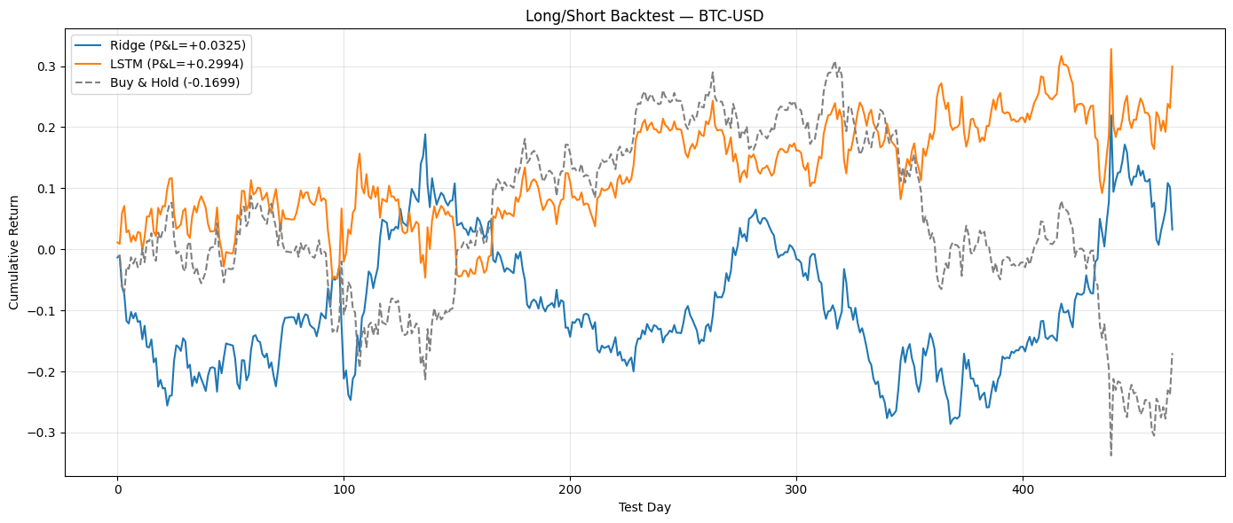
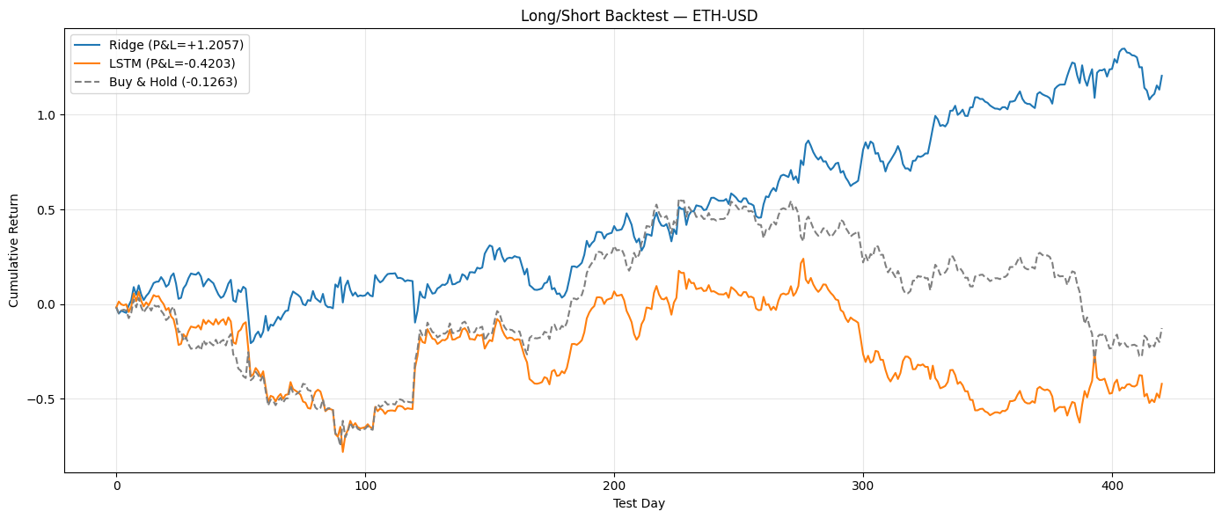
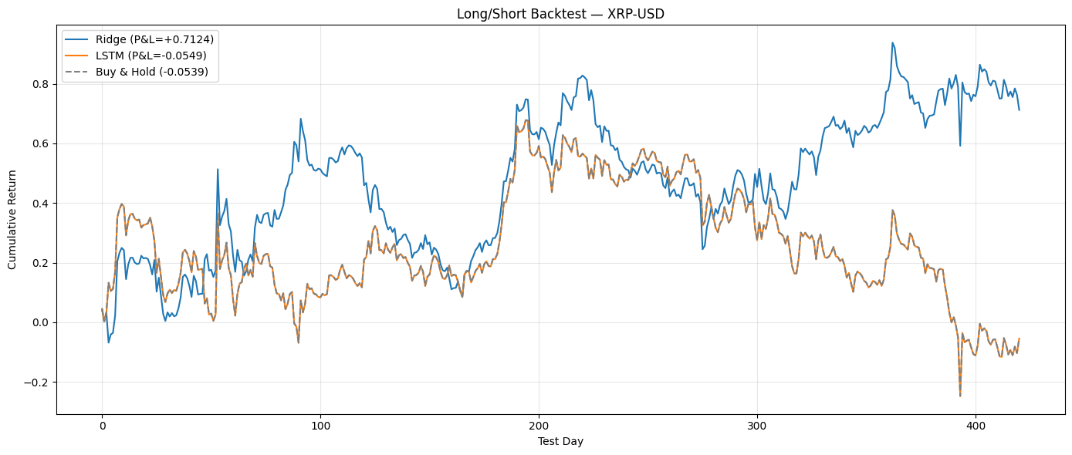
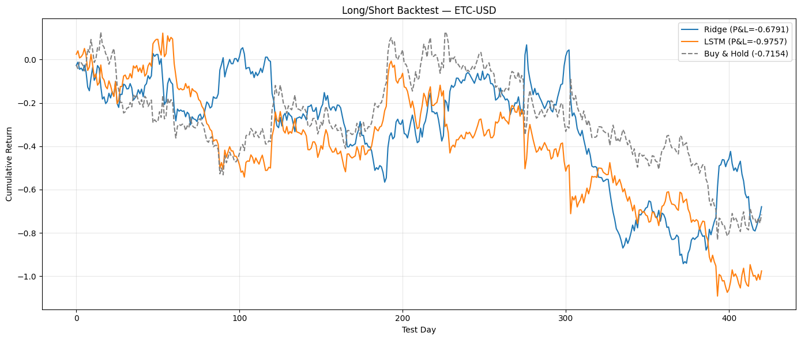
BACKTEST
Cumulative Return — All Assets (Ridge vs LSTM vs Buy & Hold)

Slide 12
RESULTS
Full Model Comparison (ETH-USD, Test Set)
Model | MAE | RMSE | Dir. Acc. | Strength
Last Value | $82.21 ★ | $117.91 ★ | 0% * | Best magnitude
7-Day MA | $138.74 | $192.77 | 51.58% | Best baseline dir.
Ridge | $83.72 | $118.41 | 54.16% ★ | Best direction
LSTM | $82.13 | $117.89 | 46.32% | Below 50% dir.
Key Takeaways
› Last value wins MAE/RMSE — hard to beat › Ridge wins direction at 54.16% › 7-Day MA best baseline dir. (51.58%); LSTM below 50% (46.32%)
* Last value predicts no change; directional accuracy = 0% is not meaningful.

Slide 13
CROSS-ASSET
Generalization Across Cryptocurrencies
BTC-USD
Best dir.: LSTM (51.0%)
All models near 50%; last value best MAE
ETH-USD
Best dir.: Ridge (54.2%)
Slightly more directionally predictable
XRP-USD
Best dir.: 7-Day MA (52.3%)
LSTM drops to 46.6%; 7-Day MA leads at 52.3%
ETC-USD
Best dir.: 7-Day MA (55.4%)
Best directional result; LSTM < 50%
Last value wins MAE/RMSE on every asset. ETH-USD: Ridge leads direction (54.2%); XRP-USD: 7-Day MA leads (52.3%). ETC: LSTM < 50% on all 3 ML assets.

Slide 14
INTERPRETABILITY
Permutation Importance · PDP / ICE
Permutation Importance (Best Lag+Ridge)
PDP / ICE Insights
Shuffle each feature 10× · measure MAE increase · ETH-USD test set
#1
lag_9
lag_9
Roughly linear PDP — higher lag_9 → higher prediction. Effect is homogeneous across ICE curves (Ridge is linear in features).
#2
lag_16
#3
lag_30
log_volume
#4
Flatter PDP — volume has a weaker marginal effect on price than lag features, but matters for directional accuracy (ablation).
log_volume
#5
volatility_14
Top-3 features are lag_9, lag_16, and lag_30 (mid-range lags dominate).
Volume and volatility rank 4th/5th — price momentum lags matter most for ETH-USD.
ICE curves for lag_9 show similar slope across samples — the linear effect is consistent, not sample-specific.

Slide 15
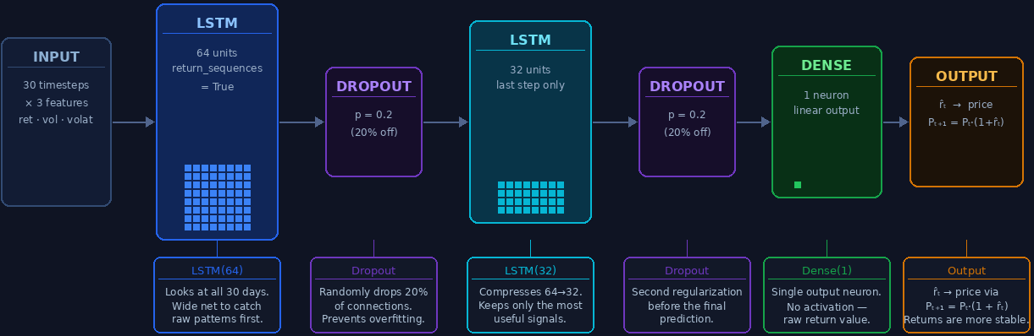
DEEP LEARNING
LSTM Architecture

Slide 16
DEEP LEARNING
LSTM Architecture & Results
Architecture
Test Set Results (ETH-USD)
Target: Next-day return rₜ (not raw price)
Converted: P̂ₜ₊₁ = Pₜ · (1 + r̂ₜ)
$82.13
$117.89
~2.7%
~3.9%
Sequence: Length 30; 3 features per timestep
(ret, log_volume, volatility_14)
MAE
RMSE
46.32%
Scaling: StandardScaler fit on train; applied to val/test
Directional Accuracy
Layers: LSTM(64) → LSTM(32) → Dense(1) + Dropout(0.2)
Key observation: LSTM MAE ($82.13) is close to Last Value; Dir.Acc (46.32%) is below 50% — no consistent edge over simpler models on ETH-USD.
Training: MSE loss · batch 32 · early stopping on val loss · ReduceLROnPlateau

Slide 17
ERROR ANALYSIS
Where Does the Model Fail?
Long-Tailed Residuals
Clustered Errors Over Time
Residual histogram is centered near zero but has heavy tails — large errors occur in both directions, indicating the model cannot handle sharp price moves.
Errors are not uniformly distributed across time. They cluster in volatility regimes — calm periods have smaller errors; turbulent periods have large errors.
High-Volatility Failure
Smoothed Extrapolation
|Residual| vs volatility_14 plot shows a positive correlation — larger absolute errors occur when the 14-day rolling volatility is high. Model performs worst in volatile markets.
Lag+Ridge behaves like a smoothed extrapolation of recent price lags. It systematically under- or over-predicts during sharp moves and mean-reverting spikes.
Conclusion: Lag+Ridge (and simpler models) are smoothing extrapolators — they fail most in high-volatility regimes and on large price moves.

Slide 18
CONCLUSION
Key Findings
Baselines are competitive: Last value achieves best MAE/RMSE across all assets — a surprisingly strong benchmark.
Ridge on direction: Best ML model — 54.16% Dir.Acc on ETH-USD test set (best of all models).
LSTM: LSTM Dir.Acc 46.32%; competitive MAE ($82.13) but below 50% direction.
Ablation (4 groups): Volume improves direction most (+2.37 pp, from 52.97% to 55.34%).
32 features total — lags + log_volume + volatility_14.
Error analysis: All models fail in high-volatility regimes and on large moves. Expanding-window is stricter than fixed-split.

Slide 19
Project Concepts
Project Phase | Technique Used | Core Lecture Concept
Data preprocessing | Return transformation, log_volume | Stationarity; feature normalization
Train/val/test split | Chronological 70/15/15 split | Data leakage; temporal ordering
Baseline models | Last value, 7-day MA | Setting performance floors; EMH
Ridge Regression | L2-regularised linear model | Bias-variance tradeoff; regularization
Feature scaling | StandardScaler (fit on train only) | Scale-invariance; leakage prevention
Hyperparameter tuning | Optuna Bayesian optimisation | Model selection; efficient search
LSTM architecture | 64→32 units, Dropout, early stopping | Ch. 10: RNNs; vanishing gradient; overfitting
Ablation study | 4 feature set configurations | Component contribution analysis
Permutation importance | Shuffle-and-measure feature relevance | Model-agnostic interpretability
PDP / ICE plots | Marginal feature effects | Interpretability; linearity of Ridge
Expanding-window eval | Walk-forward retraining, mean ± std | Time series cross-validation
The table below maps each project phase to the core ML concept from ECPS 211 lectures.

