Slide 1
PHONE SEARCH
Power BI Project

Slide 2
Step 1 : Problem Definition & Objectives
Objective: Analyze phone sales to support data-driven decisions
KPIs :
Average product price
Average star rating
total sales volume
sales per product
number of offers
best sellers count
count the amazon choice products and compare it with the best sellers and other metrics
diff between product minimum offer and original price calculate the percentage of climate friendly products

Slide 3

Step 2 : Data Collection
The data is collected from the CSV file provided by AMIT.

Slide 4
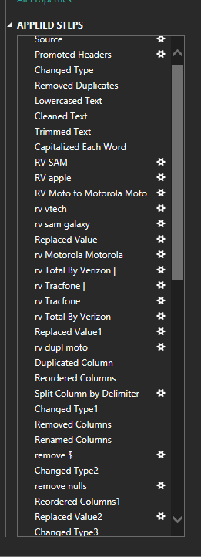
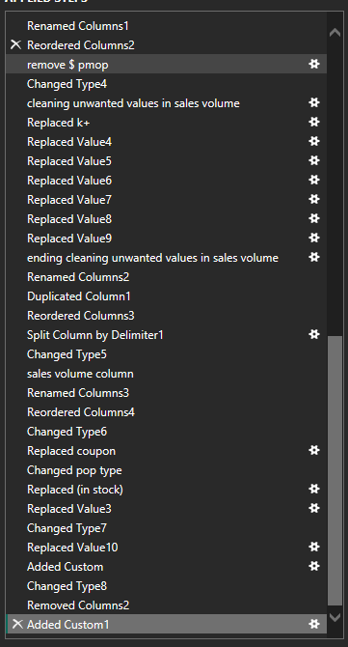
Step 3 : Data Cleaning & Data Modeling
Handling missing & duplicate values
Data transformation using Power Query

Slide 5
Step 4: Analysis Data
The data analysis process was split into two main stages:
Sales-based Analysis
Product-based Analysis

Slide 6
Sales Overview
SALES KEYS :-
Total Revenue 20.68M
Sales Units 130.55K
Average Product price 171.83
diff between product minimum offer and original price 7.04M
Top Performing Manufacturer Samsung

Slide 7
SALES
TOTAL REVENUE
20.68M
SALES UNITS 130.55K
AVRAGE PRICE 171.83

Slide 8
Products Overview
Products KEYS :-
Average Rating: 4.25/5
Number of Raters: 870.58K
Number of Coupons: 22
Number of Offers: 2.628K
Percentage of Variations: 29.26%
Percentage Climate Friendly Products: 23.15%
Percentage of Free Delivery 99.68%

Slide 9
Products

Slide 10
Step 5 : Visualization ,Decision Making & publish
In Power Bi the link : THE LINK
DECISION S : Focus on high-rated best-selling products Expand climate-friendly product portfolio Optimize pricing based on offer-price gaps

Slide 11
Thank You

