Slide 1
BASIC HEALTH INFORMATION system
By Moses Okoth

Slide 2
TABLE OF CONTENTS
Introduction
Problem Understanding
Solution Design
Database Design
System Architecture
API Design
Prototype Demonstration
Conclusion

Slide 3
INTRODUCTION
OBJECTIVE
Build a basic health system to manage clients, health programs and enrollment to health programs.
KEY FEATURES
Create Health Programs
Client Registration
Enrollment
Client Search
Expose client profile via an API

Slide 4
PROBLEM UNDERSTANDING
DOCTORS
EXTERNAL SYSTEMS
The doctors, who will be the primary system users, need a simple platform to manage health programs and patient enrollment.
External systems will need a standardized way to interact with the system
SECURITY
The API endpoints should be secure, allowing only authorized requests to go through.

Slide 5
SOLUTION DESIGN
BACKEND FRAMEWORK
The system was built with PHP 8 due to my intensive familiarity with the language in building robust and scalable APIs.
DATABASE
The system utilized MySQL database - based on MariaDB engine.
RESTFUL API
The API design was based on RESTful principles and thus being standardized to allow for integration with existing systems.
SECURITY
The system utilizes token based authentication, which is expected to curb various security risks that might occur during the long run.

Slide 6
Database design
The databse has 4 key table:
Table Name | Description
users | Stores doctors’ information
clients | Stores the patient’s data
programs | Stores data related to the health programs
client_programs | Stores the program enrollment

Slide 7
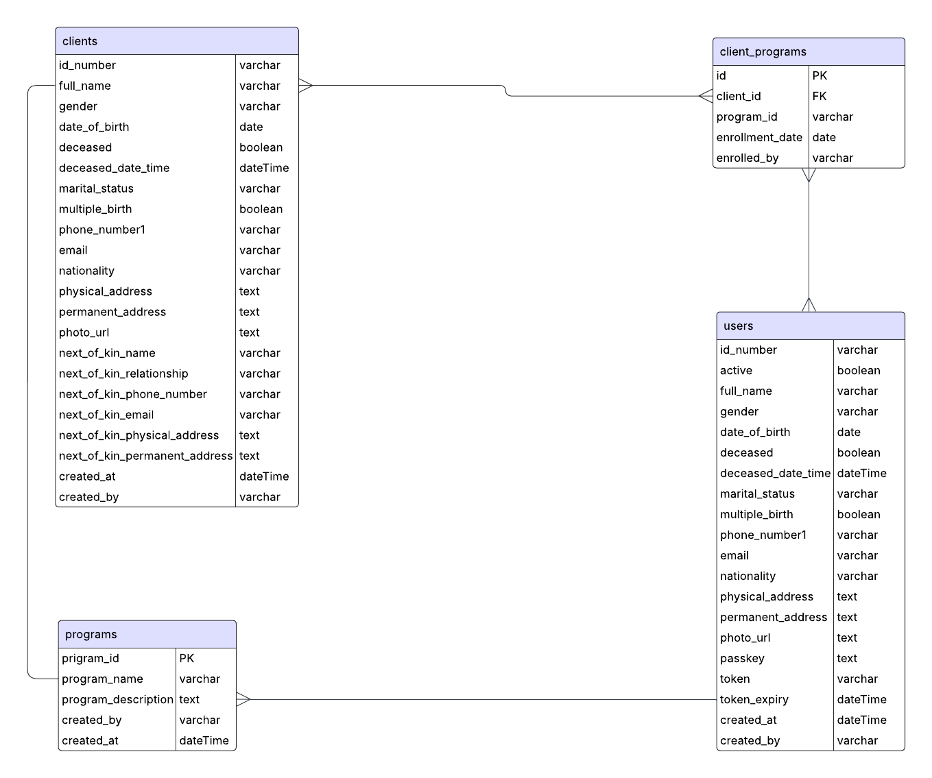
DATABASE DESIGN

Slide 8
SYSTEM ARCHITECTURE
LAYERS
Database Layer (MySQL)
Backend API Layer (PHP)
Front-end layer
API Authentication

Slide 9
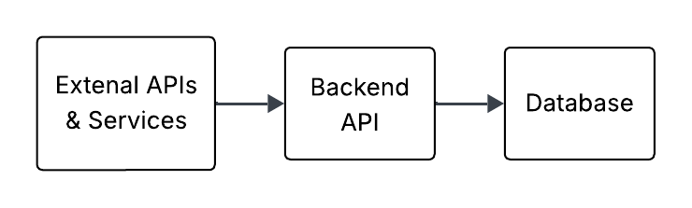
SYSTEM ARCHITECTURE

Slide 10
API DESIGN
Method | Endpoint | Description
POST | /createProgram/ | Creates a new health program
POST | /enrollProgram/ | Enrolls a patient into a health program
POST | /registerPatient/ | Registering a new patient
POST | /viewPatient/ | Expose client profile via an API

Slide 11
FUTURE IMPROVEMENTS
ROLE BASED ACCESS
Implement role based access to foster chain-of-command
AUDIT LOGS
Provide a way to keep the system logs which can be audited regularly for security measures.
CLEANER UI
Provide a cleaner UI, using a modern framework such as React or Angular

Slide 12
PROTOTYPE DEMONSTRATION
We will try to view the patients profile by hitting the endpoint /api/viewPatient/ using the POST method.
We will use JavaScript for this demonstration, the same can be replicated for other languages too.
There are two simple steps to follow to get a successful response:
Setting up the headers correctly, as per the API guidelines
Setting up the request body correctly as outlined in the API documentation
STEP 1
Essentially we only need two properties in our header, namely; Authorization and Content-Type. The Authorization header is a combination of the user id and the token, each separated by a colon (:) i.e USER_ID:TOKEN

Slide 13
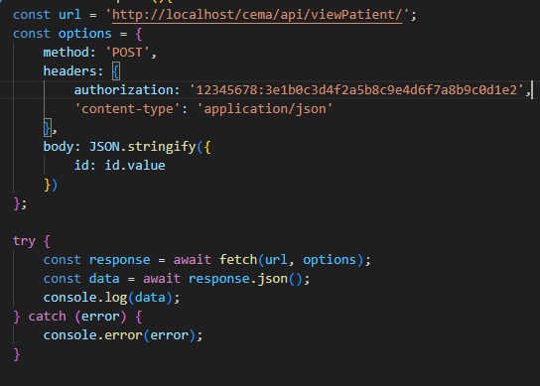
STEP 2
Setting up the request body, which in this case is just declaring the id property, since that is what the endpoint is expecting to process the request successfully.
An example in JavaScript is attached below:

Slide 14
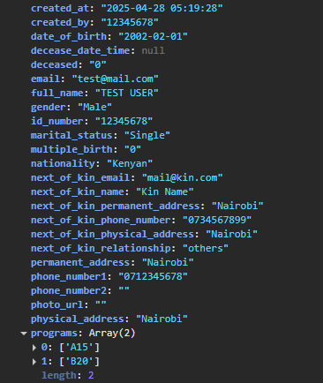
API RESPONSE
The API responds with the patient’s data in JSON format, outlining all their biodata as well as the programs they are enrolled in, as shown below

Slide 15
CONCLUSION
I successfully manage to implement all the requirements:
Clean code
API-first approach
I look forward to your feedback!

Slide 16
THANK YOU
Moses Okoth
+254-714-263-898
mosesokoth164@gmail.com
https://github.com/MOSES-OKOTH/

