Slide 1


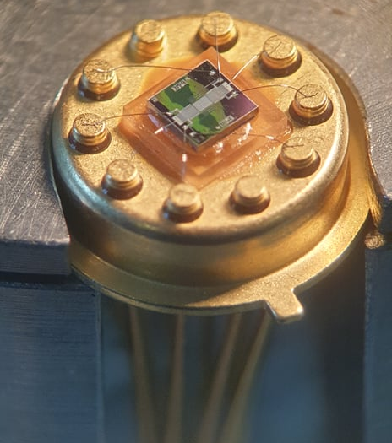
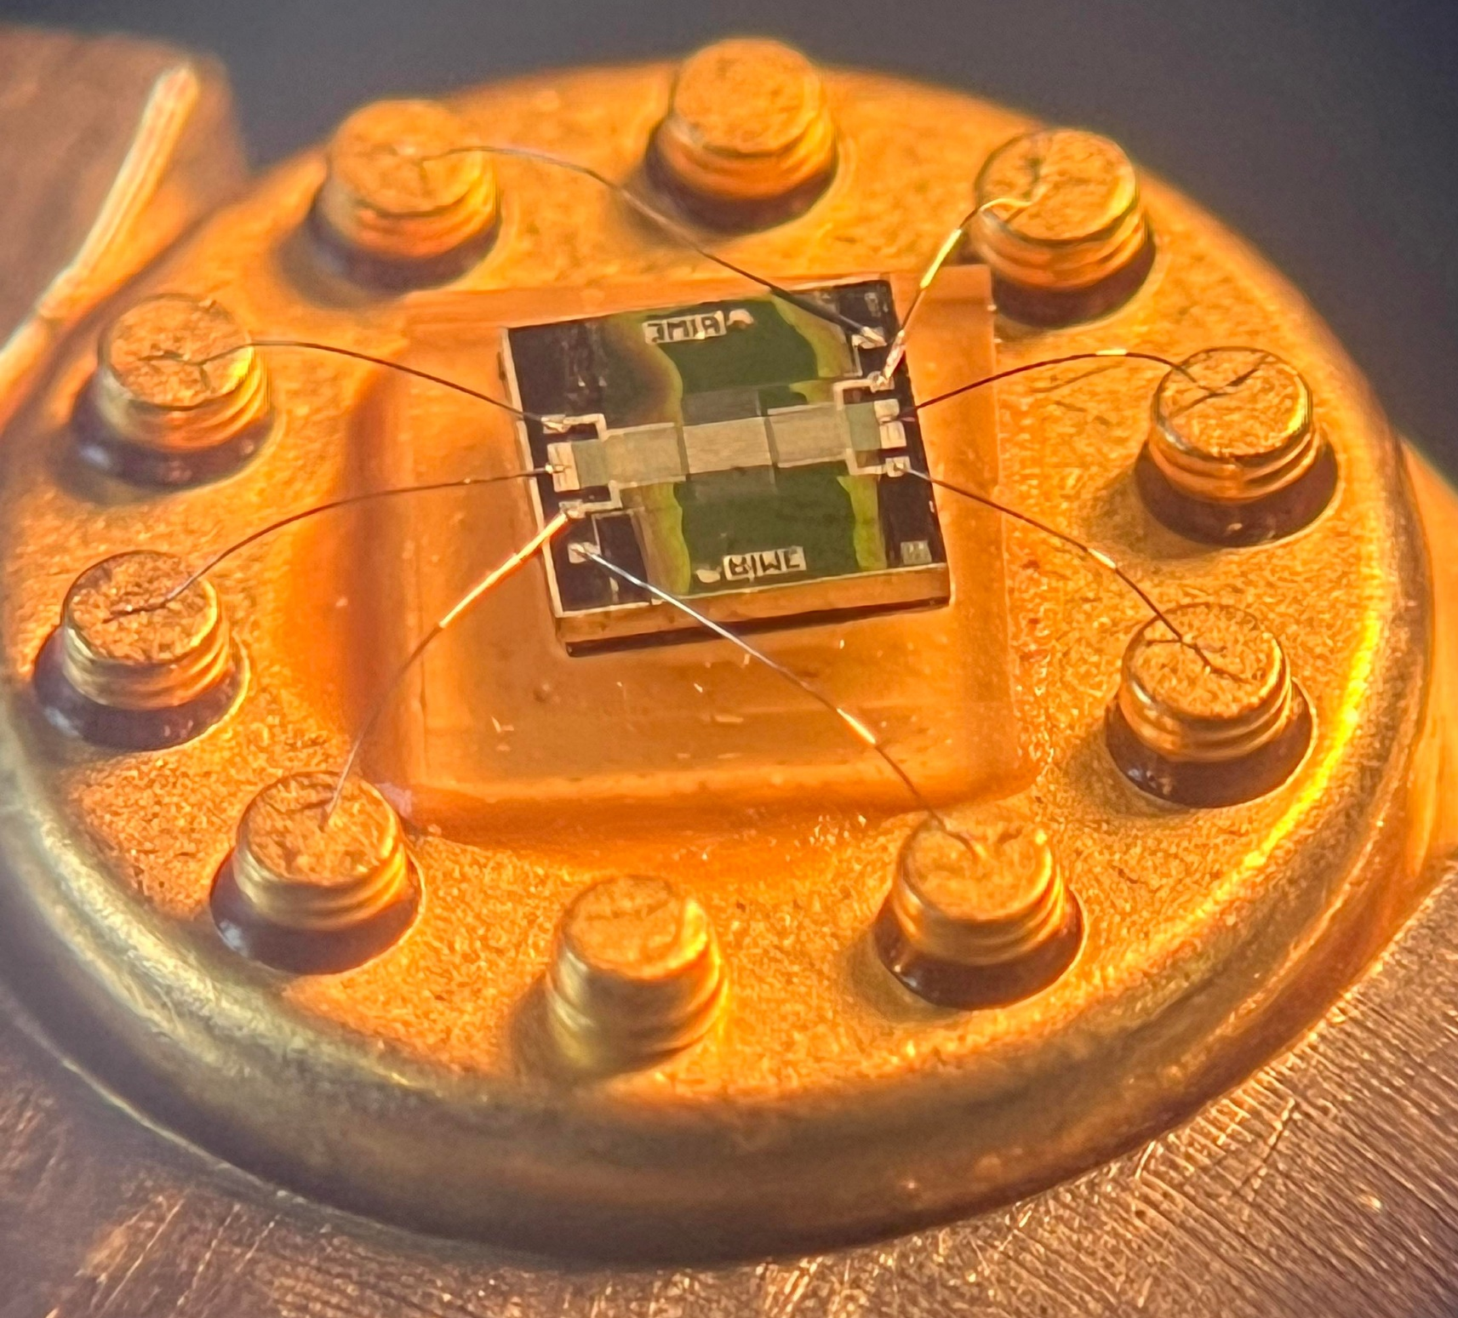
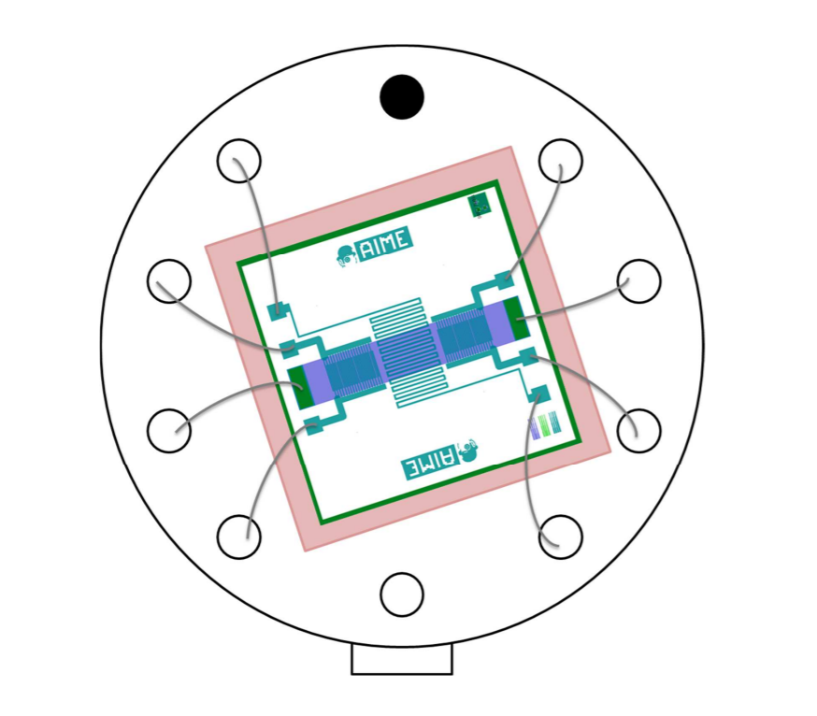
Agathe Lièvre – Assia Nguyen AIME-GSWO3 5ISS - 2021/2022
AIME-GSWO3
Low energy semiconductor gas sensor based on WO3 nanorods particles
FEATURES
Detection of Ammonia NH3, Nitrogen Dioxide NO2 and Ethanol C2H6O
Two integrated gas sensors
Temperature sensor
Thermal resistor
Low cost
Low energy consumption
Easy to use
DESCRIPTION
The AIME-GSWO3 is a semiconductor gas sensor developed by INSA Toulouse students for their 5th year in Innovative Smart System (ISS). It was made in the AIME’s labs. This gas sensor uses Tungsten Trioxide WO3 nanorods particles. It is composed of two sensitive active sides, a wide N-doped Poly-Silicium layer to heat the sensor up to 300°C and an aluminum resistor layer to measure the temperature of the sensor.
Fig 1: AIME-GSWO3
PIN LAYOUT
5
Pin number | Function
1 – 6 | Temperature sensor (Aluminum resistor)
2 – 4 | Gas sensor #1
3 – 8 | Thermal resistor (Polysilicon resistor)
7 – 9 | Gas sensor #2
5 | NC
10 | NC
6
4
7
3
8
2
9
1
10
Fig 2: Sensor Pin Layout
1

Slide 2
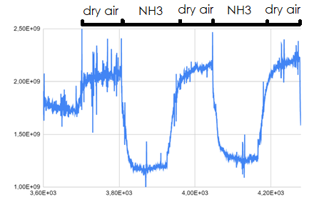
Agathe Lièvre – Assia Nguyen AIME-GSWO3 5ISS - 2021/2022
GENERAL CHARACTERISTICS
Type | Chemical sensor
Materials | Silicon N-doped poly-silicon (heater) Aluminum (temperature measurements) Nanoparticles of Tungsten Trioxide (WO3)
Sensor Type | Active (power supply required)
Gas Measurement | Resistive measure
Temperature Measurement | Resistive measure
Detectable Gases | Alcohols (-OH) Ammonia (NH3) Carbon Monoxide (CO) Dihydrogen (H2) Ethanol (C2H60) Hydrogen Sulfide (SO2) Methane (CH4) Nitrogen Dioxide (NO2)
Typical Detection Range | > 1 ppm
Package | TO-5-10 (10 pins)
Head Diameter | 9.5 mm
Head Height | 4.7 mm
Package Height | 25 mm
Pin Diameter | 0.6 mm
Mounting | Through hole fixed (THT)
GAS SENSOR CHARACTERISTICS
Fig 3:
2

Slide 3
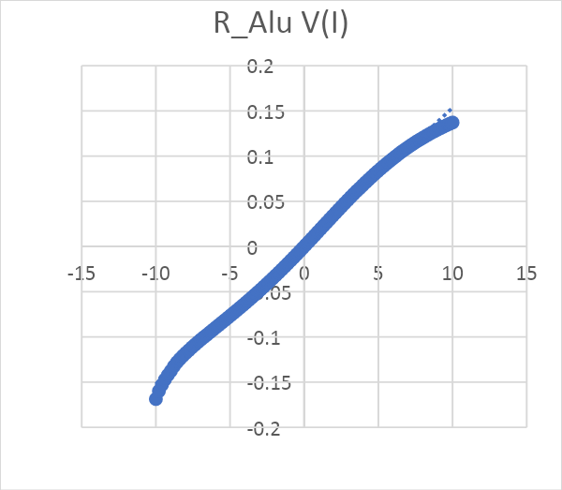
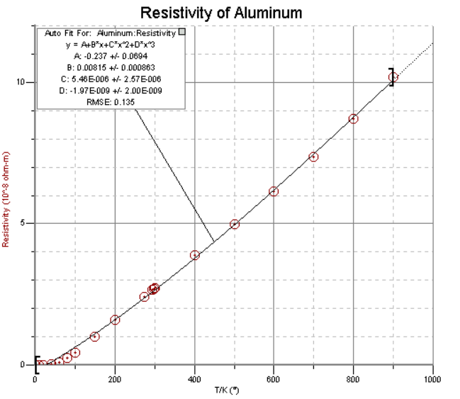
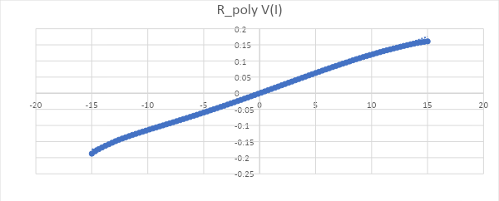
Agathe Lièvre – Assia Nguyen AIME-GSWO3 5ISS - 2021/2022
ELECTRICAL CHARACTERISTICS
 |  | Units | Values
 |  |  | Min | Typical | Max
Resistance | Gas Sensor | GΩ | 0.01 | 1 | 100
 | Temperature Sensor | Ω | 57 | 65 | -
 | Heater | Ω | 70 | 85 | -
Voltage | Gas Sensor | V | - | 3.3 | -
 | Temperature Sensor | V | 3.3 | 5 | -
 | Heater | V | 10 | 15 | 20
Fig 4: Current/Voltage characteristics of the Aluminum resistor at 20°C
Fig 5: Resistivity of Aluminum, Val Polyakov - 2004
Fig 6: Current/Voltage characteristics of the Poly-silicon resistor at 20°C
3

Slide 4
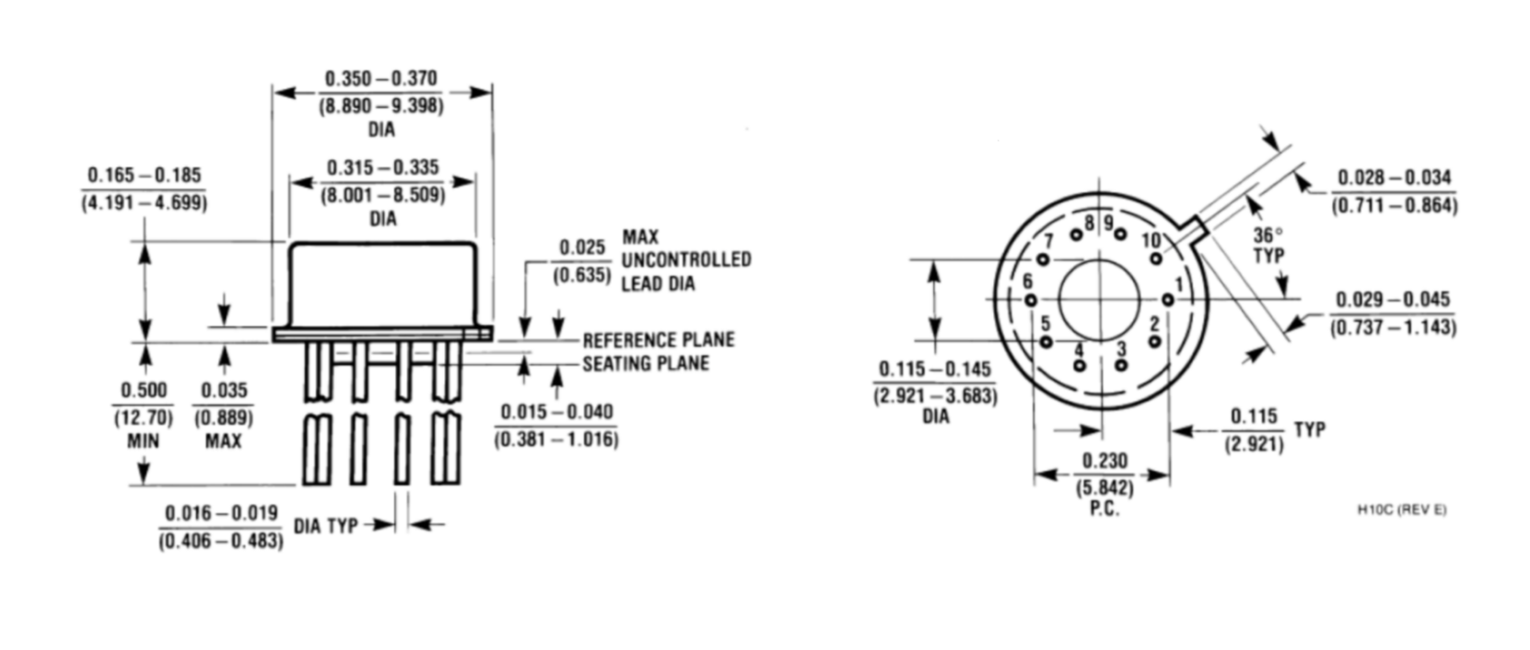
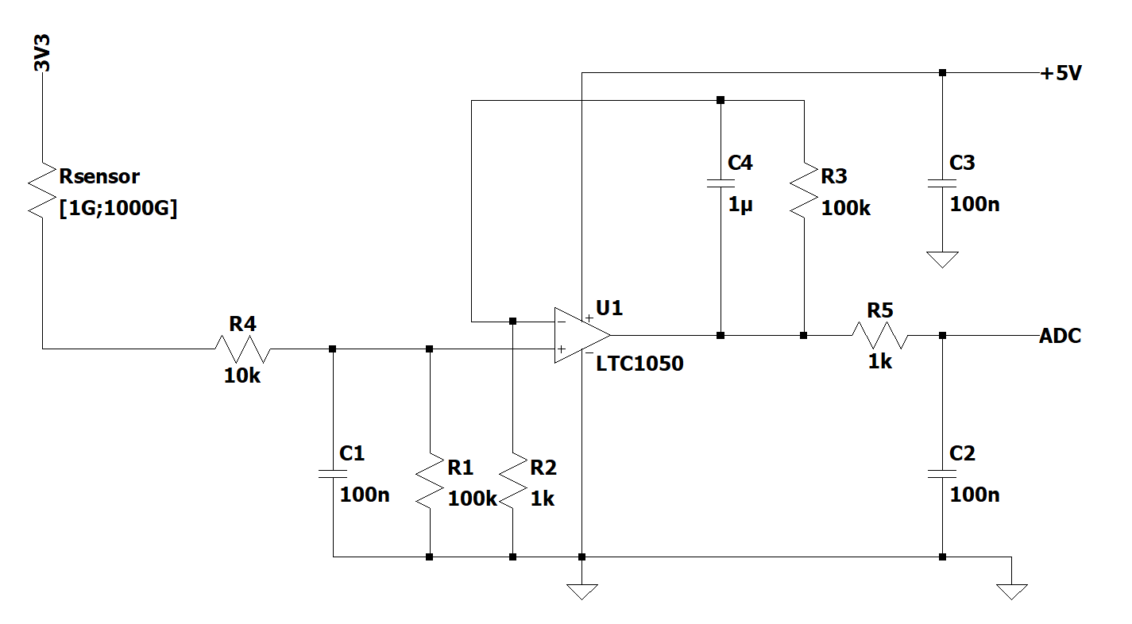
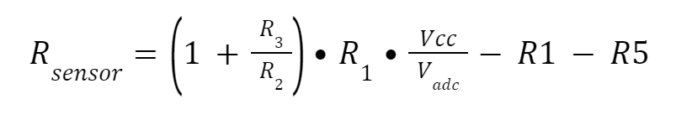
Agathe Lièvre – Assia Nguyen AIME-GSWO3 5ISS - 2021/2022
CONFIGURATION
The package is a 10-Lead TO-5 metal :
Fig 7: Package configuration
APPLICATION
Fig 8: Application example
The resistance of the sensor has a magnitude of Giga Ohm. This means that a voltage divider is not efficient to measure the voltage. The figure shown above shows a circuit that uses an operational amplifier with a low offset voltage Therefore, it is possible to convert the current of the sensor into its resistance using the following formula :
4

