Slide 1

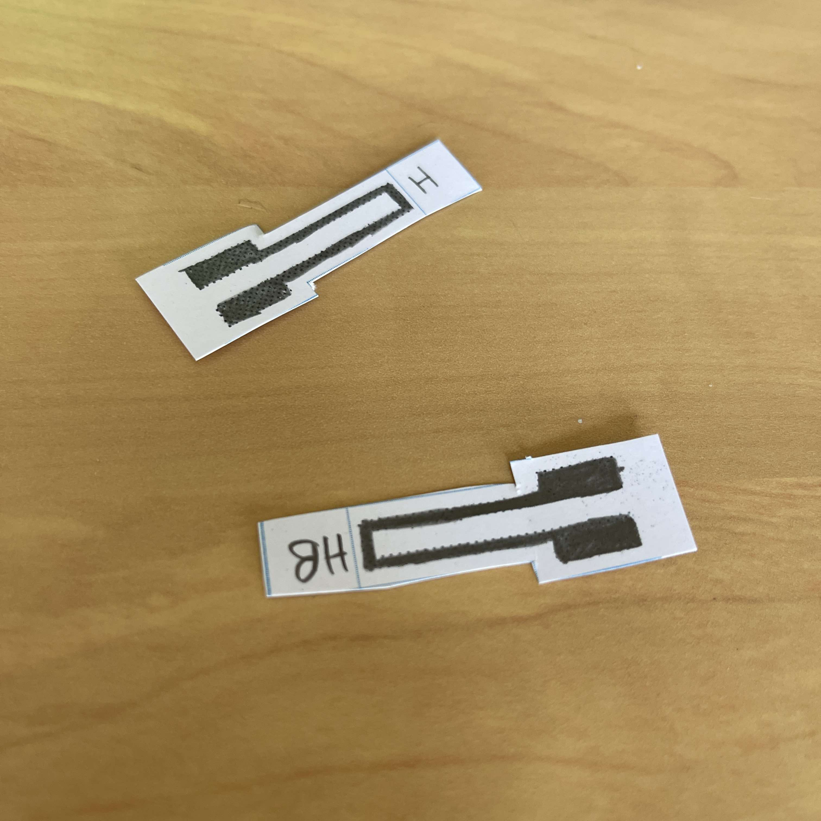
GT-LGT2803-Low Tech Graphite Strain Sensor
General Features:
-Low power consumption (3V-5V)
-Low cost
-Light and small (10cm2)
-Flexible and biodegradable
-Easy-to-use : plug and use
-Easily replaceable and reproductible)
-Bluetooth connection possible
Description:
The strain sensor was developed and made in the Applied Physics Department at the National Institute of Applied Sciences (INSA) of Toulouse, France.
The sensor technology is based on chemiresistor properties of graphite found in the article "Pencil Drawn Strain Gauges and Chemiresistors on Paper" published in 2014 by Cheng-Wei Lin, Zhibo Zhao, Jaemyung Kim, and Jiaxing Huang. The sensor can measure a resistance variation
This sensor consists of a small piece of paper coated with a graphite layer from a pencil. It can measure a resistance variation when applying a strain. The deformation leads to a change of the number of connected graphite particles in the thin layer of graphite and so it changes the resistance of the sensor. This allows us to measure deformation, like a traditional strain gauge.
The structure of the graphite layer varies depending on the type of pencil used. In order to fully understand the impact of the graphite structure on the variation of the resistance, we conducted tests with two types of pencils: HB (medium hardness) and 2B (softer). To achieve this, our sensors were coupled with a transimpedance amplifier and an Arduino Uno, all integrated on a PCB designed for tests.
Pin configuration and dimensions:
HAMADI Maoulida - TARTERA Maëlys
1

Slide 2
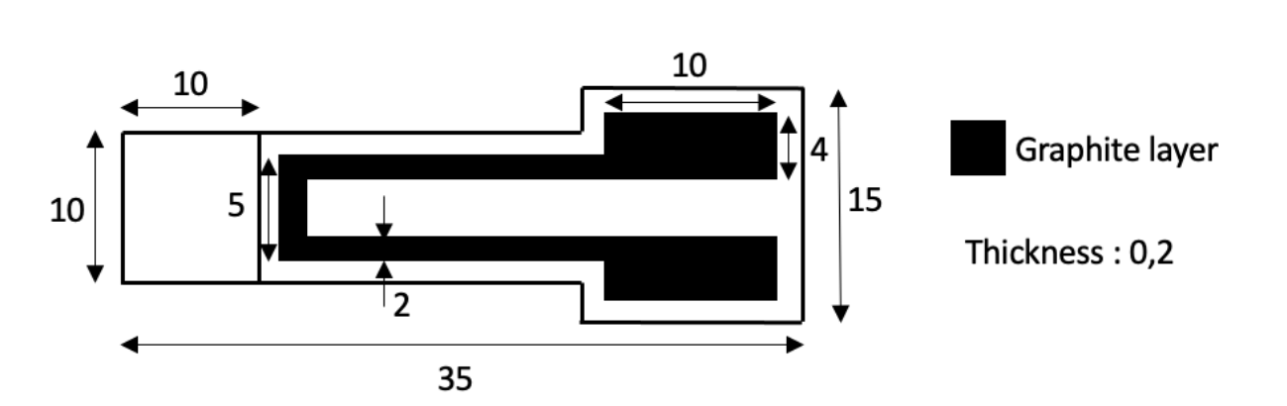
GT-LGT2803-Low Tech Graphite Strain Sensor
Pin Number | Usage
1 | Vin
2 | +Vcc (5V)
1
2
Fig 1 : Top View of the sensor with its dimension in mm
Standard use conditions:
 | Typical Value | Unit
Temperature | 20±5 | °C
Humidity | 50±5 | %
Bluetooth operation distance | 1±4 | m
Technical specifications:
Type | Strain sensor
Materials | Graphite (4B to 2H graphite pencil)
Sensor type | Passive: Power suply required
Power supply | Vcc=+5V
Nature of output signal | Analog
Nature of measurand | Voltage
Typical response time | Less than 50 ms
Typical use | Measurement of compression deformation
Electrical characteristics:
HAMADI Maoulida - TARTERA Maëlys
2

Slide 3
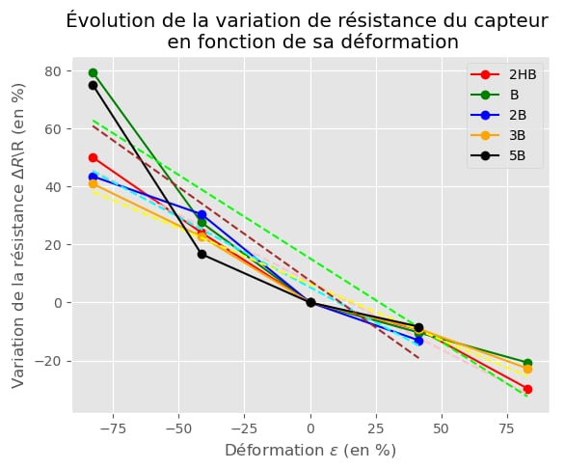
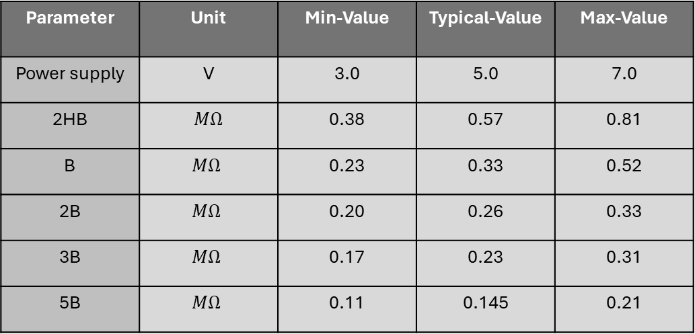
GT-LGT2803-Low Tech Graphite Strain Sensor
Parameter | Unit | Min-Value | Typical-Value | Max-Value
Power supply | V | 3.0 | 5.0 | 7.0
2HB | $$MΩ$$ | 0.38 | 0.57 | 0.81
B | $$MΩ$$ | 0.23 | 0.33 | 0.52
2B | $$MΩ$$ | 0.20 | 0.26 | 0.33
3B | $$MΩ$$ | 0.17 | 0.23 | 0.31
5B | $$MΩ$$ | 0.11 | 0.145 | 0.21
Pencil type-unit of the resistance and the resistance when no strain applied
Typical performance characteristics:
The deformation is considered positive when we apply a tensile strain and is negative when we compress the sensor
Fig 2 : Evolution of the variation of resistance depending on the deformation applied on the sensor (positive deformation=compressive strain & negative strain=tensile strain
HAMADI Maoulida - TARTERA Maëlys
3

Slide 4
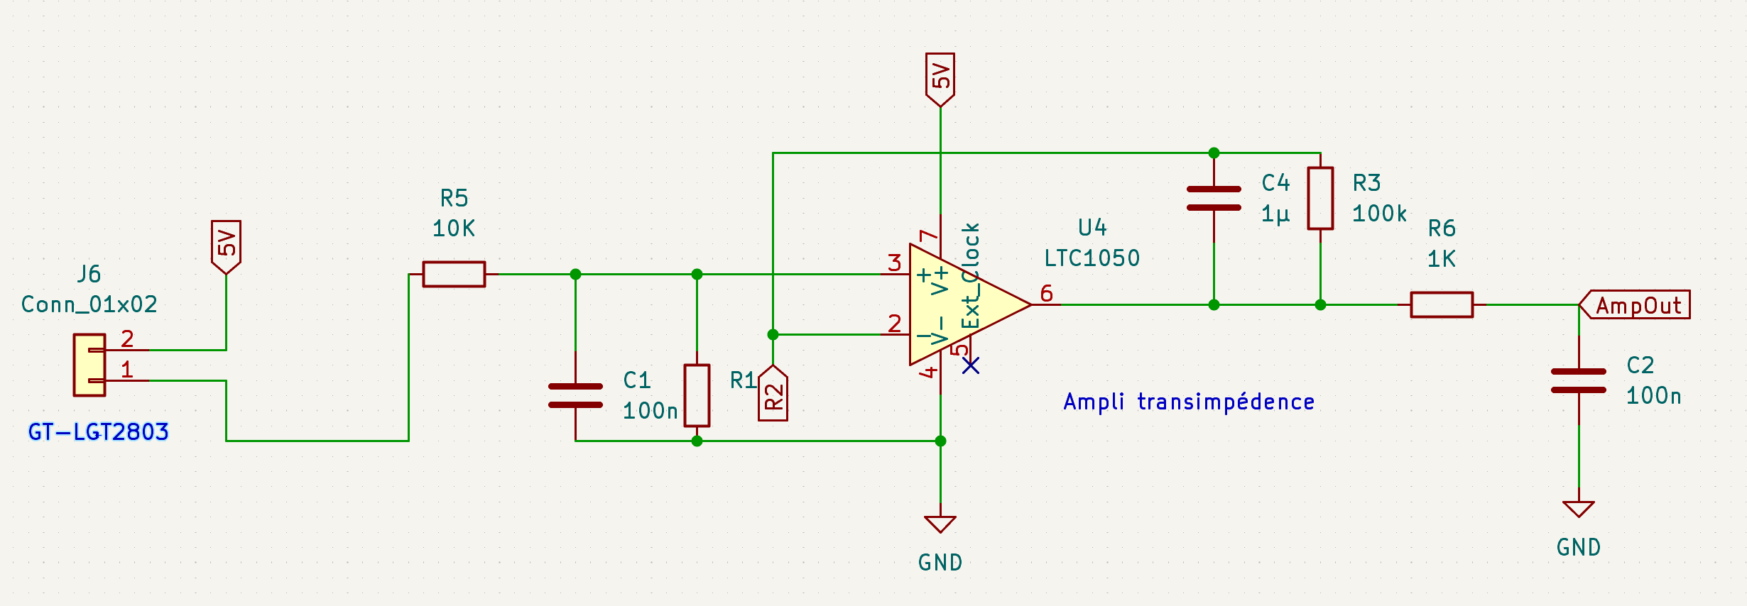
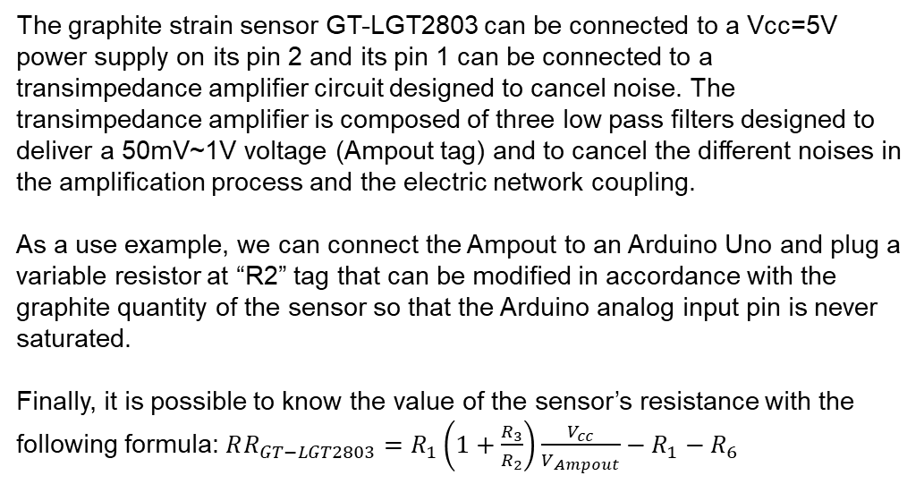
GT-LGT2803-Low Tech Graphite Strain Sensor
Typical application :
The graphite strain sensor GT-LGT2803 can be connected to a Vcc=5V power supply on its pin 2 and its pin 1 can be connected to a transimpedance amplifier circuit designed to cancel noise. The transimpedance amplifier is composed of three low pass filters designed to deliver a 50mV~1V voltage (Ampout tag) and to cancel the different noises in the amplification process and the electric network coupling.
As a use example, we can connect the Ampout to an Arduino Uno and plug a variable resistor at “R2” tag that can be modified in accordance with the graphite quantity of the sensor so that the Arduino analog input pin is never saturated.
Finally, it is possible to know the value of the sensor’s resistance with the following formula: $RR_{GT−LGT2803}=R_{1}\left(1+\frac{R_{3}}{R_{2}}\right)\frac{V_{cc}}{V_{Ampout}}−R_{1}−R_{6}$
HAMADI Maoulida - TARTERA Maëlys
4

