Slide 1

From 7 Days to 1 Day
Automating missing-document collection and verification after loan login
One secure upload link. Instant OCR + AI verification. Branch reviews only the exceptions.
AGRI Business Group | Process transformation proposal | October 2026
Notes:
Purpose: approval for a pilot that turns the missing-document loop from 7+ days into a same-day process. No product is being bought here; this is the target architecture and business case.

Slide 2





Today: a manual loop that takes 7+ days
Every missing or unclear document sends the file back through sales and branch
Customer completes loan journey
Branch Ops finds documents missing
Sales team visits customer to collect
Documents carried back to branch
Branch Ops validates again
Still missing or unclear? Customer is contacted again and the loop repeats
7+ days
4 handoffs
2-3 visits
No visibility
minimum turnaround
customer, sales, transit, branch
to the customer per case
of status until papers arrive
Missing-document automation | 2

Slide 3






What the delay is costing us
The cost is not only time: it is revenue, sales capacity and customer trust
Slow disbursal
Sales used as couriers
Sanctioned loans wait a week or more; interest income and customer momentum are lost.
Relationship managers travel to collect papers instead of sourcing new business.
Rework every cycle
Customer drop-off
Branch Ops checks the same file 2-3 times; errors are found late, not at the source.
Repeated calls and visits frustrate agri customers; some move to competitors.
No tracking
Physical document risk
No single view of which document is pending, with whom, or for how long.
Paper changes hands several times; risk of loss, misplacement and audit gaps.
Missing-document automation | 3

Slide 4





Proposed: upload once, verified in minutes
The customer or sales uploads on a secure web page; the system checks and replies instantly
1. Auto-alert
2. Upload
3. OCR + AI check
4. Instant feedback
5. Exception review
Customer gets a secure SMS / WhatsApp link listing exactly which documents are missing
Customer (or sales, assisted) uploads photos or PDFs from any phone, no branch visit
Each document is read, classified and matched with loan data in seconds
Blurry, wrong or mismatched? Customer is told why and re-uploads on the spot
Branch Ops reviews only flagged items; clean files move straight to disbursal
Result: customer interaction, verification and re-submission all happen in the same session, so the file is complete the same day.
Missing-document automation | 4

Slide 5
Turnaround: 7+ days becomes same day
Where the time goes, today versus the automated flow
Day 1
Day 2
Day 3
Day 4
Day 5
Day 6
Day 7
TODAY
Gap found, sales informed
Sales visit & collect
Transit to branch
Validation, gaps again
Second visit & re-check
AUTOMATED
Alert + upload + AI check
Complete within 1 working day
Most clean files close in under 2 hours; only flagged items wait for branch review.
Re-upload if flagged
Branch exception review
Missing-document automation | 5

Slide 6
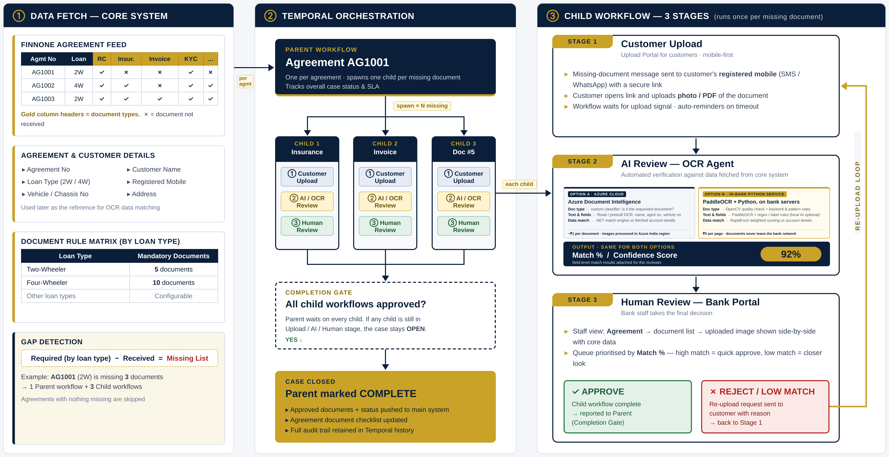








Technical architecture: workflow view
One parent per agreement, one child per missing document, three review stages
Missing-document automation | 6
Notes:
Workflow view of the target architecture: core-system fetch and document rule matrix, Temporal parent workflow per agreement with one child workflow per missing document, three stages per child (customer upload, AI/OCR review with match %, human review). Stage 2 shows two ways to build the OCR agent: Option A uses Azure Document Intelligence (custom classifier plus Read or prebuilt OCR, about ₹1 per document, processed in the Azure India region) with a .NET match engine; Option B is an in-bank Python service (OpenCV quality check, PaddleOCR, keyword, pattern and label rules, optional local AI, RapidFuzz scoring) with no per-page cost and documents never leaving the bank. Both return the same match % and field-level results. The cost slides assume Option B, re-upload loop, and case closure when all children are approved.

Slide 7
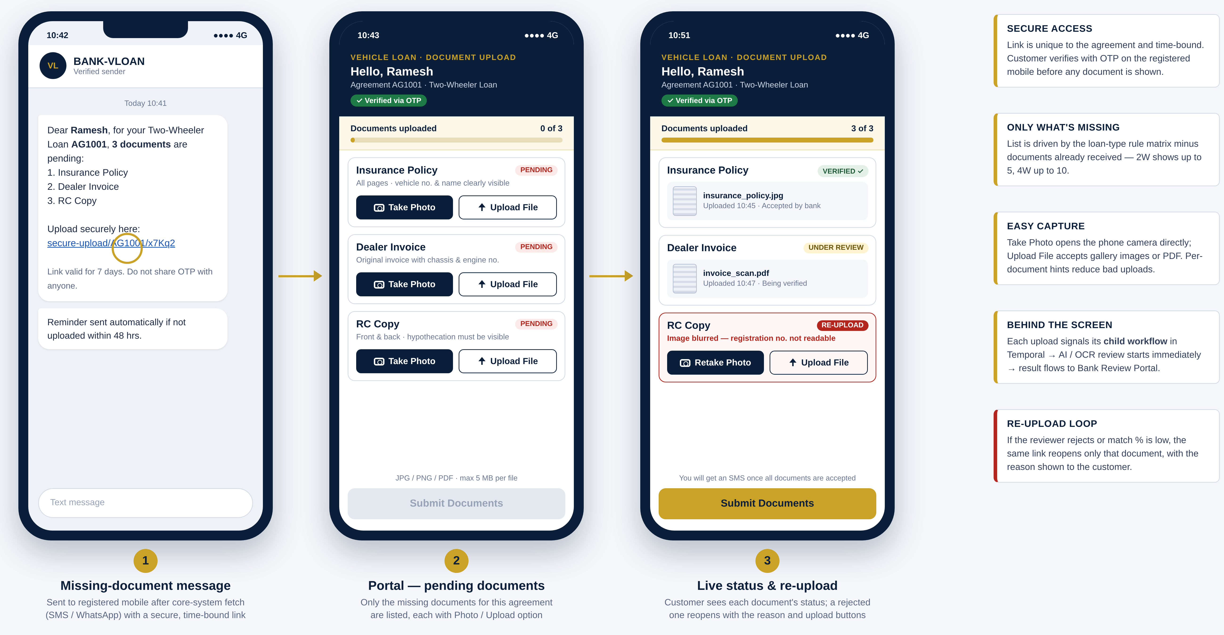
Customer upload portal
Opened from the SMS link; shows only missing documents with photo or file upload
Missing-document automation | 7
Notes:
Customer journey: secure SMS/WhatsApp link, OTP-verified portal listing only the missing documents with Take Photo / Upload File, then live status per document and re-upload with reason.

Slide 8
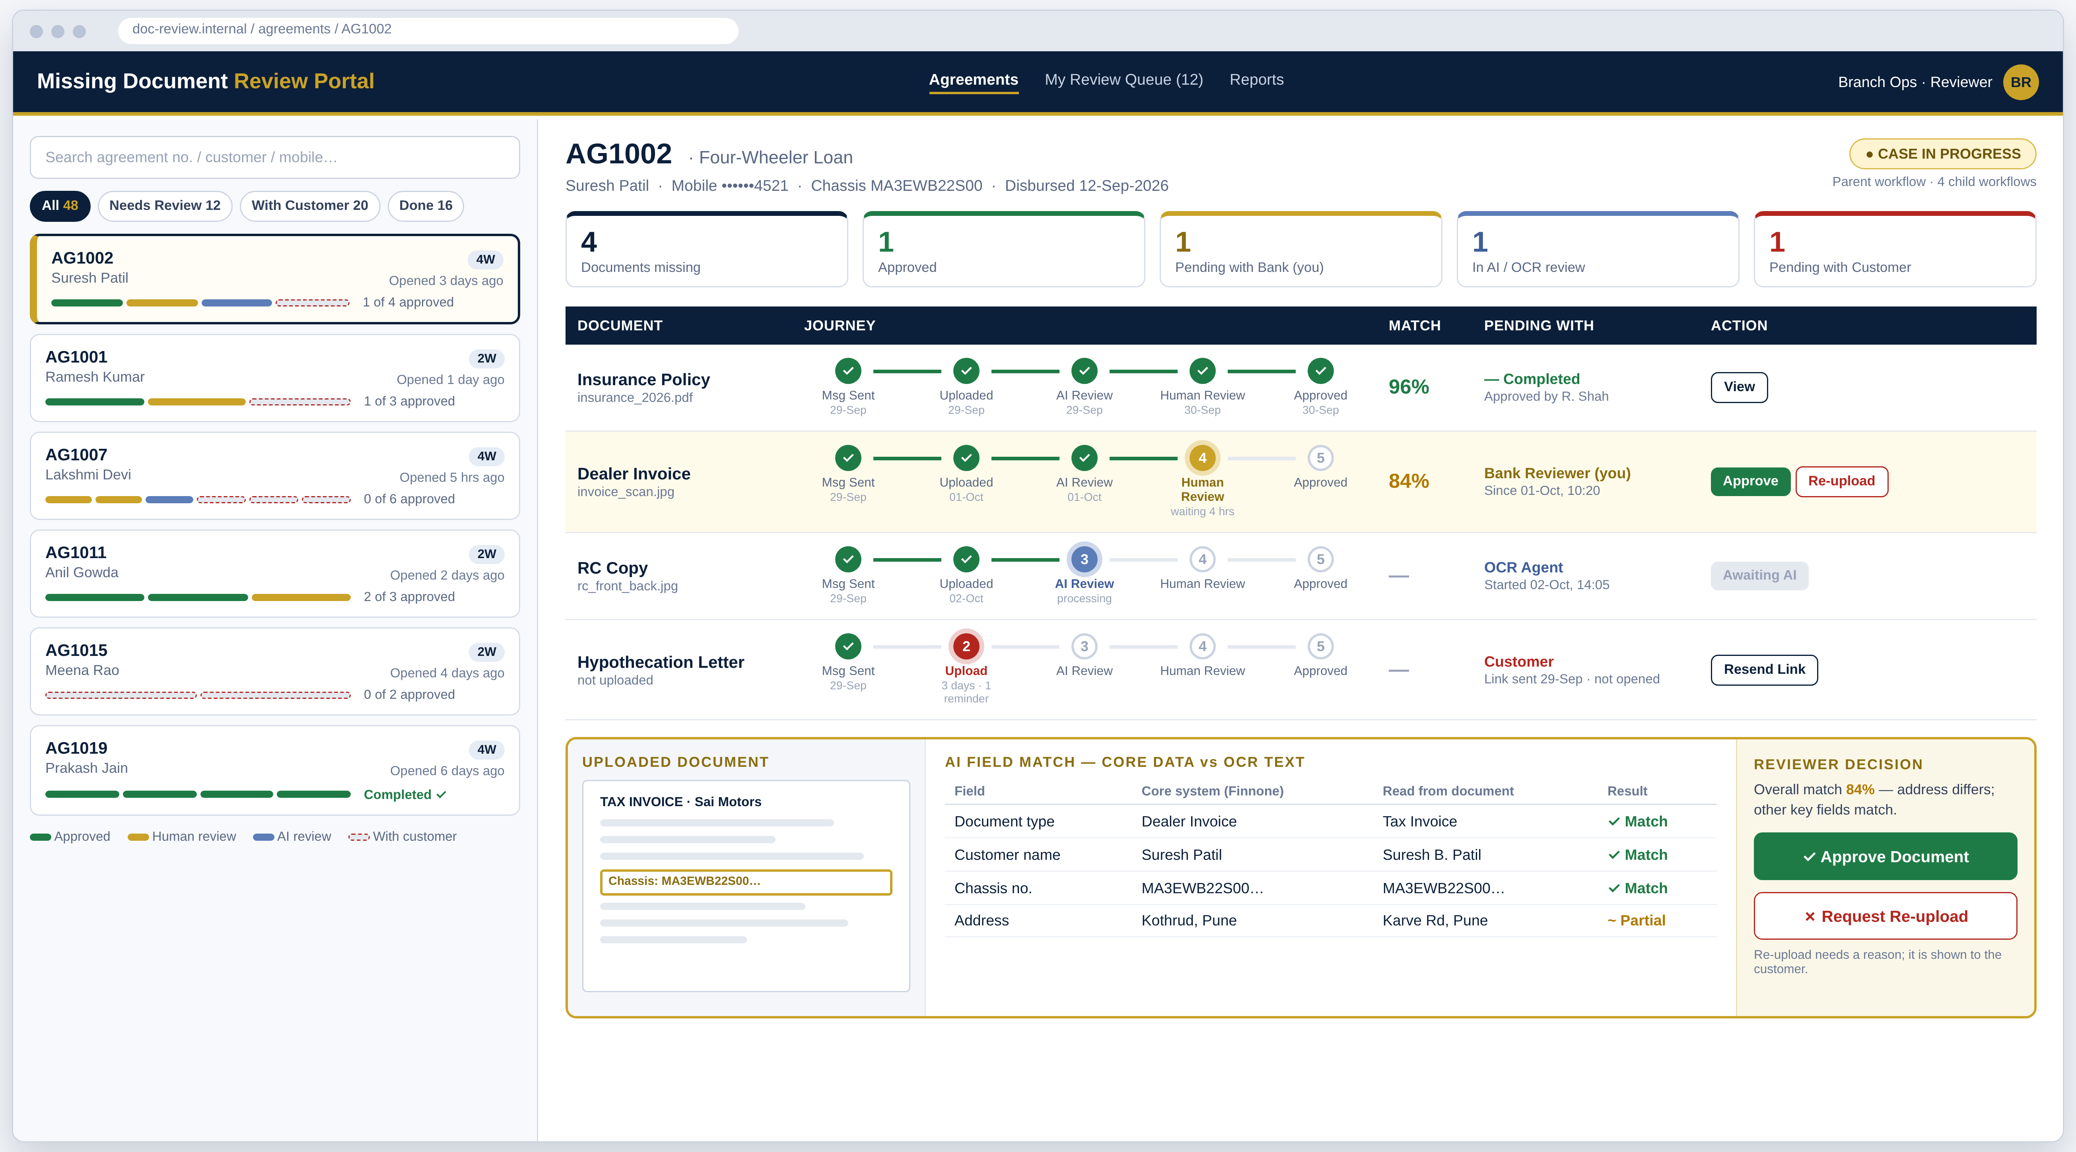
Branch review portal
Agreement list, document-level journey and where each document is pending
Missing-document automation | 8
Notes:
Bank staff view: agreement list with progress, per-document 5-step tracker, match %, pending-with column, and side-by-side AI field match with Approve / Request re-upload.

Slide 9



How automated verification decides
Every document gets a confidence score; only uncertain cases reach a person
Readable?
Auto-accept
Image quality, all pages present, not cropped
High confidence
Moves straight to disbursal checklist
Right document?
Classified as the requested type (land record, ID, bank statement)
Branch review
Data matches?
Medium confidence
Ops sees document beside extracted data
Name, ID, survey number and amounts match loan application
Genuine & current?
Re-upload now
Tamper signs, expiry and issue date checks
Low quality / mismatch
Customer told the exact reason instantly
Missing-document automation | 9

Slide 10



Reliable use of AI: it checks, people decide
AI reads and matches documents; trust is earned in measured phases, with staff owning every decision
1
Shadow mode
2
Assisted review
3
Auto-accept high confidence
Pilot · first 4–6 weeks
After accuracy is proven
Only when the target is met
AI scores every document, but staff still check all of them. AI accuracy is measured against staff decisions.
Staff review every case, pre-sorted by match %, with mismatched fields highlighted for them.
Clean, high-score documents pass straight through; a 5% random sample is still checked by staff.
Gate to move up a phase: proposed ≥ 98% agreement with staff decisions on at least 1,000 pilot documents, signed off by Credit and Ops.
GUARDRAILS IN EVERY PHASE
Explainable
People own decisions
Monitored
Safe fallback
Reviewer sees each field match beside the image, not just a score
AI only accepts or flags; a content rejection is always made by staff, with a reason
Weekly accuracy and false-accept rate; every score and model version is logged
If AI is unsure or unavailable, the case goes to manual review, never stuck
Missing-document automation | 10
Notes:
AI is introduced in three phases. In shadow mode it scores every document while staff still check all of them, so its accuracy is measured against real decisions. Only after a proposed gate (about 98% agreement on 1,000+ pilot documents, signed off by Credit and Ops) does it move to assisted review, and later to auto-accepting high-confidence documents with a 5% random audit sample. In every phase: explainable field-level matches, staff own all content rejections, weekly accuracy monitoring with full logging, and manual fallback.

Slide 11
Effort per case: 10 hours down to 1 hour
Staff hours spent per missing-document case, by activity
90%
less staff effort per case
Biggest win
Sales visits drop from 6 hours to 30 minutes of optional assisted upload. That time goes back to sourcing loans.
Missing-document automation | 11

Slide 12
Cost comparison: existing vs new process
Per case and per year at 1,000 cases a month; detailed assumptions on slide 14
Cost line | Existing | New process
Gap identification & follow-up calls | ₹600 · 1.5 h | — automated alerts
Sales visits to collect documents | ₹3,000 · 6 h | ₹250 · optional assist
Travel (2 visits per case) | ₹600 | —
Handover & branch re-validation | ₹1,000 · 2.5 h | ₹200 · exceptions only
OCR / AI verification | — | ₹0 · in-house OCR
SMS / WhatsApp messages | — | ₹10
Bank infrastructure | — | ₹100
Cost per case | ₹5,200 | ₹560
Cost per year (12,000 cases) | ₹6.24 Cr | ₹0.67 Cr
89%
lower cost per case
₹5.57 Cr saved a year
Existing = staff time + travel. New = remaining staff time + messaging and bank infra; OCR runs in-house. One-time build cost excluded.
Missing-document automation | 12
Notes:
Per case, the existing process costs about ₹5,200: ₹600 gap identification and follow-up, ₹3,000 sales visits, ₹600 travel and ₹1,000 handover and branch re-validation. The new process costs about ₹560: ₹250 optional assisted upload, ₹200 branch exception review, and ₹110 technology run cost (OCR ₹0 as PaddleOCR runs in-house on bank servers, messaging ₹10, bank infrastructure ₹100 per case). At 12,000 cases a year that is ₹6.24 Cr versus ₹0.67 Cr, a net saving of ₹5.57 Cr (89% lower cost per case).

Slide 13




Annual impact
Illustrative, at 1,000 missing-document cases per month (assumptions on next slide)
108K
₹5.57 Cr
~54 FTE
7 → 1
staff hours saved per year
net saving per year, after SMS & infra
capacity freed for business
days turnaround
RUN COST PER YEAR · at 10,000 documents / month
₹0
₹1.2 L
₹12.0 L
₹13.2 L
OCR / AI · in-house, ₹0 / doc
SMS / WhatsApp · ₹1 / doc
Bank infra · fixed ₹1 L / month
total = ₹11 / document, ₹110 / case
Plus revenue upside: disbursing 6 days earlier adds about ₹740 interest per case, roughly ₹0.89 Cr a year, before counting fewer customer drop-offs.
Per case: ₹5,200 today vs ₹560 automated (₹450 staff + ₹110 run cost) = ₹4,640 saved. Infra is fixed, so ₹/doc falls with volume: ~₹6 at 20K, ~₹3.5 at 40K docs/month.
Notes:
Net saving = (₹5,200 − ₹560) × 12,000 cases = ₹5.57 Cr. Run cost ₹13.2 L/yr: OCR ₹0 (PaddleOCR and Python matching run in-house on bank servers, no per-page fee), messaging ₹1.2 L (10,000 × 4 × ₹0.25 × 12), bank infrastructure ₹12 L (₹1 L/month fixed, including the OCR server). At 20K docs/month run cost is ₹1.2 L/month (~₹6/doc); at 40K, ₹1.4 L/month (~₹3.5/doc), assuming the OCR server keeps up at that volume.

Slide 14
Assumptions behind the numbers
Indicative figures; replace with branch MIS data before final sign-off
Input | Value used | Basis
Missing-document cases | 1,000 / month | To be confirmed from LOS pendency report
Sales RM / Branch Ops cost | ₹500 / ₹400 per hour | Blended CTC incl. overheads
Travel per customer visit | ₹300 | Fuel / conveyance, 2 visits per case today
Staff hours per case | 10 today → 1 automated | Activity breakdown on effort slide
Documents processed | 10,000 / month | OCR + messages; conservative, incl. re-uploads
OCR / AI processing | ₹0 / document | PaddleOCR in-house; no per-page fee
SMS / WhatsApp | ₹0.25 × 4 per document | Link, OTP, reminder, status; incl. GST
Bank infrastructure | ₹1,00,000 / month | App, workflow, OCR service, DB, storage; fixed
Loan size / rate / days saved | ₹5,00,000 / 9% / 6 days | For interest-upside estimate only
Hours per FTE | 2,000 / year | Standard working hours
Excludes one-time build cost and drop-off revenue benefit. Run-cost rates are indicative 2026 prices; confirm SMS rates and server cost with IT.
Missing-document automation | 14
Notes:
Run-cost basis (indicative): transactional SMS about ₹0.12–0.22 per SMS plus GST; WhatsApp utility/authentication template about ₹0.115 per message plus provider fee; OCR has no per-page cost because PaddleOCR, OpenCV and RapidFuzz are open source and run on bank servers. For reference, cloud OCR would cost roughly $1.5 (read) to $10–50 (prebuilt/custom) per 1,000 pages. ₹0.25 per message is rounded up to stay conservative. Infra ₹1 L/month is a fixed estimate for app hosting, workflow engine, the Python OCR service, database, document storage and monitoring.

Slide 15

Built-in controls and compliance
Automation adds control rather than removing it
Data protection
Full audit trail
Human in the loop
Encryption in transit and at rest; Aadhaar and PAN masked on screen and in logs.
Who uploaded, what the system decided, who approved, with timestamps.
Auto-accept only above a set confidence; thresholds owned by Credit and Ops.
Secure access
Data stays in India
Accuracy monitoring
One-time links with OTP and expiry; role-based access for staff.
Hosted on bank-approved infrastructure per RBI data localisation norms.
Weekly review of AI decisions vs manual checks; models retuned as needed.
Missing-document automation | 15

Slide 16
Phased rollout
Start small, measure, then scale across branches
1
2
3
4
Weeks 1-4
Weeks 5-10
Weeks 11-14
Week 15+
Design
Build
Pilot
Scale
Map document types, validation rules and LOS integration points
Upload page, OCR/AI checks for top 5 documents, Ops console
5-10 branches; run alongside manual checks to prove accuracy
All branches, more document types, raise auto-accept thresholds
Pilot success measures: turnaround under 1 day • 80%+ documents auto-verified • zero sales visits for document collection
Missing-document automation | 16

Slide 17
Thank you
Questions and discussion
From 7 days to 1 day: same-day files, ~54 FTE of capacity back to the business, ₹5.57 Cr a year in net savings.
AGRI Business Group | Process transformation proposal | October 2026

