Slide 1
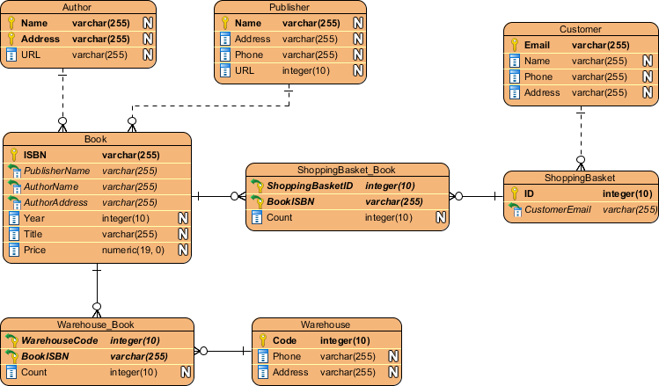
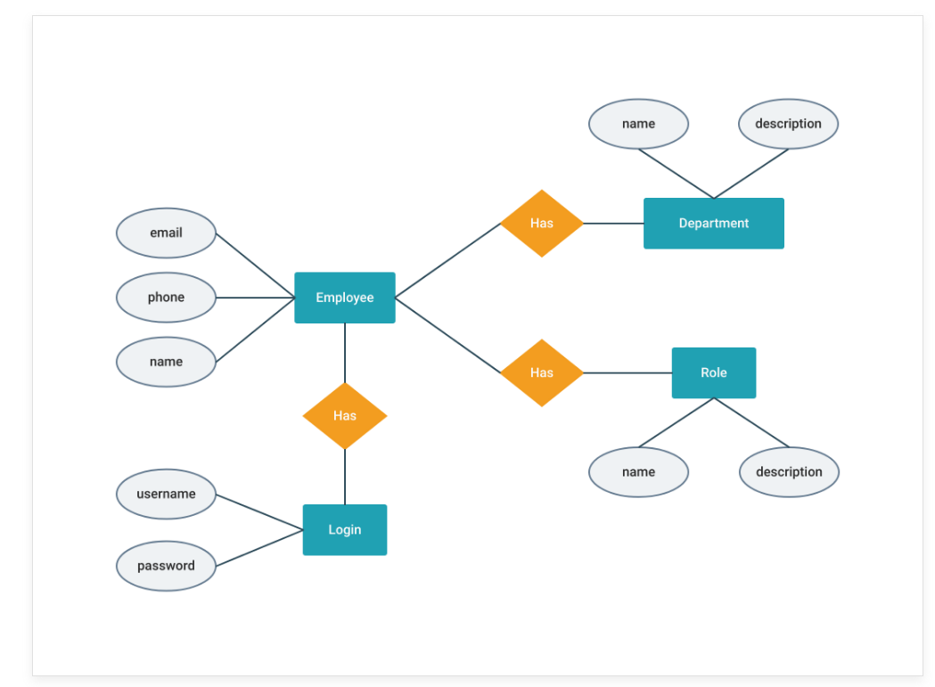
ERD

Slide 2
Components of ERD
Entities - typically displayed in a rectangle, entities can be represented by objects, persons, concepts, or events that contain data.
Attributes - displayed in a circle or an oval, the attributes refer to the characteristics of an entity. They can be categorized as simple, composite, or derived, and an object can have one or multiple attributes.
Relationships - illustrate how two or more entities interact with each other. They are displayed as labels placed on the lines connecting the objects.

Slide 3
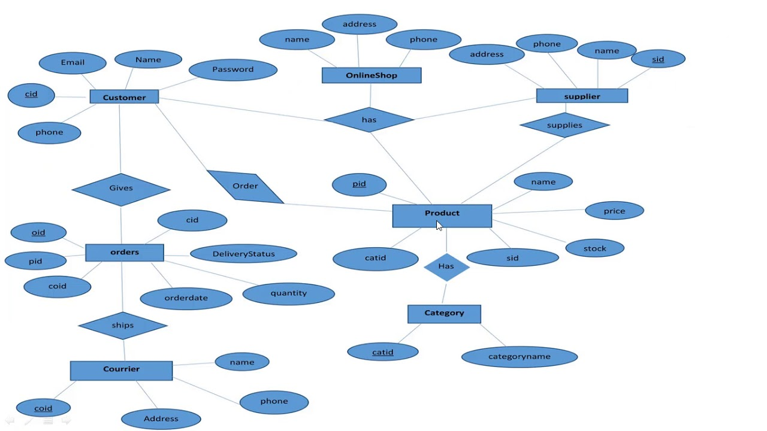
Entities
Training center
Courses
Categories
Students
Instructors
Employees
Orders
Services
Events

Slide 4
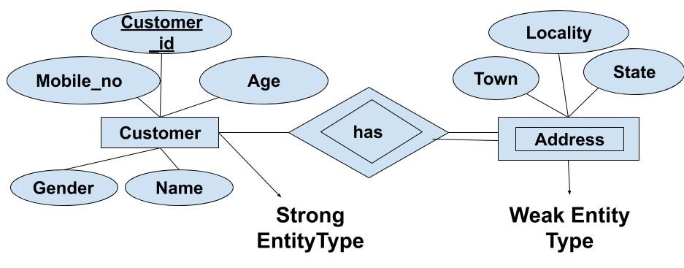
Types of Entities
Strong Entity
Week Entity

Slide 5
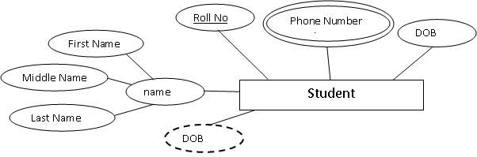
Attributes
Simple attribute
Composite attribute
Multi valued attribute
Derived attribute

Slide 6
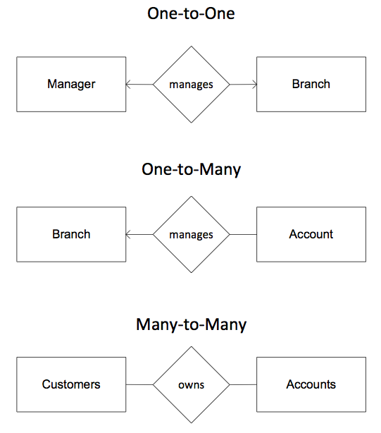
Types of relationships

Slide 7
TASK - Make ERD for
School
Restaurant
Shipping System
Ecommerce
Company

Slide 8
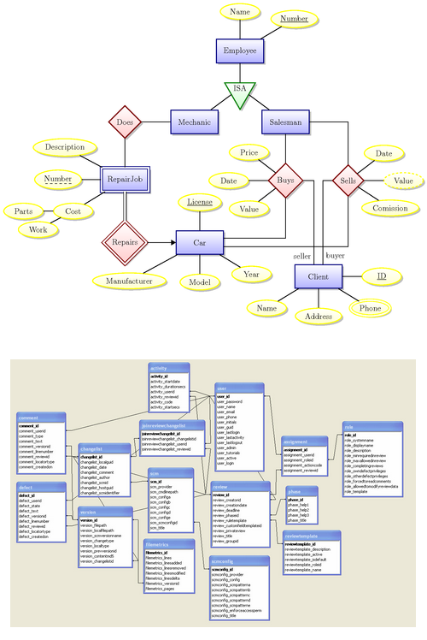
ERD to SCHEMA

Slide 9
