Slide 1
S.O.L.I.D
by
Ahmed Syam

Slide 2
1- The Single Responsibility Principle

Slide 3
Single Responsibility Principle
A class should have one, and only one, reason to change.

Slide 4
Single Responsibility Principle
the class has many instance variables.
the class has many public methods.
each method of the class uses different instance variables.
Specific tasks are delegated to private methods.

Slide 5
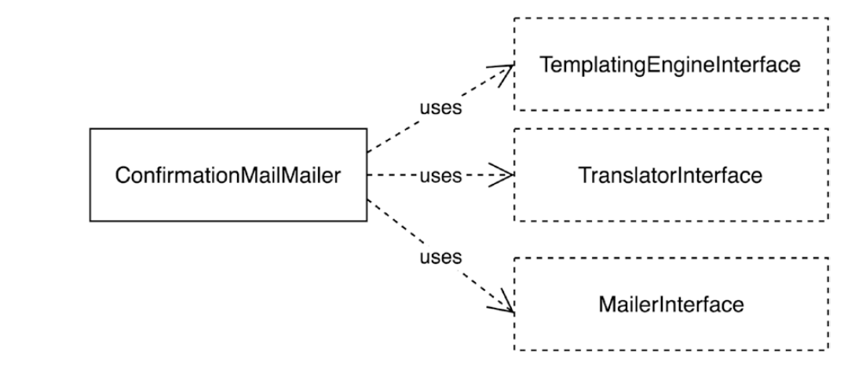
Single Responsibility Principle
Before

Slide 6
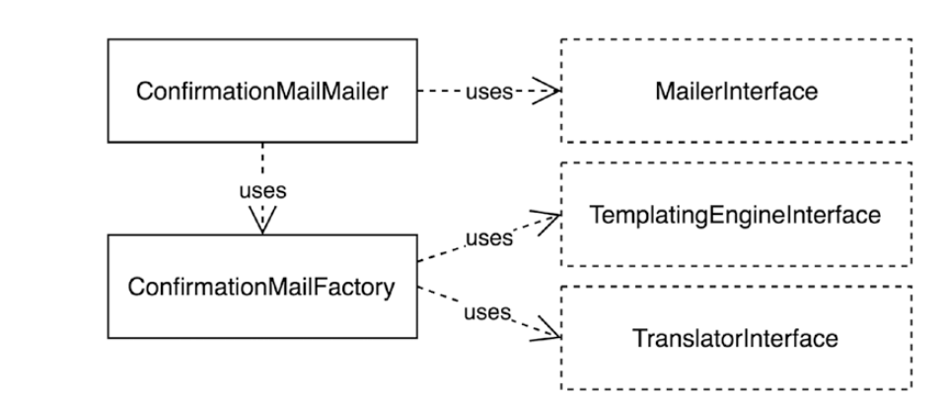
Single Responsibility Principle
After

Slide 7
2- The Open/Closed Principle.

Slide 8
Open/Closed Principle
You should be able to extend a class’s behavior without modifying it.

Slide 9
Open/Closed Principle
it contains conditions to determine a strategy.
Conditions using the same variables or constants are recurring inside the class or related classes.
class contains hard-coded references to other classes or class names.
inside the class, objects are being created using the new operator.
the class has protected properties or methods, to allow changing its behavior by overriding state or behavior

Slide 10
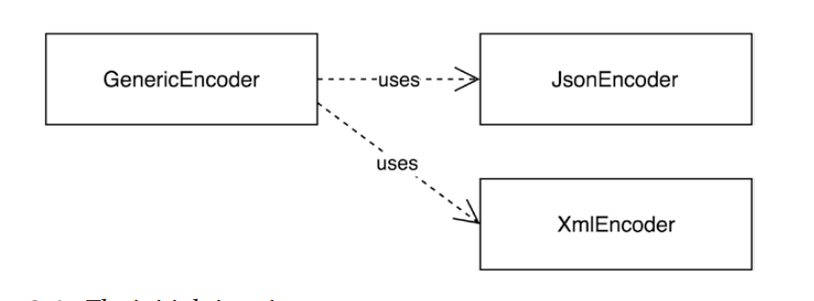
Open/Closed Principle
Before

Slide 11
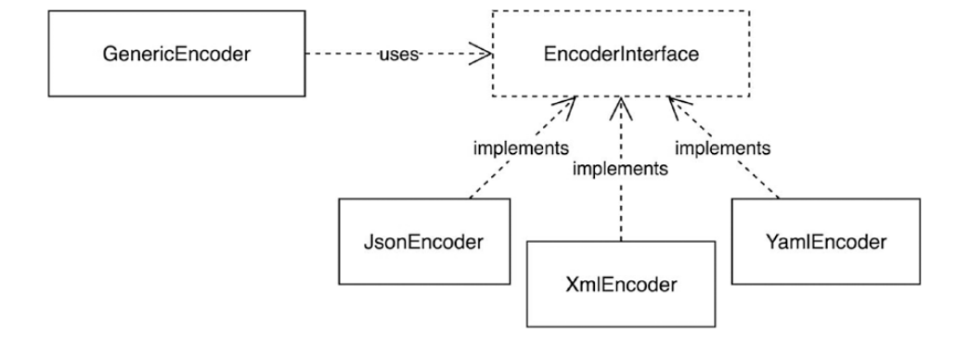
Open/Closed Principle
After (using Factory)

Slide 12
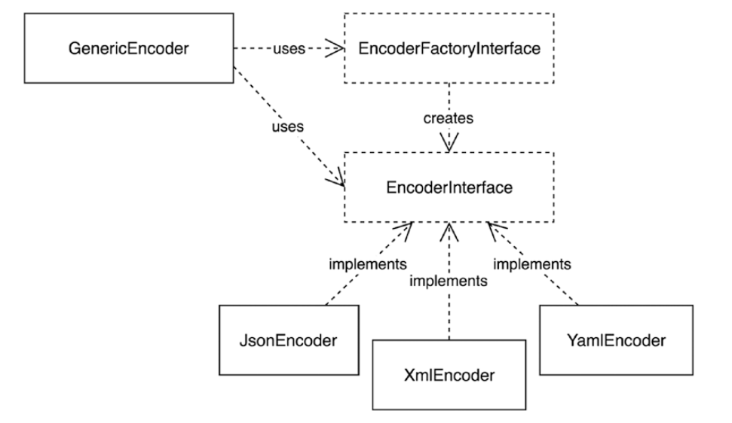
Open/Closed Principle
After (Making Factory Open for extension)

Slide 13
Open/Closed Principle
we make sure that objects open for extension, but closed for modification. Several techniques to accomplish this:
Apply the Single Responsibility principle and extract collaborating objects.
Inject collaborating objects as constructor arguments (dependency injection).
Provide interfaces for collaborating objects, thereby allowing the user to replace dependencies, or decorate them.
Mark classes as final, to make it impossible for the user to change the behavior of a class by extending it.

Slide 14
3- The Liskov Substitution Principle.

Slide 15
Liskov Substitution Principle
Derived classes “subclasses” must be substitutable for their base classes “parent”.

Slide 16
Liskov Substitution Principle
Depending on the programming language you work with, a base class can be:
a concrete class:
has no “missing” or “virtual” methods.
derived class, or subclass, overrides one or more methods that are already implemented
an abstract class:
there are one or more pure virtual methods that have to be implemented by the derived class.
an interface:
all of the methods of a base class are pure virtual methods

Slide 17
Liskov Substitution Principle
Violation 1:
A Derived Class Does Not Have an Implementation for All Methods.
“ex. Leaky Abstractions”

Slide 18
Liskov Substitution Principle
Violation 2:
Different Substitutes Return
Things of Different Types.

Slide 19
4- The Interface Segregation Principle.

Slide 20
Interface Segregation Principle
Make fine-grained interfaces that are client specific.

Slide 21
Interface Segregation Principle
“Fine-grained interfaces” stands for interfaces with a small amount of methods.
“Client specific” means that interfaces should define methods that make sense from the point of view of the client that uses the interface.

Slide 22
Interface Segregation Principle
Violation 1:
Multiple Use Cases

Slide 23
Interface Segregation Principle
Refactoring 1:
Separate Interfaces and Multiple Inheritance

Slide 24
Interface Segregation Principle
Violation 2:
No Interface, Just a Class

Slide 25
Interface Segregation Principle
Refactoring 2:
Add Header and Role Interfaces

Slide 26
5- The Dependency Inversion Principle.

Slide 27
Dependency Inversion Principle
Depend on abstractions, not on concretions.

Slide 28
Dependency Inversion Principle
Violation 1:
A High-Level Class Depends on a Low-Level Class

Slide 29
Dependency Inversion Principle
Refactoring 1:
Abstractions and Concretions Both Depend on Abstractions.

Slide 30
Dependency Inversion Principle
Violation 2:
Vendor Lock-In.

Slide 31
Dependency Inversion Principle
Solution 2:
Add an Abstraction and Remove the Dependency Using Composition

Slide 32
Thank You

