Slide 1

Beyond the Haze: Integrating SAM with Traditional Algorithms for Advanced Satellite Dehazing
Layal Saadeddine - Ali Assi - Mohamad Tarekh

Slide 2
Agenda
01
Introduction
02
Methodology
03
Results
Discussion
Conclusion
04
05

Slide 3
Introduction
01

Slide 4
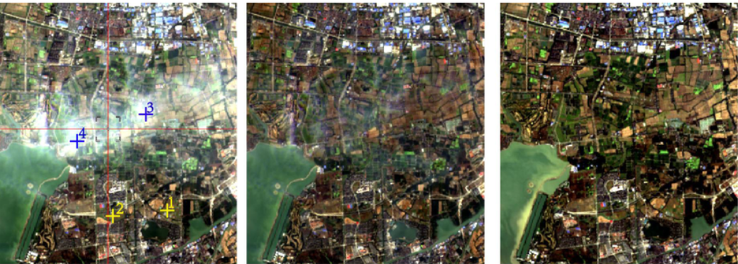
What is Dehazing?

Slide 5
Problem Statement
Reduced Visibility.
Spectral Distortion.
Loss of Contrast.

Slide 6
Methodology
02

Slide 7
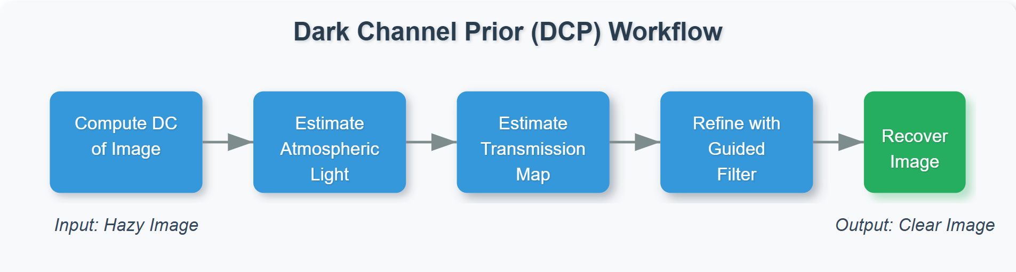
Dark Channel Prior (DCP)

Slide 8
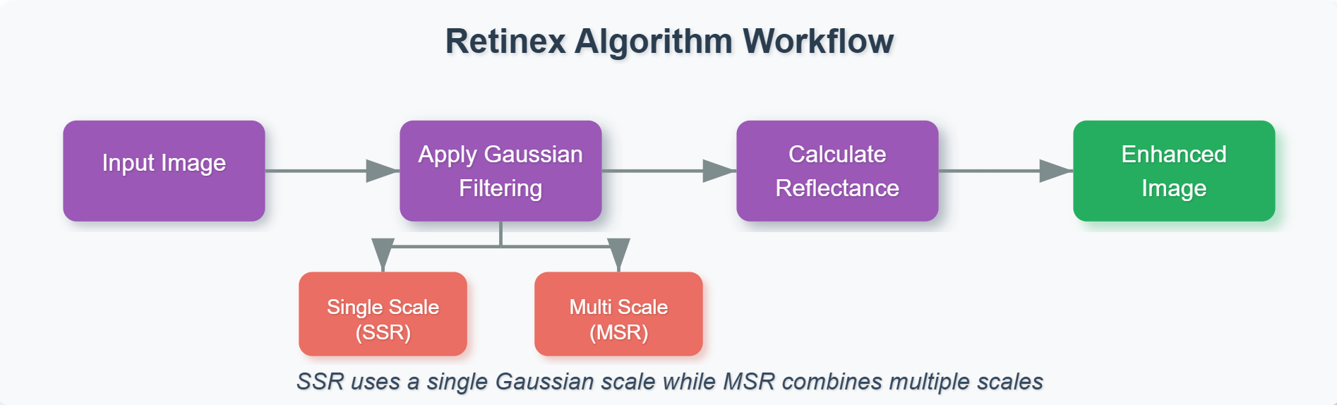
Retinex Algorithm

Slide 9
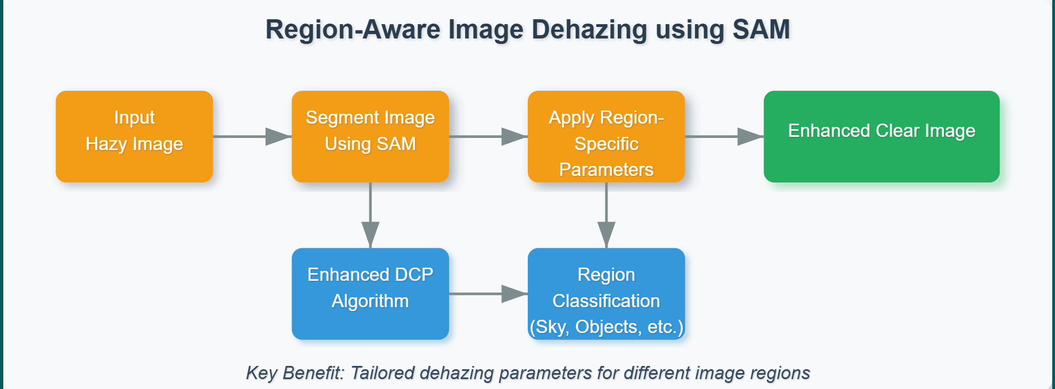
SAM-based region-aware approach

Slide 10
Deep Learning approach
Dehaze Former
Maxim

Slide 11
Results
03

Slide 12
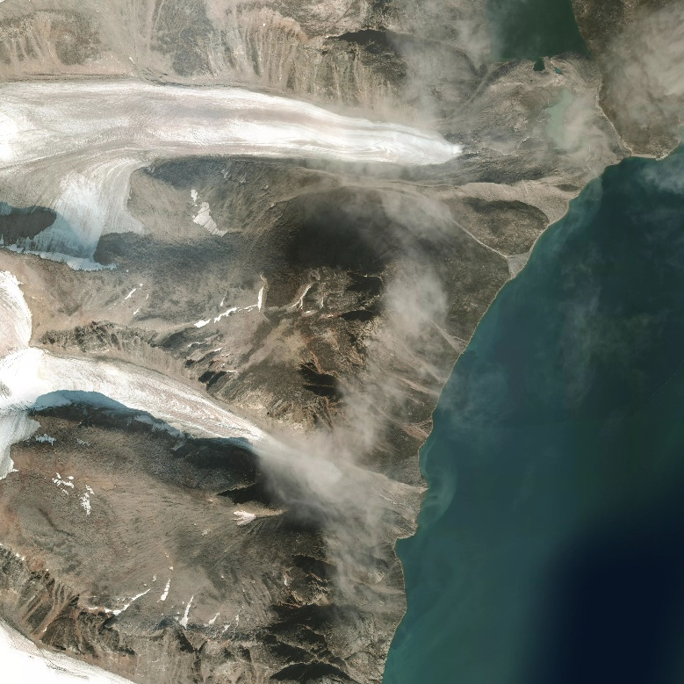
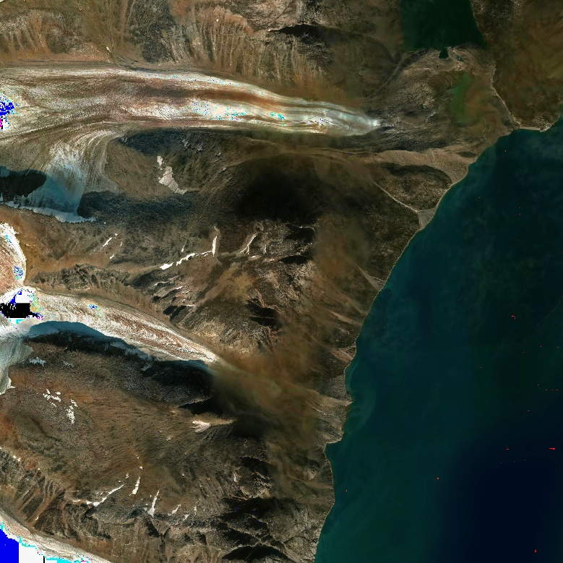
Dark Channel Prior (DCP)

Slide 13
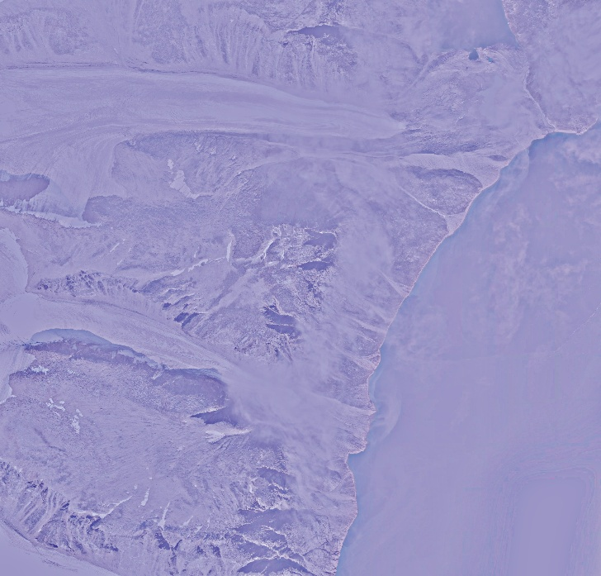
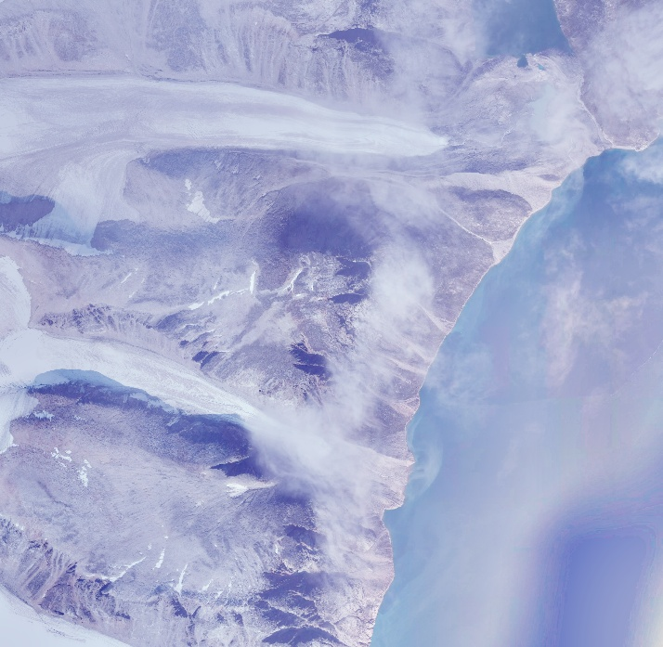
Retinex Algorithm

Slide 14
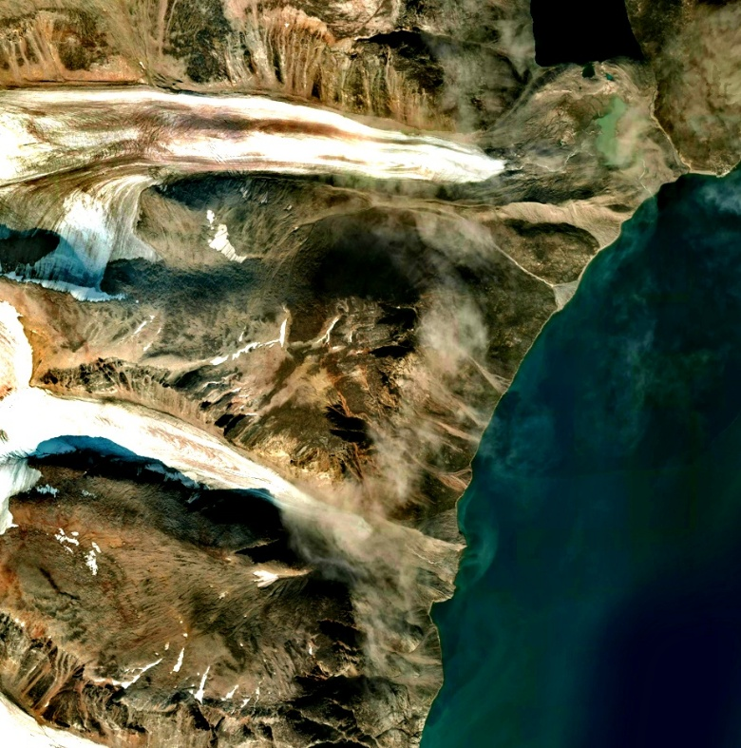
SAM-based region-aware approach

Slide 15
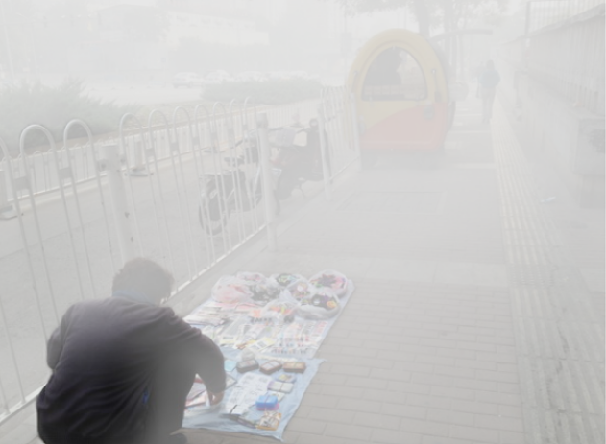
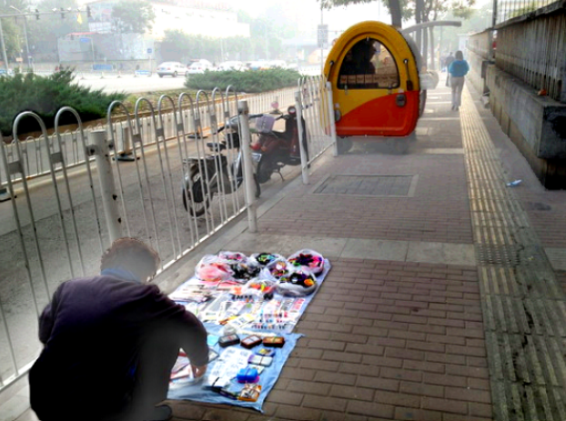
SAM-based region-aware on no satellite images

Slide 16
Discussion
04

Slide 17
Achievements
Successfully applied various existing methods.
Introduced an entirely new, semantically-driven approach.
Explored and analyzed deep learning techniques.

Slide 18
Limitations
DCP: Over Enhancement.
Retinex: artifacts and unnatural color.
SAM-based: needs to enhancement.
Deep learning approach: High computational resource requirements.

Slide 19
Future Work
Investigate deep learning-based dehazing approaches.
Enhance Region-Aware Image Dehazing using SAM approach to assign region colors more efficiently.

Slide 20
Conclusion
05

Slide 21
Thank You!!

