Slide 1
ideas
Filter scn list by creation year ….

Slide 2
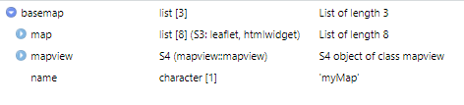
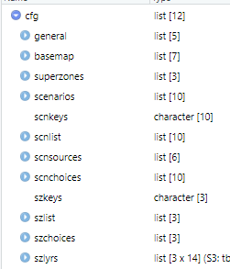

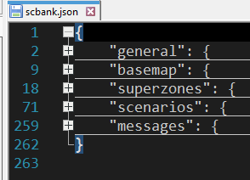
scbank.json
cfg <- initapp()
{
"general": ,
"basemap": ,
"superzones": ,
"scenariolist": ,
}
basemap = createmap(cfg$basemap)
# initialstatus : 0 do not load, 1 load&display, 2 load&no display
cfg$basemap
mapproperties

Slide 3
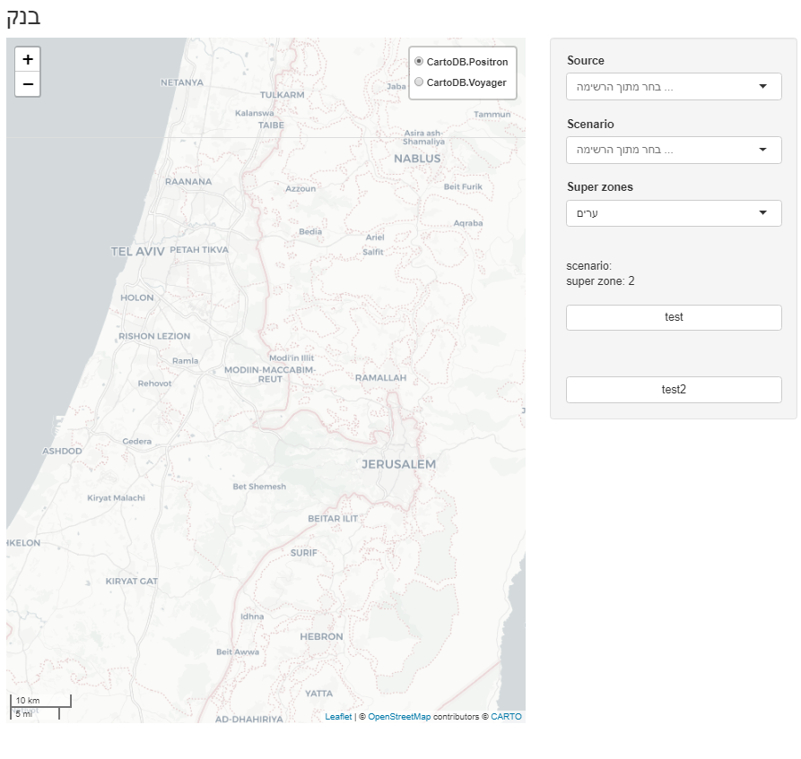
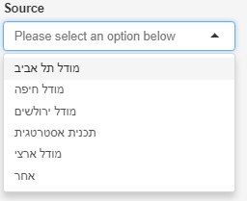
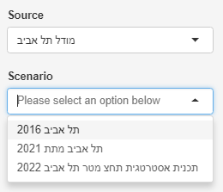
Getsrcscn()
cfg$scnchoices
1,2,3…
cfg$scnsources
updateSelectInput()
currentsrc
setScn()
currentscn

Slide 4
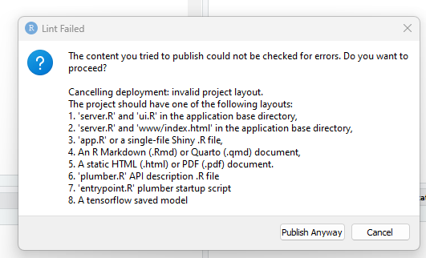
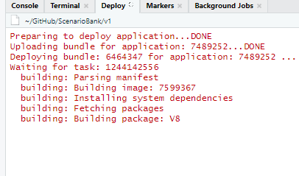
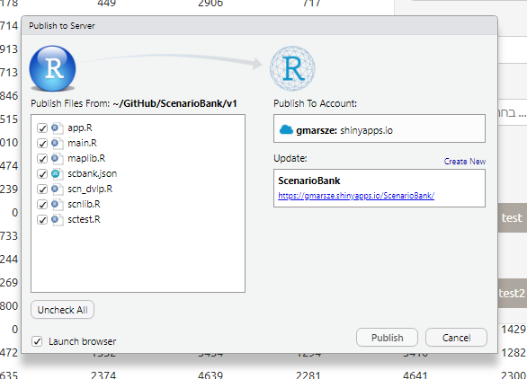
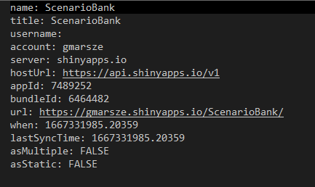
ScenarioBank.dcf
C:\Users\marsz\Documents\GitHub\ScenarioBank\v1\rsconnect\shinyapps.io\gmarsze\ScenarioBank.dcf
https://gmarsze.shinyapps.io/ScenarioBank/

