Slide 1
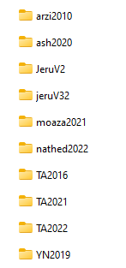
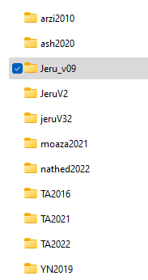

C:\Users\marsz\OneDrive\job\16\Models\Workgroups\Forecasts\System\Scn_lib\Jeru_v09\data
C:\Users\marsz\OneDrive\job\16\Models\Workgroups\Forecasts\System\Scn_lib
Sub x (xpt)
Export to csv
C:\Users\marsz\OneDrive\job\16\Models\Workgroups\Forecasts\System\dvlp\xpjson.rsc
“X”
Export to geojson
22.9.23

Slide 2
Need to create one file only

