Slide 1
story5
File created on: 10/29/2023 5:45:53 PM

Slide 2
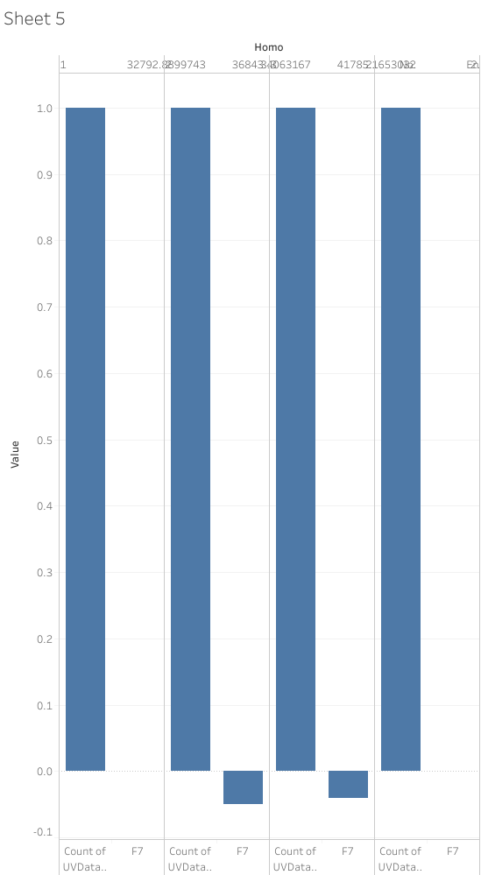

Slide 3
