Slide 1
Emirates Case Study
MOURIK Abdelhakim
17/02/2023

Slide 2
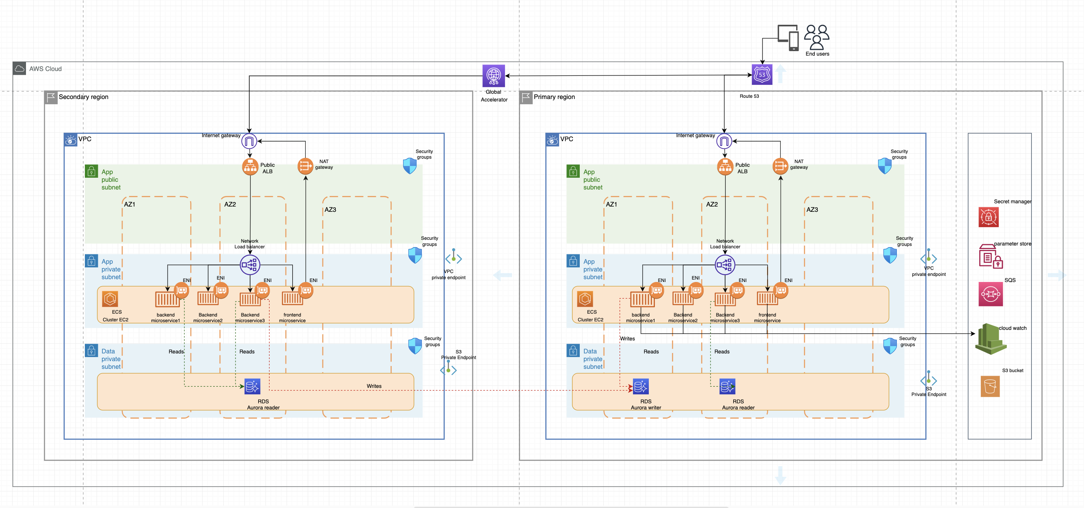
Emirates WebApp architecture

Slide 3
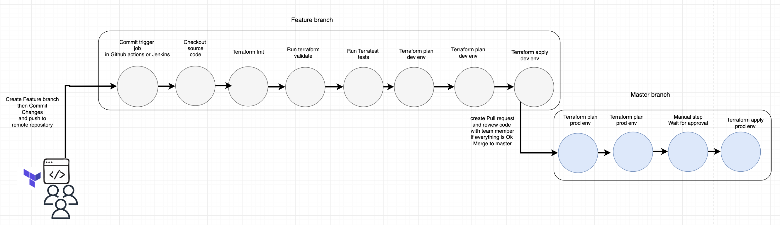
Infrastruction deployment workflow

