Slide 1
Emirates Case Study
MOURIK Abdelhakim
17/02/2023

Slide 2
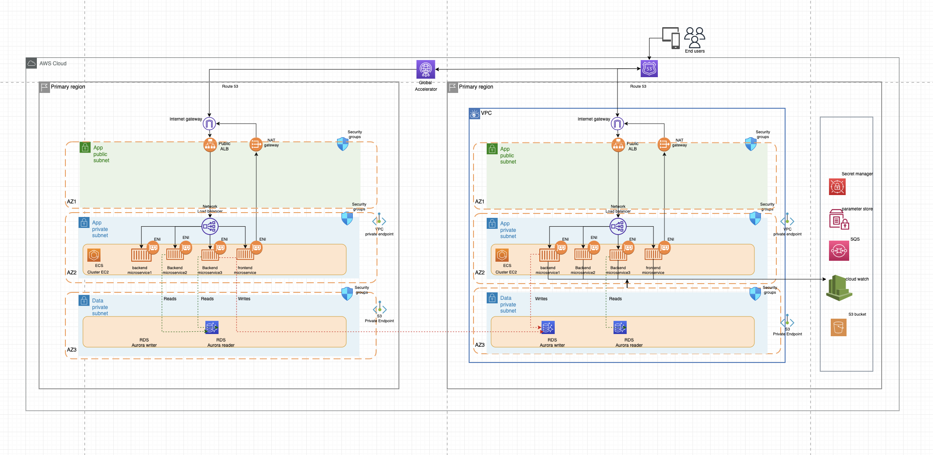
Emirates WebApp architecture

Slide 3
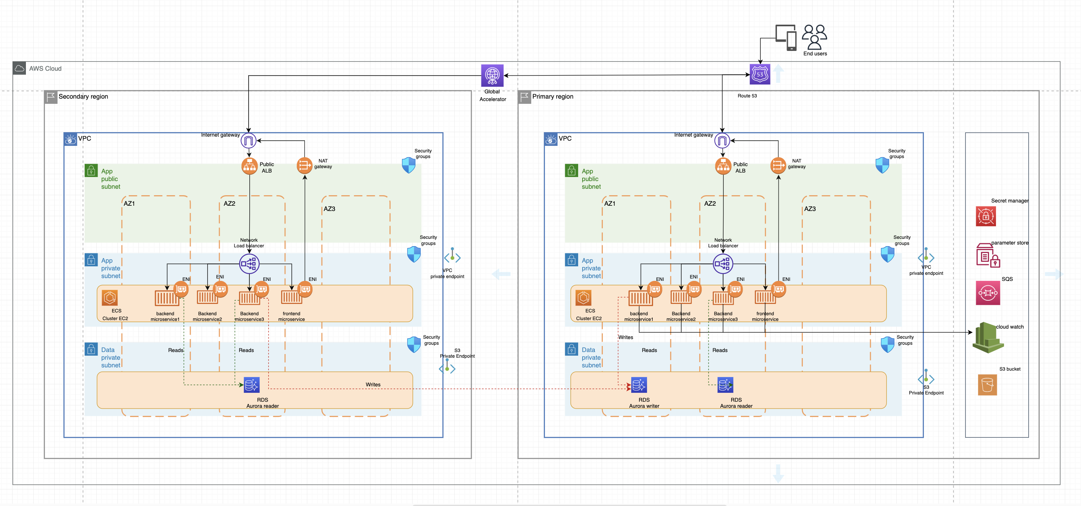
First version of archi with mistake related to az and subnets

Slide 4
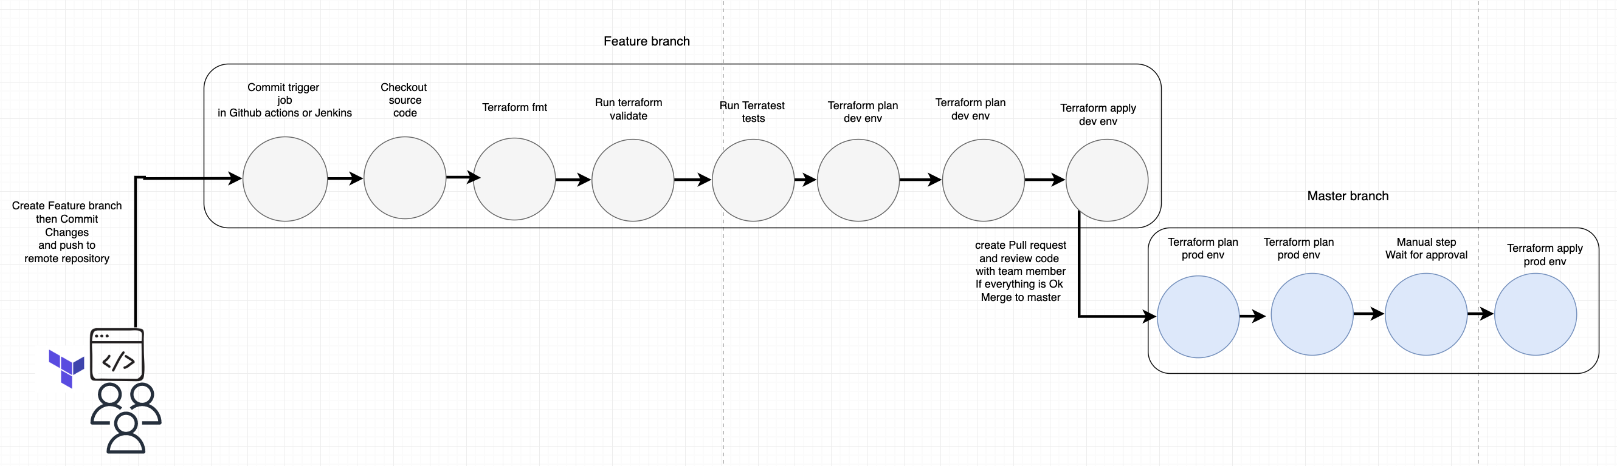
Infrastruction deployment workflow

