Slide 1
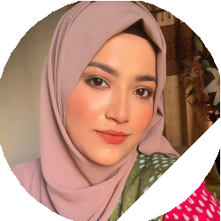



ABOUT ME
I am hardworking and put extra eﬀort into achieving my goals. I am resourceful and excel at ﬁnding ways to overcome any obstacles or challenges.
WORK EXPERIENCE
01/01/2020 – 01/02/2020 Dhaka, Bangladesh
Volunteer SCARS (Warmth for All)
Collected clothes and foods for the poor and suﬀering people near Uttara, Dhaka
Tasﬁa Rahman
Date of birth: 21/01/2003
Nationality: Bangladeshi
01/01/2019 – 03/02/2019 Dhaka, Bangladesh
Volunteer Red Crescent Bangladesh
I gained my communication skills from working as a volunteer.
CONTACT
Shadhinota Sarani, North Badda, Dhaka,
1212 Dhaka, Bangladesh
(Home)
moushi.zoo@gmail.com (+880) 1763725725
EDUCATION AND TRAINING
01/01/2018 – 10/02/2019 Dhaka, Bangladesh
SSC Banani Bidyaniketon School & College
Website https://www.bbnsc.edu.bd/
01/02/2020 – 08/04/2021 Dhaka, Bangladesh
HSC South Point School & College
Website https://spscmb.edu.bd/
06/02/2022 – CURRENT Dhaka, Bangladesh
Bachelor of Business Administration Independent University Bangladesh
Website http://www.iub.edu.bd/
LANGUAGE SKILLS
MOTHER TONGUE(S): Bangla
OTHER LANGUAGE(S): English
Hindi
ADDITIONAL INFORMATION
Hobbies and interests Travelling
Cooking
Trying new Foods
Communication and interpersonal skills Punctuality
Creativity Negotiation Critical Thinking Decision Making

