Slide 1
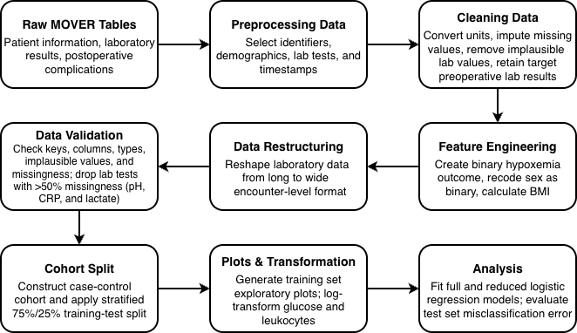
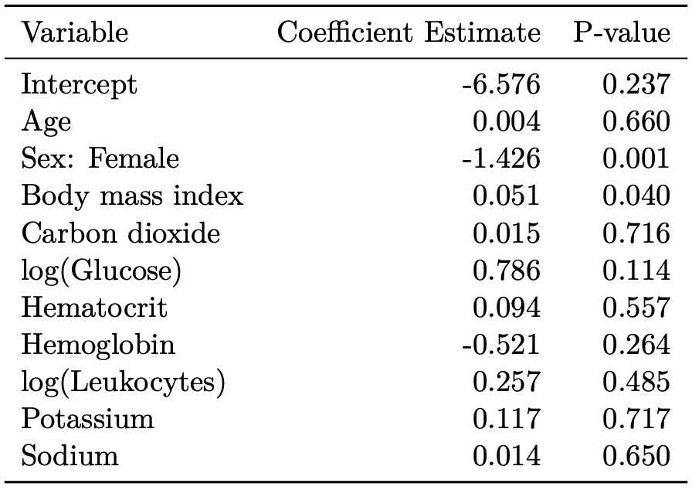
Investigating Postoperative Hypoxemia Using the Medical Informatics Operating Room Vitals and Events Repository (MOVER)
Yunfei Yu¹, Yang Lei¹, Benny Rochwerg¹, & Camellia Zakaria¹
¹Dalla Lana School of Public Health, Biostatistics Division, University of Toronto, Toronto, Canada
Abstract
Methodology (The Pipeline)
Conclusion & Impact
MOVER data were wrangled to find significant predictors of postoperative hypoxemia using a full logistic regression model
Male sex and higher body mass index (BMI) were identified
A reduced logistic regression model was then fitted solely using sex and BMI as predictors
The test set misclassification error rate for the reduced model was 28.0%, slightly lower than that for the full model
The results suggest that high-BMI or male patients should be paid greater attention to improve clinical outcomes
Also, including more variables when modelling may not be clinically beneficial
Key Takeaway: Patients who are male or have high BMI may benefit from closer postoperative monitoring for timely detection and intervention of hypoxemia
Key Risk Factors for Postoperative Hypoxemia
Higher BMI elevates odds, aligning with established literature⁴
Higher odds among males, contradicting previous findings⁴
Model Performance and Limitation
The reduced model outperformed the full model, suggesting that additional variables introduced noise rather than clinical signal
Only 98 out of 24,167 entries (0.4%) had hypoxemia; this extreme class imbalance limited model performance despite undersampling control cases to balance the data
Future Directions
Employing systematic oversampling or re-weighting techniques to improve minority class classification
Investigating alternative biomarkers and the interplay between hypoxemia and concurrent postoperative complications to enhance predictive accuracy
Figure 1. Flow chart of data wrangling architecture [CRP = C-reactive protein]
Key Findings
Introduction & Literature Review
Table 1. Full logistic regression model results
Postoperative hypoxemia is a frequent complication from anesthetic¹
The MOVER EPIC dataset includes records from 64,354 surgeries between 2017 and 2022² and can be used to study this issue
Prior research has assessed how postoperative hypoxemia is affected by different variables, but these models only contained up to four laboratory test results^{3,4,5}
To fill this gap characterized by few laboratory test results, this work modelled postoperative hypoxemia probability using logistic regression with up to ten preoperative laboratory test results and three demographic variables as covariates
The objective was to detect significant predictors of postoperative hypoxemia and determine the accuracy of predicting its probability with just these variables
References
¹ Yosef Belay Bizuneh, Mulualem Endeshaw Zeleke, Ashebir Mamay Gebru, Destaw Fetene Teshome, Fantahun Ayenew Mekonnen, Dessie Abebaw Angaw, and Amare Belete Getahun. 2025. Global prevalence of postoperative hypoxemia among adult and pediatric surgical patients: a systematic review and meta-analysis. BMC Anesthesiology 25, Article 284 (June 2025), 10 pages. doi:10.1186/s12871-025-03146-3
² Muntaha Samad, Mirana Angel, Joseph Rinehart, Yuzo Kanomata, Pierre Baldi, and Maxime Cannesson. 2023. Medical Informatics Operating Room Vitals and Events Repository (MOVER): a public-access operating room database. JAMIA Open 6, 4, Article ooad084 (Oct. 2023), 8 pages. doi:10.1093/jamiaopen/ooad084
³ Huiqing Ge, Ye Jiang, Qijun Jin, Linjun Wan, Ximing Qian, and Zhongheng Zhang. 2018. Nomogram for the prediction of postoperative hypoxemia in patients with acute aortic dissection. BMC Anesthesiology 18, Article 146 (Oct. 2018), 9 pages. doi:10.1186/s12871-018-0612-7
⁴ Ming Gong, Zining Wu, Shijun Xu, Lei Li, Xiaolong Wang, Xinliang Guan, and Hongjia Zhang. 2019. Increased risk for the development of postoperative severe hypoxemia in obese women with acute type a aortic dissection. Journal of Cardiothoracic Surgery 14, Article 81 (April 2019), 9 pages. doi:10.1186/s13019-019-0888-9
⁵ Debas Yaregal Melesse, Zewditu Abdissa Denu, Habtamu Getinet Kassahun, and Abatneh Feleke Agegnehu. 2020. The incidence of early post-operative hypoxemia and its contributing factors among patients underwent operation under anesthesia at University of Gondar comprehensive and specialized referral hospital, Gondar, North West Ethiopia, 2018. A prospective observational study. International Journal of Surgery Open 22 (2020), 38–46. doi:10.1016/j.ijso.2019.11.011
In the full model, sex and body mass index (BMI) were the only predictors significant at the 0.05 level (Table 1)
Female sex and higher BMI were associated with lower and higher odds of postoperative hypoxemia, respectively
The reduced model, which included only sex and BMI as predictors, achieved a lower test set misclassification error rate (28.0%) than the full model (29.3%)
Generative AI: Yang Lei refined writing using generative AI (ChatGPT). Benny Rochwerg used no generative AI tools. Yunfei Yu refined writing using generative AI (Gemini).

