Slide 1
文字文稿1
2026/04/20
汇报人: Muhammad Umar Farooq Qaisar

Slide 2
目录
Bullet points
Speaker notes
01
02
CONTENTS
Core Challenges Summary
03

Slide 3


What is ISAC for 6G
ISAC Definition
ISAC Advantages
Deep integration of communication and sensing via unified signal processing, hardware, and waveforms.
Improves spectral efficiency, reduces cost/energy use, enables real-time environmental intelligence.

Slide 4

What is ISAC for 6G
6G Role
Evolves to dual-function joint transceivers, cornerstone of adaptive intelligent systems.
Key Technologies
RIS enhances coverage, AI optimizes performance, novel waveforms improve accuracy/robustness.

Slide 5
Bullet points
01

Slide 6


Standardization
Leading Organizations
Key Responsibilities
3GPP Rel‑19/20, IEEE 802.11bf, ETSI ISG lead standardization efforts.
Define architectures and KPIs, details on pages 20–22.

Slide 7
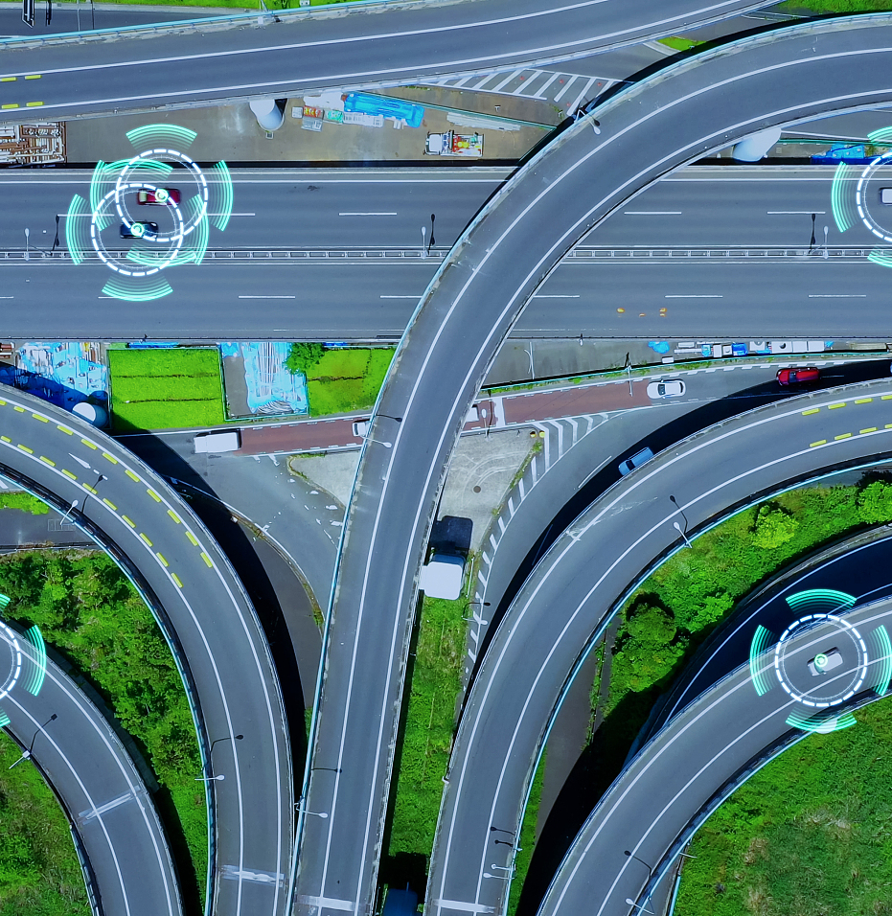
Applications
Intelligent transportation
Cm-level positioning for intelligent transportation applications.
Industrial IoT
Industrial IoT as an application scenario mentioned.

Slide 8

Applications
Immersive XR
Immersive XR included in application scenarios.
Info pages
Relevant info on pages 21 and 26 for applications.

Slide 9
Testbeds
Testbeds content
Datasets content
Involves mmWave prototyping platforms, driving algorithm validation, covered in pages 23–24.
Includes multi-modal datasets, aiding algorithm validation, covered in pages 23–24.

Slide 10
Speaker notes
02

Slide 11

Base Station
Industry Leaders
Functional Transformation
Companies like Huawei and Nokia are leading base station transformation efforts.
Base stations are being turned into multi-function sensing-communication hubs.

Slide 12


RIS Sensing
RIS Sensing Improvement
RIS Sensing Bottleneck
Testbeds indicate RIS enhances sensing fidelity in complex environments (page 23).
Lack of unified evaluation standards remains a key issue (page 24).

Slide 13


ISAC Application
Application Area
Performance Requirement
Autonomous driving applications require ISAC for cooperative sensing.
Achieves cooperative sensing with millisecond-level latency.

Slide 14
Core Challenges Summary
03

Slide 15


Slide Content：ISAC Obstacles
Interference
Sensing and communication share resources, causing mutual interference needing dynamic beamforming, scheduling, and AI-adjusted real-time waveforms.
Hardware
Non-linear effects and phase noise in mmWave/THz bands limit performance, and full-duplex designs must address self-interference.

Slide 16


Slide Content：ISAC Obstacles
Protocol Issue
Missing cross-layer protocols hinder multi-vendor interoperability, highest priority per Table VIII.
Privacy Problem
Privacy frameworks lacking, prominent in human-centric sensing applications (pages 25,28).

Slide 17

Slide Content：ISAC Obstacles
KPI Unification
3GPP needs to unify sensing (e.g., detection probability) and communication KPIs (e.g., throughput).

Slide 18

Slide Content：Future ISAC
Evolution Phases
Shifts from data transmission to task-relevant info extraction, evolving in three phases.
Focus Areas
Currently focused on constrained scenarios like industrial robots, long-term goal to quantify task-critical info with "semantic entropy".

Slide 19

Slide Content：Future ISAC
Quantum Integration
Current Status
Involves quantum sensing improving accuracy and quantum security enhancing communication.
At TRL 1 - 2, facing challenges like cryogenic hardware, expected to mature after 6G.

Slide 20

Slide Content：Future ISAC
Security Defense
Cross-layer mechanisms against eavesdropping and tampering for security.
Spectrum Regulation
Dynamic spectrum-sharing regulations need improvement for future ISAC.
Algorithm Design
Anti-jamming algorithms and privacy-preserving sensing protocols must be designed.

Slide 21
谢谢
THE END

