Slide 1
CSS
Instructor Name: Moresh Londe

Slide 2
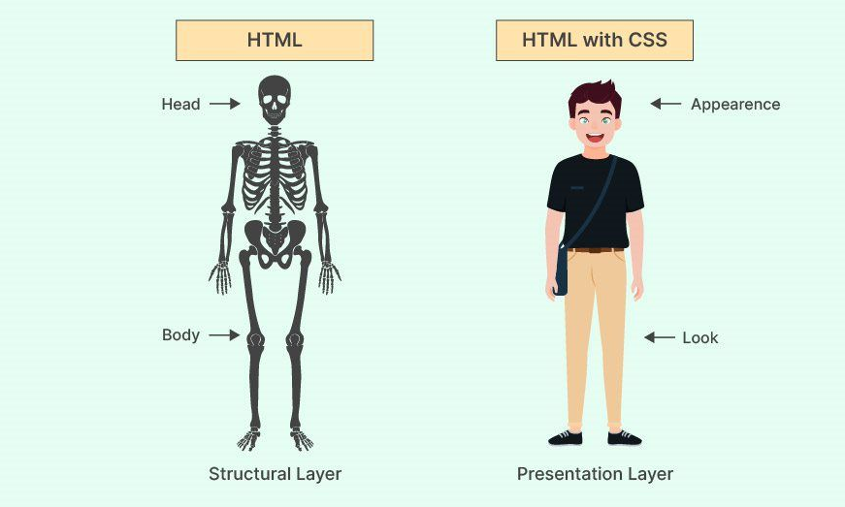

Slide 3
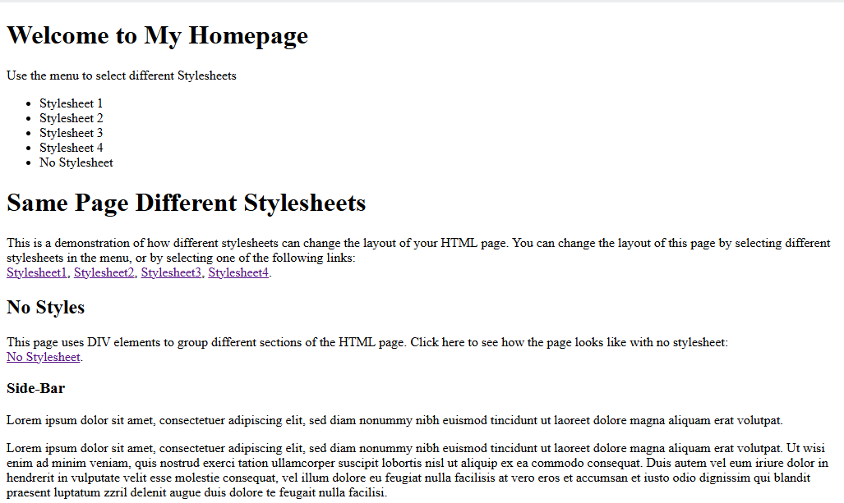

Slide 4
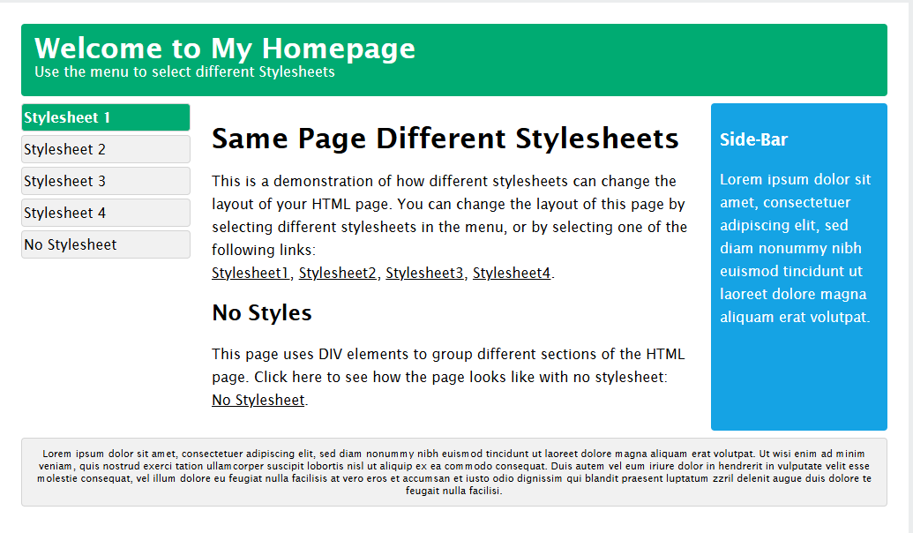

Slide 5
Cascading Style Sheets
CSS is the styling language.
CSS stands for Cascading Style Sheets.
CSS describes how HTML elements are to be displayed on screen, paper, or in other media.
CSS saves a lot of work. It can control the layout of multiple web pages all at once

Slide 6
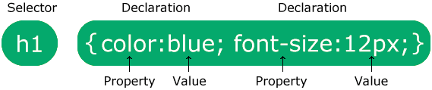
CSS syntax
A CSS rule consists of a selector and a declaration block.
The selector points to the HTML element you want to style.
The declaration block contains one or more declarations separated by semicolons.
Property defines what you want to change.
Value specifies the setting of the property.

Slide 7
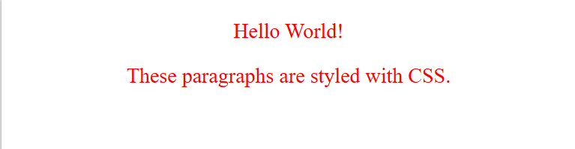
<!DOCTYPE html>
<html>
<head>
<style>
p {
color: red;
text-align: center;
}
</style>
</head>
<body>
<p>Hello World!</p>
<p>These paragraphs are styled with CSS.</p>
</body>
</html>
p is a selector in CSS (it points to the HTML element you want to style: <p>).
color is a property, and red is the property value
text-align is a property, and center is the property value

Slide 8
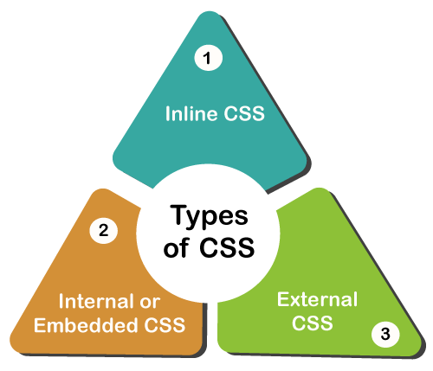
Types of CSS

Slide 9
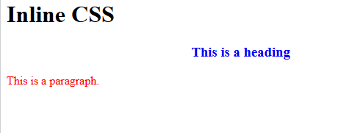
Inline CSS
Syntax
<tag style="property:value;">
An inline style may be used to apply a unique style for a single element.
<!DOCTYPE html>
<html>
<body>
<h1>Inline CSS</h1>
<h3 style="color:blue;text-align:center;">This is a heading</h3>
<p style="color:red;">This is a paragraph.</p>
</body>
</html>

Slide 10
Internal CSS
Also known as Embedded Stylesheet.
CSS is written inside the <style> tag.
The <style> tag is placed inside the <head> section of the HTML document.
It applies styles to only that single HTML page.
Best suited for small websites or single-page applications. Helps keep HTML cleaner than using inline CSS.

Slide 11
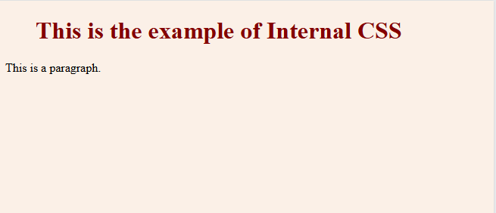
<!DOCTYPE html>
<html>
<head>
<style>
body {
background-color: linen;
}
h1 {
color: maroon;
margin-left: 40px;
}
</style>
</head>
<body>
<h1>This is a heading</h1>
<p>This is a paragraph.</p>
</body>
</html>

Slide 12
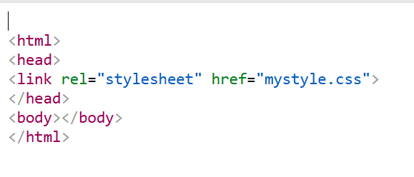
External CSS
External CSS keeps your styling completely separate from your HTML
Generally used when you want to make changes on multiple pages.
Uses <link> tag inside head section.
< link > - tag used to link external resources
rel="stylesheet“ - Specifies that the linked file is a stylesheet
href=“mystyle.css” - the path and filename of the CSS file
href - Hypertext Reference.

Slide 13
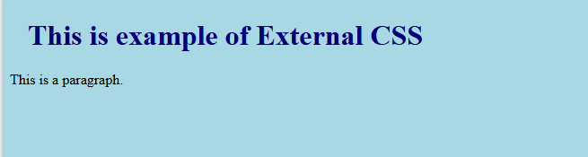
index.html
<!DOCTYPE html>
<html>
<head>
<link rel="stylesheet" href="mystyle.css">
</head>
<body>
<h1> This is a example of External CSS </h1>
<p>This is a paragraph.</p>
</body>
</html>
mystyle.css
body { background-color: lightblue; } h1 { color: navy; margin-left: 20px; }

Slide 14
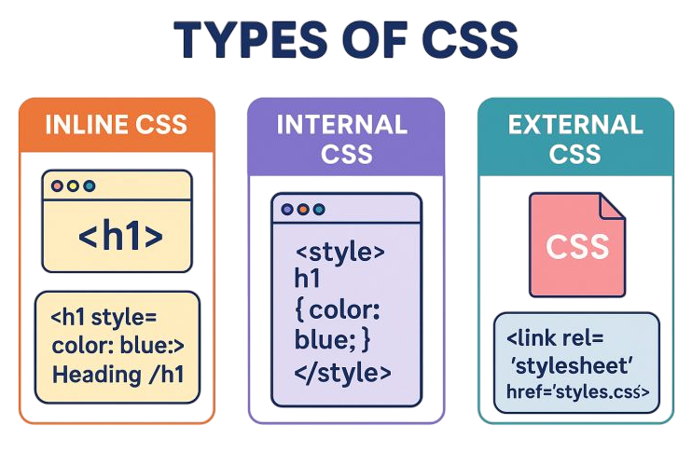

Slide 15
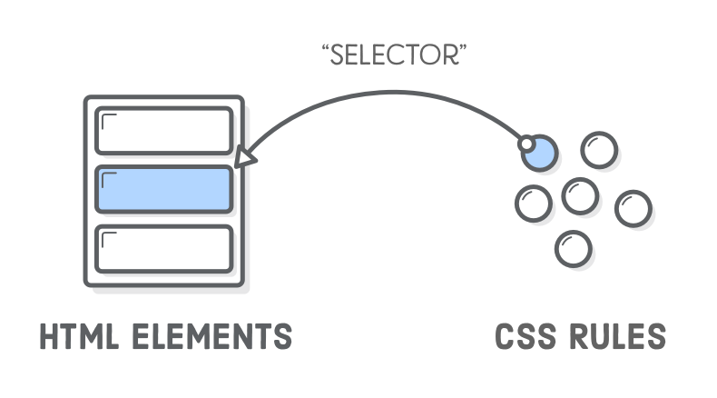
Selectors
CSS selectors are used to target and select the HTML elements you want to style.
They act as the link between your HTML structure and your CSS design.

Slide 16
Id Selector
ID Selector selects one unique HTML element using its id attribute
id of an element is unique within a page.
Written with a hash character (#) followed by the id name.

Slide 17
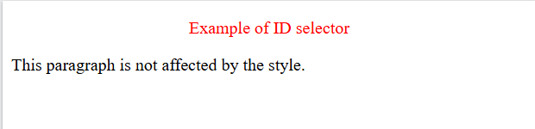
<!DOCTYPE html>
<html>
<head>
<style>
#para1 {
text-align: center;
color: red;
}
</style>
</head>
<body>
<p id="para1">Example of ID selector</p>
<p>This paragraph is not affected by the style.</p>
</body>
</html>

Slide 18
Class Selector
Class Selector selects one or more HTML elements with the same class name.
class selectors are reusable and can be applied to as many elements on a page as needed.
Written with a period (.) followed by the class name.

Slide 19
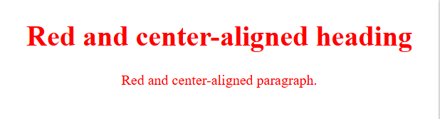
<!DOCTYPE html>
<html>
<head>
<style>
.center {
text-align: center;
color: red;
}
</style>
</head>
<body>
<h1 class="center">Red and center-aligned heading</h1>
<p class="center">Red and center-aligned paragraph.</p>
</body>
</html>

Slide 20
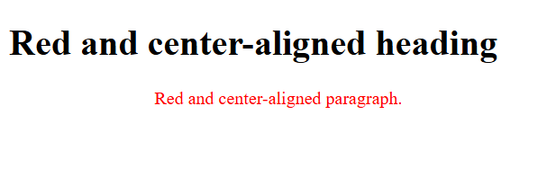
<!DOCTYPE html>
<html>
<head>
<style>
p.center {
text-align: center;
color: red;
}
</style>
</head>
<body>
<h1 class="center">Red and center-aligned heading</h1>
<p class="center">Red and center-aligned paragraph.</p>
</body>
</html>
class selector to a specific HTML element

Slide 21
Universal Selector
Universal Selector selects all HTML elements on the page.
Written as a single asterisk (*).

Slide 22
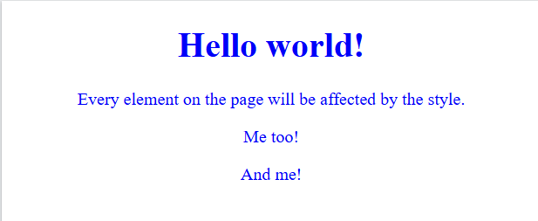
<!DOCTYPE html>
<html>
<head>
<style>
* {
text-align: center;
color: blue;
}
</style>
</head>
<body>
<h1>Hello world!</h1>
<p>Every element on the page will be affected by the style.</p>
<p id="para1">Me too!</p>
<p>And me!</p>
</body>
</html>

Slide 23
Group Selector
Group Selector allows you to apply the same style to multiple elements.
Written as a comma-separated list of multiple individual selectors.

Slide 24
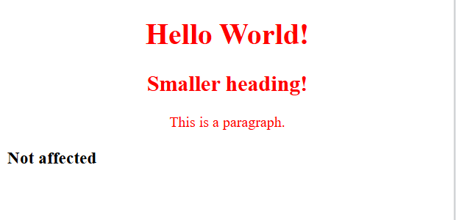
<!DOCTYPE html>
<html>
<head>
<style>
h1 { text-align: center; color: red; } h2 { text-align: center; color: red; } p { text-align: center; color: red; }
</style>
</head>
<body>
<h1>Hello World!</h1>
<h2>Smaller heading!</h2>
<p>This is a paragraph.</p>
<h3>Not affected</h3>
</body>
</html>

Slide 25
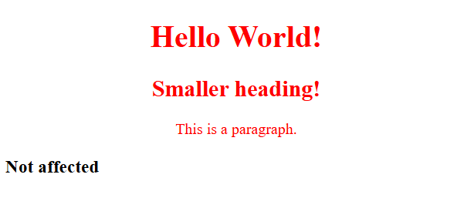
<!DOCTYPE html>
<html>
<head>
<style>
h1, h2, p {
text-align: center;
color: red;
}
</style>
</head>
<body>
<h1>Hello World!</h1>
<h2>Smaller heading!</h2>
<p>This is a paragraph.</p>
<h3>Not affected</h3>
</body>
</html>
Group Selector

Slide 26
CSS PROPERTIES
CSS Property | Use | Common Values | Example
color | Changes text color | red, blue, #000, rgb() | color: blue;
background-color | Sets background color | color names, hex codes | background-color: yellow;
font-weight | Controls text thickness | normal, bold, 100–900 | font-weight: bold;
font-style | Makes text italic or normal | normal, italic, oblique | font-style: italic;
text-decoration | Adds decoration to text | underline, overline, line-through, none | text-decoration: underline;
text-align | Aligns text | left, center, right, justify | text-align: center;
font-family | Changes font type | Arial, Times New Roman, sans-serif | font-family: Arial;
font-size | Changes text size | px, em, rem, % | font-size: 20px;
letter-spacing | Controls space between letters | px, em | letter-spacing: 2px;
padding | Adds space inside an element | px, %, em | padding: 10px;
border | Adds a border around an element | width style color | border: 2px solid black;
background-image | Adds an image as background | url() | background-image: url("bg.jpg");
margin-left | Adds space on the left side of an element | px, %, em | margin-left: 50px;

Slide 27
<!DOCTYPE html>
<html>
<head>
<title>CSS Properties Examples</title>
<style>
.color {
color: red;
}
.bgcolor {
background-color: yellow;
}
.fontweight {
font-weight: bold;
}
.fontstyle {
font-style: italic;
}
.decoration {
text-decoration: underline;
}
.align {
text-align: center;
}
.family {
font-family: Arial, sans-serif;
}
.size {
font-size: 30px;
}
.spacing {
letter-spacing: 5px;
}
.padding {
padding: 20px;
background-color: lightblue;
}
.border {
border: 3px solid black;
}
.bgimage {
background-image: url(“image.jpg");
height: 150px;
color: white;
}
.marginleft {
margin-left: 50px;
background-color: lightgreen;
}
</style>

Slide 28
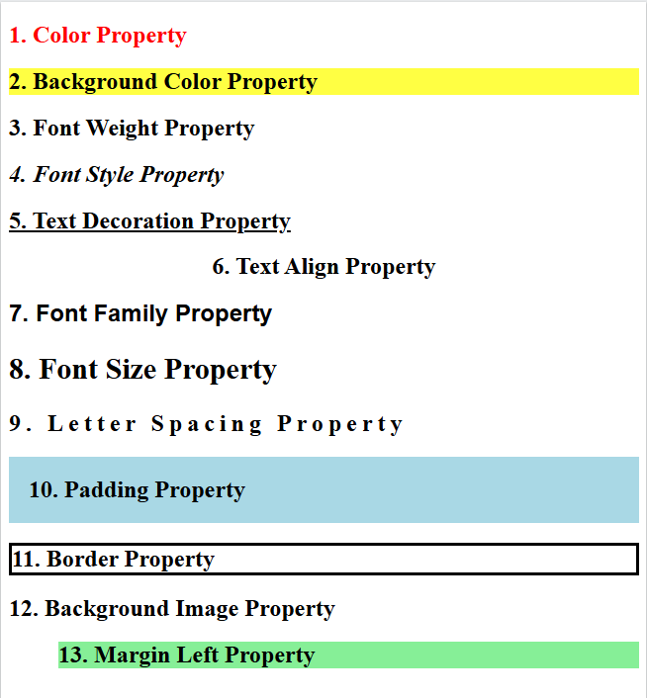

</head>
<body>
<h2 class="color">1. Color Property</h2>
<h2 class="bgcolor">2. Background Color Property</h2>
<h2 class="fontweight">3. Font Weight Property</h2>
<h2 class="fontstyle">4. Font Style Property</h2>
<h2 class="decoration">5. Text Decoration Property</h2>
<h2 class="align">6. Text Align Property</h2>
<h2 class="family">7. Font Family Property</h2>
<h2 class="size">8. Font Size Property</h2>
<h2 class="spacing">9. Letter Spacing Property</h2>
<h2 class="padding">10. Padding Property</h2>
<h2 class="border">11. Border Property</h2>
<h2 class="marginleft">13. Margin Left Property</h2>
</body>
</html>

Slide 29
Positioning
Positioning is about controlling the location of elements within a web page.
It helps us decide:
Where an element should appear
How elements should move or stay fixed
How elements should overlap with each other
CSS provides different positioning methods to arrange elements on a webpage.

Slide 30
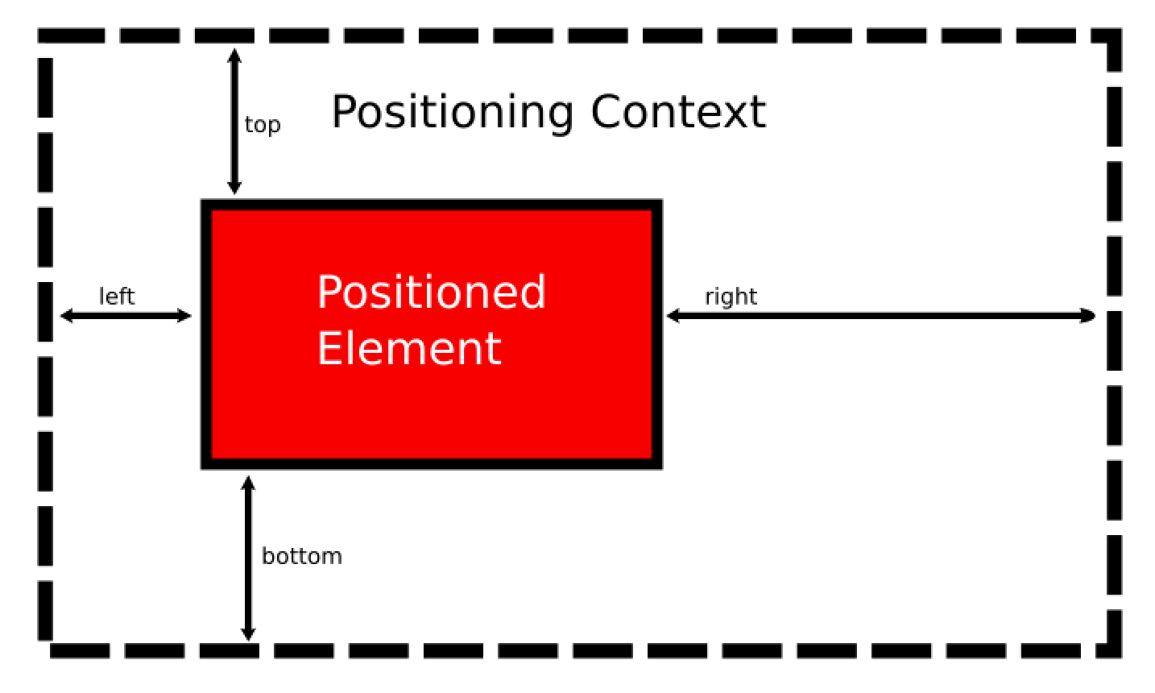
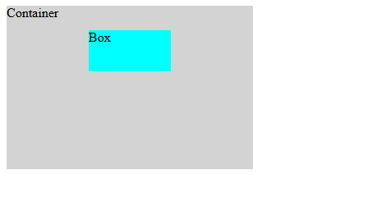
The position property is used to define how an element is placed on a webpage.
Syntax:
selector {
position: value; top:value; left:value
right:value; bottom:value;
}
example: .box {
position: absolute;
top: 50px; left: 100px;
}

Slide 31
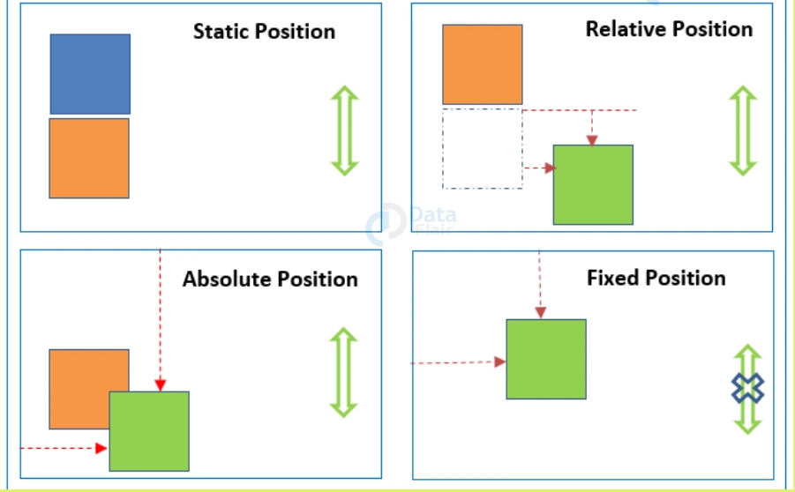
Types of CSS Positioning
Static Positioning
Relative Positioning
Absolute Positioning
Fixed Positioning

Slide 32
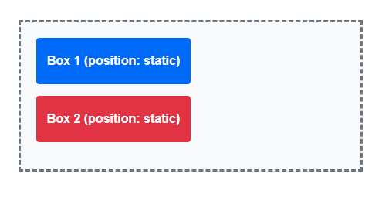
Static Positioning
Static positioning is the default position of every HTML element.
Elements appear according to the normal flow of the webpage.
Top, bottom, left, and right properties do not work with static positioning
box {
position: static;
}

Slide 33
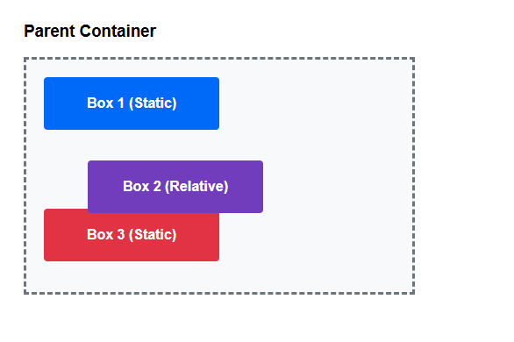
Relative Positioning
Relative positioning moves an element from its original position.
The original space of the element is maintained.
We can move the element using top, bottom, left, and right.
.box {
position: relative;
left: 50px;
}
Moving a book slightly away from its original place on a table.

Slide 34
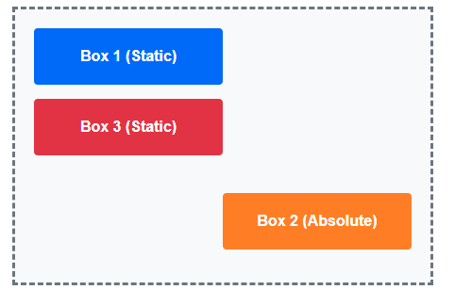
Absolute Positioning
Absolute positioning places an element at a specific location.
The element is removed from the normal document flow
.box {
position: absolute
bottom: 20px;
right: 20px;
}
The "X" Close Button on a Pop-up Banner

Slide 35
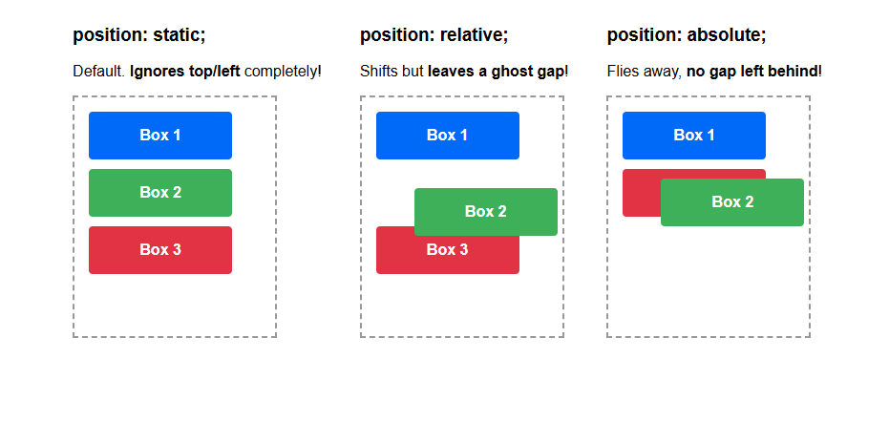

Slide 36
Fixed Positioning
Fixed positioning keeps an element fixed on the screen.
The element does not move even when we scroll the page
It is positioned relative to the browser window.
A chat support button that stays visible while scrolling.

Slide 37
Position Type | Moves relative to... | Saves its original spot? | Scrolls with page?
static | Normal Page Flow | Yes | Yes
relative | Its Own Original Spot | Yes | Yes
absolute | Nearest Parent Container | No | Yes
fixed | The Browser Window Screen | No | No (Stays)

Slide 38
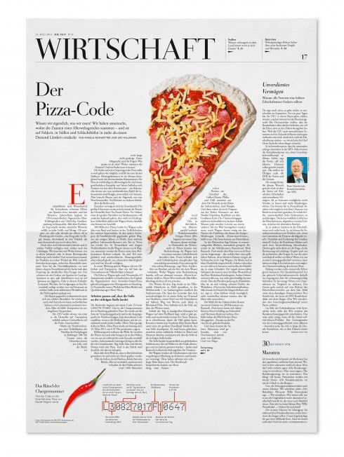
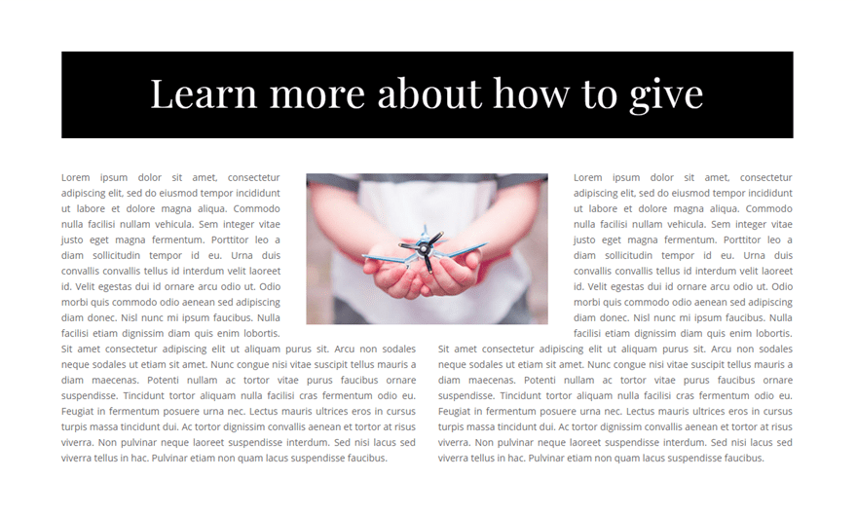
Float Property
The float property is used to move an element to the left or right side of its container.
It was mainly used for creating layouts and wrapping text around images.
Syntax:
selector {
float: value;
}
Values:
Left
Right
None

Slide 39
Display Property
The display property controls how an element appears on a webpage.
1. Block
Takes the full width available.
Starts from a new line.
Syntax:
selector {
display: value;
}
2. Inline
Takes only required space.
Does not start from a new line.
3. Inline-Block
Behaves like inline but allows width and height.
4. None
Hides the element completely.
The element does not take any space.

Slide 40
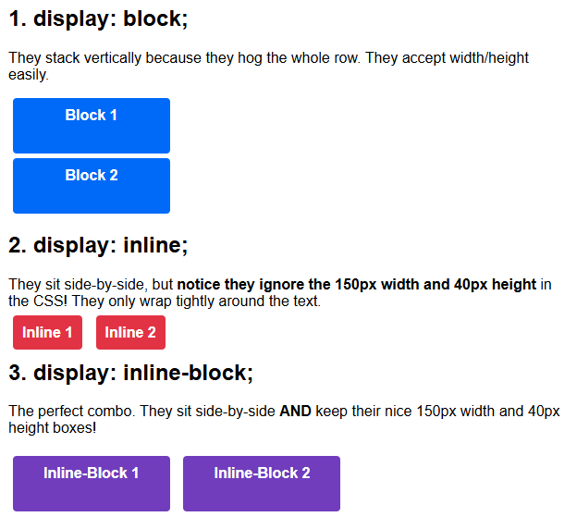

Slide 41
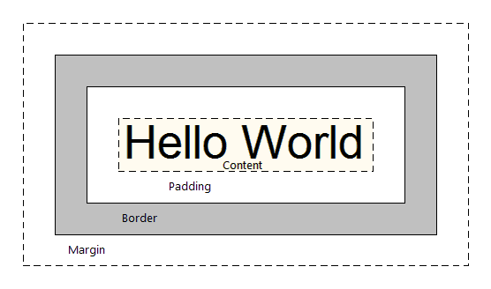
CSS Box Model
Every HTML element is a rectangular box.
By default, elements just stack on top of each other or sit side-by-side.
To break this default layout, we use Display, Position, and Floats.
Content - It is the text, image, or button on the webpage.
Padding - Inside space (pushes the border away from the content).
Border - The edge outline
Margin - Outside space (pushes other elements away from this box).

Slide 42
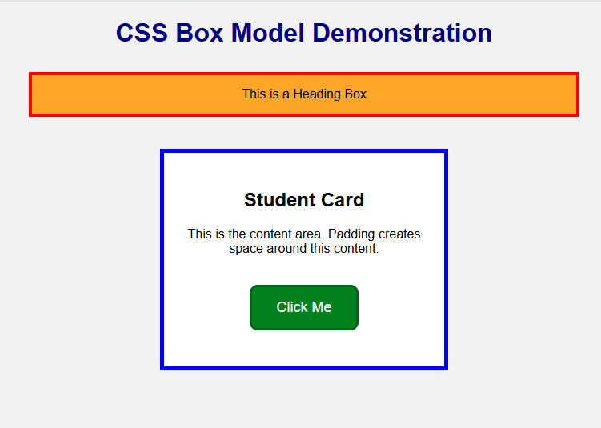
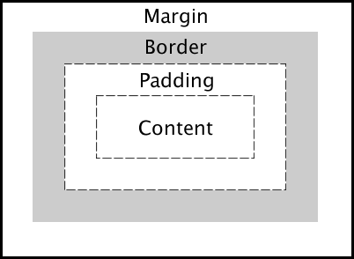
Heading Box
padding: 15px;
border: 4px solid red;
margin: 30px;
Student Card
.card {
padding: 25px;
border: 5px solid blue;
margin: 40px;
}
Button
.btn {
padding: 15px 30px;
border: 3px solid darkgreen;
margin: 20px;
}

