Slide 1

Search Engine Optimization
Moresh Londe

Slide 2

What is SEO?
SEO (Search Engine Optimization) is the process of improving a website so that it appears higher in search engine results like Google, Bing, and Yahoo.
Simple Definition
SEO helps people find your website when they search online.

Slide 3
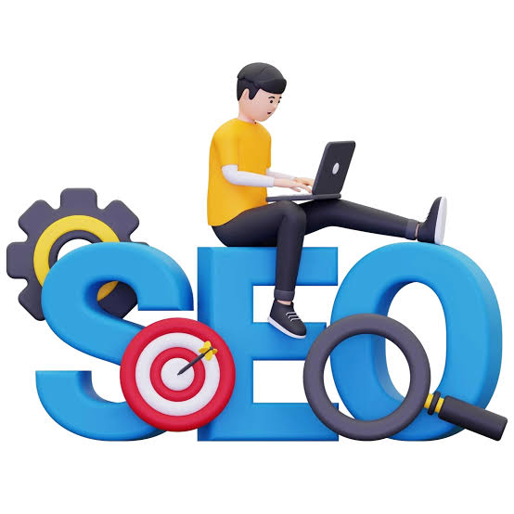
Types of
On-Page SEO
Off-Page SEO
Changes made inside the website.
Examples:
Title
Content
Images
Keywords
Headings
Activities outside the website.
Examples:
Backlinks
Social sharing
Reviews

Slide 4

On-Page SEO
What is On-Page SEO?
Optimizing elements inside webpages.
Example: Restaurant Website:
Displayed to the end user such as text, images
<title>
Home
</title>
<title>
Best Pizza Restaurant in Mumbai
</title>

Slide 5

Off - page SEO
Activities done outside your website.
Main techniques:
Backlinks
Social Bookmarking
Social Media Optimization
A backlink is a link from another website to your website.
Saving and sharing website links on bookmarking websites.
Using social media to increase website visibility.

Slide 6


Techniques OF SEO
White Hat | Black Hat
Relevant Content | Duplicate Content
Well labelled images, Relevant links, good spelling, Grammer. | Duplicate text, Links from non relevant content
There is high risk in Black Hat SEO. | There is low or zero risk in White Hat SEO.
White Hat SEO follows search engine guidelines.
Black Hat SEO uses unfair methods to manipulate ranking.

Slide 7
Optimizing Website
Website optimization means improving website elements to make it search engine friendly.
Main areas:
Page Structure Optimization
Keywords
Social Bookmarking
SMO
Backlinks
Technical Factors

Slide 8
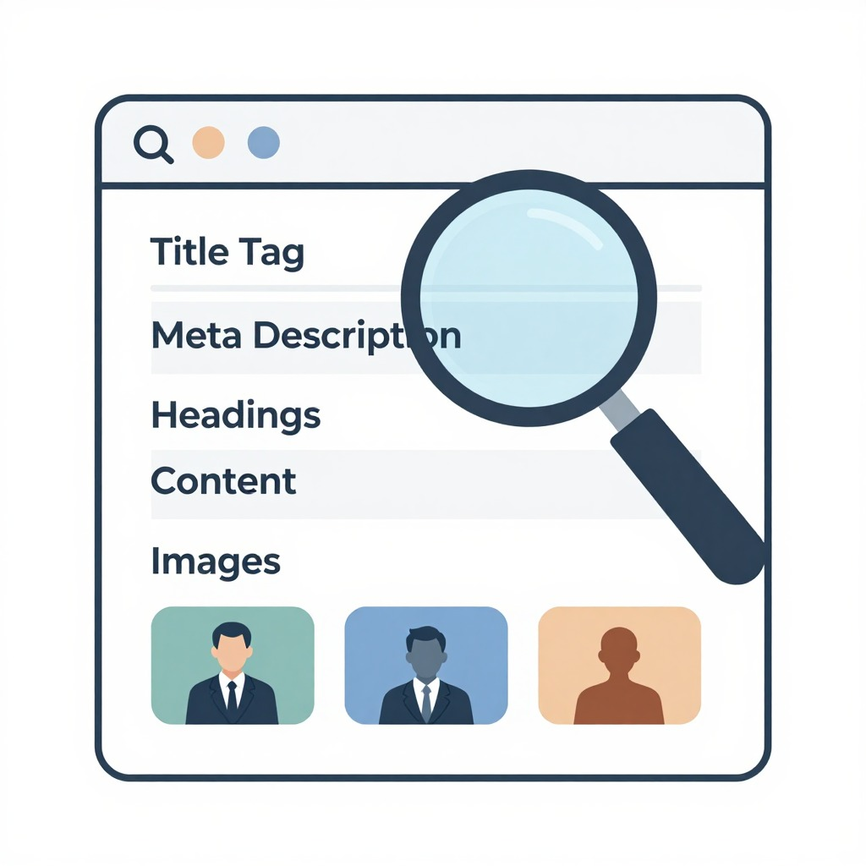
SEO Page Structure Optimization
<title>
↓
Meta Description
↓
Heading Tags
↓
Content
↓
Images
Each element helps search engines understand the page.

Slide 9
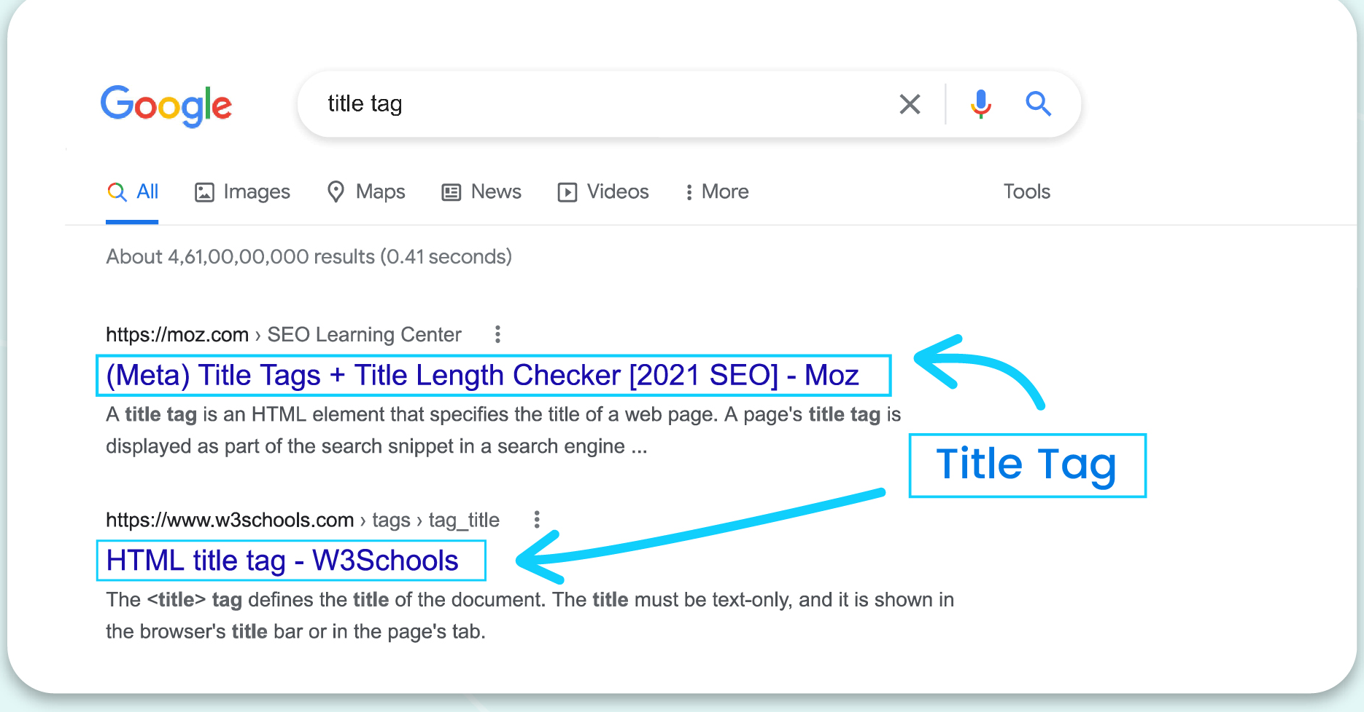
Title Tag
HTML:
<title>
Best Pizza Restaurant Mumbai
</title>
Purpose:
Shows page topic
Appears in Google results
Example:
Search result:
Best Pizza Restaurant Mumbai
Fresh Italian pizza delivery

Slide 10
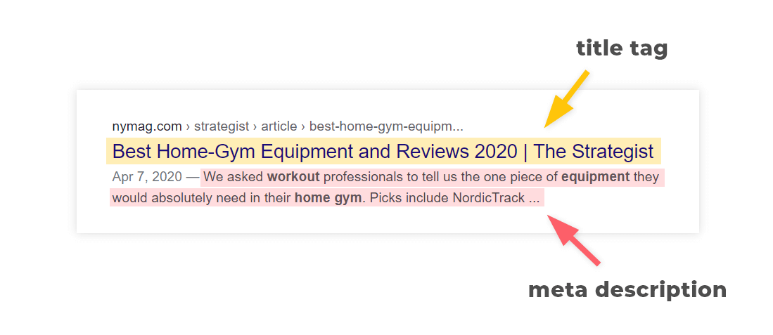
Meta Description Tag
HTML:
<meta name="description“ content="Fresh pizza delivery in Mumbai">
Purpose:
Gives summary of webpage
Improves click rate
Example:
Fresh Italian pizza with fast delivery.
Order online today.

Slide 11
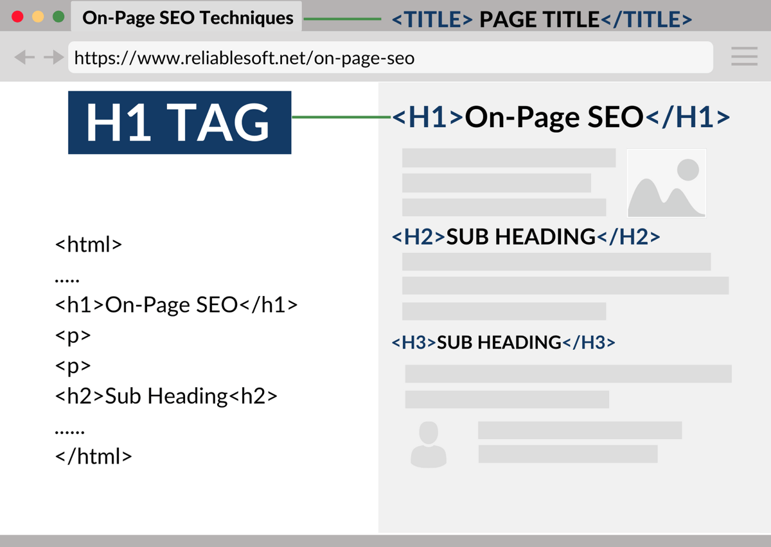
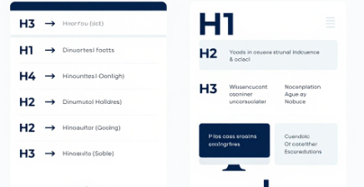
Heading Tags
HTML headings: <h1>
<h2>
<h3>
Example:
H1: Best Pizza Restaurant Mumbai
H2: Pizza Menu
H2: Customer Reviews
Benefits:
Organizes content
Helps Google understand sections

Slide 12
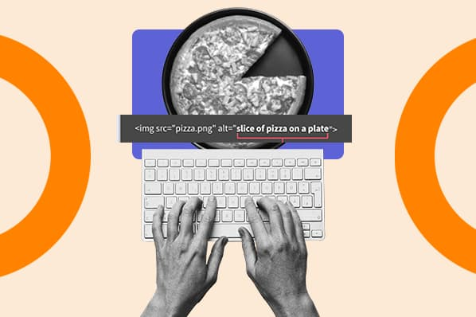
Image Tag with ALT Attribute
Images need descriptions.
Bad:
<img src="pizza.jpg" alt="image">
Good:
<img src="pizza.jpg“ alt="Fresh cheese pizza Mumbai">
Why?
Search engines cannot see images.
ALT text explains the image.

Slide 13
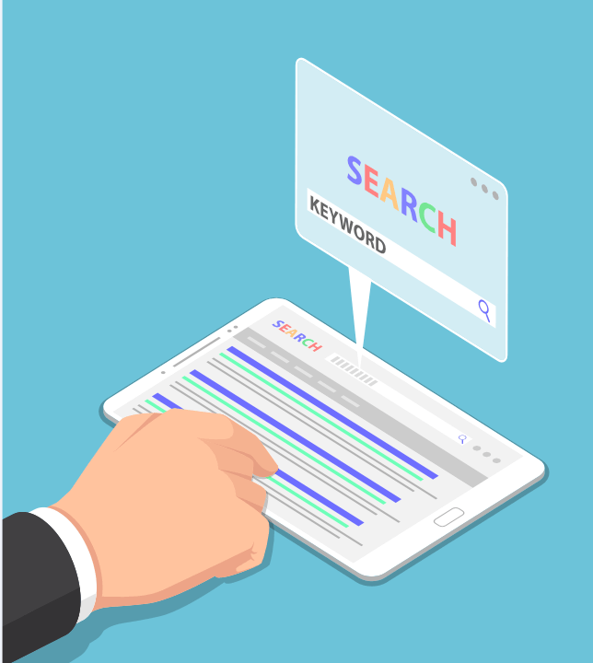
SEO Keywords
What are Keywords?
Words users type into search engines.
Example:
User searches:
Best pizza Mumbai
Keyword:
Best pizza Mumbai

Slide 14

SEO Social Bookmarking
Saving and sharing website links on bookmarking platforms.
Example:
A user shares:
Best Pizza Places Mumbai
Website Link
Benefits:
More visibility
More traffic

Slide 15

SEO Social Media Optimization (SMO)
Using social media platforms to promote websites.
Platforms
Instagram
Facebook
YouTube

Slide 16
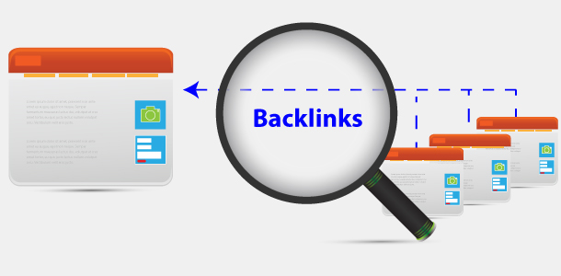
SEO Backlinks
A backlink is a link from another website pointing to your website.
Example:
Food Blog
↓
Pizza Restaurant Website
Benefits:
Builds trust
Improves authority

Slide 17
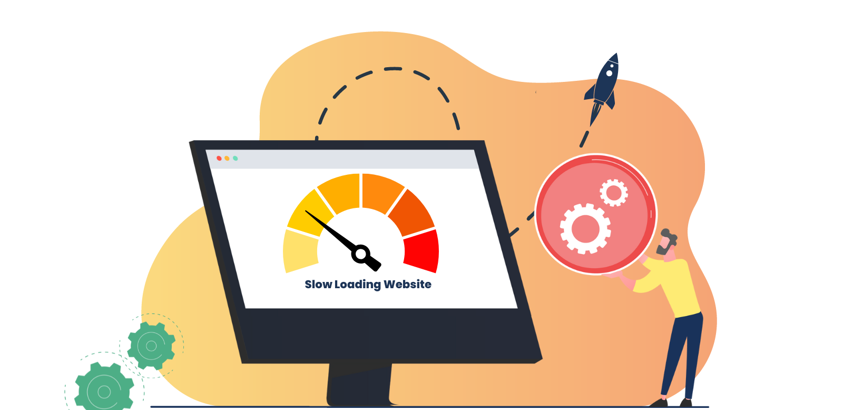
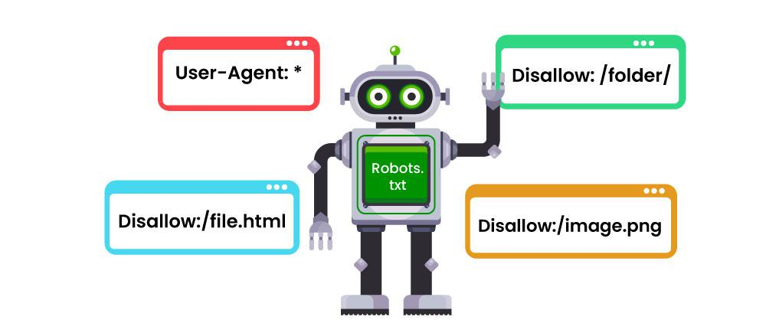
Other Factors for SEO
Website Speed
Mobile Friendly Website
Robots.txt

Slide 18
Website Speed Fast websites provide better user experience.
Slow website:
User waits
↓
Leaves website
↓
Ranking decreases
Fast website:
Happy Users
↓
Better Experience
↓
Better Ranking

Slide 19
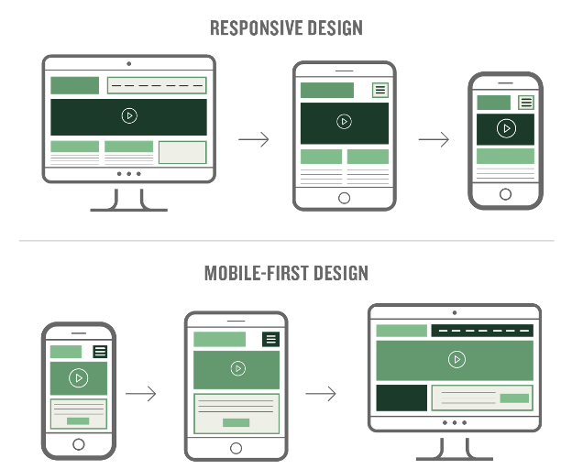
Mobile Friendly Website
Most users search using mobile phones.
A mobile-friendly website:
Adjusts screen size
Easy navigation
Fast loading

Slide 20
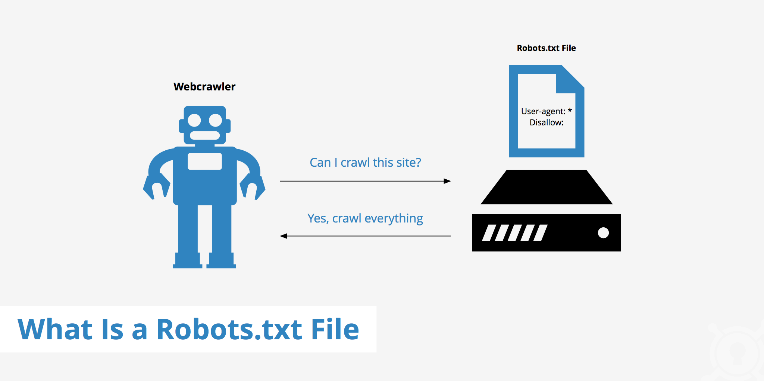
Robots.txt
Tells Search engine which pages you want to exclude from indexing.

Slide 21
SEO Audit
SEO audit is checking website performance and SEO health.
It checks:
Title
Meta Description
Keywords
Content
Speed
Mobile Friendly
Backlinks
Technical errors

