Slide 1
Audio & Video
MORESH LONDE

Slide 2
Audio
Format | Full Form | Used In
MP3 | MPEG Audio Layer 3 | Songs, Music
AAC | Advanced Audio Coding | YouTube, iPhone
OGG | Open Source Audio Format | Firefox, Open Source Apps
Real Life Example
Spotify songs → MP3/AAC
YouTube audio → AAC

Slide 3

Attribute | Purpose | Example
controls | Shows play, pause and volume | controls
autoplay | Starts automatically | autoplay
loop | Repeats forever | loop
muted | Starts without sound | muted
src | Audio file location | song.mp3
<audio controls>
<source src="song.mp3" type="audio/mp3">
</audio>

Slide 4
Video
Format | Used In
MP4 | Most websites
WebM | Google Chrome
OGG | Firefox

Slide 5
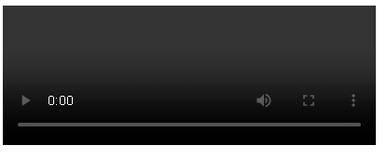
Attribute | Purpose
controls | Shows video controls
autoplay | Starts automatically
width | Video width
height | Video height
loop | Plays repeatedly
muted | No sound
poster | Shows thumbnail image
preload | Loads video before playing
<video controls>
<source src="movie.mp4" type="video/mp4">
</video>

Slide 6
Image Map in HTML5
An Image Map is a single image that contains multiple clickable areas (hotspots).
Types of Image Maps
Type | Description
Client-Side Image Map | Processed by the browser (Most Common)
Server-Side Image Map | Processed by the web server
In HTML5, we mostly use Client-Side Image Maps.

Slide 7
Tags Used in Image Map
Tags Used in Image Map
Tag | Purpose
<img> | Displays the image
<map> | Defines the image map
<area> | Defines clickable regions (Hotspots)

Slide 8
<img> Tag
Important
The value of usemap always starts with #
<img src="campus.jpg"
usemap="#campusmap"
alt="School Campus">
Attribute | Purpose
src | Image file
usemap | Connects image with map
alt | Alternative text
<map> Tag
The <map> tag stores all clickable regions.
<map name="campusmap">
</map>

Slide 9
<area> Tag
The <area> tag creates clickable hotspots.
<area
shape="rect"
coords="20,30,120,100"
href="library.html"
alt="Library">
Attribute | Purpose
shape | Shape of hotspot
coords | Coordinates
href | Link
alt | Description

Slide 10
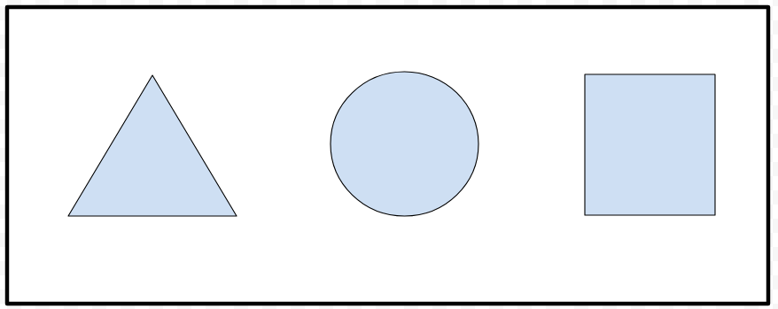
Shape | Purpose | Coordinates Required | Example
rect | Rectangle | x1, y1, x2, y2 (Top-left and Bottom-right corners) | coords="20,30,180,120"
circle | Circle | centerX, centerY, radius | coords="150,100,50"
poly | Polygon (Irregular Shape) | Multiple x,y coordinate pairs (at least 3 points) | coords="30,50,90,20,120,90,60,140"
default | Entire Image | No coordinates required | shape="default"

Slide 11
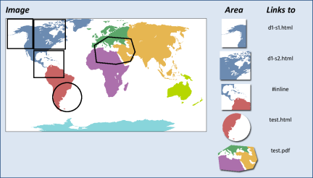

Slide 12
Inline Frame (<iframe>) in HTML5
Embedding One Webpage Inside Another
An Inline Frame (<iframe>) is used to display another webpage, video, map, or document inside the current webpage.
Basic Syntax
<iframe src="URL"></iframe>
<iframe
src="https://www.wikipedia.org"
width="600"
height="400">
</iframe>

Slide 13
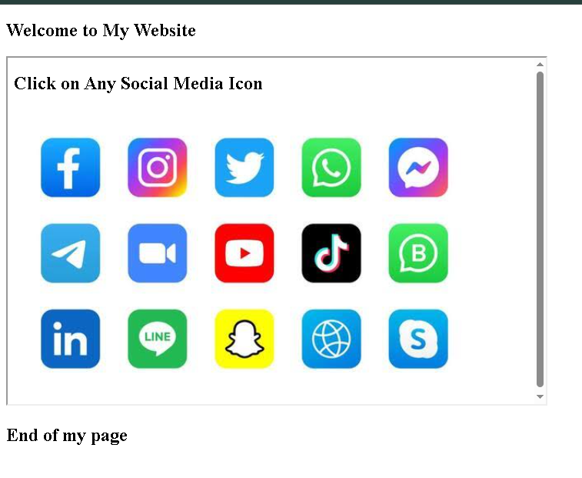
<!DOCTYPE html>
<html>
<head>
<title>Iframe Example</title>
</head>
<body>
<h2>Welcome to My Website</h2>
<iframe
src=“imagemap.html"
width="600"
height="350">
</iframe>
</body>
</html>

Slide 14
WEB HOSTING
Website Hosting is a service that provides storage space on a web server so that a website can be accessed through the Internet.
A Web Server is a powerful computer that stores website files and delivers them to users when requested.

Slide 15
*What is a Web Host?
A Web Host is a company that provides web hosting services.
The web host:
Stores website files
Keeps the website online 24×7
Provides Internet connectivity
Maintains the web server

Slide 16
Types of Web Hosting
Type | Best For
Shared Hosting | Small websites
Free Hosting | Learning and practice
Dedicated Hosting | Large websites

Slide 17
Shared Hosting
In Shared Hosting, multiple websites share the same server.
Many websites share one server.
Advantages
Low cost
Easy to use
Good for beginners
Disadvantages
Slower if many websites receive heavy traffic
Limited resources
Ex: Apartment Building
Many families live in one building and share facilities.

Slide 18
Free Hosting
Some companies provide free hosting for learning or testing.
ex: Free trial at a gym or streaming service.
Advantages
No cost
Good for students
Easy to practice
Disadvantages
Limited storage
Limited features
May display advertisements
Not suitable for business websites

Slide 19
Dedicated Hosting
A complete server is dedicated to one website.
ex: Own Independent House
No sharing with others.
Advantages
Fast performance
Better security
More storage
Full control
Disadvantages
Expensive
Requires technical knowledge

