Slide 2
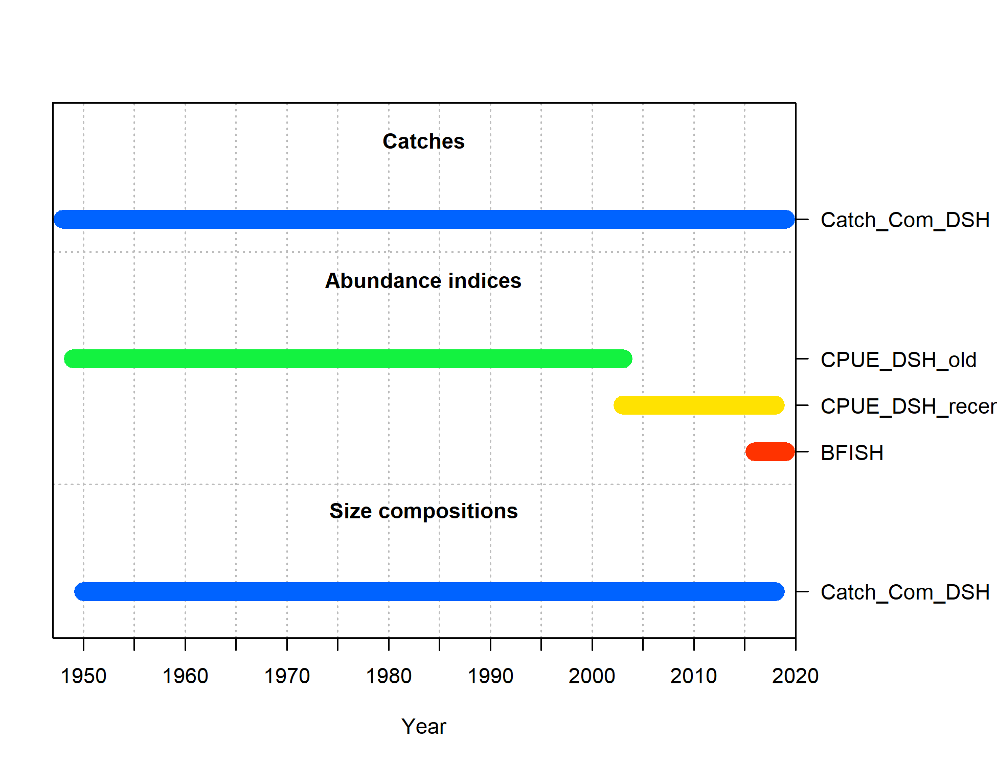
Data Inputs
Commercial catch – 1949 – 2018 (used 2018 catch for 2019)
Commercial catch weight composition – 1950 - 2018
CPUE from commercial fishery (2 time series) – 1949 – 2003, 2003 – 2018
BFISH Survey Index (2016 – 2019)

Slide 3
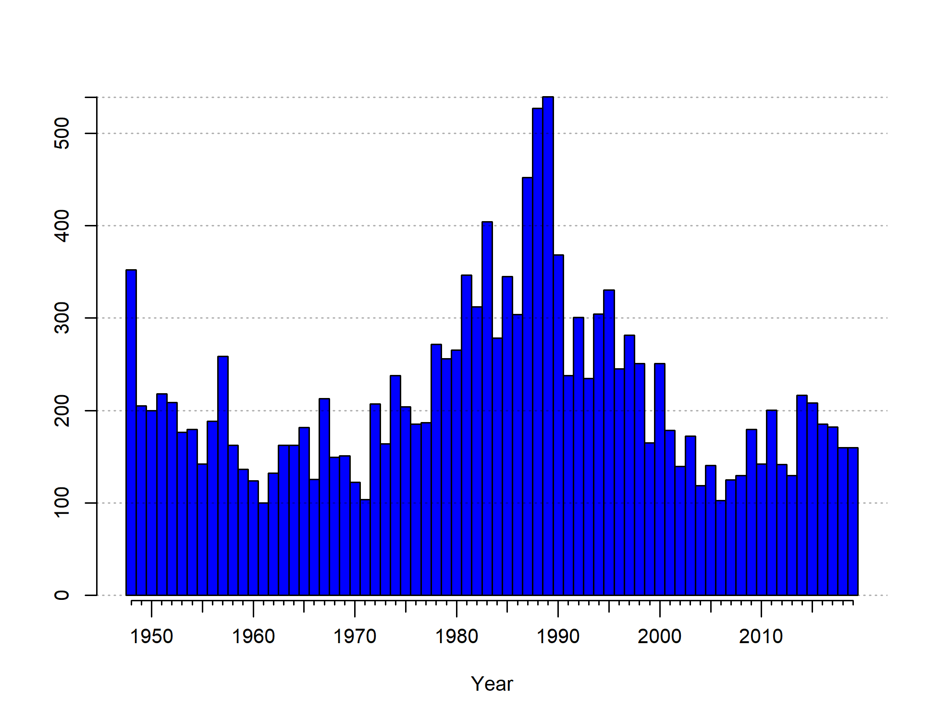
Catch

Slide 4
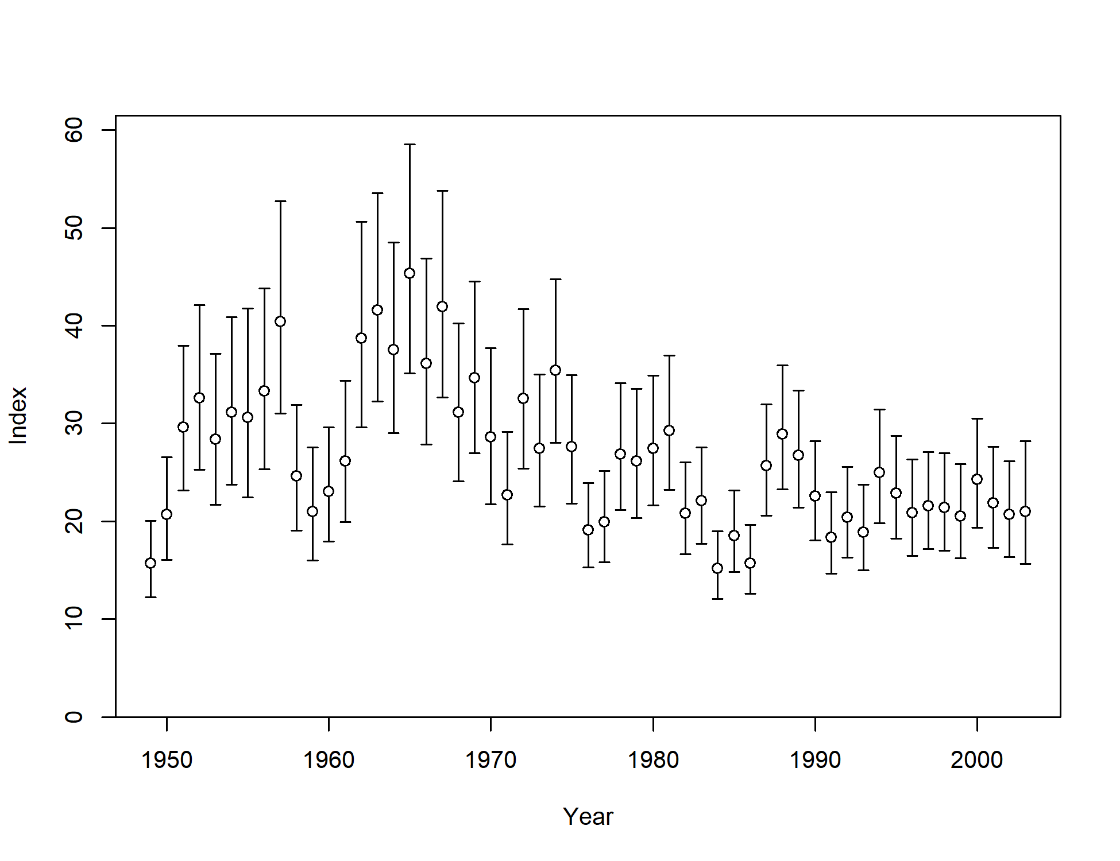
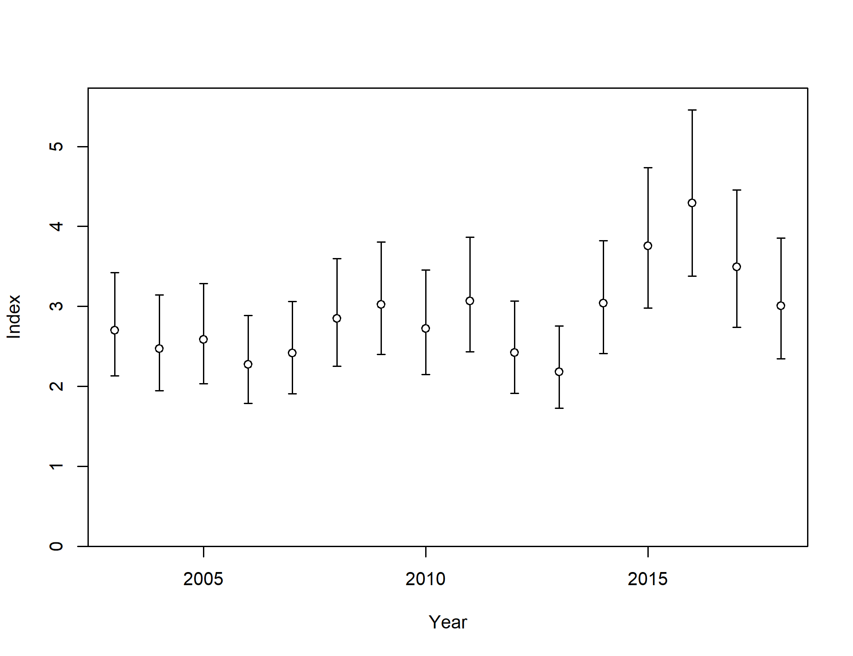
CPUE_DSH_Old
CPUE_DSH_Recent

Slide 5
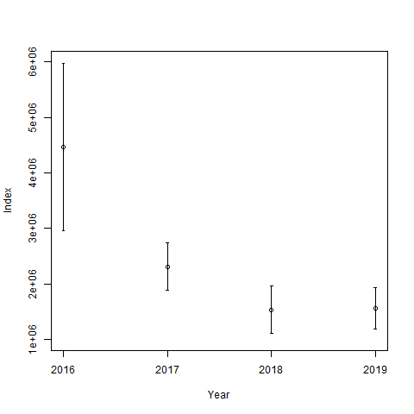
Bfish Survey Index

Slide 6
Growth Curve (Life History)

