Slide 1
Opakapaka SS Model Data Inputs

Slide 2
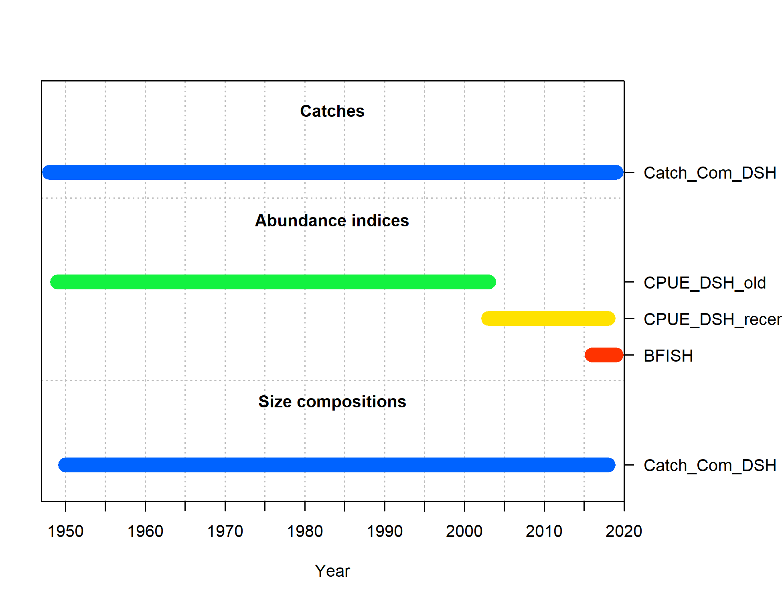
Data Inputs
Commercial catch – 1949 – 2018 (used 2018 catch for 2019)
Commercial catch weight composition – 1950 - 2018
CPUE from commercial fishery (2 time series) – 1949 – 2003, 2003 – 2018
BFISH Survey Index (2016 – 2019)
Commercial catch weight composition data (1950 – 2018)

Slide 3
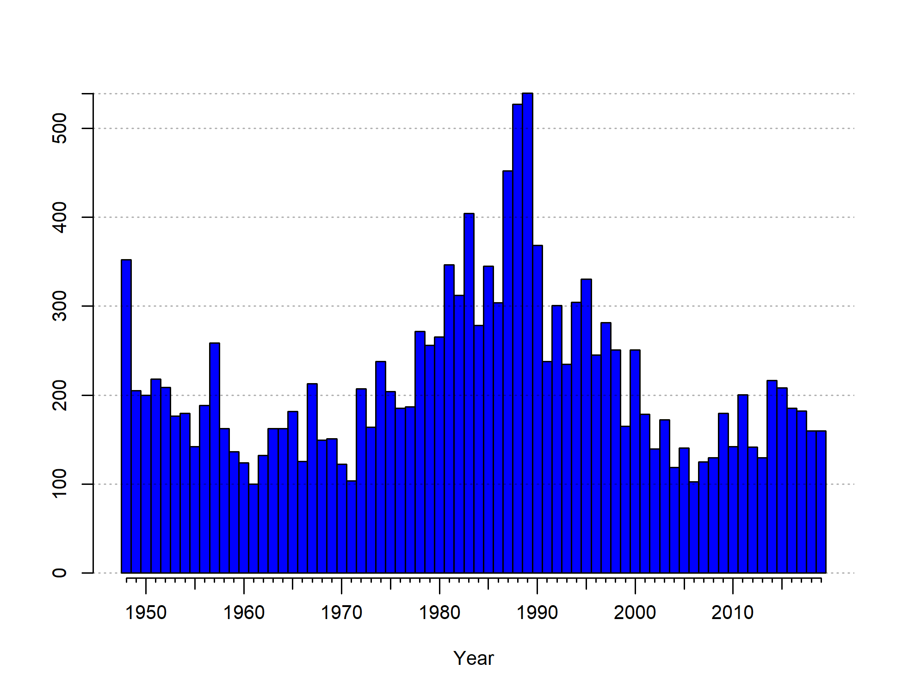
Catch

Slide 4
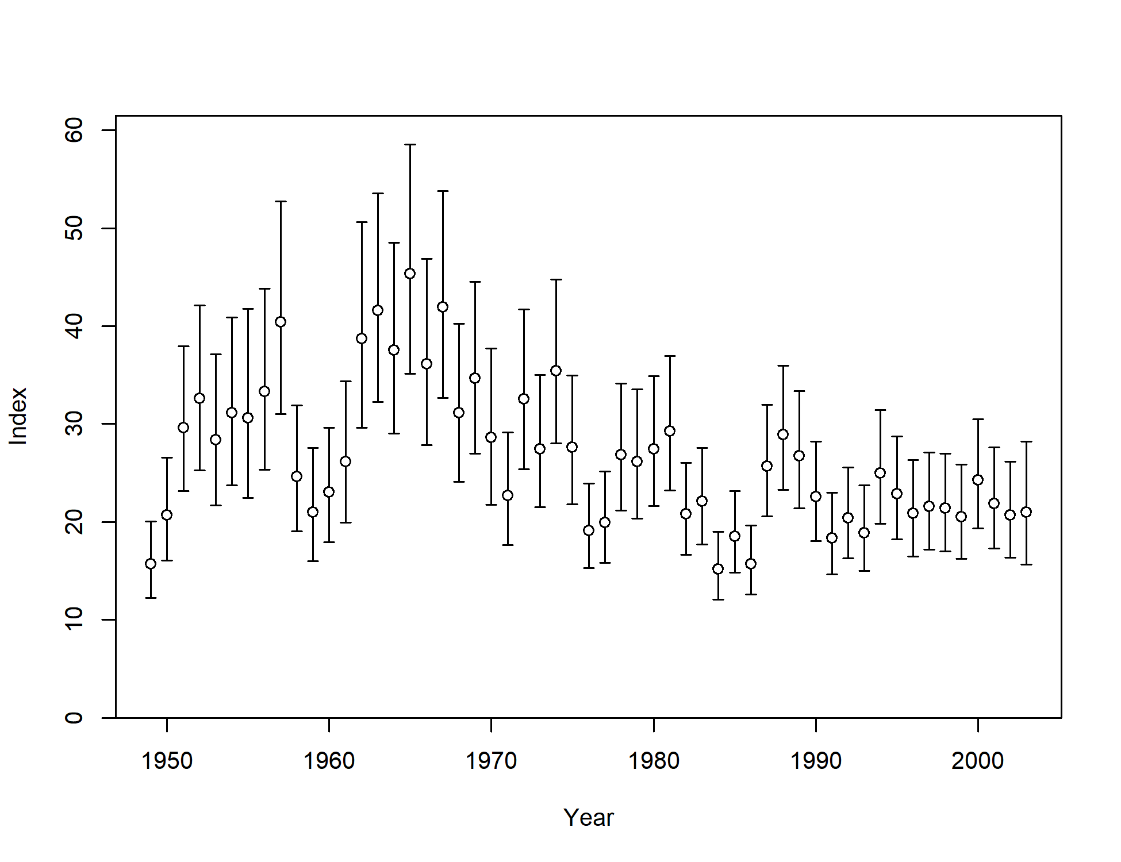
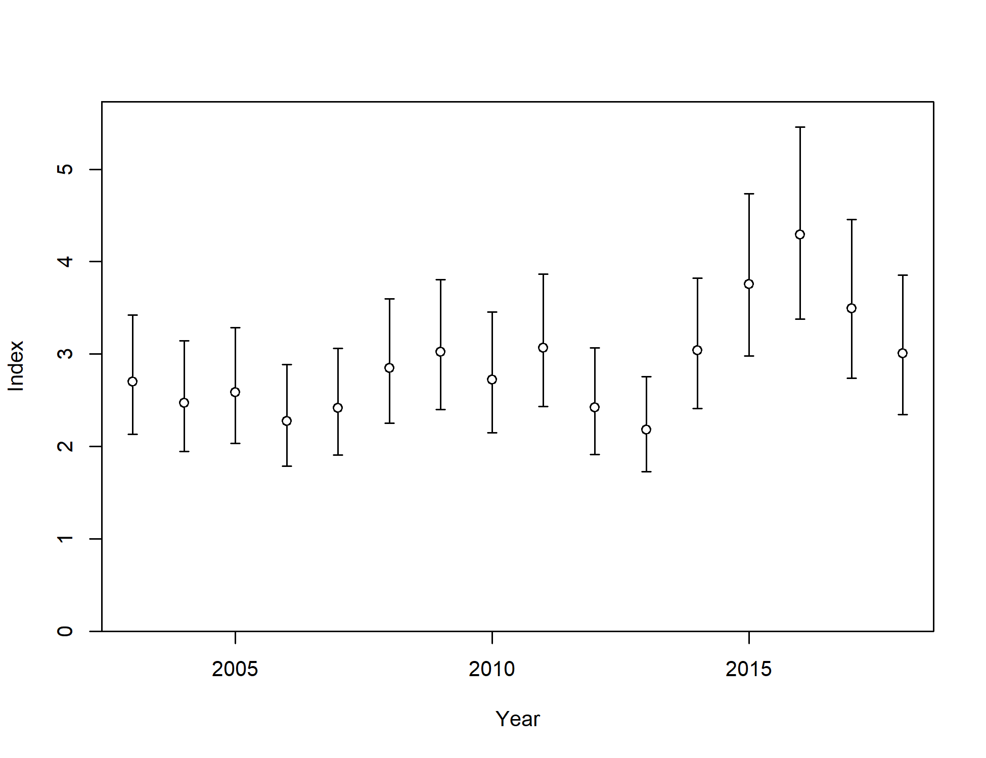
CPUE_DSH_Old
CPUE_DSH_Recent

Slide 5
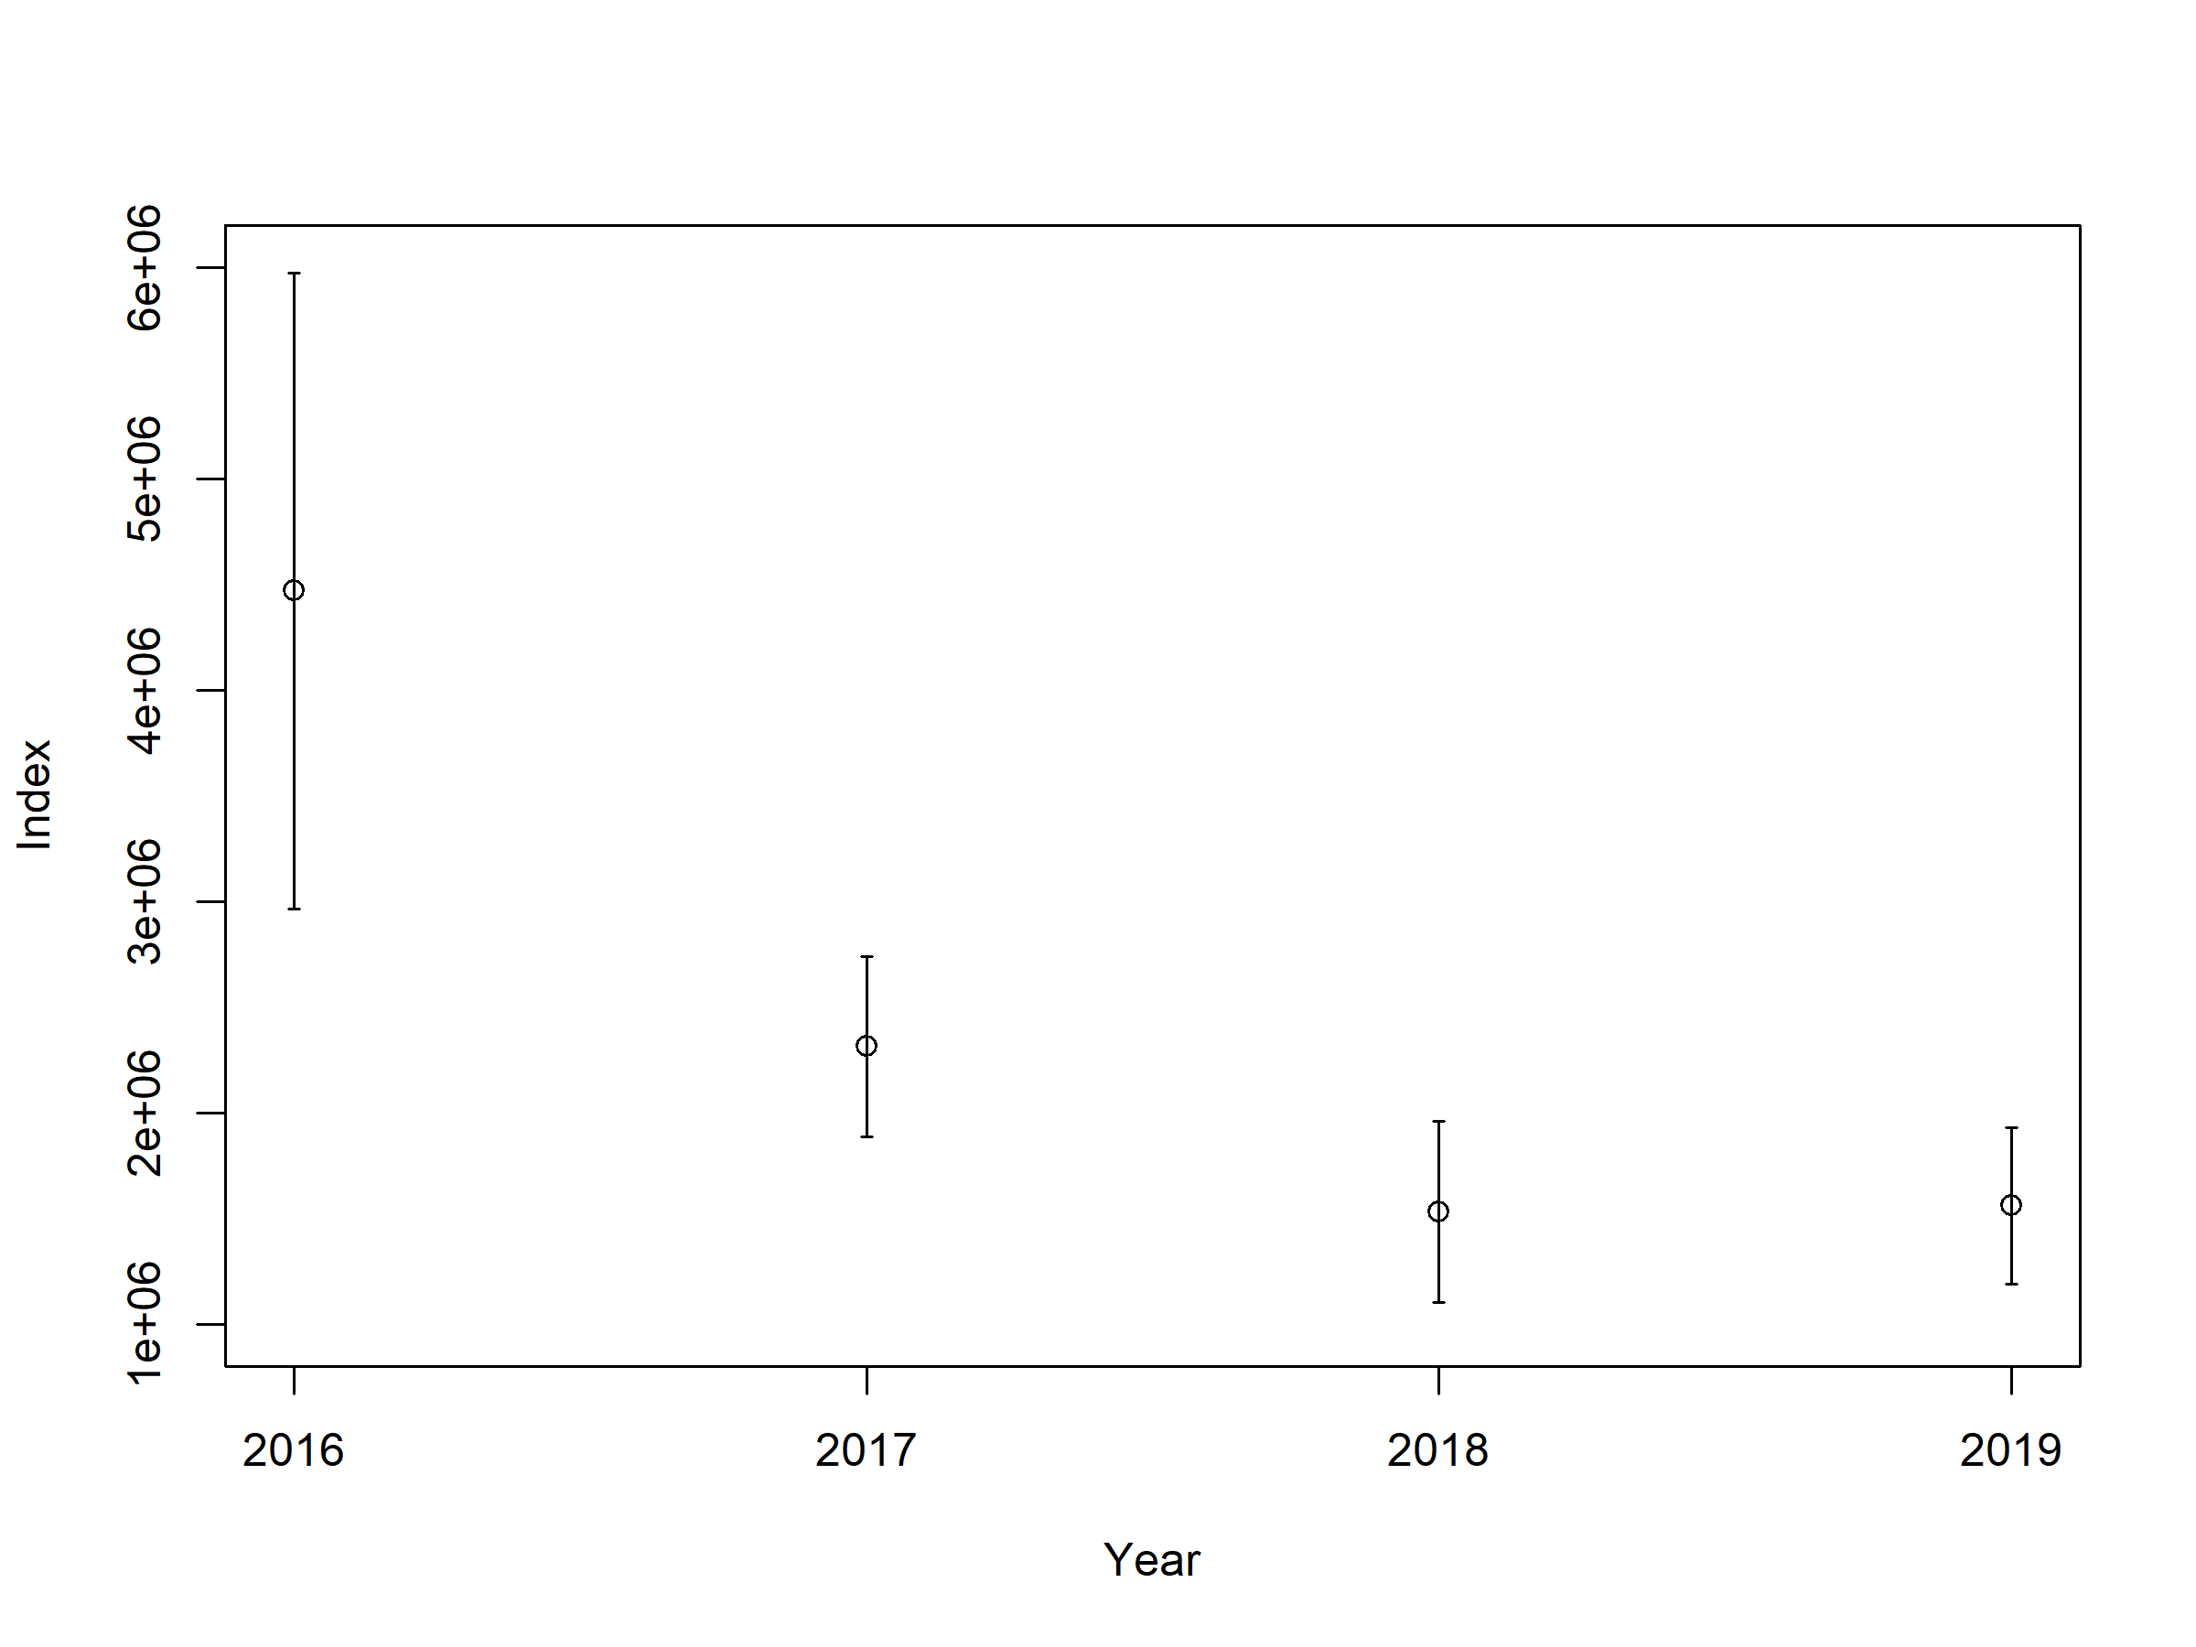
Bfish Survey Index

Slide 6
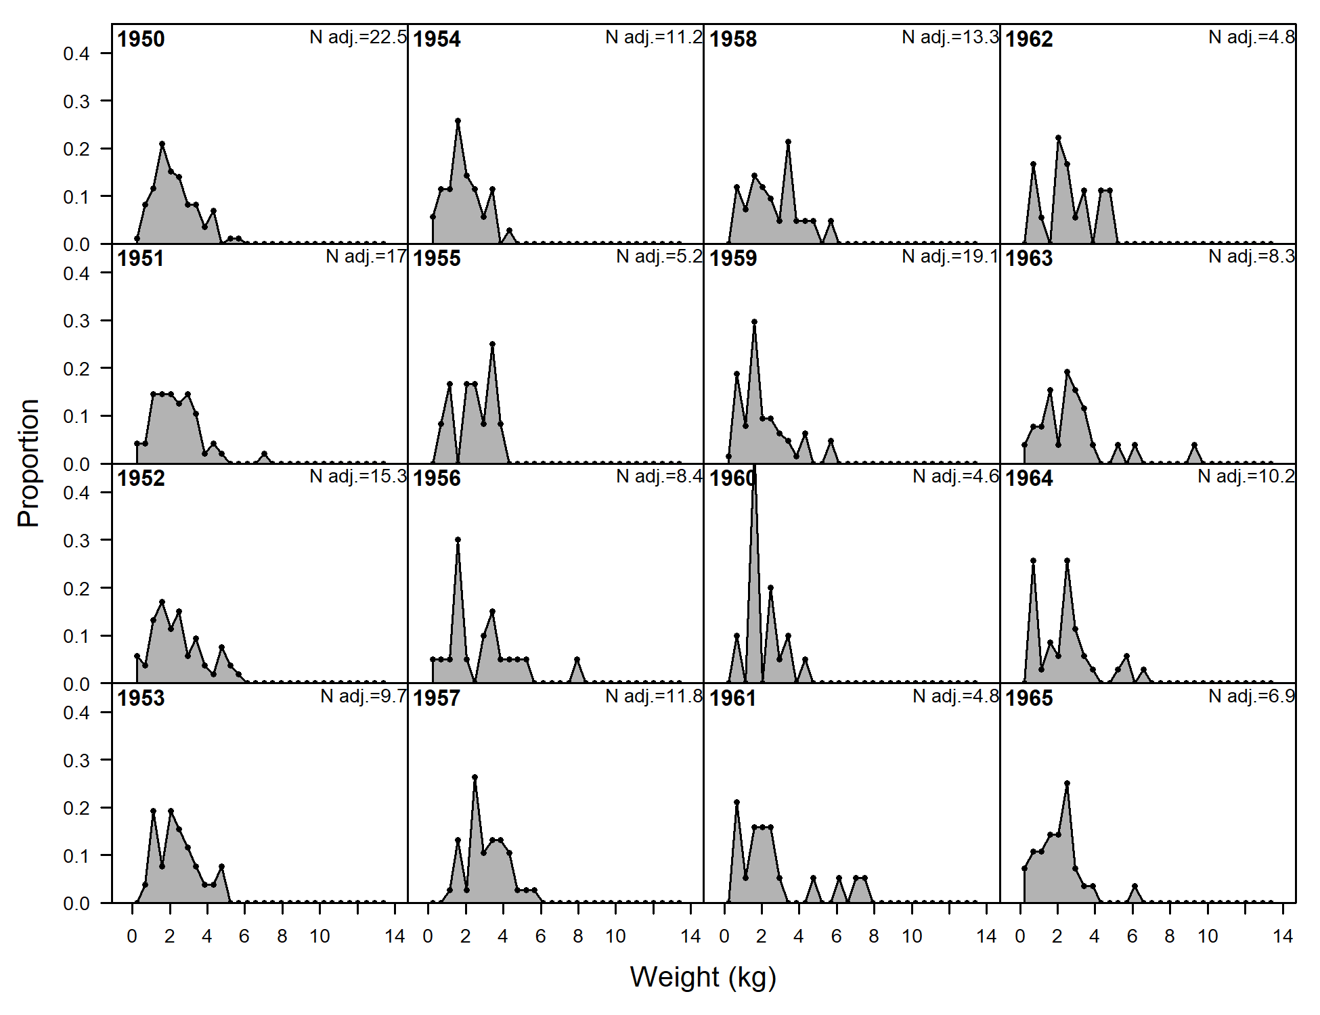
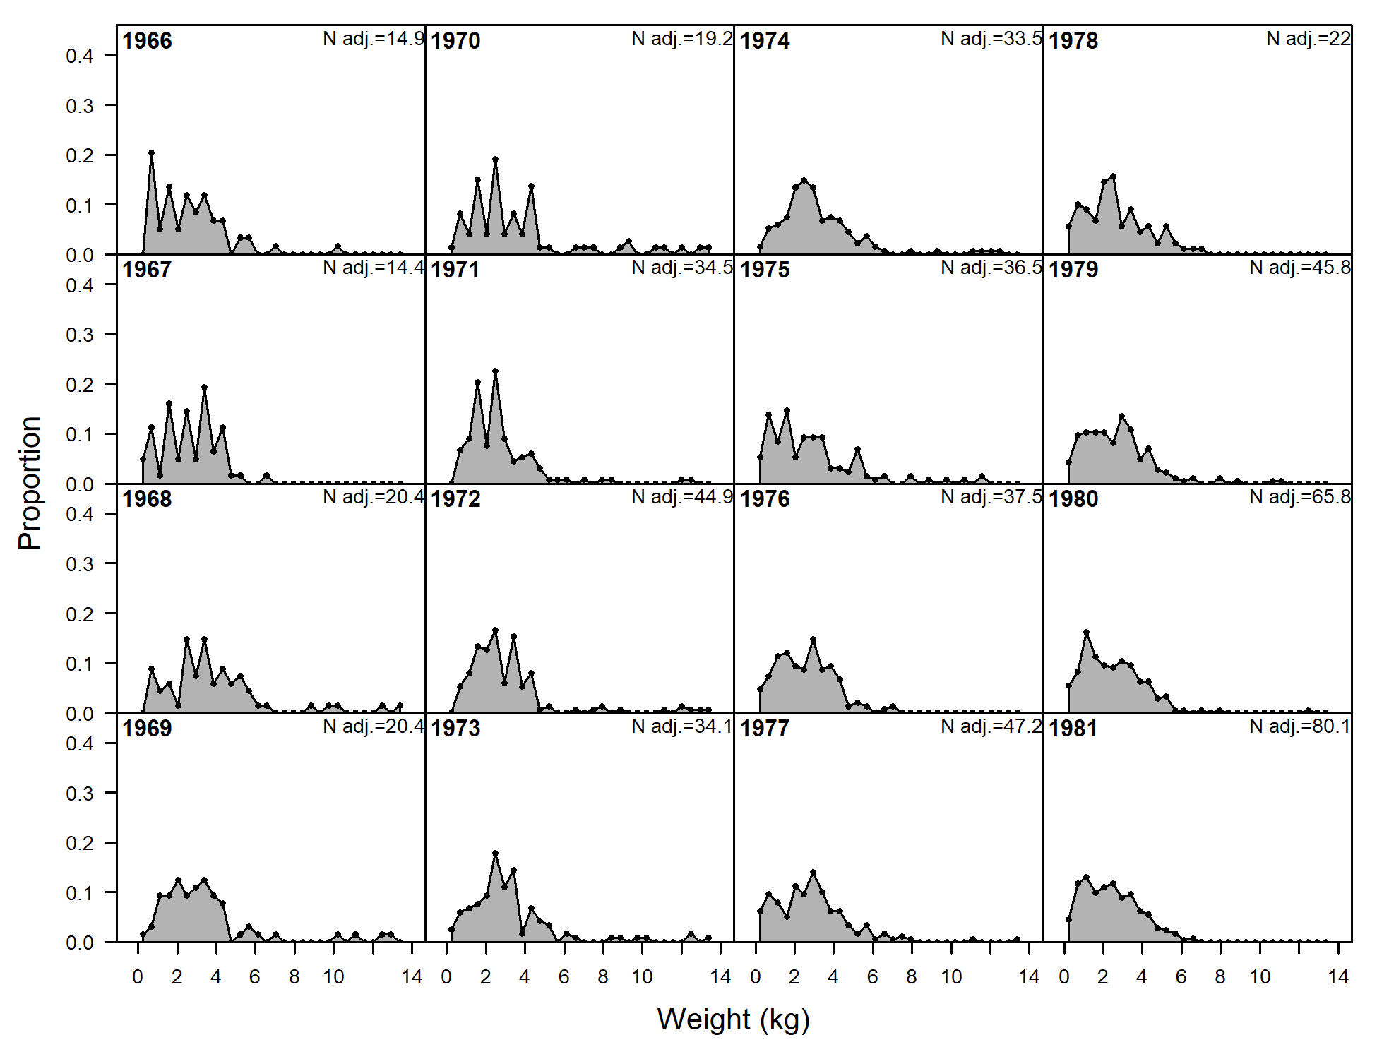
Commercial Catch Weight Composition

Slide 7
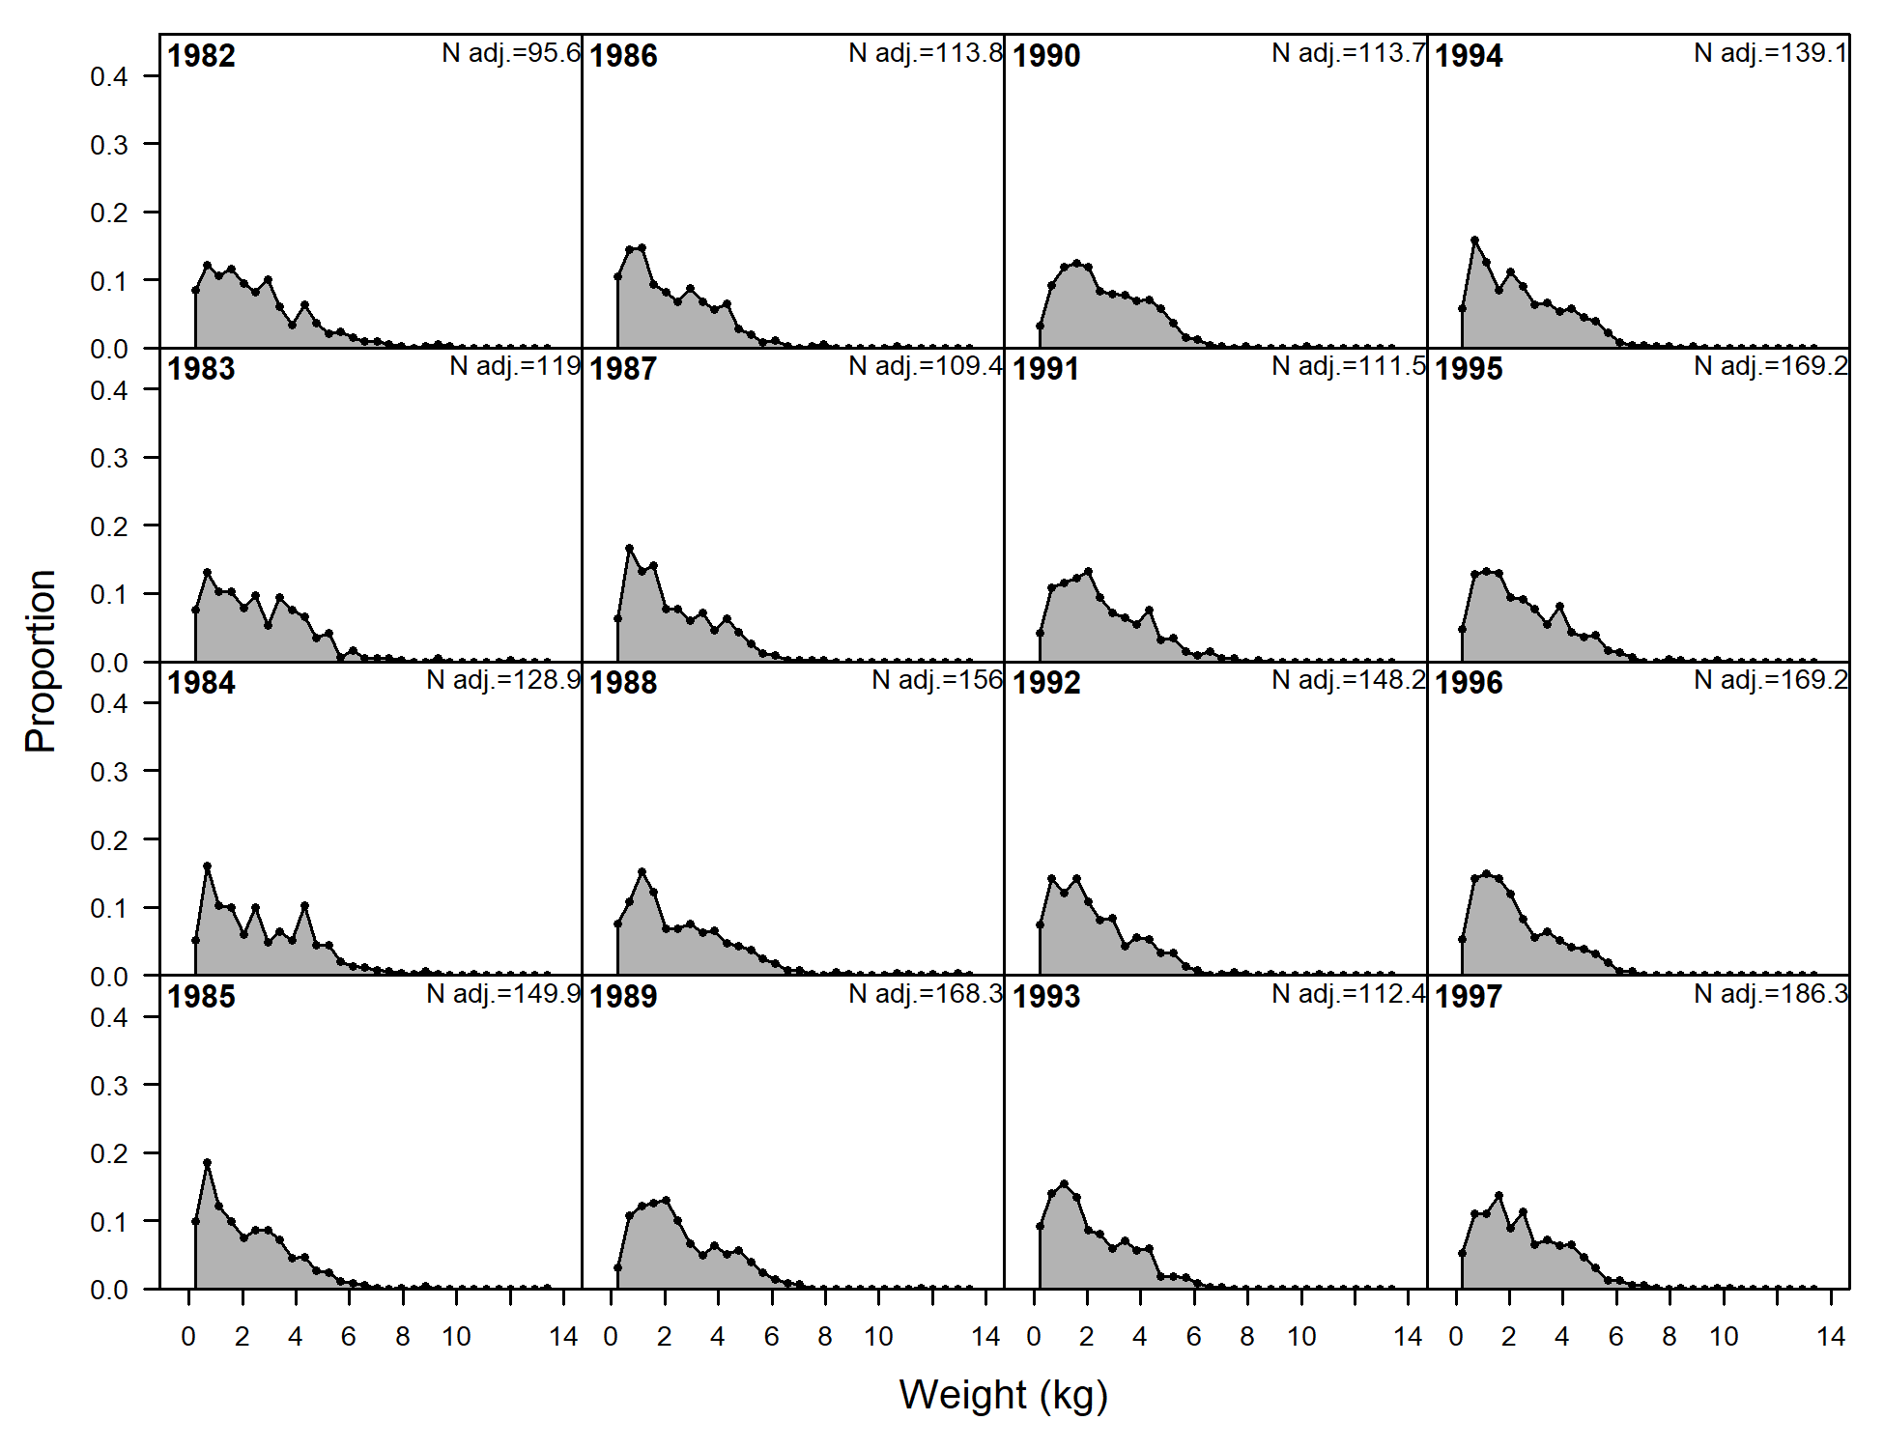
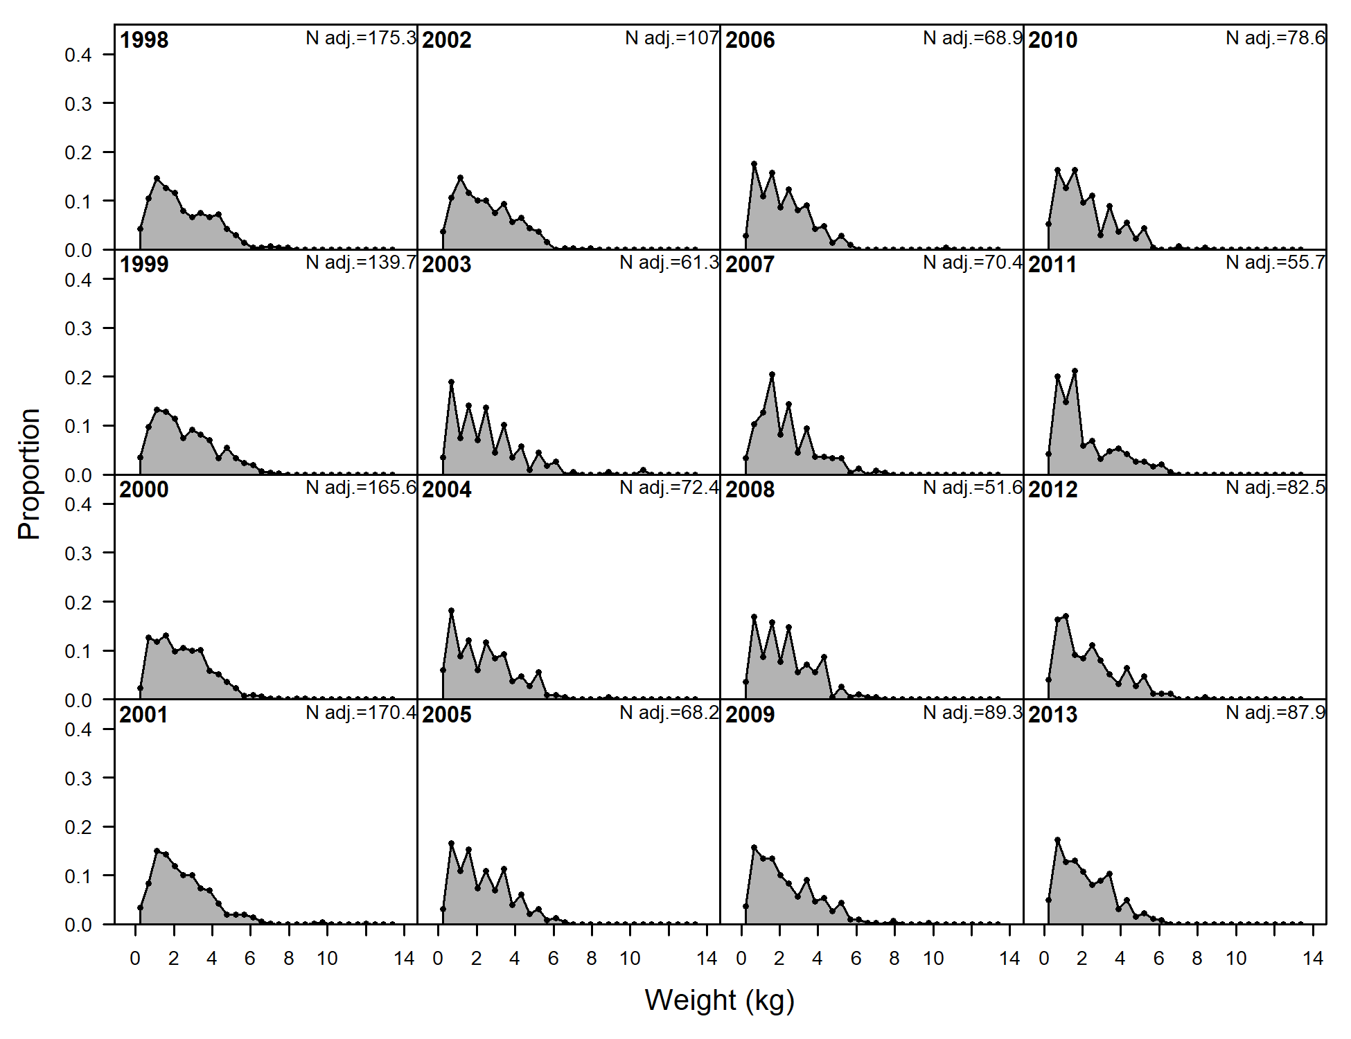
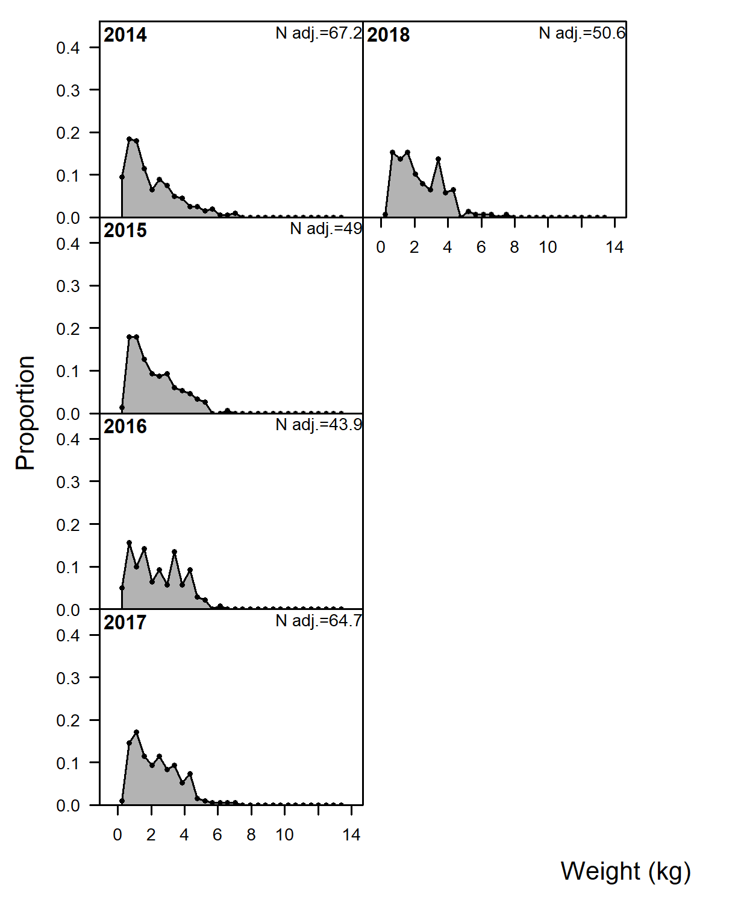
Commercial Catch Weight Composition

Slide 8
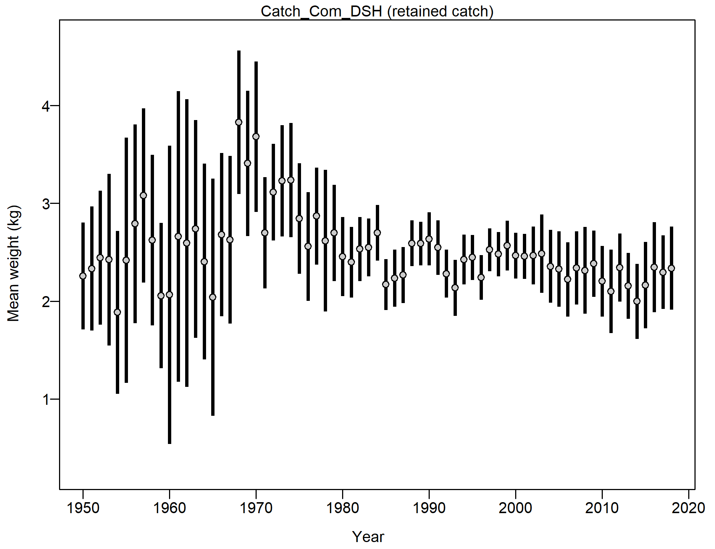
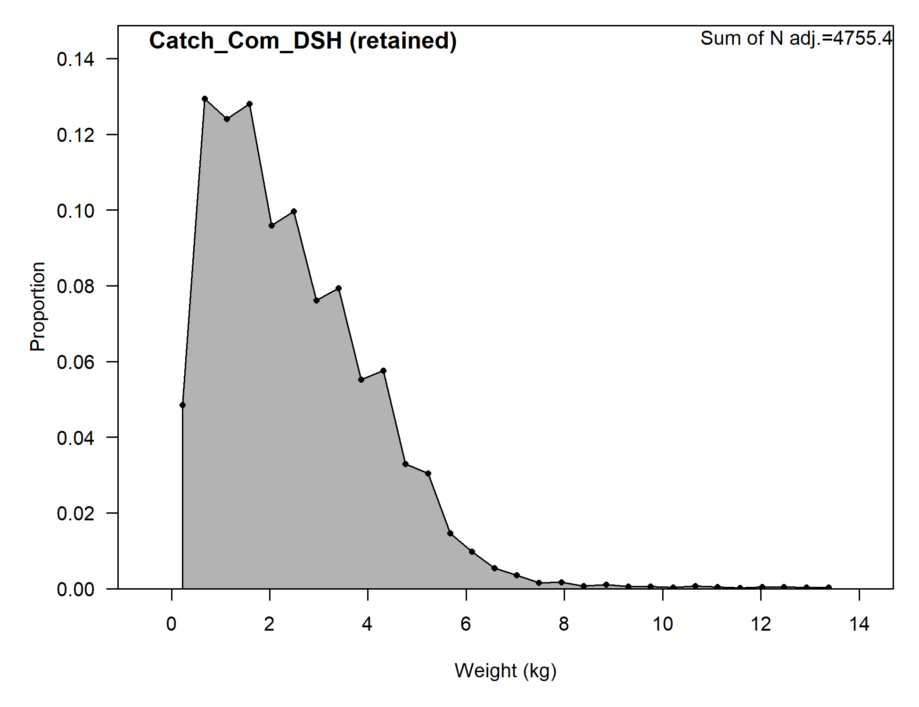
Commercial Catch Weight Compositions

Slide 9
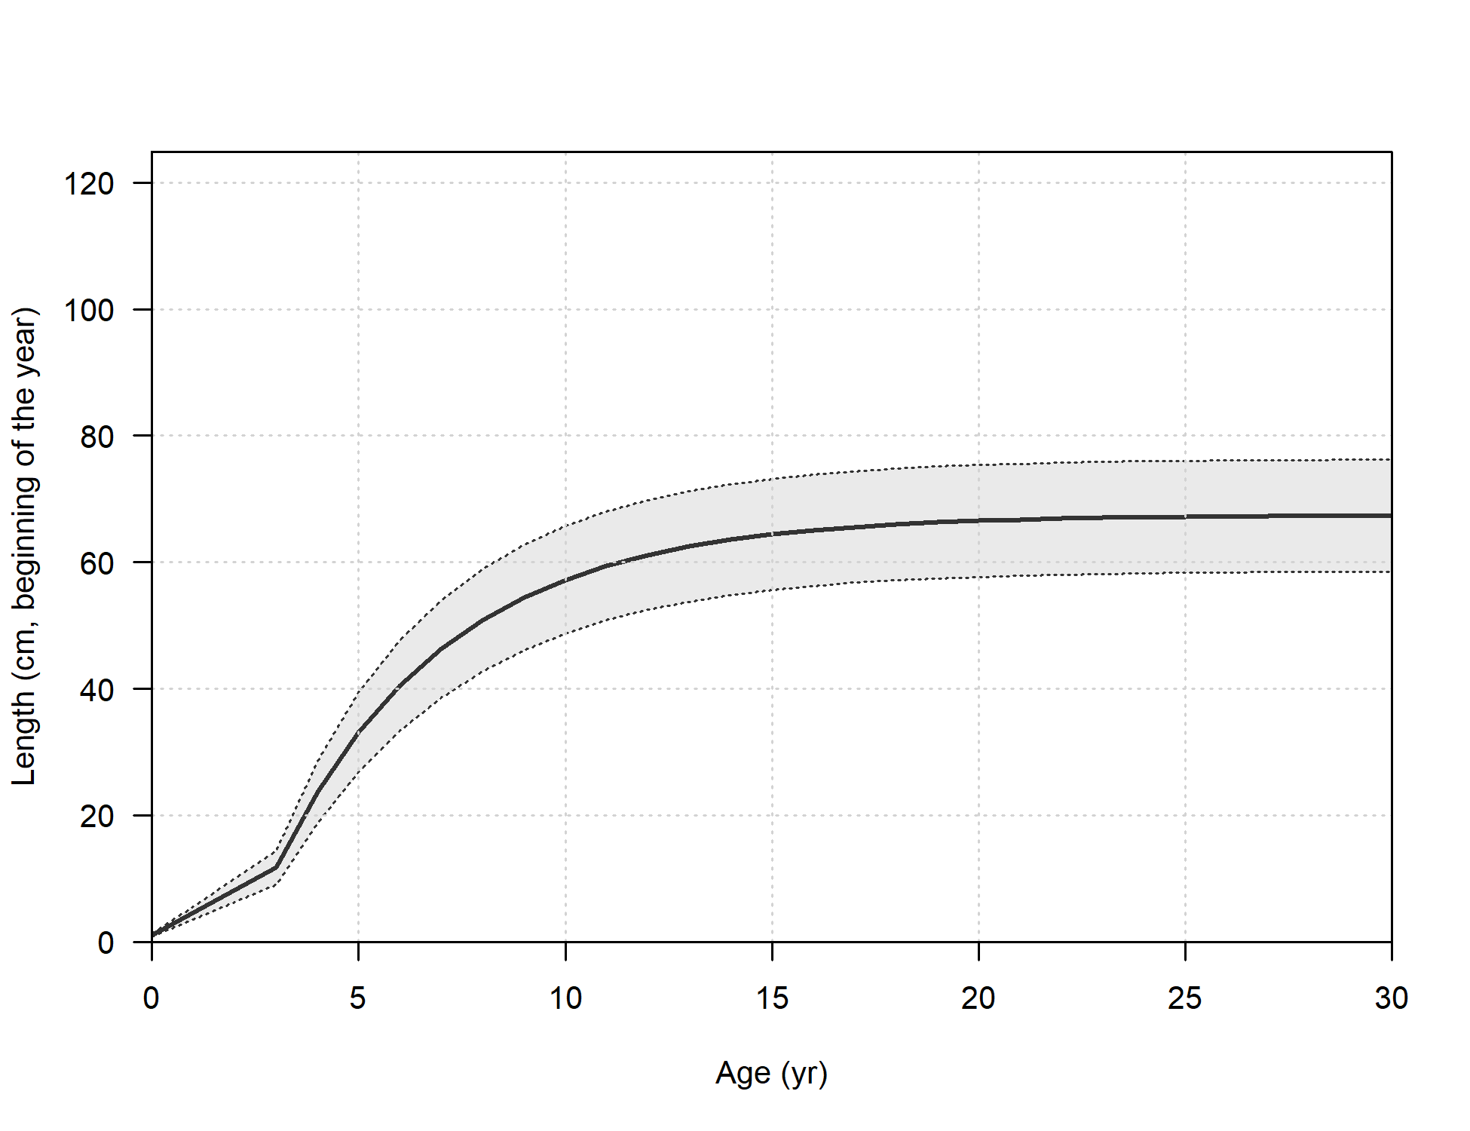
Age-at-Length
von Bertalanffy with L1 and L2 Parameters
k = 0.242
L1 = 11.7
L2 = 67.4
CV young = 0.115
CV old = 0.067

Slide 10
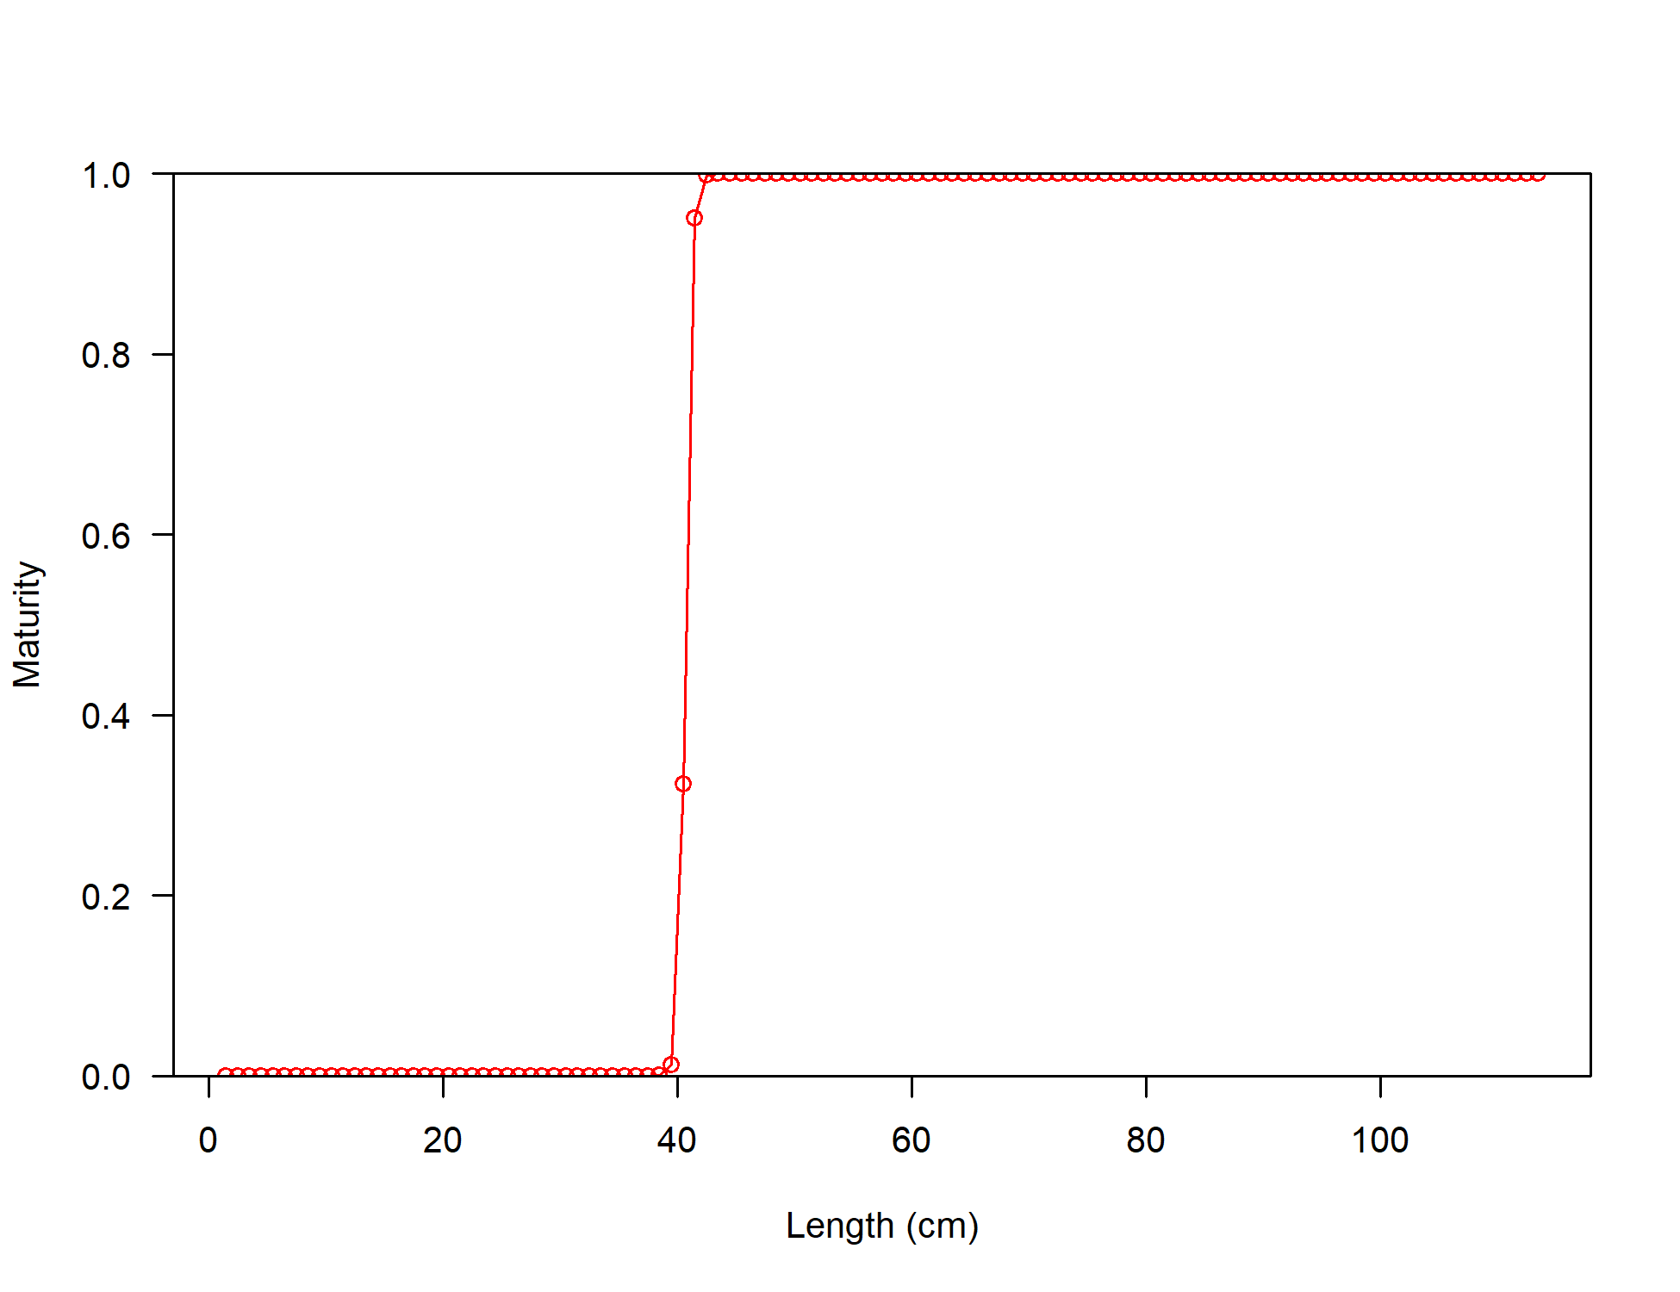
Maturity-at-Length
Maturity Parameters
L50 = 40.7
Maturity slope = -3.7
First Mature Age = 2

Slide 11
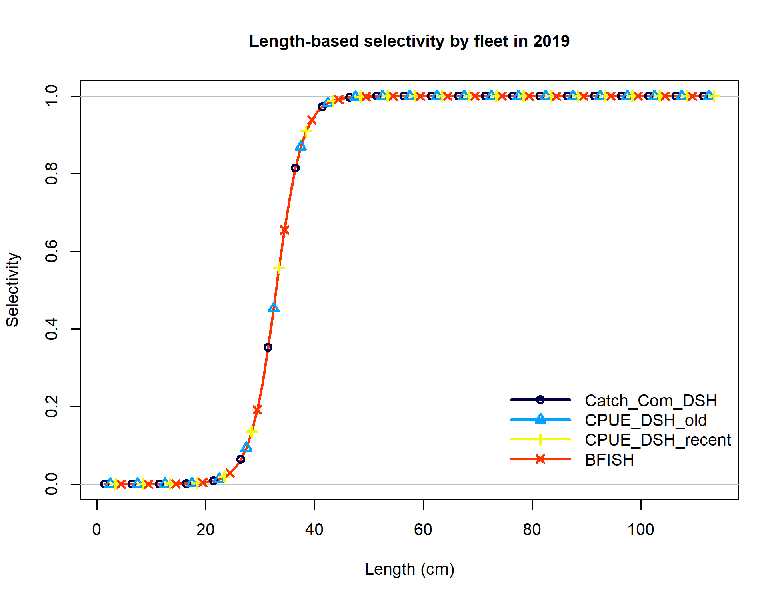
Selectivity
Selectivity Parameters
Size inflection = 32.9585
Size 95% width = 7.06601

