Slide 1


Slide 2
The Problem
Students struggle with:
- Slow manual solving
- Confusing steps
- Weak calculator explanations
- No unified tool for screenshots + images + typed math

Slide 3
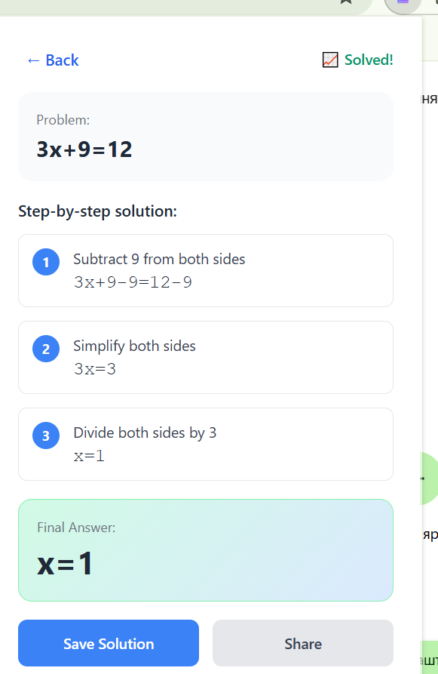
The Solution
MathSnap AI provides:
- Screenshot solving
- Image upload solving
- Typed equation solving
- AI step-by-step explanations
- Stripe-based premium upgrade

Slide 4
Demo Flow
Flow:
1. Home popup
2. Type a problem
3. AI solving screen
4. Step-by-step solution
5. Premium upgrade → Success screen

Slide 5
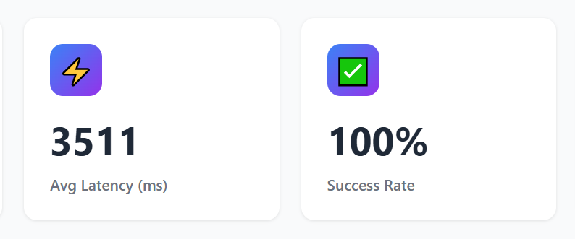
Metrics

