Slide 1
Social Media Features Presentation
Max Owens

Slide 2
What’s in this presentation:
Behat Features, requirements and associated scenarios
Basic HTML forms which represent Behat features
Entity Relationship Diagram
SQL code and queries
Class diagram

Slide 3
Behat Features Feature 1: Login/Authentication
Users who want to log into the website with an existing account will be presented with a login form. The login form will contain a username text box input, and a password text box input. The password text box content will be hidden as the user types it. Below the two text input boxes will be 3 buttons; a login button, which will display above the other two. The remaining buttons will be “Forgot your password” and “Sign up” these buttons will be for people who would like to register to the website, and for people who have forgotten their password.

Slide 4
Scenario: username entered does not exist in database
Given the entered username does not exist
When the username is submitted into the form
Then display a message telling the user that the name does not exist
And clear the form, allowing them to try again

Slide 5
Scenario: password entered with correct username is incorrect
Given The entered username is correct, but the password isn’t
When the submit button is clicked with an incorrect password
Then display a message telling the user that the password is incorrect
And clear the password field, allowing them to try again

Slide 6
Scenario: user forgot their password
Given the user has an account but has forgotten their password
When the user clicks the button “forgotten your password”
Then redirect the user to a page where they can confirm their identity
And provide fields allowing them to reset password when authentication conditions are met

Slide 7
Behat Features Feature 2: Registration
Users who wish to create an account on this website must be able to enter in all their information in the provided fields. The form with said fields will contain Username, password, email address, first name, last name, address line 1, address line 2, phone number, and date of birth. Below these fields will be a button which will create an account on the condition that fields such as email address and username do not already exist in the database.

Slide 8
Scenario: Entering a username that’s already in use
Given the desired username is in use
When the user tries to submit the existing username
Then a message will display telling them the name is already in use
And the form will clear so they can try again

Slide 9
Scenario: Entering a password that’s too weak
Given the desired password is too weak
When the user tries to submit the password
Then a message will display telling them the password is too weak
And the form will clear so they can try again

Slide 10
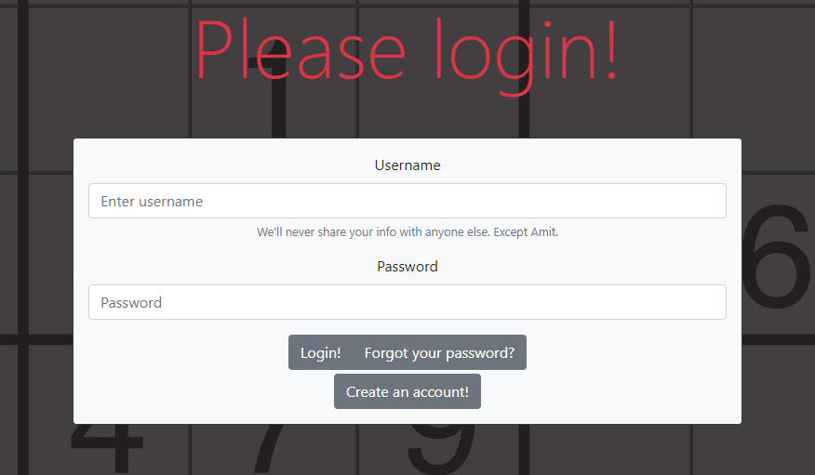
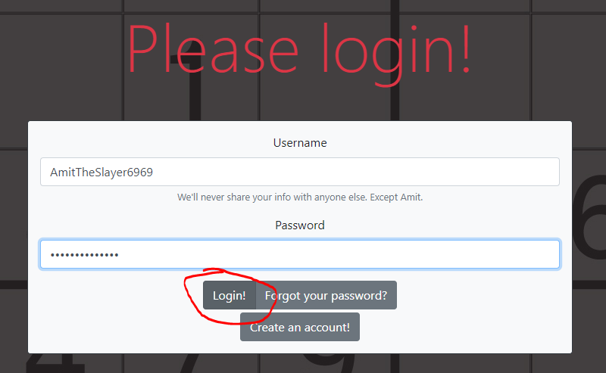
Example: login

Slide 11
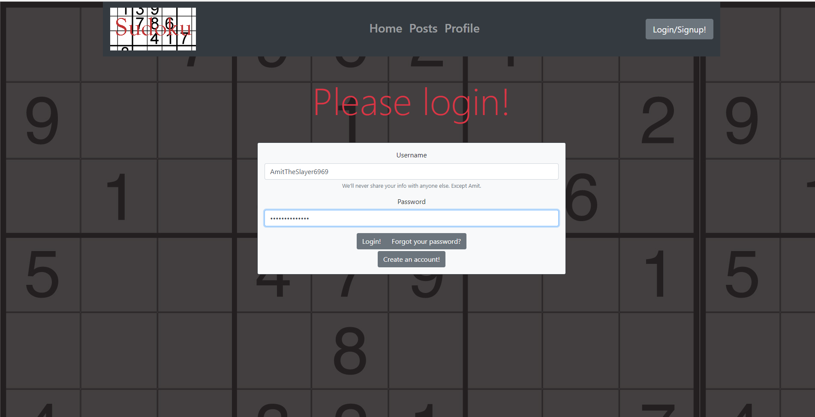
Mock HTML

Slide 12
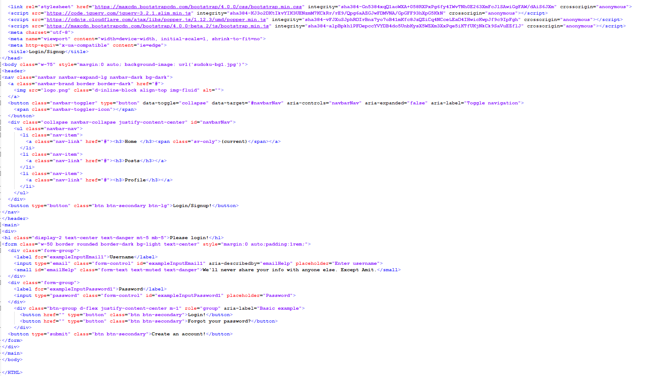
HTML Code

Slide 13
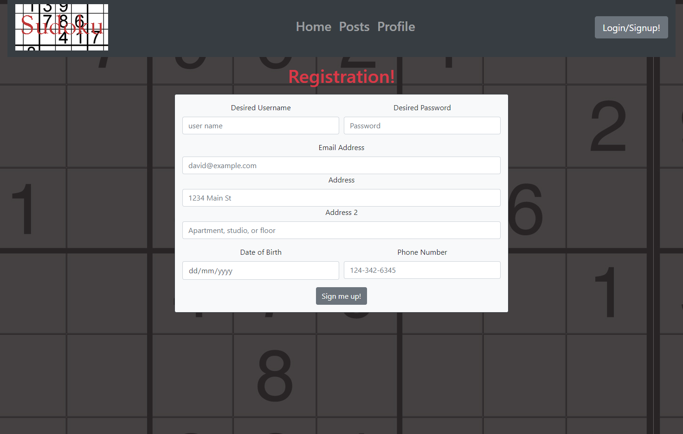
Mock HTML - Registration

Slide 14
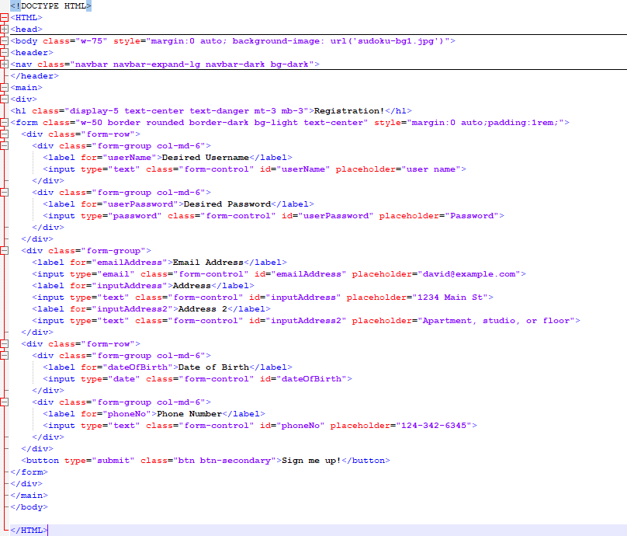
HTML Code

Slide 15
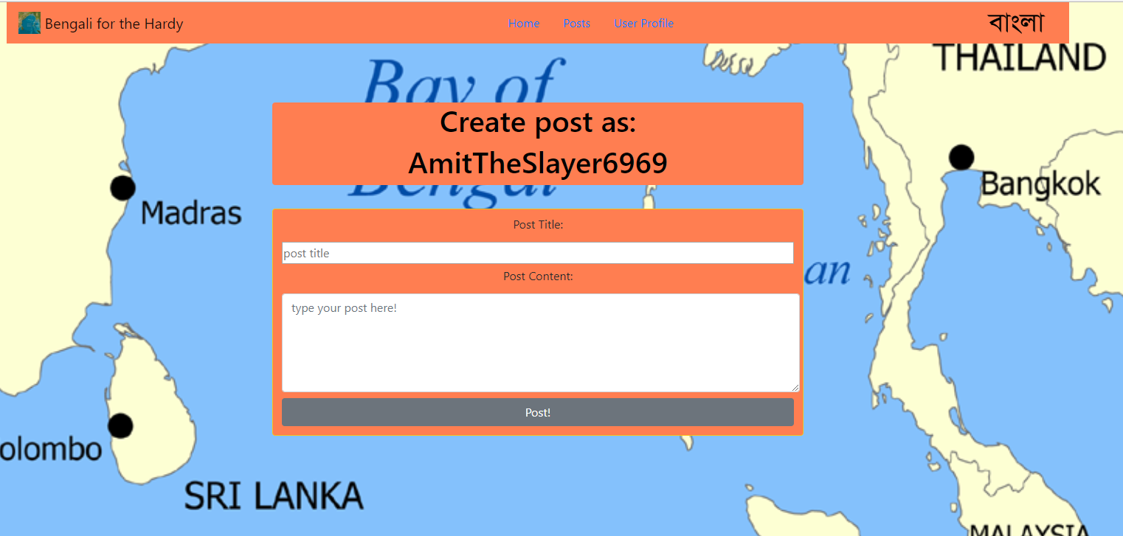
Mock HTML – Create Post

Slide 16
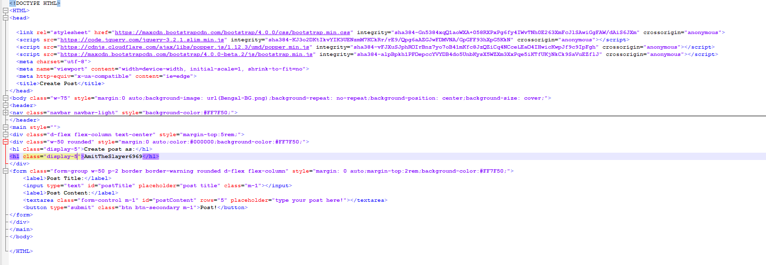
HTML Code

Slide 17
Entity Relationship Diagram
My ERD has five tables: AccountDetails, OldDetails, Login, BlogPost, and BlogComment
The AccountDetails table contains all a registered users provided information. It’s primary key is an auto-incremented integer. It’s connected to the UserAccounts table, which is used for logging in.
The Login table contains a username, password, and accountID column. The username, password and AccountID are foreign keys of the Account Details table, and the primary key is the username. This table is created for each row in AccountDetails.
The OldDetails table is designed to store old information whenever a row in AccountDetails is changed, as well as a timestamp of when it was updated.
The BlogPost table contains a PostID, which is an auto-incremented primary key. It also has a postTitle, postContent and username attribute. The username attribute is a foreign key to the Login table, in order to allocate a post to a user.
The BlogComment table contains a CommentID, which is an auto-incremented primary key. It also has a PostID, commentContent and username attribute. The PostID and username attribute are both foreign keys, in order to link the comment to the post, and the comment to which user made it.
The Login and AccountDetails tables have a 1 to 1 relationship as they cannot have more than one of the other.
The Login and BlogPost tables have a 1 to many relationship, as one user can have one or many blog posts.
The same relationship applies to BlogPost and BlogComment, a Comment can only belong to one post, but the post can have many comments.

Slide 18
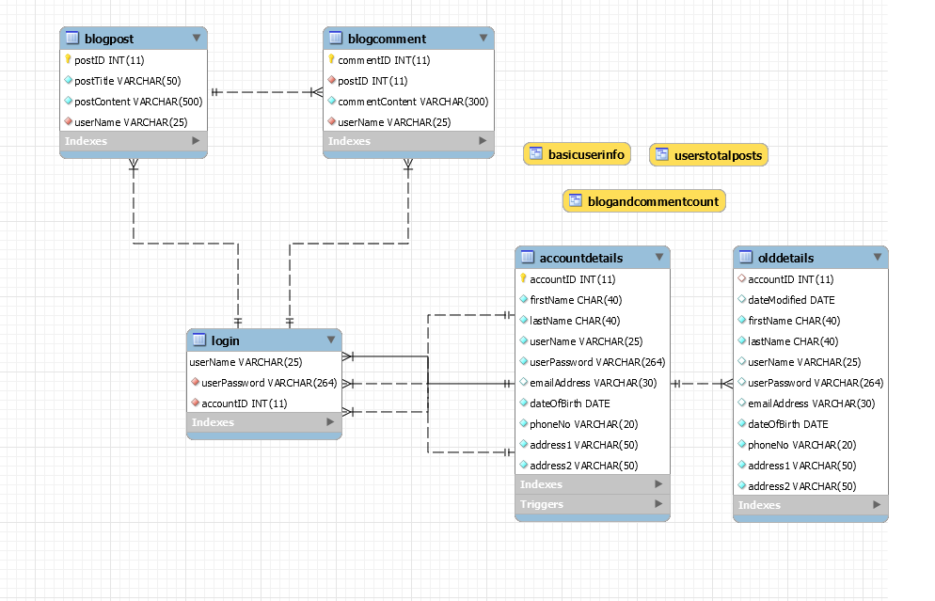
ER Diagram

Slide 19
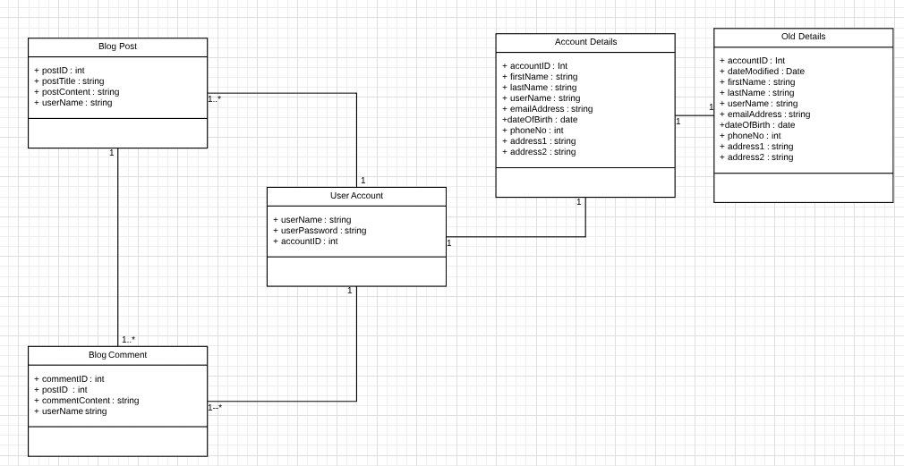
Class Diagram

Slide 20

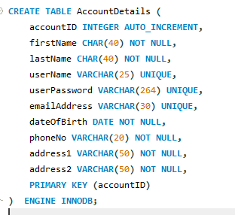
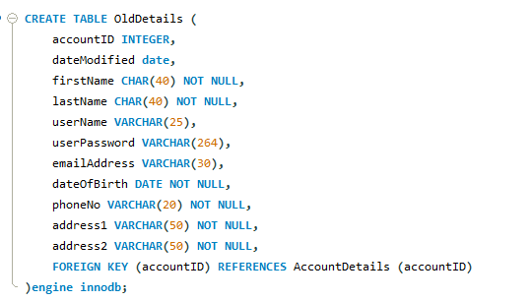
SQL Queries – DB Creation and Table Creation
Create the database, and use it
Creating the AccountDetails Table
Creating the OldDetails table

Slide 21
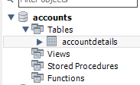

AccountDetails Table

Slide 22
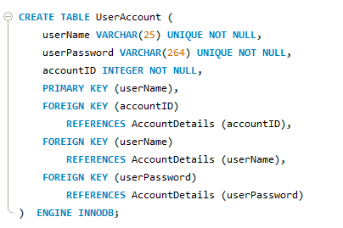
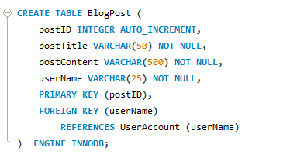
SQL Queries
Creating the UserAccount Table
Creating the BlogPost Table

Slide 23
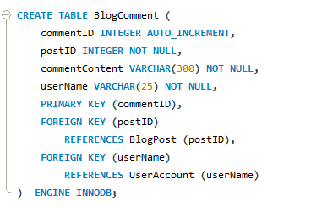
SQL Queries
Creating the blogComment table

Slide 24
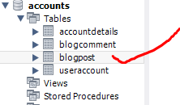
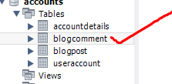




Existing Tables

Slide 25
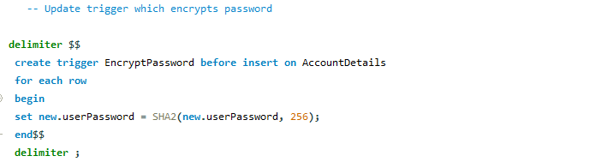
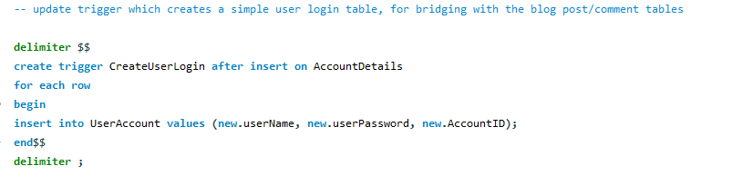
Triggers
This trigger immediately encrypts a password upon insertion, so password is NOT stored in raw format. Occurs before UserAccount insertion so both passwords are stored encrypted.
This trigger occurs after an insertion on AccountDetails, in order to create a table for logging in with the submitted username/password.

Slide 26
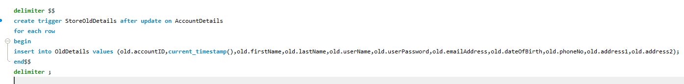
Triggers
trigger which updates OldDetails whenever a row in AccountDetails is updated

Slide 27
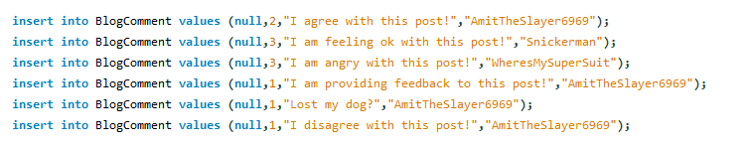
Inserting Data

Slide 28
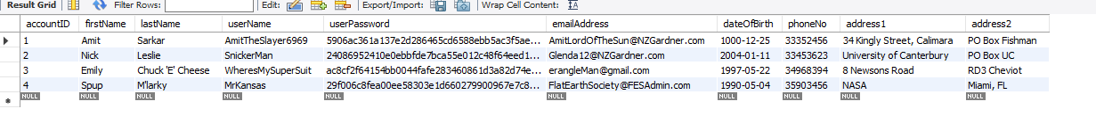
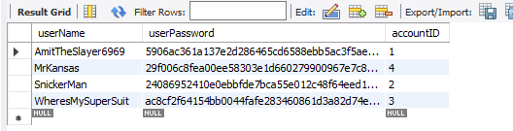
Tables after data insertion
AccountDetails
The existence of this table proves the success of both triggers; it creates a UserAccount table for each AccountDetails row inserted, WITH the encrypted password.

Slide 29
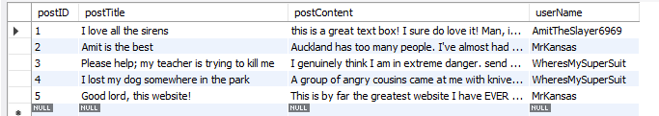
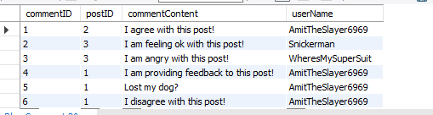
Tables after data insertion
Blog Post Table
Blog Comment Table

Slide 30
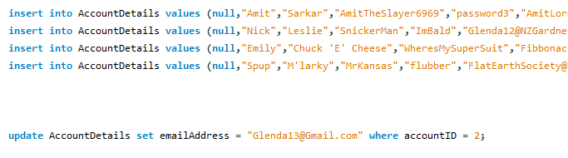

OldDetails table after an entry is updated
New detail vs old detail

Slide 31
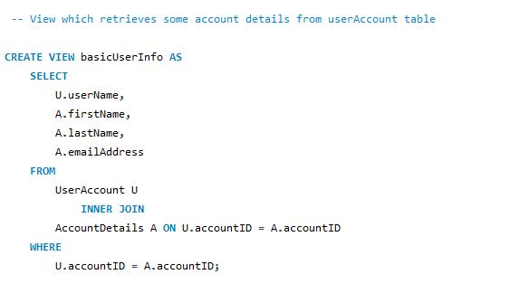
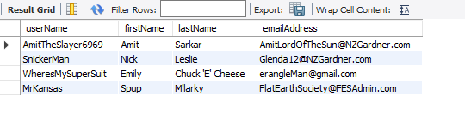
View 1 – basic user info displays basic user information

Slide 32
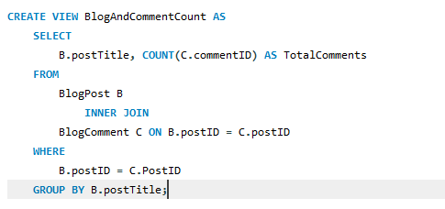
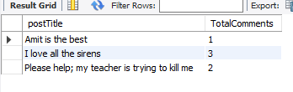
View 2 – Display each blog post, with total comments made

Slide 33
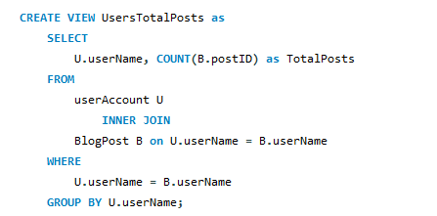

View 3: display each user and the total posts made

