Slide 1
PR283 Assignment Part B
Theory Presentation
Max Owens - 99125006

Slide 2
Referenced Material for the program
I used Alistair’s model which was available on Moodle to build on, extend and implement my view.

Slide 3
Item #4: Design User Interfaces which conform to recognised usability criteria
This item dictates that all windows forms and the layout/design of these forms all follow a pre-set criteria of usability, which basically means that the UI has to be easy to look at and use rather than having users tilt their heads in confusion and wonder who the genius was that put the exit button in the middle of the form, or changed all the occurrences of the word ‘The’ to ‘Teh’.

Slide 4
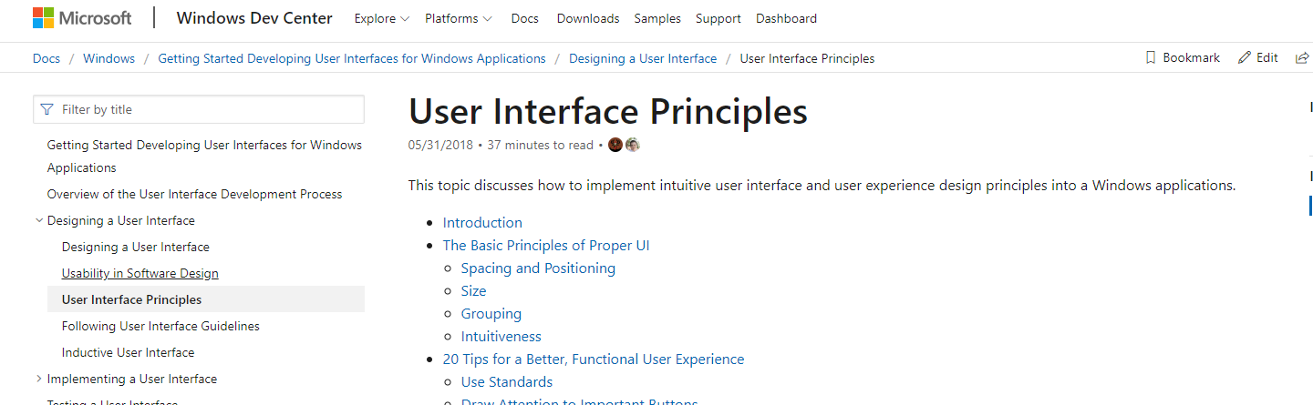
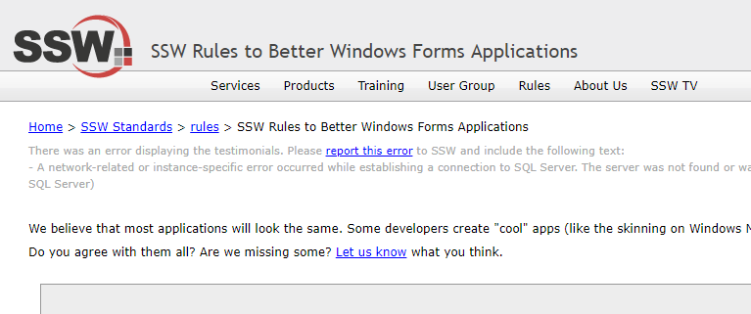
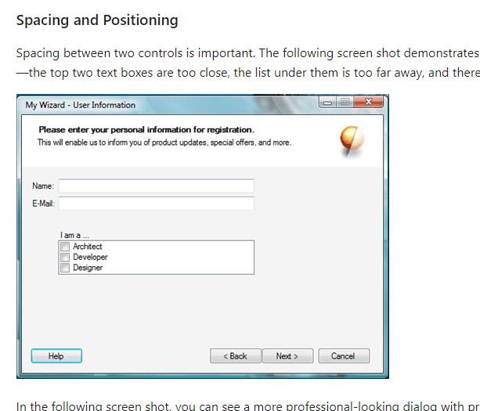
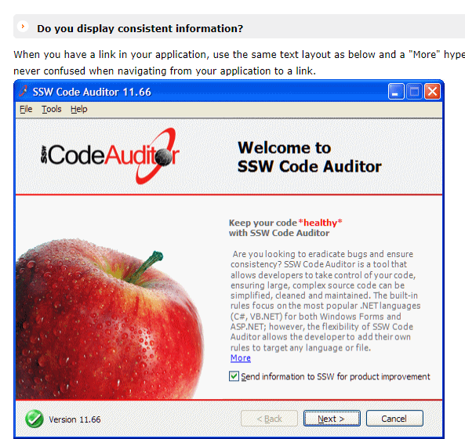
Credible References of this theory
https://docs.microsoft.com/en-us/windows/win32/appuistart/-user-interface-principles
https://www.ssw.com.au/ssw/Standards/rules/rulestobetterwindowsforms.aspx

Slide 5
Show/Say what you have done / used / implemented
In my assignment, it was important to me that while my form had little in the way of interaction compared to the examples provided by the online documentation, that it still maintained a high standard of usability and quality. For example, sizing of buttons is a critical part of making a windows form user friendly. Microsoft Documentation suggests that the text should take up most of the button size, and if the text is small yet the button size large, it should be revaluated or scrapped.
User disruption plays a major role in the effectiveness of your windows form design, and with notifications required for informing the user that they have completed a row, column or square, I needed to ensure that whatever I used to notify the user of this wasn’t disruptive to their experience. Following this guideline, I applied the notification to the bottom of the board, simply isolating and grouping the labels in a place the user can quite easily see, yet it doesn’t disrupt the flow of the windows form.

Slide 6
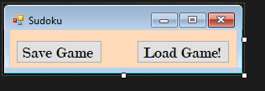
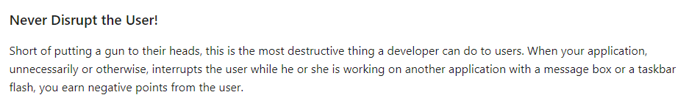
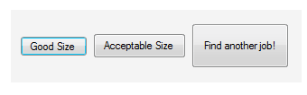
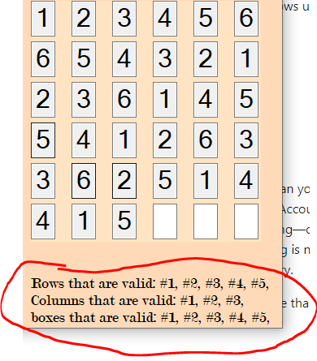

Evidence of previous slide
Button sizing
Validation Notifications

Slide 7
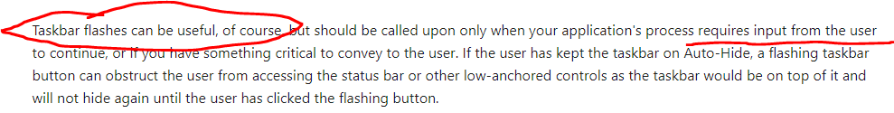
Comparing other approaches
Microsoft documentation suggests that taskbar flashing can be considered a good method of notifying the user. I considered this, however with the nature of the form being simply a game which will likely have most of the users attention, I thought that taskbar flashing was unnecessary and could prove annoying if nothing meaningful at all to the user.

Slide 8
Evaluation of the effectiveness of my approach/potential improvement
The simplicity of the approach is what makes it successful and effective. There are no overwhelming controls, or too many controls grouped together, and the notification system is at a successful standard for myself and other users of the application. By following the guidelines set out by Microsoft and SSW, I successfully provided controls and panels which conveyed the purpose and interactivity of the application without breaking any major or minor usability guidelines.
To improve for next time, I would definitely broaden my research for various standards available on the internet. While the standards I followed were helpful and reliable, if I extended my research I would be able to apply different strategies and hopefully increase the success of my application.

Slide 9
Item #5: Code programs in the specified language using the prescribed standards
The language we are required to develop the Sudoku program in is C#. This is a strong language that is widely used with desktop applications, and primarily for windows forms. The widely accepted standards that C# follows dictate variable naming conventions, algorithm simplicity (for loops, while loops etc) and how much a function should contain realistically for it to still be considered good practice. The standards set are primarily that of Microsoft, the creators of the programming language used.

Slide 10
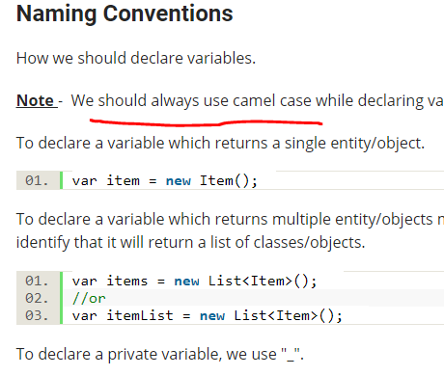
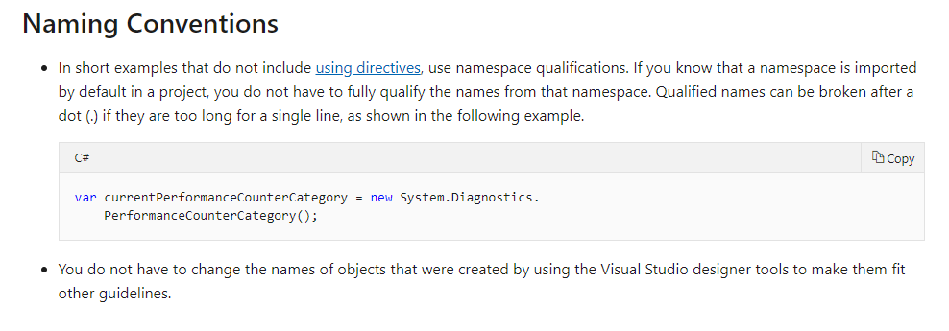
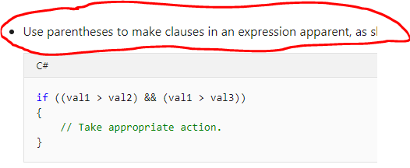
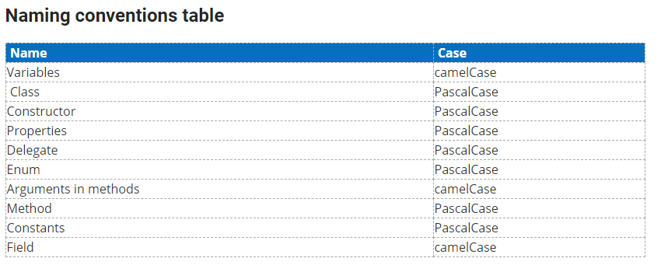
Credible references for this theory
https://docs.microsoft.com/en-us/dotnet/csharp/programming-guide/inside-a-program/coding-conventions
https://www.c-sharpcorner.com/article/c-sharp-coding-standards/

Slide 11
Show/Say what you have done / used / implemented
In my project I made it a priority that as I developed my program I strictly followed good practice and widely accepted standards. By using Microsoft available documentation and the documentation provided by C# Corner.com, I believe I have managed to maintain my code to a high standard, a standard set by Microsoft themselves.

Slide 12
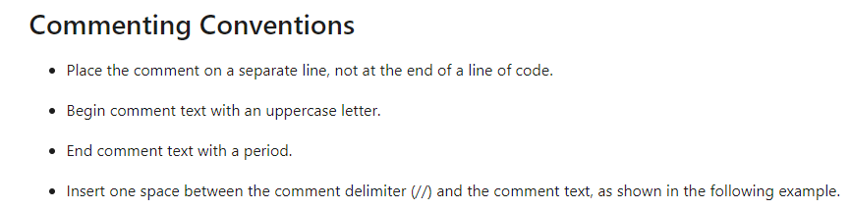
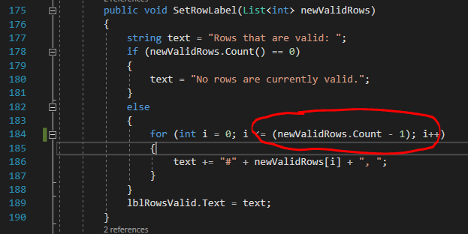

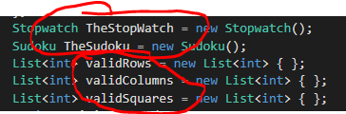
Evidence of Previous Slide
“Use parenthesis to make clauses in an expression apparent”

Slide 13
Comparing Other Approaches
In reality, the ‘other approach’ I could potentially use would be not following any coding conventions at all. While yes, this would mean less time is spent structuring code and checking whether I’m following guidelines, and overall reduce time spent constructing, it would mean reusability and readability of my code would be terrible. It would be very difficult to revisit code created in the past, if variable names are poor and there’s too much crammed into one function. The way I have done it means that people should have very little trouble (or no trouble at all!) understanding my code from beginning to end.

Slide 14
Evaluation of the effectiveness of my approach/potential improvement
The effectiveness of the coding conventions for C# is that because I followed it, it meant that with 3 different coding projects due around the same time I was able to hop between them with ease and was able to understand how they all functioned. The similarity in style and structure meant that readability was high and very little time was spent re-studying my own design trying to figure out what it was I was trying to do.
A potential improvement for next time would definitely be that I can study a variety of coding conventions. While yes, the Microsoft documentation is well structured and thought out, other approaches may better suit my coding style, and may be more up to date than Microsoft’s own documentation. Even applying different conventions at once may turn out to be more successful than originally anticipated. More research will definitely be carried out in the future.

Slide 15
Item #2: Use appropriate software life cycle models and software construction steps
Software life cycle models are techniques/approaches which dictate in which order/which method you should follow to complete a software project, from start to finish. They are excellent at assisting people to pace themselves, and maximise efficiency. Certain life cycle models are excellent at doing different things. My point being, that there is no one life cycle which can accomplish all development projects.
Software Construction Steps dictates that development must follow a variety of steps that should be taken in order for a software project to be successful. These steps can vary, and much like the various life cycle models, each can be successful for different approaches/projects.

Slide 16
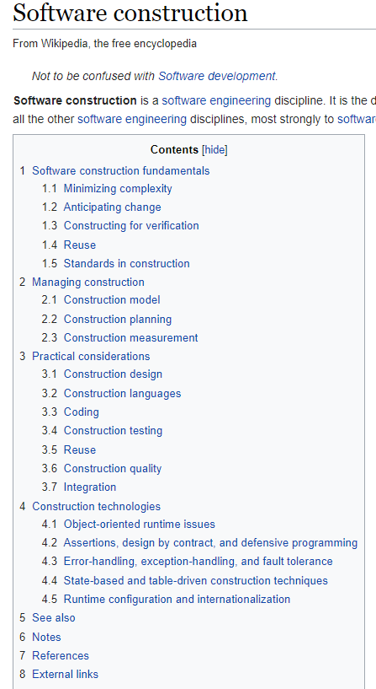
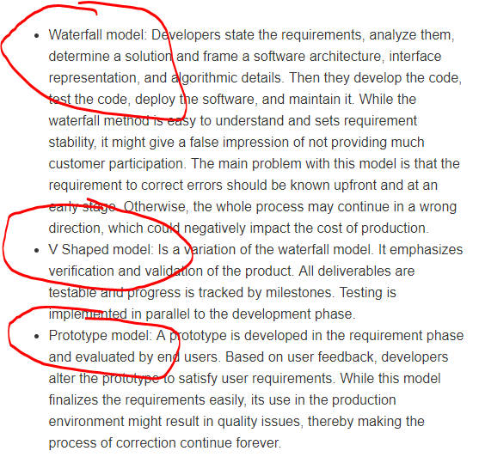
Credible References for this theory:
https://en.wikipedia.org/wiki/Software_construction
https://www.techopedia.com/definition/25976/software-development-life-cycle-model-sdlc

Slide 17
Show/Say what you have done / used / implemented
In my project I

Slide 18
Evidence of Previous Slide

Slide 19
Comparing Other Approaches

Slide 20
Evaluation of the effectiveness of my approach/potential improvement

