Slide 1
Snake game
Microprocessor project
DR : Abdelhamid Attaby
Eng : Mahmoud Taha

Slide 2
Team members
BN | Name
01 | Ibrahim Ali Ibrahim Kaldesh
03 | Ahmed Gamal Saeed Abosalem
04 | Ahmed Hamdy Mohamed Fahmy
13 | Aya Osama Sayed Taha
14 | Passant Amr Ali Hassan

Slide 3
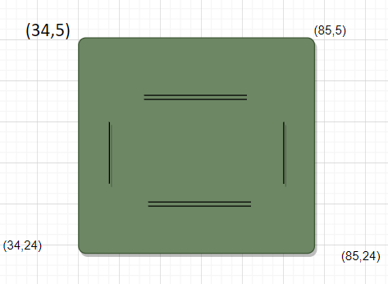
1- Draw-First we begin to draw wall.
- we set coordenaties of wall
(34,5),(85,5),(34,24),(85,24)
- key symbole of wall is #
- the snake will apper as Xxxxx with its head
directed to left but not moving until
Player enter any movement key.
- Initial coordenaties of snake is (45,15)
for head,(44,15),(43,15),(42,15),(41,15)
- Added barriers to increase the difficulty of the game
in different places(50,8) (70,21)(42,16)(77,10)
2-Draw Title of the game (106,1)
3 - "Your score is 0" will apper in left top of screen and
when snake eats a coin it increment score and display it .
-High score
-LIves

Slide 4
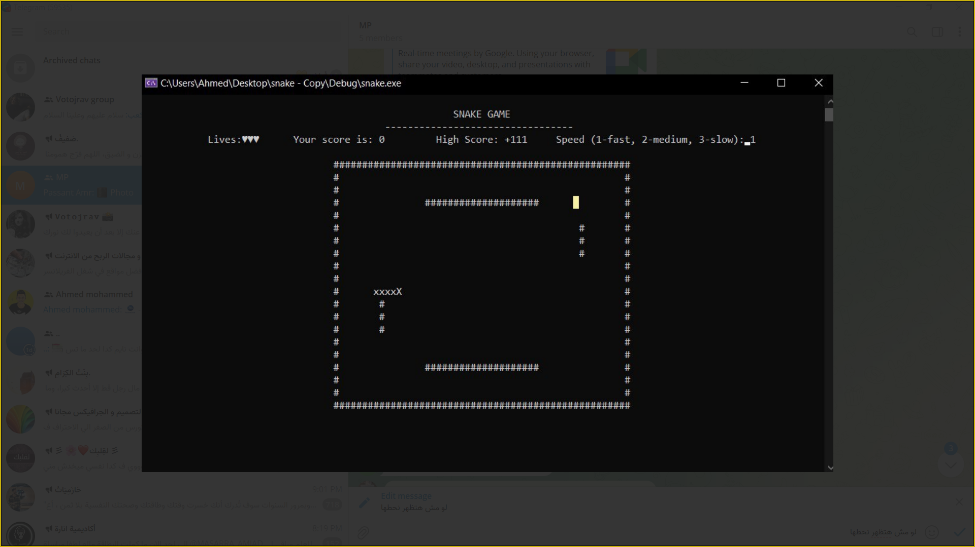
Speed Selection- User may choose from three speed levels:
level 1(fastest)
level 2,(Medium)
level 3 (slowest)
Each of the speed levels have a 40ms difference.- we implement that by using delay function when moving snake.

Slide 5
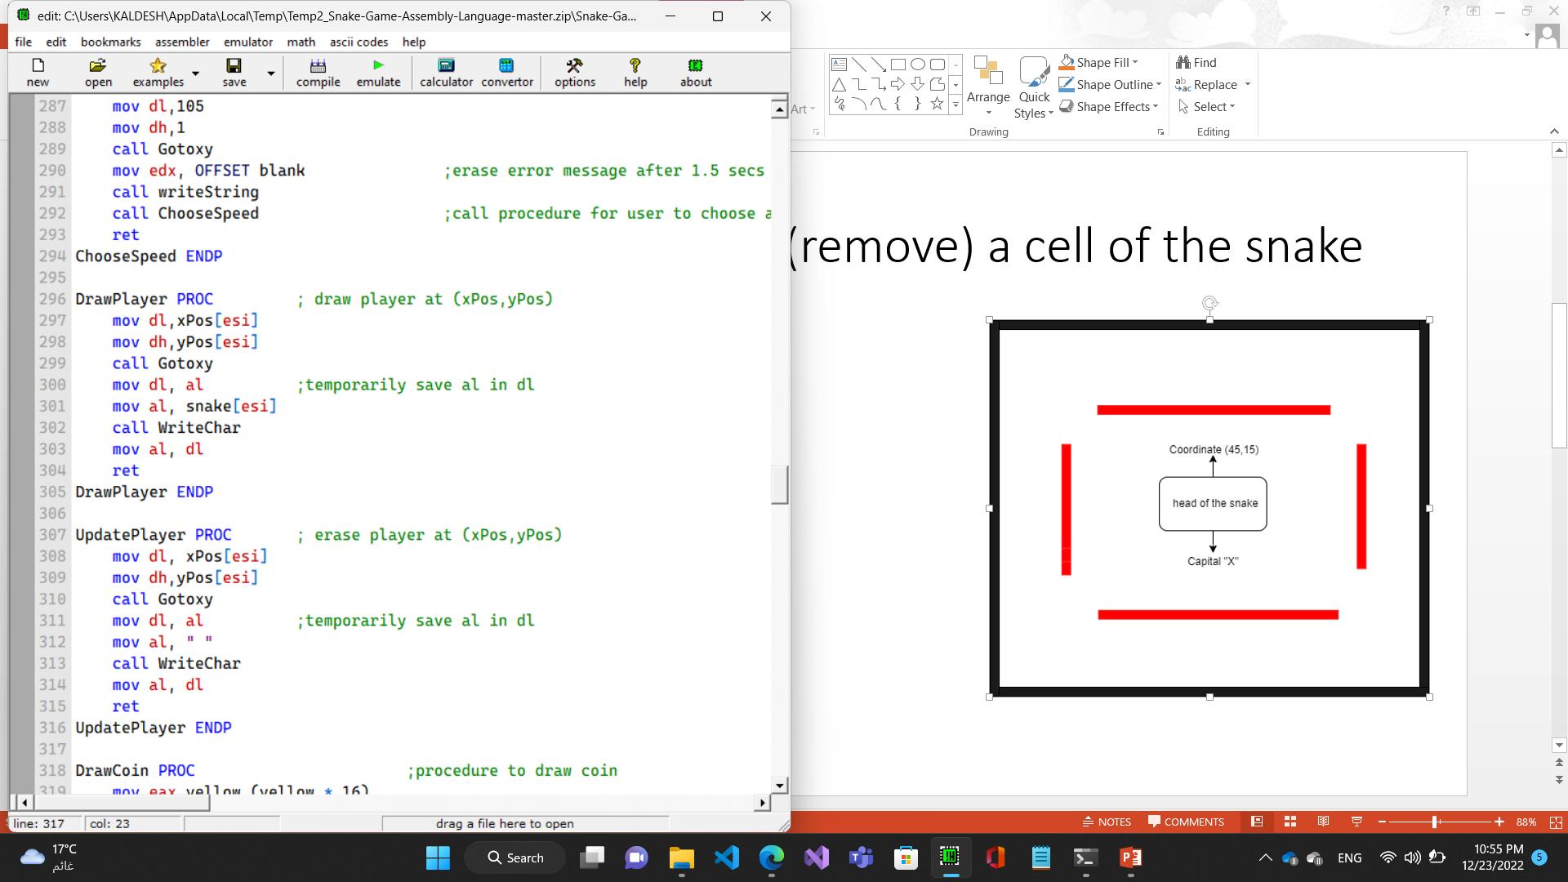
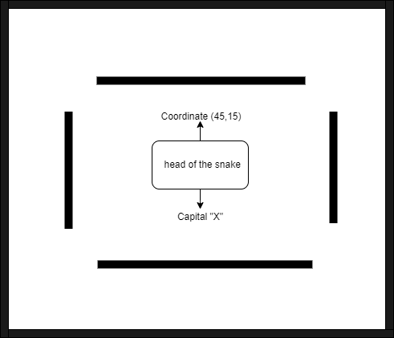
Draw and update (remove) a cell of the snake

Slide 6
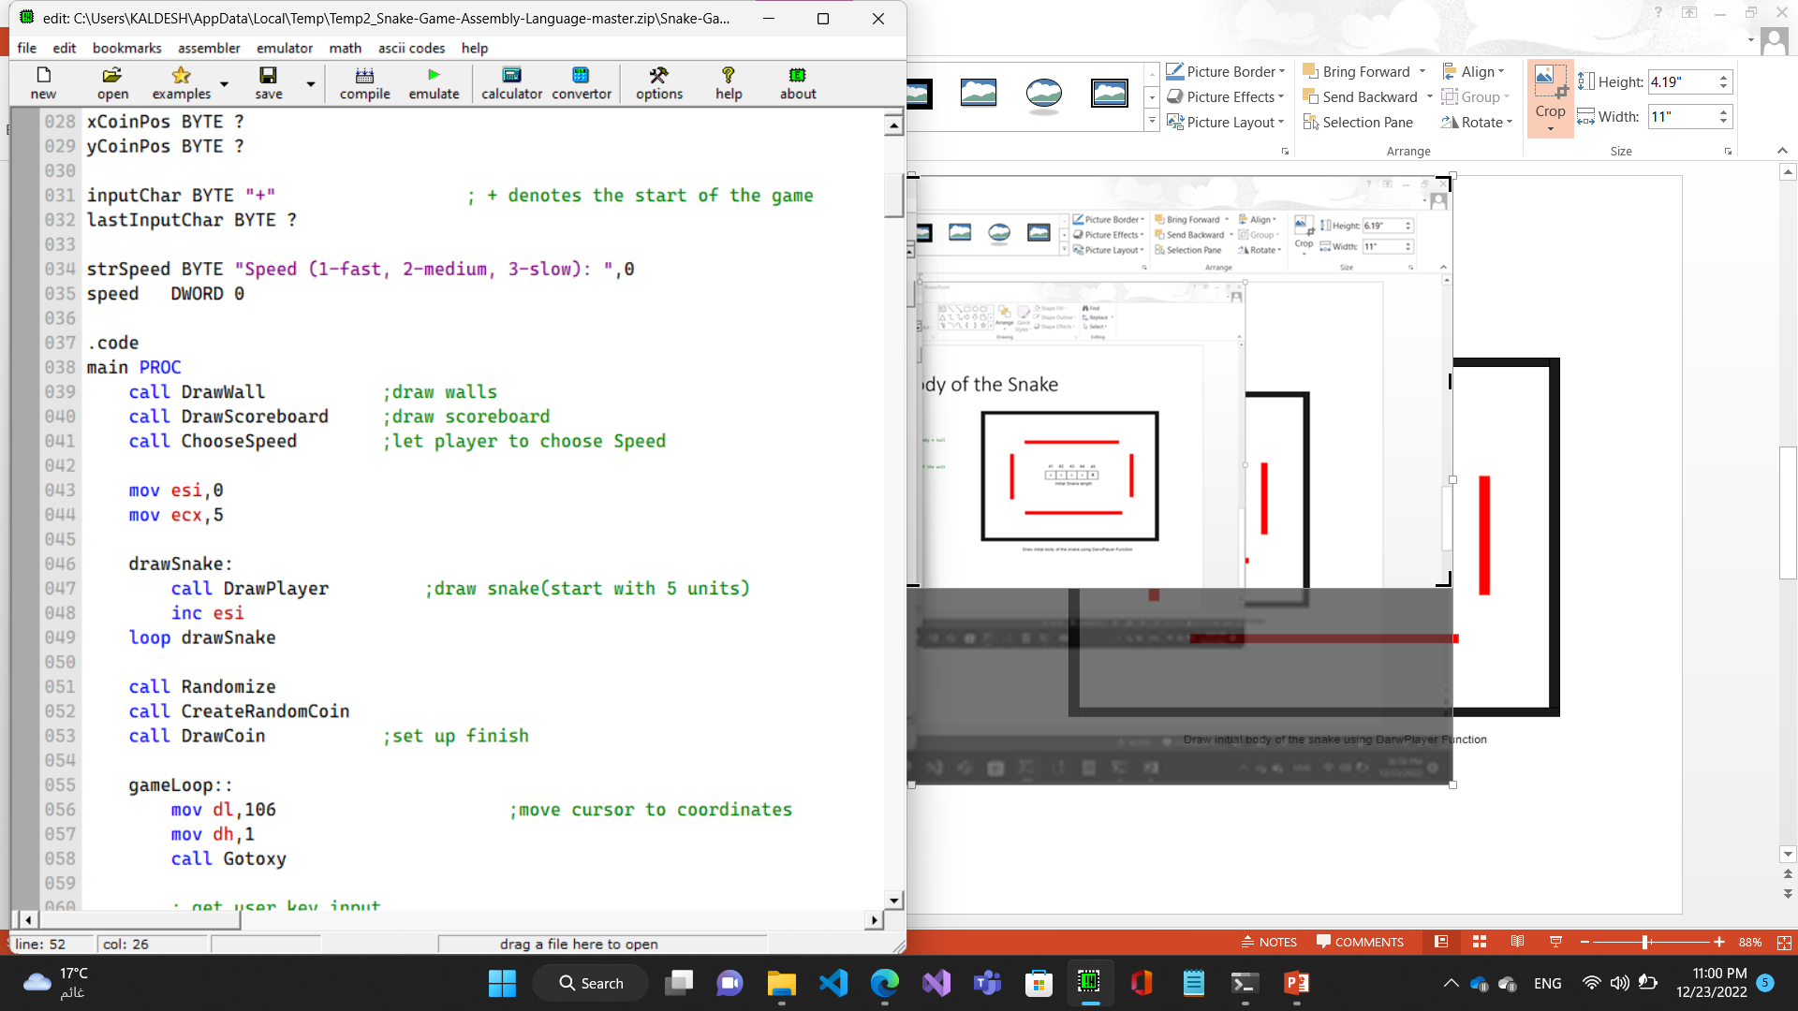
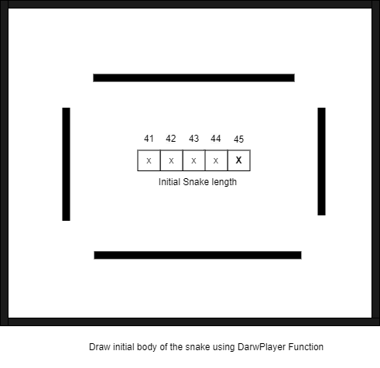
Draw the initial body of the Snake

Slide 7
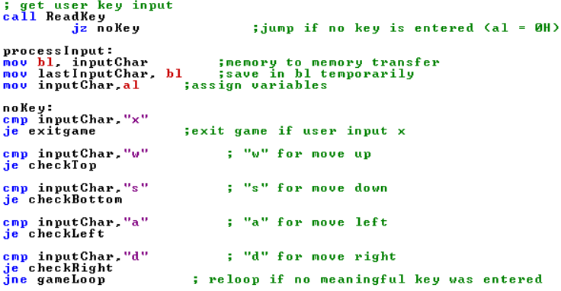
Start game loop and Take the direction form user
Direction | Key
Left | a
Top | w
Right | d
Down | s
Exit | x

Slide 8
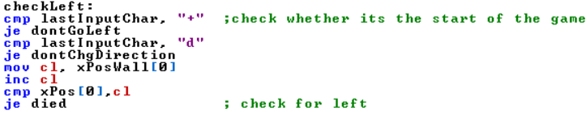
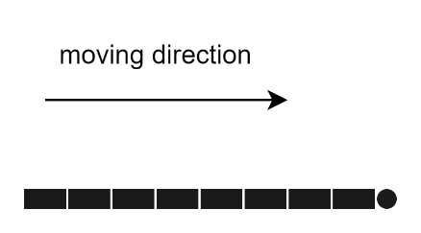
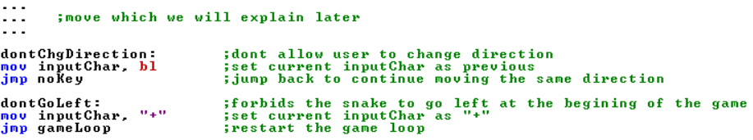
Check if we can move to desired direction(Left for example)

Slide 9
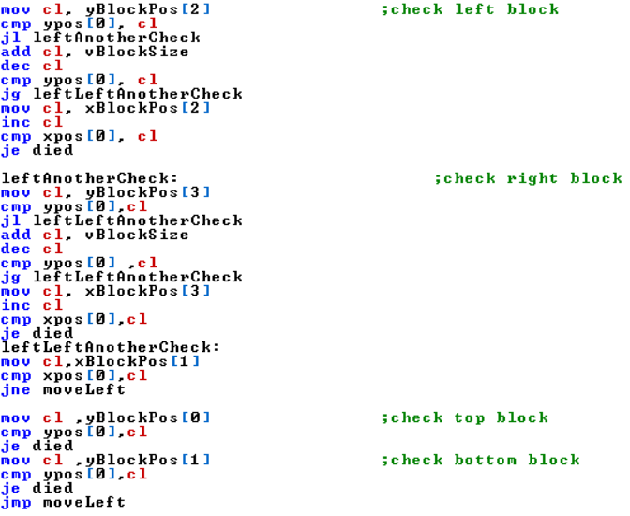
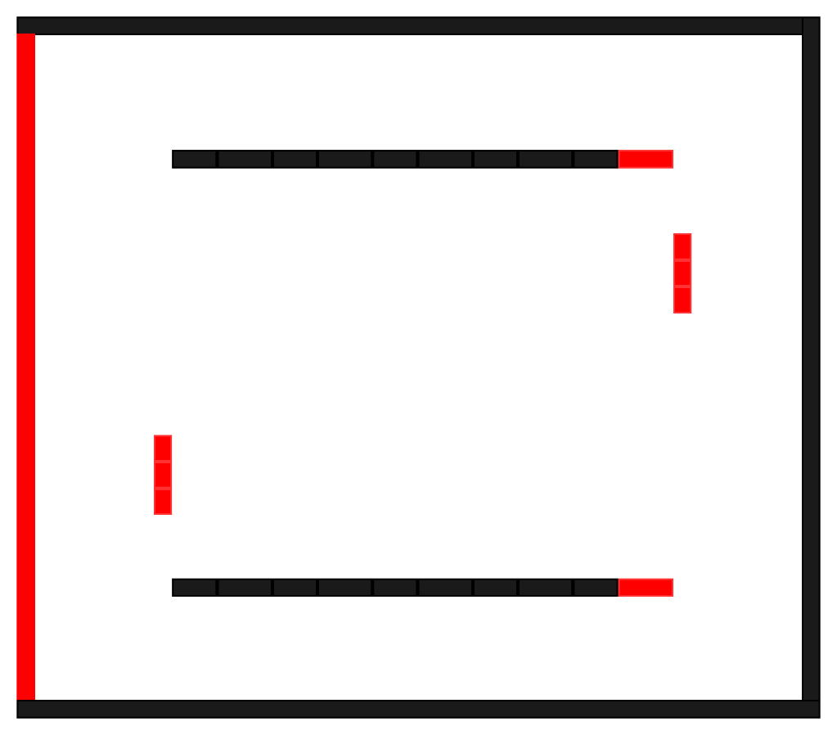
cont.

Slide 10
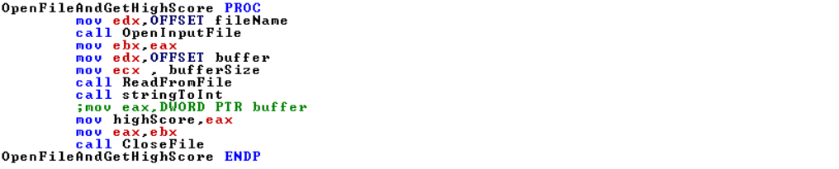
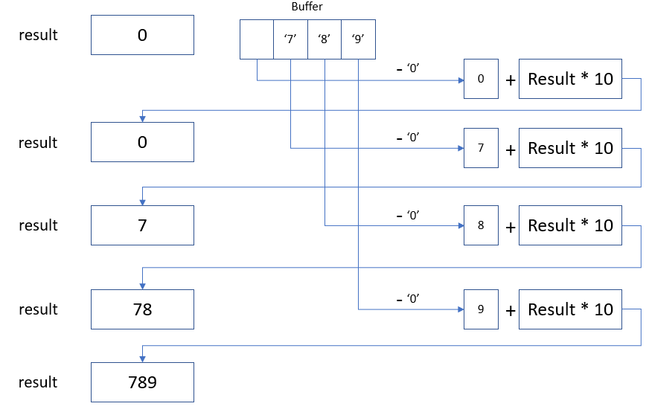
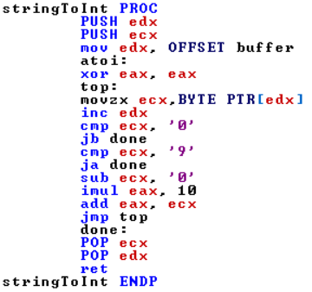
Open file and read

Slide 11
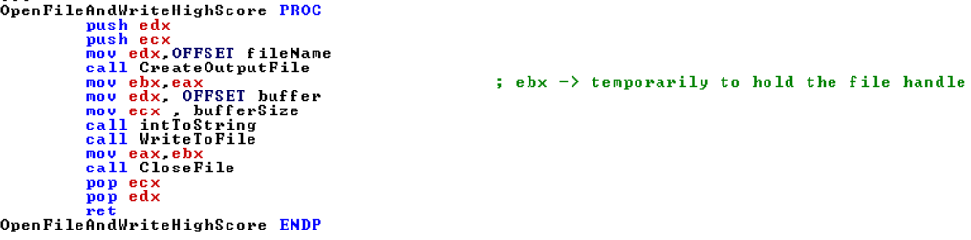
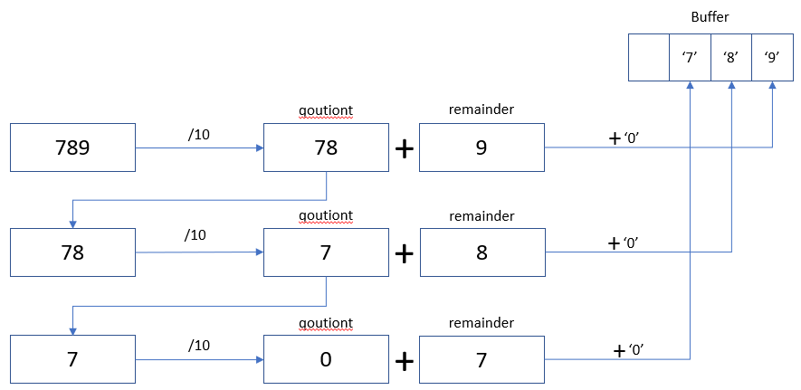
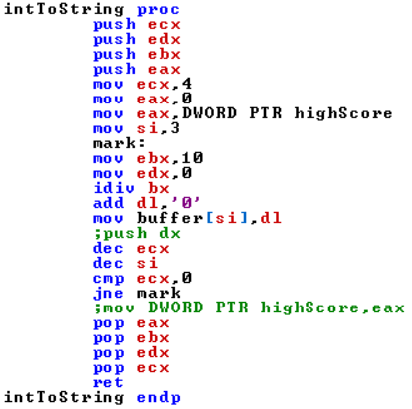
Open File And Write

Slide 12
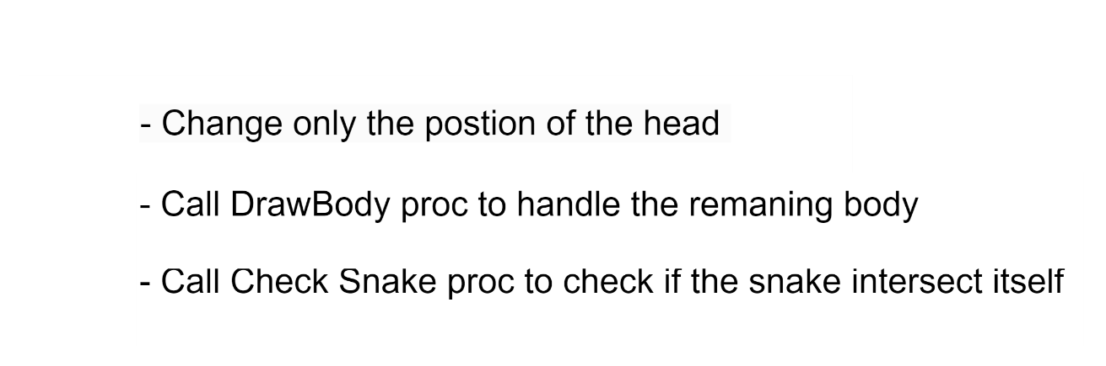
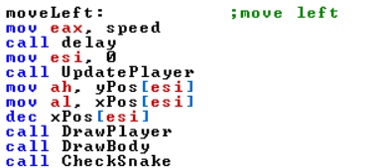
Move to the desired direction after check

Slide 13
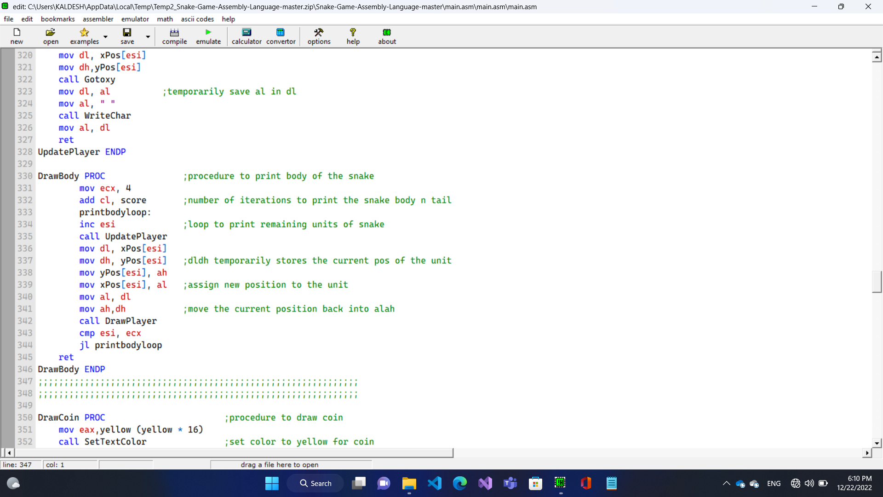
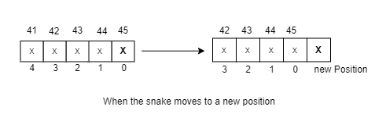
Update the position of the Snake

Slide 14
DRAW COIN
In this part, we begin with call Randomize where its implementation is in Irvine library. It is used to re-seeds the random number generator with the current time.
Then call CreateRandomCoin which we implement to generate coordinate of coin which is symbolic by ‘X’ ,then check if random coordinates are not the same as snake units and are not the same of barriers if yes then regenerate the coordinates again if not return to caller.
Then call DrawCoin which we implement to draw coin (‘X’) in coordinates we randomly generate then return to caller(main).
When coordinates of snake head matches coordinates of coin, call EatingCoin which we add another unit to snake which will take the same x-coordinate if the last two unit have the same x-coordinate and inc/dec y-coordinate Or will take the same y-coordinate if the last two unit have the same y-coordinate and inc/dec x-coordinate.

Slide 15
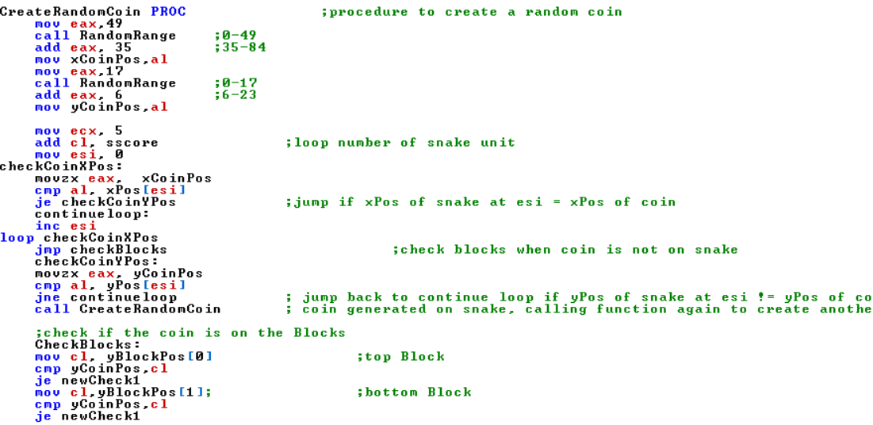
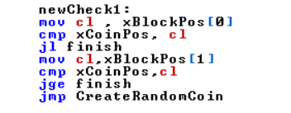
CREATE RANDOM COIN PROC

Slide 16
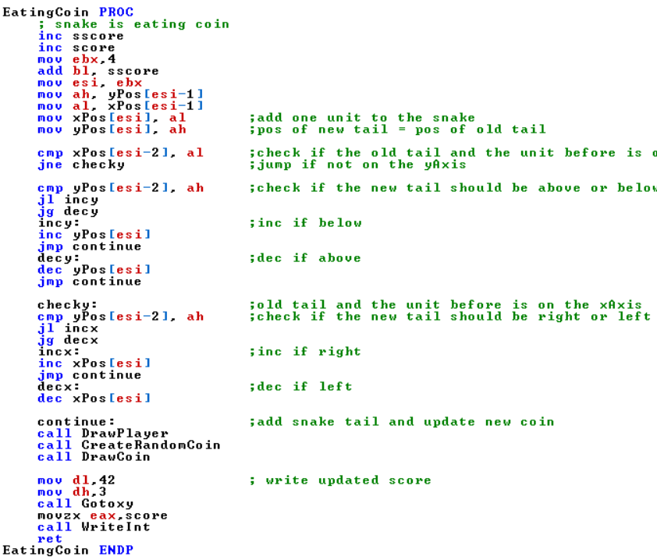
EATING COIN PROC

Slide 17

Check Snake()
Checksnake() is a function which checks whether the snake head collides its body or not.
The function compares the coordinates of the snake’s head ($x_{head}, y_{head}$) with all other parts of the snake’s body array starts from index 4 ($x_{i}, y_{i})$ and $ⅈ≥4.$
If the coordinates are the same, the snake will die and the function youdied() is called.
After comparing all elements, the program checks coins and continues the game loop.

Slide 18
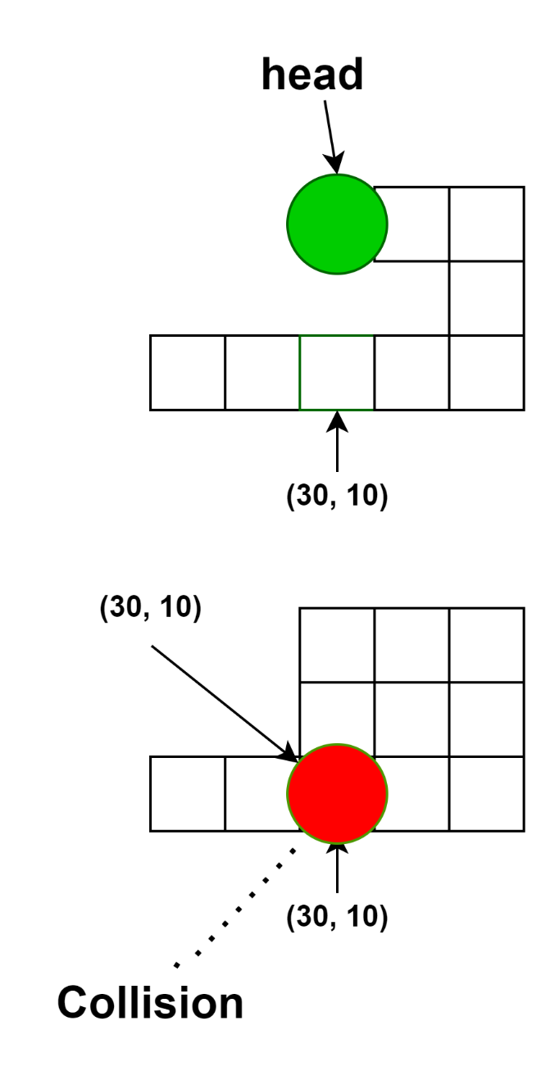
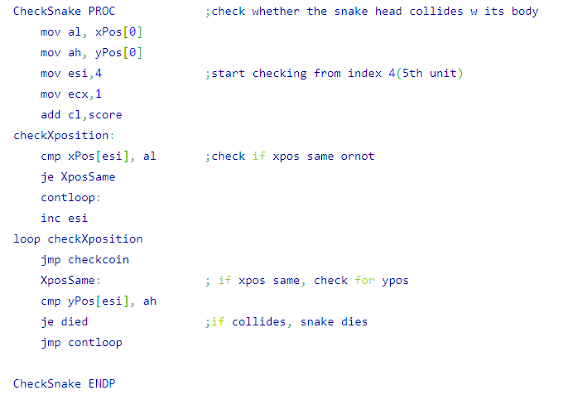
Code

Slide 19
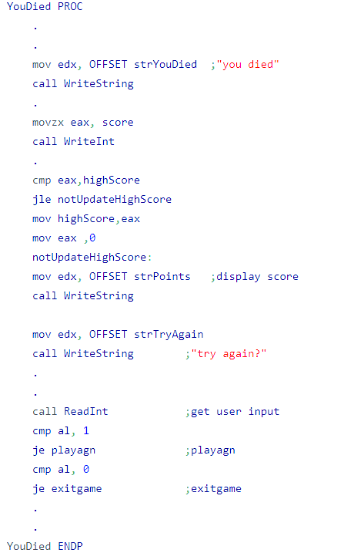
You died()
It is a function tells the user that he died, displays his score, update the best score(if needed) and asks him if he wants to play again.
If user wants to play again, it calls the function ReinitializeGame() otherwise, it finishes the program.

Slide 20
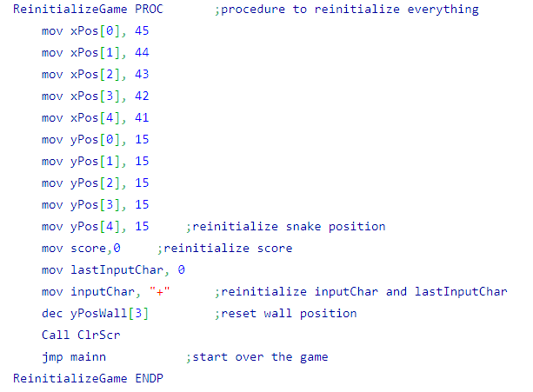
ReinitializeGame()
This function is called when user wants to try again after he died.
It is used to reset all the positions of the walls and used variables (i.e score).

