Slide 1

OPTEE – Introduction to Trusted Applications

Slide 2
Topics
1
OPTEE Background Information
2
Building Trusted Applications
3
Security Aspects to be Aware of
4
Lab Experiment

Slide 3
OPTEE Background Information

Slide 4
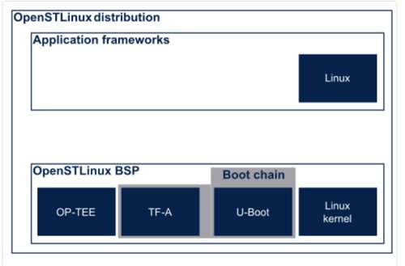
What is OP-TEE
"OP-TEE is an open source project, which contains a full implementation to make up a complete Trusted Execution Environment using the ARM® TrustZone®. technology. OP-TEE meets the GlobalPlatform TEE System Architecture specification. It also provides the TEE Internal core API v1.1 as defined by the GlobalPlatform TEE Standard for the development of Trusted Applications. OP-TEE Trusted OS is accessible from the Linux based OS using the GlobalPlatform TEE Client API Specification v1.0, which also is used to trigger secure execution of applications within the TEE."
BSP Component distributed with Open ST Linux
Responsible for providing a Trusted Execution Environment (TEE)

Slide 5
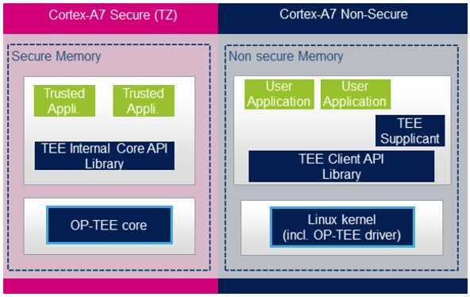
OP-TEE provides
Framework to allow execution of trusted applications in the secure context
Allows use of protected peripherals from user space without exposing the peripheral to the non-secure context
Examples of Protected Functionality
Power Control Peripheral
Instantiate Low Power mode
Clock Control
Change the CPU frequency
Change supply clock for a peripheral
Allows Trusted Applications to be added

Slide 6
Trusted Application
Allows functionality to be extended and customized as needed
Trusted Applications execute in the TEE (Trusted Execution Environment)
Have access to secure peripherals that aren't available directly from User Space
Possible Examples
encryption and decryption using Internal Core API
Generates RSA key pair and encrypt a string
Implement secure path for proprietary encryption / decryption

Slide 7
Building A Trusted Application

Slide 8
OP-TEE Examples Collection
A Set of examples are provided by Linaro Security Working Group
https://github.com/linaro-swg/optee_examples
Provides sample code for host and Trusted Application that can be used directly in the OP-TEE project
Each example results in two binary files
Optee_application_name
Executable to run in user space
can be placed in /usr/bin
< UUID >.ta
Trusted Portion of the application that will be executed in the secure context
Must be placed in /lib/optee_armtz/

Slide 9
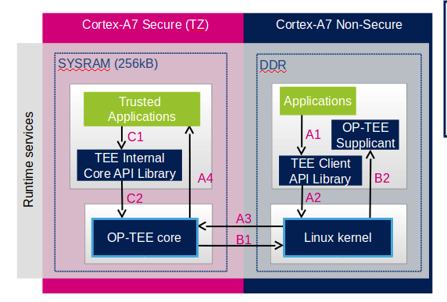
Operational Flow for Trusted Application
A1 – User Space request for service
A2 – TEE Driver translate to Kernel
A3 – Kernel call into the op-tee core
If the Trusted App is not loaded
B1 – optee core requests TA load from kernel
Else (trusted app is loaded)
A4 – core calls into the trusted app
Trusted Apps can also initiate calls
C1 – from trusted app into (C2) optee core

Slide 10
Building Locally – SDK
Can be built with the Open ST Linux Developer Package
source <SDK installation directory>/environment-setup-cortexa7t2hf-neon-vfpv4-ostl-linux-gnueabi
git clone https://github.com/linaro-swg/optee_examples
make -C optee_examples/hello_world
Generates two files needed for the target platform
optee_hello_world
User space application that will attempt to "call" the "extension" offered by the TA
scp optee_examples/hello_world/host/optee_example_hello_world root@<board ip address>:/usr/bin
<UUID>.ta
Trusted application – will execute in the secure context
scp optee_examples/hello_world/ta/<UUID>.ta root@<board ip address>::/lib/optee_armtz/

Slide 11
Security Aspects

Slide 12
Top Level
Trusted Applications must be signed to allow execution in Trusted Environment
Signing done by default in build of Trusted Application
Signature is checked when attempting to launch the Trusted Application
OP-TEE Core responsible for signature verification
A public key is embedded in OP-TEE
TAs are signed with the Private Key

Slide 13
Security – Default Key
The OPTEE open-source project ships with a development key
A default private key in source to facilitate easy development, testing, debugging and QA
This key must never be deployed in production firmware
https://optee.readthedocs.io/en/latest/building/trusted_applications.html
Risk - Anyone can build a Trusted Application to run in your secure context
This key is found in the OPTEE build at
optee-os-stm32mp-3.16.0-stm32mp-r2/keys/default_ta.pem
Included in the OPTEE binary and used to verify signatures on trusted applications
This key is found in the SDK at
sdk/sysroots/cortexa7t2hf-neon-vfpv4-ostl-linux-gnueabi/usr/include/optee/export-user_ta/keys/default_ta.pem
Used to sign trusted applications for execution in the secure context

Slide 14
Security - Generating a key for Experimentation
Product security demands will dictate proper generation and handling of keys
The steps below can be used to generate a key for local experimentation
Generate private key
openssl genrsa -out rsa2048.pem 2048
Extract public key from the newly generated private key
openssl rsa -in rsa2048.pem -pubout -out rsa2048_pub.pem
A product would embed the public key in OPTEE binary and sign TAs with Private Key
The Private Key would be managed in a secure environment by the developer

Slide 15
Hands On Experiment

Slide 16
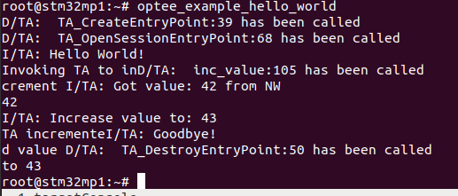
Build With Default Key
Build hello world with the default key (OPTEE binary is also built with default key)
source <SDK install directory>/environment-setup-cortexa7t2hf-neon-vfpv4-ostl-linux-gnueabi
git clone https://github.com/linaro-swg/optee_examples
make -C optee_examples/hello_world
scp optee_examples/hello_world/host/optee_example_hello_world root@<board ip address>:/usr/bin
scp optee_examples/hello_world/ta/<UUID>.ta root@<board ip address>::/lib/optee_armtz/
On Target execute the optee_hello_world application
OP-TEE Executable built with the
default key allows anyone to generate a TA that will pass the signature validation

Slide 17
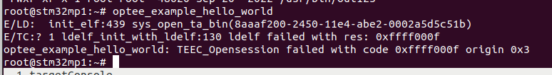
Rebuild OPTEE with new public key
Rebuild the OPTEE binary with the new Public key
Generate private key
openssl genrsa -out rsa2048.pem 2048
Extract public key from the newly generated private key
openssl rsa -in rsa2048.pem -pubout -out rsa2048_pub.pem
Copy Public Key (rsa2048_pub.pem) to the optee build
optee-os-stm32mp-3.16.0-stm32mp-r2/keys/default_ta.pem
Rebuild OPTEE
make -f $PWD/../Makefile.sdk CFG_EMBED_DTB_SOURCE_FILE=stm32mp135f-dk all
Reimage the target platform with this set of BSP components and run original optee_hello_world
SECURITY ERROR
shows public / private keys
aren't aligned – As Expected

Slide 18
Rebuild Trusted Application with New Private Key
Sign the TA with a newly generated key
We previously generated a private key rsa2048.pem
Copy Private Key (rsa2048.pem) to the SDK for TA signing
sdk/sysroots/cortexa7t2hf-neon-vfpv4-ostl-linux-gnueabi/usr/include/optee/export-user_ta/keys/default_ta.pem
make -C optee_examples/hello_world clean
make -C optee_examples/hello_world
scp optee_examples/hello_world/host/optee_example_hello_world root@<board ip address>:/usr/bin
scp optee_examples/hello_world/ta/<UUID>.ta root@<board ip address>::/lib/optee_armtz/
TA Signed with our new private key is functional
Only people with access to this Private key will be able to generate TAs with valid signature

Slide 19
References

Slide 20
References
https://optee.readthedocs.io/en/latest/general/presentations.html
https://github.com/linaro-swg/optee_examples
https://wiki.st.com/stm32mpu/wiki/SCMI_overview
https://wiki.st.com/stm32mpu/wiki/How_to_develop_an_OP-TEE_Trusted_Application
https://wiki.st.com/stm32mpu/wiki/How_to_configure_OP-TEE

Slide 21


You can personalize this
last page with a short link
(ex. www.st.com/shortlink)
You can find a complete list of st.com short links on this page:
http://seo.st.com/toolbox/shortcuts/
Find out more at www.st.com

