Slide 1
BLOM: Berkeley Library for Optimization Modeling
Anthony Kelman
Email: kelman@berkeley.edu
Website: www.mpc.berkeley.edu
Sergey Vichik, Francesco Borrelli
Department of Mechanical Engineering
University of California
Berkeley, CA
November 12, 2012
TexPoint fonts used in EMF.
Read the TexPoint manual before you delete this box.: AAAAAAAAAAAAAAAAAAAA

Slide 2
Outline
Motivation and Background
Optimization modeling, existing tools
Dynamic optimization and model predictive control (MPC)
Components and Workflow of BLOM
Simulink front end
Efficient problem representation
Compiled interface to optimization solvers
Performance Results
Release Availability and License
Ongoing Development
Conclusions and Demo

Slide 3
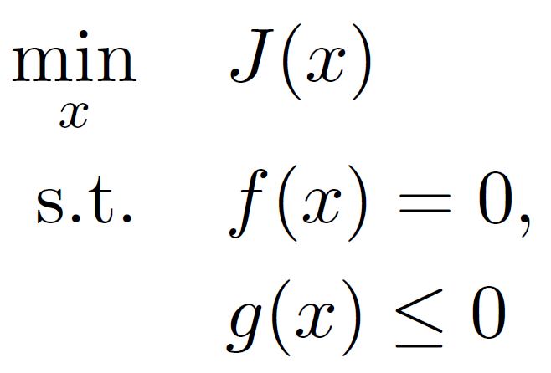
Motivation and Background
Want to solve optimization problems from
Optimal control
System identification
Scheduling, resource allocation, etc
Conventional approach
Manual formulation and coding
Time consuming, error prone (especially gradients, Jacobian, Hessian)
Difficult to change solvers
Tricky to get good performance
Better way: use an optimization modeling tool

Slide 4
Optimization Modeling Tools
Overview of existing tools
Standalone, text-based, proprietary: AMPL, GAMS, AIMMS
Standalone, text-based, open source: ACADO
Modelica-based, open source: Optimica
Matlab-based, proprietary: TOMLAB
Matlab-based, open source: Yalmip, CVX
Simulink-based, open source: BLOM
BLOM created to fill need for
Intuitive user-friendly model creation
Good performance on large scale nonconvex problems
Integration with Matlab/Simulink environment

Slide 5
Dynamic Optimization
System model propagating over time horizon
States x(t), inputs u(t), disturbances w(t)
Constant parameters p
MPC: p known, x(0) measured, w(t) predicted, optimize u(t)
System ID: x(t), u(t), w(t) measured/estimated, optimize p
Continuous-time model:
Discrete-time model:
Dynamic optimization leads to specific structure
BLOM, ACADO, Optimica designed for this structure
Otherwise requires manual replication of model over time

Slide 6
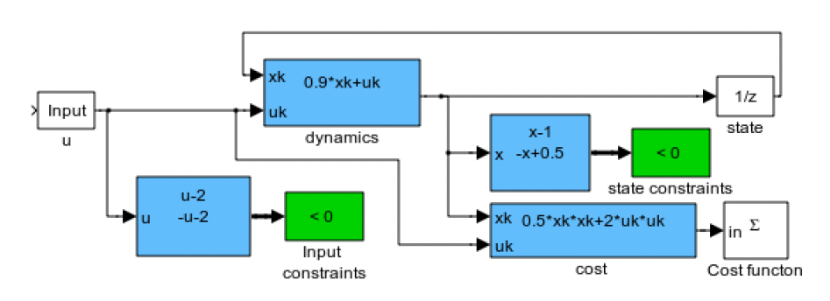


Components and Workflow of BLOM
BLOM model
Forward simulation
Model validation
Auto translation
Export opt problem
Ipopt
fmincon
….
Optimal Control
System
Identification
Optimization results
Create model in Simulink with BLOM library
Automatically generate efficient problem representation
Compiled interface to optimization solvers

Slide 7
Simulink Front End
Create block diagram model using BLOM library
Cost function
Constraints
Unknown variable inputs
Known external inputs
Nonlinear function blocks
Continuous-time or discrete-time states
Intuitively captures signal flow, connectivity, and hierarchy of large scale models
Same model used for forward simulation, model validation, and optimization
Productivity and collaborative benefits of graphical model vs text-based code

Slide 8
Automatic Conversion of Simulink Model
Every Simulink wire is a variable at each time step
Nonlinear function blocks are equality constraints between inputs and outputs
States are equality constraints between adjacent time steps
Continuous states discretized using fixed-step implicit or explicit Runge Kutta, Euler, trapezoidal, etc (user selects discretization)
Leads to many variables, but very sparse problem
Need to capture and take advantage of sparsity structure
Currently nonlinear functions must use our Polyblock format to extract structure, work in progress to automatically convert general Simulink blocks

Slide 9
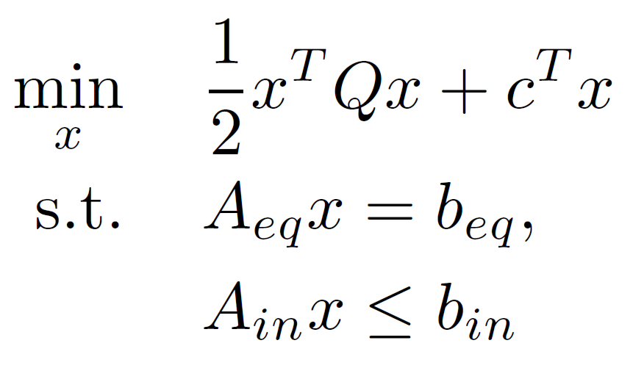
Efficient Problem Representation
Why are LP, QP easy?
Standard format, e.g. for QP:
Gradient, Jacobian, etc immediate
Typical nonlinear approach:
Code generation or parsing, algorithmic differentiation
Explicit code gen does not scale well to very large problems
BLOM is our proposal for standardized NLP format
Represent nonlinear structure of model in sparse matrices
Matrix of exponents/functions, matrix of coefficients
Cost vector, upper and lower bound vectors
Key to performance of optimization algorithms

Slide 10
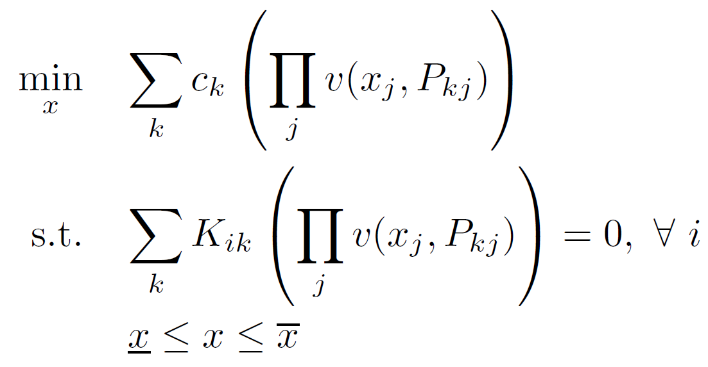
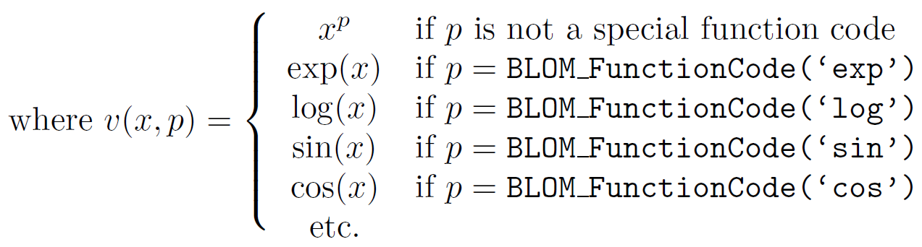
BLOM Format Details
Multivariate polynomial-like structure with sparse P, K
Closed-form sparse Jacobian, Hessian

Slide 11
Interface to Optimization Solvers
Solvers need functions for cost, constraint, gradient, Jacobian, Hessian evaluation given current x
With BLOM format, these are simple wrappers
Save P, K, c, and bound vectors from Matlab
We mostly use Ipopt, which is open source and very fast
Can use fmincon via Matlab code generation, only viable for small problems
Can linearize and use linprog
More can be added, just need to write wrapper functions to translate BLOM format into solver inputs
Auto-generation of AMPL, ACADO, Optimica, etc for comparison

Slide 12
Performance Results
EPMO model from Oct 29th
28 discrete-time states, 48 step prediction horizon
3900 total variables, 1100 fixed (external inputs)
1400 equality constraints, 3400 inequality constraints
Time to extract model: < 3 sec
Optimization solution using Ipopt and MUMPS linear solver: 7 sec (MA57 linear solver: 4 sec)
Productivity and development savings vs manual formulation: probably hundreds of man-hours

Slide 13
Release Availability and License
Publicly available since September
Follow links at www.mpc.berkeley.edu, under Software
BSD license: free to use, modify, or redistribute
Please cite us if you find it useful
(as academic courtesy, not a condition of license)
Being used in Master’s level MPC course at Berkeley, HVAC MPC in our lab, wave energy conversion research
Not application specific, feel free to evaluate for other projects

Slide 14
Ongoing Development
Top priority: allow models constructed from built-in Simulink blocks – products, sums, nonlinear functions
Would be able to take preexisting Simulink models (if simple), just mark cost, constraints, and inputs
Improved documentation, including quick-start guide
Code cleanup for better data structures, readability
Interface to more optimization solvers, languages
Thorough benchmarking vs other similar tools
Simpler mechanism for terminal constraints and cost
Norms over vector elements or time for cost, constraints
Discretization enhancements, fixes, more methods

Slide 15
Conclusions
BLOM eliminates manual coding of optimization model, facilitates very fast development cycle
Don’t need optimization expert to perform a model update
High performance for very large scale models
Simplifies collaborative development and knowledge transfer between team members
Using someone else’s block diagram vs reading their code
Develop model once, use with any solver and environment later

Slide 16
Thanks! Any questions?

Slide 17
Demonstration…

