Slide 1
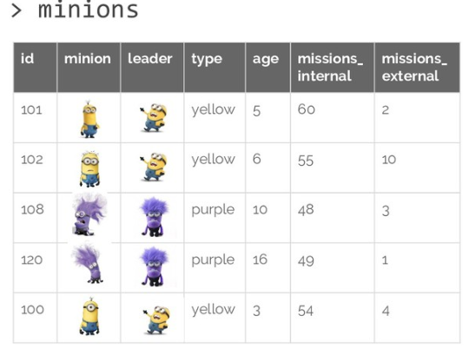

Slide 2
> minions
id | minion | color | age | wins | losses
1 |  | yellow | 5 | 33 | 66
2 |  | yellow | 6 | 41 | 90
3 |  | purple | 11 | 39 | 12
4 |  | purple | 12 | 54 | 25
5 |  | yellow | 3 | 49 | 79
6 |  | purple | 2 | 44 | 16
7 |  | purple | 9 | 26 | 37

Slide 3






> minions
id | minion | color | age | wins | losses
1 |  | yellow | 5 | 33 | 66
2 |  | yellow | 6 | 41 | 90
3 |  | purple | 11 | 39 | 12
4 |  | purple | 12 | 54 | 25
5 |  | yellow | 3 | 49 | 79

Slide 4
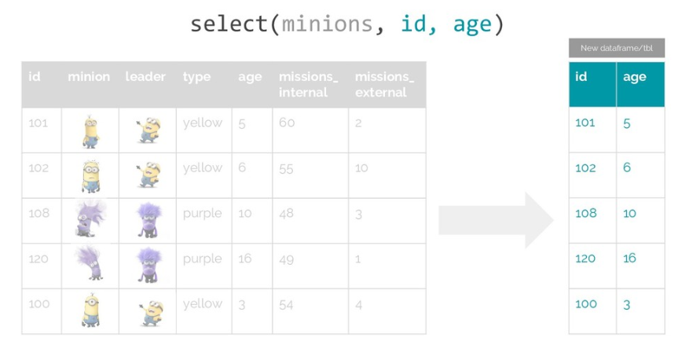
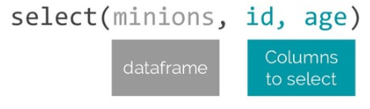





New dataframe
id | minion | color | age | wins | losses
1 |  | yellow | 5 | 33 | 66
2 |  | yellow | 6 | 41 | 90
3 |  | purple | 11 | 39 | 12
4 |  | purple | 12 | 54 | 25
5 |  | yellow | 3 | 49 | 79
id | age
1 | 5
2 | 6
3 | 11
4 | 12
5 | 3

Slide 5
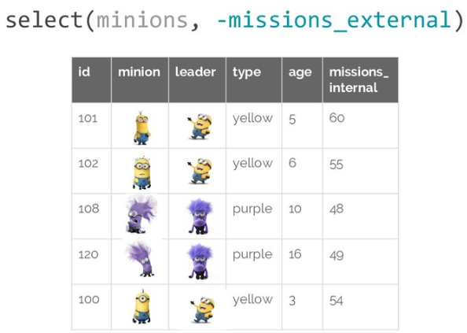
-losses
id | minion | color | age | wins
1 |  | yellow | 5 | 33
2 |  | yellow | 6 | 41
3 |  | purple | 11 | 39
4 |  | purple | 12 | 54
5 |  | yellow | 3 | 49

Slide 6
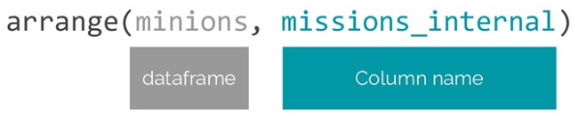
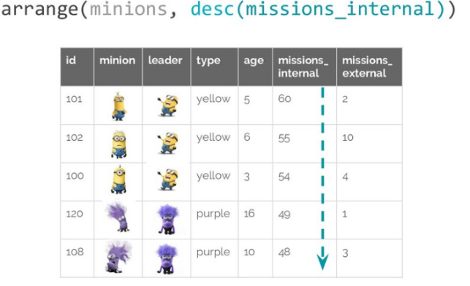
wins
id | minion | color | age | wins | losses
1 |  | yellow | 5 | 33 | 66
3 |  | purple | 11 | 39 | 12
2 |  | yellow | 6 | 41 | 90
5 |  | yellow | 3 | 49 | 79
4 |  | purple | 12 | 54 | 25
DEFAULT
Ascending order

Slide 7
desc(wins)
id | minion | color | age | wins | losses
4 |  | purple | 12 | 54 | 25
5 |  | yellow | 3 | 49 | 79
2 |  | yellow | 6 | 41 | 90
3 |  | purple | 11 | 39 | 12
1 |  | yellow | 5 | 33 | 66
Descending order

Slide 8
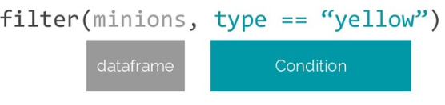
color
id | minion | color | age | wins | losses
1 |  | yellow | 5 | 33 | 66
2 |  | yellow | 6 | 41 | 90
5 |  | yellow | 3 | 49 | 79

Slide 9
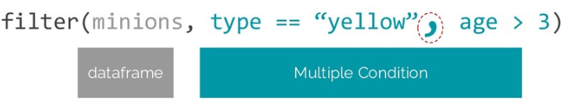
color
id | minion | color | age | wins | losses
1 |  | yellow | 5 | 33 | 66
2 |  | yellow | 6 | 41 | 90
5 |  | yellow | 3 | 49 | 79

Slide 10
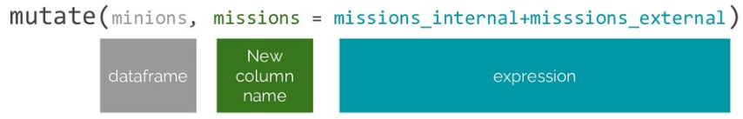
color
id | minion | color | age | wins | losses
1 |  | yellow | 5 | 33 | 66
2 |  | yellow | 6 | 41 | 90
5 |  | yellow | 3 | 49 | 79

