Slide 1
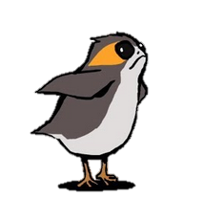

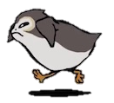

> porgs
id | porg | color | age | mass | height
1 |  | yellow | 5 | 36 | 66
2 |  | yellow | 6 | 41 | 72
3 |  | gray | 11 | 39 | 58
4 |  | gray | 12 | 43 | 53
5 |  | yellow | 3 | 39 | 79

Slide 2
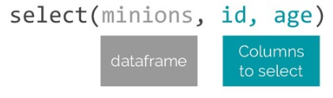
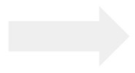
select( porgs, id, age)
porgs
New dataframe
id | porg | color | age | mass | height
1 |  | yellow | 5 | 36 | 66
2 |  | yellow | 6 | 41 | 72
3 |  | gray | 11 | 39 | 58
4 |  | gray | 12 | 43 | 53
5 |  | yellow | 3 | 39 | 79
id | age
1 | 5
2 | 6
3 | 11
4 | 12
5 | 3

Slide 3
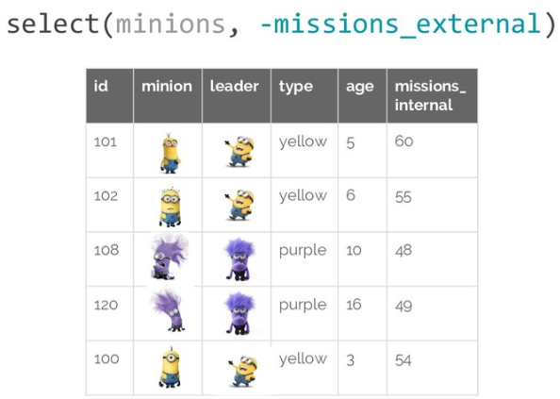
select( porgs, -height )
porgs
-height
id | porg | color | age | mass
1 |  | yellow | 5 | 36
2 |  | yellow | 6 | 41
3 |  | gray | 11 | 39
4 |  | gray | 12 | 43
5 |  | yellow | 3 | 39

Slide 4
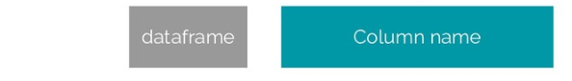
arrange( porgs, age )
id | porg | color | age | mass | height
5 |  | yellow | 3 | 39 | 79
1 |  | yellow | 5 | 36 | 66
2 |  | yellow | 6 | 41 | 72
3 |  | gray | 11 | 39 | 58
4 |  | gray | 12 | 43 | 53
DEFAULT
Ascending order

Slide 5
arrange( porgs, desc(age) )
id | porg | color | age | mass | height
4 |  | gray | 12 | 43 | 53
3 |  | gray | 11 | 39 | 58
2 |  | yellow | 6 | 41 | 72
1 |  | yellow | 5 | 36 | 66
5 |  | yellow | 3 | 39 | 79
Descending order

Slide 6
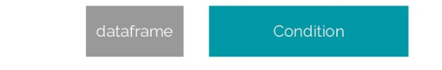
filter( porgs, color == “yellow” )
color
id | porg | color | age | mass | height
2 |  | yellow | 6 | 41 | 72
1 |  | yellow | 5 | 36 | 66
5 |  | yellow | 3 | 39 | 79

Slide 7
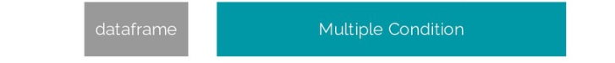
filter( porgs, color == “yellow”, age > 3 )
id | porg | color | age | mass | height
2 |  | yellow | 6 | 41 | 72
1 |  | yellow | 5 | 36 | 66

Slide 8
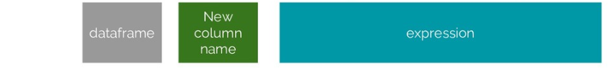
mutate( porgs, bmi = mass / height )
id | porg | color | age | mass | height | bmi
4 |  | gray | 12 | 43 | 53 | 81
3 |  | gray | 11 | 39 | 58 | 67
2 |  | yellow | 6 | 41 | 72 | 57
1 |  | yellow | 5 | 36 | 66 | 55
5 |  | yellow | 3 | 39 | 79 | 50

Slide 9
summarize( porgs, age_avg = mean(age) )
id | porg | color | age | mass | height
1 |  | yellow | 5 | 36 | 66
2 |  | yellow | 6 | 41 | 72
3 |  | gray | 11 | 39 | 58
4 |  | gray | 12 | 43 | 53
5 |  | yellow | 3 | 39 | 79
New dataframe
age_avg
7

Slide 10
group_by( porgs , color ) %>%
summarize( age_avg = mean(age),
mass_avg = mean(mass) )
id | porg | color | age | mass | height
1 |  | yellow | 5 | 36 | 66
2 |  | yellow | 6 | 41 | 72
3 |  | gray | 11 | 39 | 58
4 |  | gray | 12 | 43 | 53
5 |  | yellow | 3 | 39 | 79
New dataframe
color | age_avg | mass_avg
yellow | 5 | 39
gray | 11.5 | 41

